Slide 1
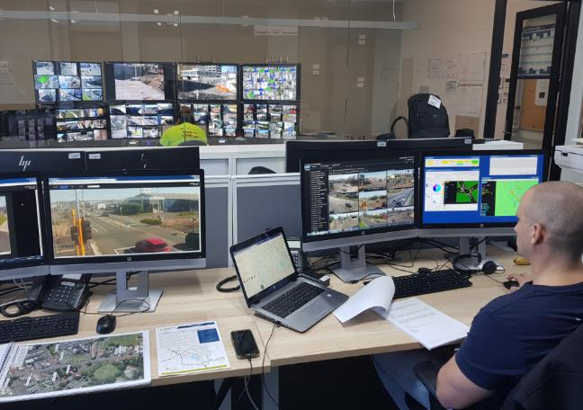
Genesis building – transport ops
IL4 building
Co-located with Civil Defense (regional & local)
Co-located with CitySafe (CCTV crime prevention)
Shared resources
Video wall
Server room
Training rooms
Currently only used for major events or incidents
May be staffed in the future (business case)

Slide 2
SNUG 2018 – Technical tour
1:40pm Bus leaves for private Railway museum
Bus will return to the Genesis building at 3pm
3:00pm Electric-bike tour down the rail-trail to see the integrated crossing in action
Meet at Norris Ward Park (across the road, opposite Kmart)
Please bring covered footwear for use of the electric bikes
You must SIGN the T&C form to use a bike
Please split into two groups – those who have ridden e-bikes vs who needs briefing
4:00pm Tour of FMG Waikato Stadium
We will walk from Norris Ward Park to the Stadium (1km)
5:00pm Meet at the Novotel Bar for drinks
We will walk there from the Stadium
Location 7 Alma Street (off Victoria St)
Bar Tab is provided at the main bar

Slide 3
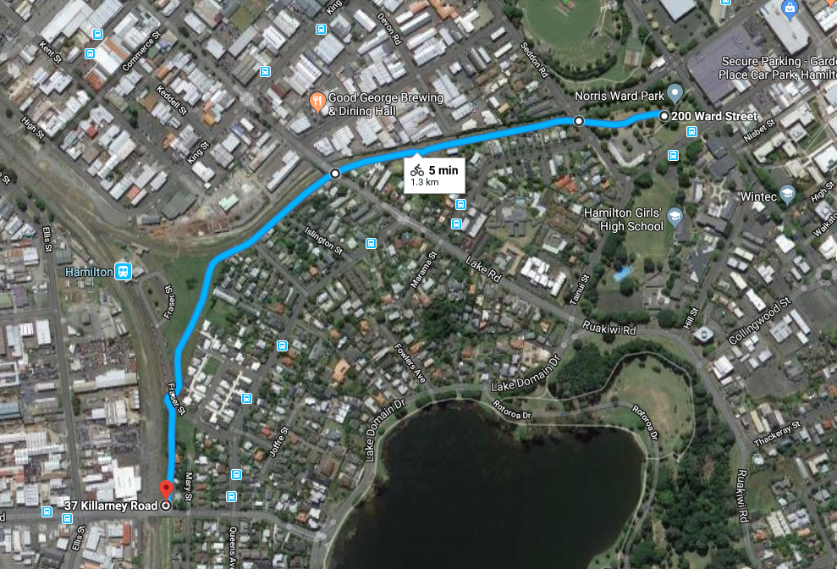
Start / finish
Meet here at rail crossing

