Slide 1
SNUG 2018 Hamilton
National Signals Specification
Education, Standards, Qualifications

Slide 2
SNUG 2018 Hamilton
National Signals Specification (P43)
www.snug.org.nz Select ‘SPECIFICATIONS’ from the menu links

Slide 3
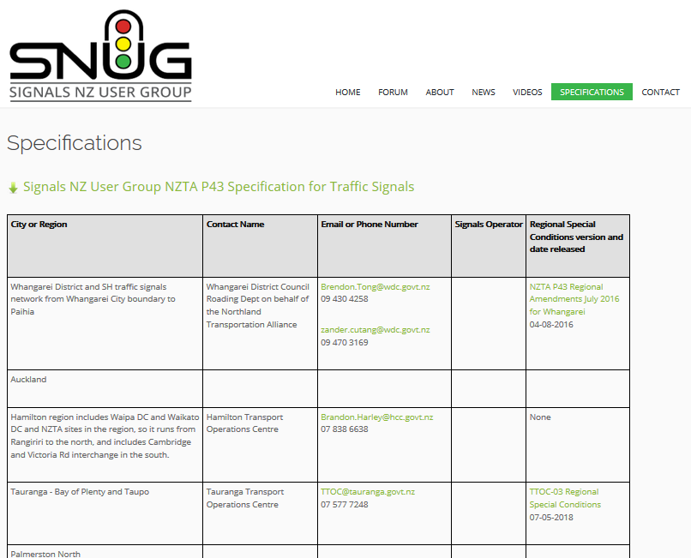
SNUG 2018 Hamilton
National Signals Specification (P43)

Slide 4
SNUG 2018 Hamilton
National Signals Specification (P43)
What about updates?

Slide 5
SNUG 2018 Hamilton
National Signals Specification
Education, Standards, Qualifications
SNUG Forum

Slide 6
SNUG 2018 Hamilton
SNUG Forum
www.snug.org.nz Select ‘FORUM’ from the menu links

Slide 7
SNUG 2018 Hamilton
SNUG Forum
Connect to internet and show how to use forum for discussions on Specification updates & Training Topic discussions.

Slide 8
SNUG 2018 Hamilton
SNUG Forum
Questions?

