Slide 1
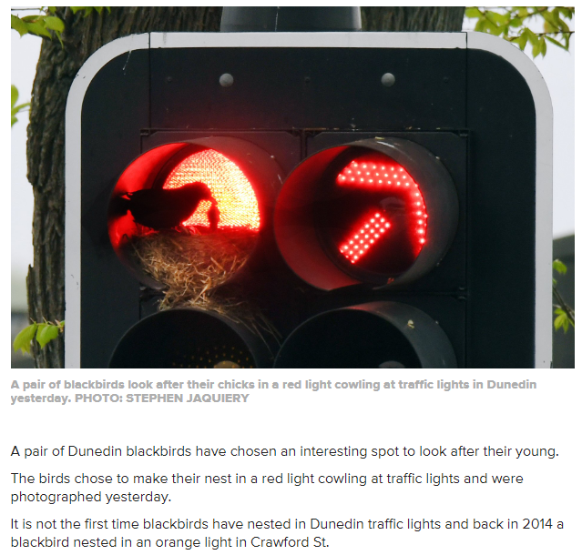
DUNEDIN CITY SIGNALS UPDATE
Biggest story of the year

Slide 2
Dunedin City Signals update
1 November 2018 our new Traffic Signals and ITS Maintenance contract commences – it’s a 5+2+2 year contract.
Total of 91 signals – incl. 3 new installs in 2018 – All on SCATS
47 DCC, 35 NZTA,8 Oamaru and Beumont Bridge.
7 mid block sites.
24 CCTV’s operational 14 PTZ and 10 360 ͦ (12 being installed this FY)

Slide 3
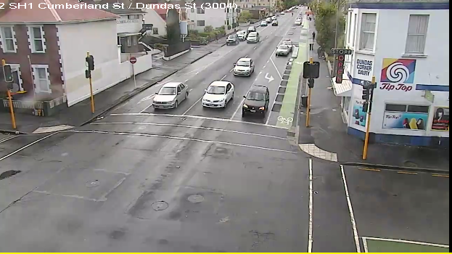
Dunedin City Signals update
SH One Way Pair Cycle lane – includes 25 signals upgrades
Mast Arm test and replacement programme
Safety improvements at 10 intersections

Slide 4
Dunedin City Signals update
1 November 2018 our new Traffic Signals and ITS Maintenance contract commences – it’s a 4yr 8mth+2+2 year contract.
New Traffic Signals and ITS Contract KPIs
Fault recording using SCATS to track trends
Response times using Eroads
TMP audits – min. 2 per month.
RAMM
All Dunedin and Oamaru signals updated and included in RAMM
New contract uses RAMM Contractor

