Slide 1
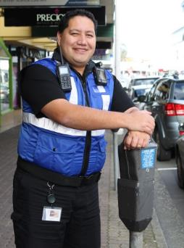
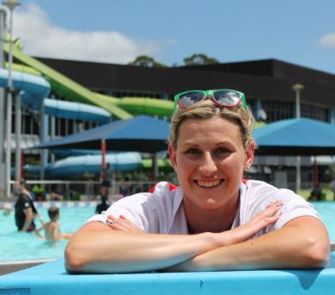
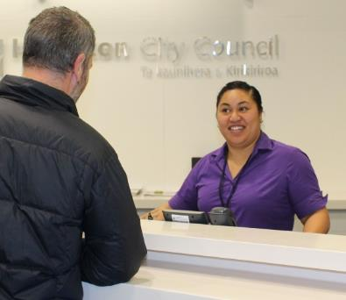
Design for mid-block traffic signals adjacent rail

Slide 2
KiwiRail design guide
Soon to be published
Key design principles:
Minimise the need for at-grade crossings
Seek awareness by users
Seek compliance by users
Provide safe accessible and practical use
Provide appropriate and consistent treatments
Treatments should be maintainable

Slide 3
KiwiRail design guide – traffic signal integration
Section 5.4.3: Path Signals for Parallel Pathways
Integration required when a pathway crosses a road within 30m of a level crossing
Four interfaces are available:
Pre-warning (train approaching, terminate phase)
Pre-emption (cut the traffic signal green for redundancy)
Pre-cancellation (terminate the ped/cycle phase)
Hold down (traffic signals can keep barriers down until ped/cycle phase has completed clearance)

Slide 4
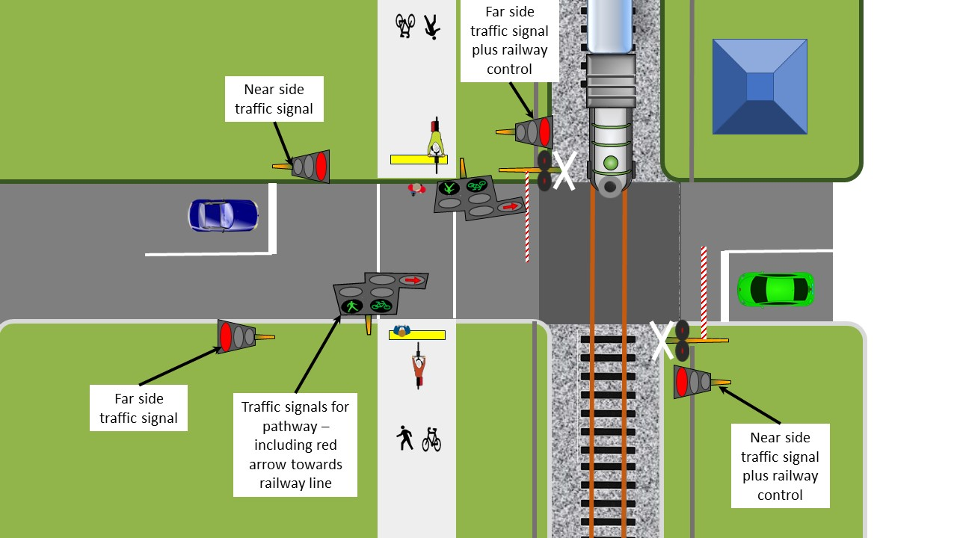
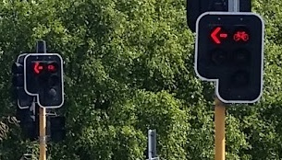
Layout considerations:
Pole locations – both approaches (careful positioning of far side poles…)
Conflicting displays
Rail displays facing down paths
Yellow hatching?
Red arrows for turning cyclists

Slide 5
Traffic Signal Considerations
Traffic lights must be in red prior to barriers start
Take into account travel time so people aren’t ‘trapped’ at railway
Allow the pedestrian/cycle crossing to run safely during train phase
Delay the start to ensure barriers are down
Reintroduction / walk for green (reintroduction reduces unnecessary delay below)
Use pre-cancellation to know when train is almost clear to stop ped running
Hold barriers down until clearance complete for those drivers who go when barriers start rising
Sequence the end of the train phase
Use the ‘Barriers rising’ circuit to run the intergreen prior to barriers vertical
Other considerations
Use a max timer (e.g. 5mins) on the train phase due to pre-warning only and no train
Earthing must be separated and 230V traffic circuits isolated from railway interface (no direct circuits)
Consider all scenarios of when train phase called in cycle

Slide 6
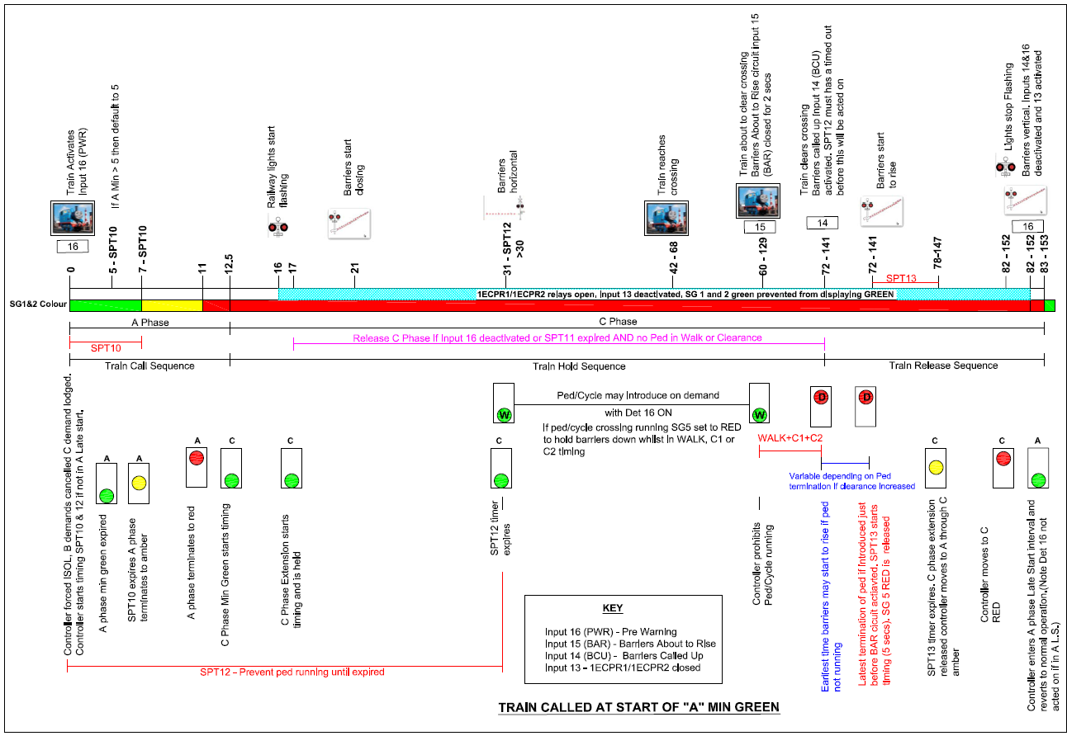
Traffic Signal Considerations

Slide 7
Advice & feedback
Engage KiwiRail early – lots of people will be involved
Talk to someone who’s been through it before
Have good documentation
Feedback sought from KiwiRail:
Is there value in traffic and rail signal experts working together?
Feedback on the design guide so it can be improved
Where would their guidance documentation be housed for that relating to traffic signal engineers?

Slide 8
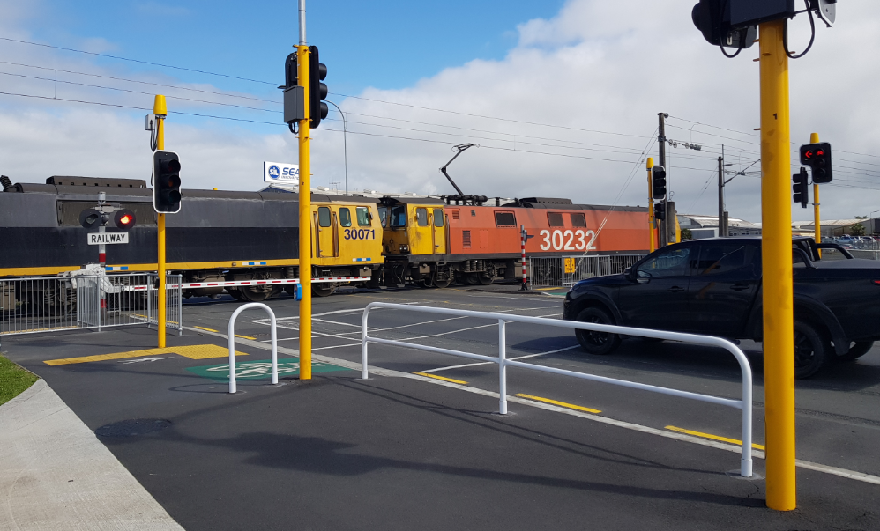
The end… questions?
John.Kinghorn@hcc.govrt.nz
Thomas.Wood@kiwirail.co.nz

