Slide 1
Traffic Control & Coordination
Next Generation Traffic Signal Controller (VC6)
Presenter : Paul Milazzo

Slide 2
Traffic Control & Coordination
Traffic Signal Controllers in Australia
All Traffic Signal Controllers currently in production for the Australian market are manufactured to the Roads and Maritime Services Specification TSC/4
All TSC/4 controllers are fully functional with SCATS
All TSC/4 controllers currently run as VC5 controllers

Slide 3
Traffic Control & Coordination
Controller Software Overview
SCATS and TRAFF Software developed by Roads and Maritime Services, NSW
TRAFF software integrated into the controller by manufacturers
TRAFF software interacts with manufacturer developed software sometimes referred to HRS
TRAFF software interacts with the controller personality (Site Specific Configuration Data)
Memory allocation increased in VC6 for Personality Data

Slide 4
Traffic Control & Coordination
System Overview
SCATS
Personality
TRAFF
HRS

Slide 5
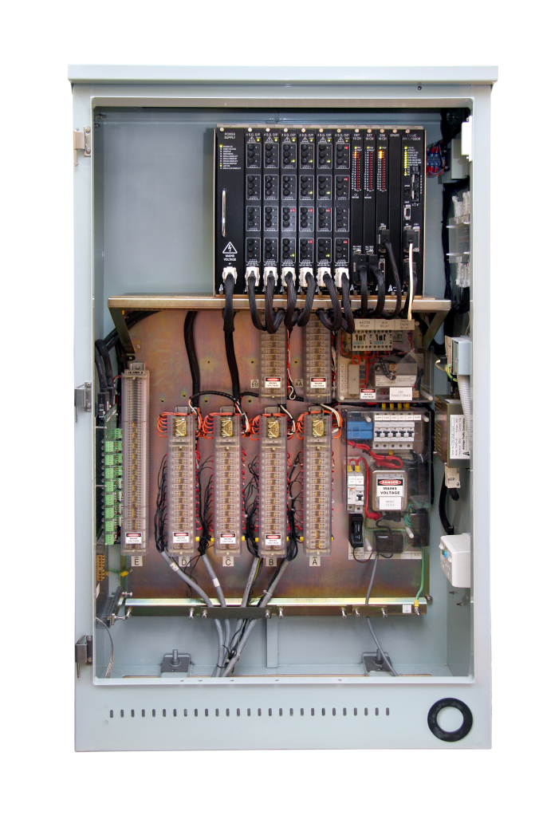
Traffic Control & Coordination
A TSC/4 Controller
Typical Controller
Current controllers can have up to the following hardware configuration:
24 Signal Groups
16 Can be configured as Vehicle Groups, and
8 Can be configured as Pedestrian Groups

Slide 6
Traffic Control & Coordination
The New Generation Controller can have up to 32 Signal Groups
These 32 Signal Groups can be ALL vehicle groups with no Pedestrian Groups or a mix as before with up to a maximum of 8 Pedestrian Groups
All signal groups have lamp monitoring capabilities (some older generation controllers only monitored the first 16 signal groups)
All signal groups have full conflict monitoring capabilities

Slide 7
Traffic Control & Coordination
A TSC/4 Controller
Typical Controller
Current controllers can have up to the following hardware configuration:
32 Inputs
24 Can be configured as Vehicle Detectors (e.g. loops), or TRAM Detectors, Emergency Vehicle Inputs
8 Can be configured as exclusively as Push Button Inputs

Slide 8
Traffic Control & Coordination
The New Generation Controller can have up to 48 Inputs and 8 Push Button Inputs
This allows for addition detection features such as advance and departure detection as well as queue detection
The New Generation Controller can have up to 24 Special Purpose Inputs and 24 Special Purpose Outputs
These inputs and outputs can be used to controller ancillary devices
The New Generation Controller can have up to 32 XSF and MSS Flags, increased from 16 of each.
These flags can be used for features such as TRAM Priority.

Slide 9
Traffic Control & Coordination
Future Development
  Ability to maintain co-ordination through a short communications error
  Increase reported operational data to SCATS for remote monitoring
  Implement Signal Phasing and Timing data (SPaT)
  Increase number of phases

Slide 10
Traffic Control & Coordination
This is the end of this presentation.
Thank you for your attention.

