Slide 1
SCATS Update
SNUG, February 2017
Tauranga

Slide 2
SCATS Update – Feb 2017
SCATS 6.9.3 CR – reported issues
SCATS 6.10 CR
New features
VC5.1 trial results
SCATS Priority Engine (SPE) trial results
Planned work packages
Vehicle detection technology
Upstream vehicle detection
External detectors

Slide 3
SCATS 6.9.3 CR - Issues
Pedestrian movement terminates on expiration of minimum green interval
RPS before NXP
Phase gap events not recorded as specified
Rare incorrect VC 5.x recognition
Communication stalls – set to VC=4!
Patch released 6.9.3 Build 21
If CL > 180 seconds, SK=AR! fails

Slide 4
SCATS 6.10 CR – prepared
New ITS interface
System status
Intersection status/monitor
Scheduled Dwell replacing GWR
SDS support – TransIS replacement
SPaT map and message
SSDI – spatial support for measured data
SPE
SPE-Web interface
Spatial queries instead of SCATS centric

Slide 5
SCATS 6.10 CR - cont’d
SCATS SIM Repeatability
Access: support new operating systems
Windows 10
Access uses true-type font
Unlimited VR
Increased the number of scheduler items
Provide SS fallback reason
Show last 4 voted SP, LP, marriage

Slide 6
VC5.1 trial
4 x each controller type deployed
True signal group state – verified
Intersection fallback - verified
Issues
SS fallback is not managed as specified
Detector state gets stuck on actuation
VC6.2 is now compiled (VC6.1 + VC5.1)

Slide 7
SPE trial: PTIPS
PTIPS replacement

Slide 8
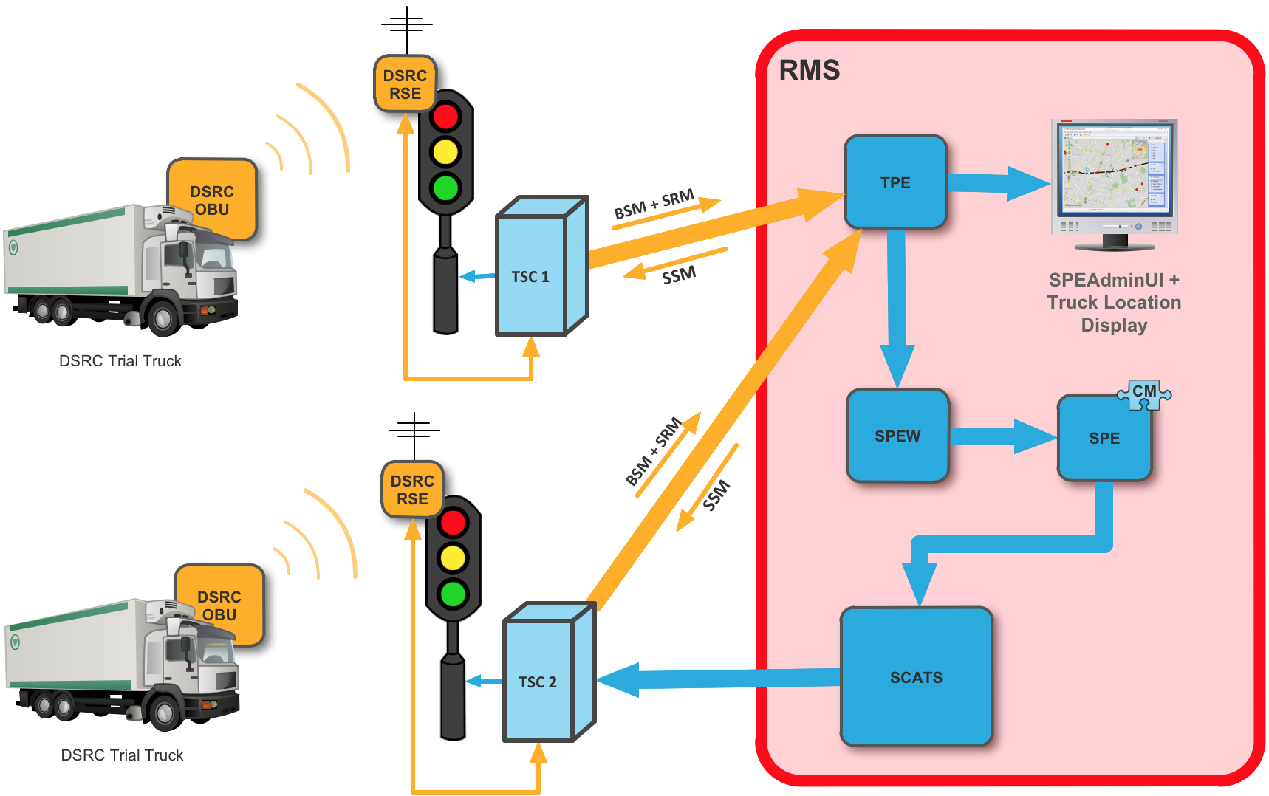
SPE trial: TPE extension

Slide 9
SBC 1: vehicle detection
Re-wiring of existing induction loops
Provide information on travel speeds and vehicle lengths
New detection technology:
Count on half loop
Calculate DS with full loop
Optimise the offset time between intersections

Slide 10
SBC 2: upstream detection
Measure all arriving vehicles, including queued vehicles, using mid-link upstream detectors
Improve SCATS real-time optimisation at the downstream traffic signals
Combine with SBC1 (detection technology + associated SCATS algorithm changes)
Improve congestion measurement
slow short vehicle from an efficient, fast long truck

Slide 11
SBC 3: external detectors
Enable use of IP base detectors
Provide drivers for converting continuous detection to SCATS input (Vo, NonOcc)
Provide interface delivering speed and length of each vehicle/pedestrians
Ability to define SI in a region from external sources

