Slide 1
MOVA Traffic Signal Control
Trial
Stephen Wright

Slide 2
The Trail and Current Position
Working with NZTA, Christchurch, to trail an alternative method of control at isolated signalised intersections
Work undertaken as part of Efficiencies Programme
Funding approved

Slide 3
Way Forward
Work with NZTA (client) and CTOC to agree on a suitable intersection
Formally engage a signals contractor to supply and build a MOVA compatible controller
Engage with local signals contractor to work with MOVA supplier
Complete MOVA design and follow through to construction

Slide 4
What is Mova?
Mova, Microprocessor Optimised Vehicle Actuation, control software to self-optimise the control system for traffic signals
“Using an online microprocessor, Mova maintains the optimum green phase, cycle time and control strategy to accommodate prevailing conditions to minimise queuing at traffic signal intersections achieving significant improvement in performance”

Slide 5
Dynamic Signal Control
A dynamic control system works on the spot, in the “now”
Deals with traffic as it arrives
Clears traffic on the first green it receives
Each approach should clear all traffic each and every green (unless the junction is saturated) – should
Fully automatic – to deal with varying conditions
Constantly changes green times to suit prevailing conditions, entirely automatically

Slide 6
Detection requirements
Vehicle detection using inductive loops – one or two loops per lane to count vehicle arrivals
An ‘X’ loop, about 3.5 seconds travel time from the limit line
An ‘IN’ loop to give a more distant view, important in the inter- and off-peak when vehicles are free flowing
Side roads, limit line loops
Move maintains historic data for each lane in half hour intervals so it can use previous flows if all detectors fail on an approach

Slide 7
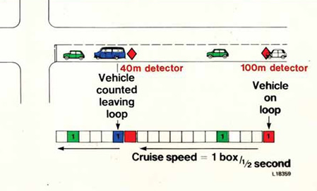

Slide 8
How Does Mova Work?
MOVA Operational Modes
MOVA has two operational modes; the first deals with un-congested conditions, the second with situations when the intersection becomes overloaded or congested. MOVA determines which mode is appropriate by accessing information from on-street detection equipment and stored historical data.
Un-congested mode
MOVA seeks to disperse any queue which has built up during the red signal of each traffic phase, and then carries out a delay-and-stops minimising procedure every half second.
If there would be a benefit from extending the current green, then the current green would continue and the calculations repeated. If no benefit were predicted, the signals would change to the next stage.
Congested mode
In the congested mode, MOVA operates a capacity-maximising routine. This routine takes into account which approaches are overloaded; the efficiency of green use, and determines the signal timings which will maximise the intersection throughput under the flow conditions prevailing.

Slide 9
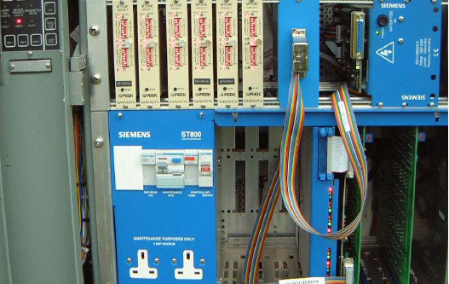
Hardware

Slide 10
Mova in congested conditions?
Queues should not form on any approach until the intersection as a whole has demand in excess of capacity
As demand approaches saturation, the “delay minimising” algorithm changes to a “capacity maximising” algorithm
This creates more green time for congested approaches, at the expense of those uncongested, maximising control effectiveness

Slide 11
What is the effect of this?
All approaches clear every cycle
Mova automatically adjusts green time to accommodate demands
No queuing occurs until the junction as a whole is saturated
When running at or above capacity, queue management occurs automatically to ensure critical approaches are kept clear
A high capacity, flexible and effective solution which automatically accommodates intermittent queuing, accidents and ‘events’

Slide 12
Benefit Achieved by Implementing Mova
How good is it? by comparison with VA…
TRL’s own research, (TRRL Research Report RR 279) indicated that crash reduction at major high speed high flow intersections was as high as 30%”
“As regards performance, measured in terms of delay, the extent of improvement ranges from single percentage figures up to more than 20%, with an average of typically 13%.” Source: TRL
On roundabouts, improvement between 20% and 30%

Slide 13
Remote Monitoring
Once Commissioned and Validated, the only monitoring needed is to identify and resolve hardware issues, for instance lamp fails and detection issues
Future compatibility within SCATS?

Slide 14
Bus Priority
Mova incorporates emergency and priority vehicle (bus priority) control parameters allowing normal optimised Mova control until priority is needed, when it is achieved within Mova without changing mode
Various degrees of priority are available, including priority dependant upon current traffic conditions

Slide 15
Thank you

Slide 16
MOVA Decision Making Process
once commissioned MOVA is continuously making decisions regarding the optimum performance of the intersection by utilising dynamic and historical information from its detector loops.
Since MOVA will dynamically make decisions as to the optimum length of each particular green period, signal timings can vary widely as the traffic conditions change and MOVA will generate its own signal timings cycle-by-cycle, varying continuously with traffic conditions.
The optimum cycle time is a product of intersection geometry and lost time, flows and turning movements.
MOVA continually monitors conditions during oversaturated periods and will, when appropriate, select and enforce the cycle time which maximises capacity.
The decision-making algorithm is based upon a relationship between the duration of the current green stage and the likely duration of the other stages, plus the lost time, making up the full cycle time.

