Slide 1
Workshop 2017 – Trinity Wharf Tauranga

Slide 2
My Brief – Workshop Overview
Regional Updates
NZ Innovation
National Signals Specification
Education, Standards, Qualifications

Slide 3
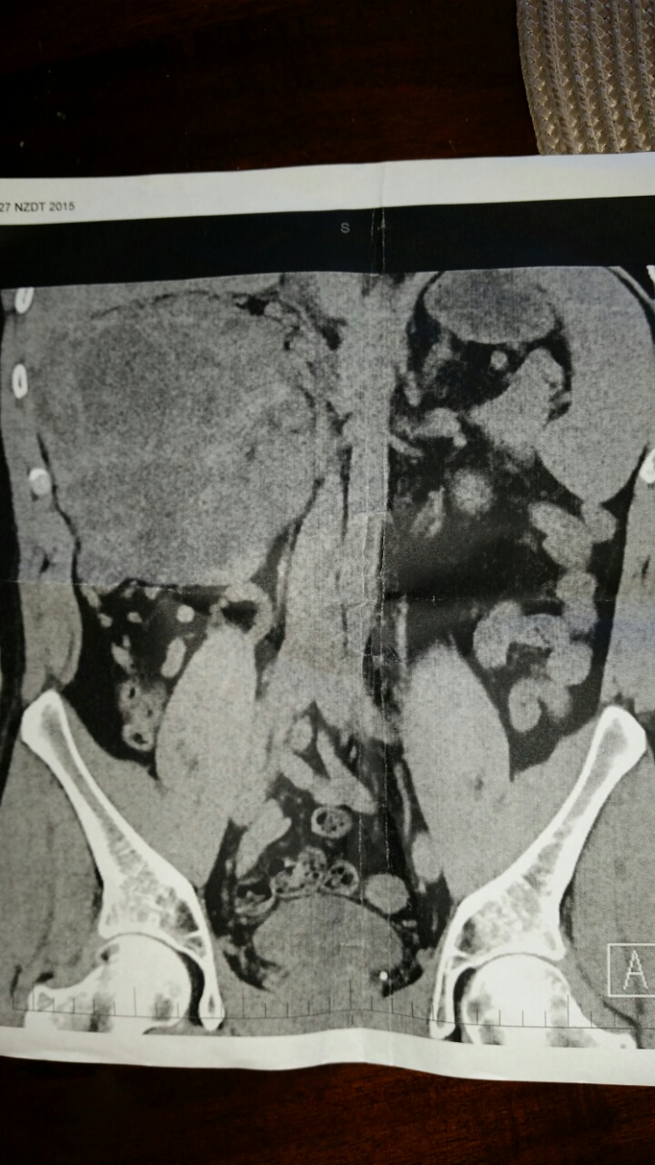
NOT Good Side
Good Side

Slide 4
My Brief – Workshop Overview
Regional Updates
NZ Innovation
National Signals Specification
Education, Standards, Qualifications

