Slide 1
Welcome!
Connect to WiFi:
Step 1: log into Novotel Conference Wireless
Step 2: Open internet Browser
Step 3: select Visitors access
Step 4: Enter Code “ZJKPNQ”
Access Slido (for asking questions)
Browse to www.slido.com
Enter code: #SNUG
Please help yourself to tea and coffee….
The conference will start at 8.55am

Slide 2
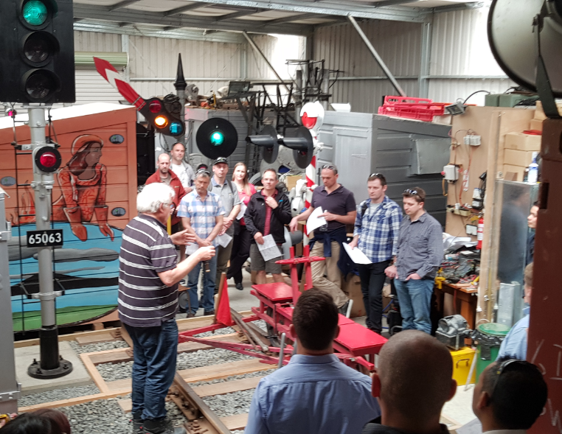
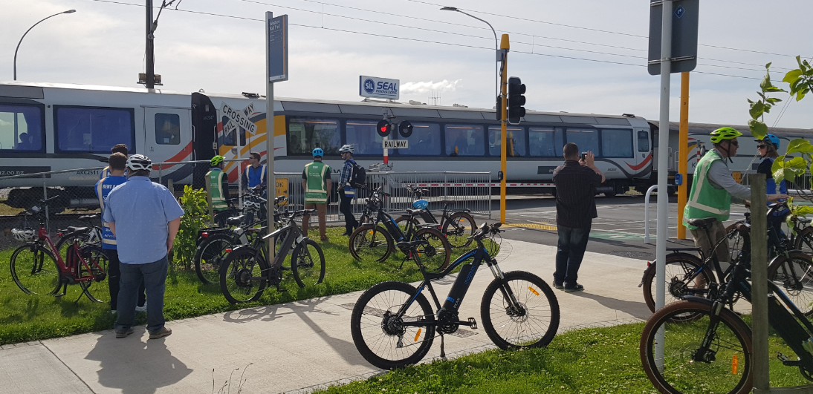
Tech tour

Slide 3
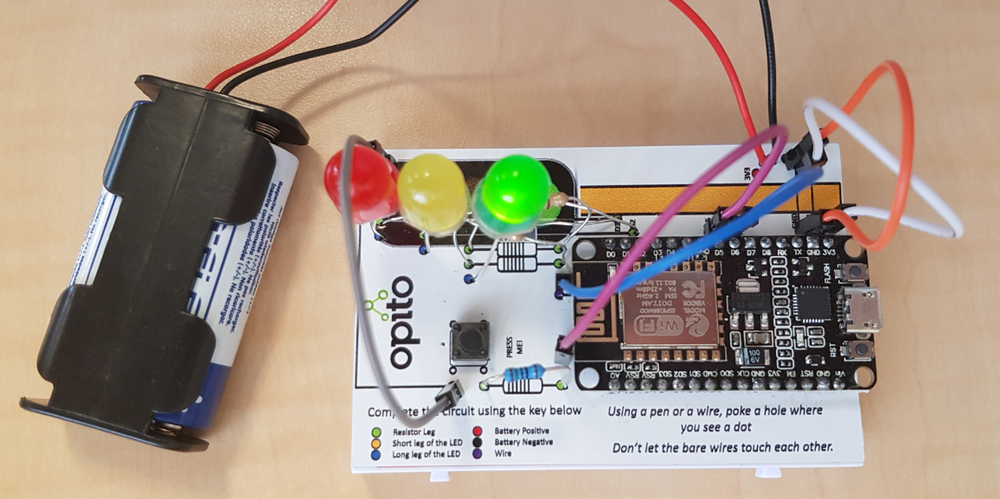
Activity Build a traffic signal toy
All the LED’s go the other way around (long leg in blue dot)
This one is a trick.. It actually goes into the next hole over from where marked (in the ‘D6’ text)
Button inserted with wires where yellow dots indicate

