Slide 1
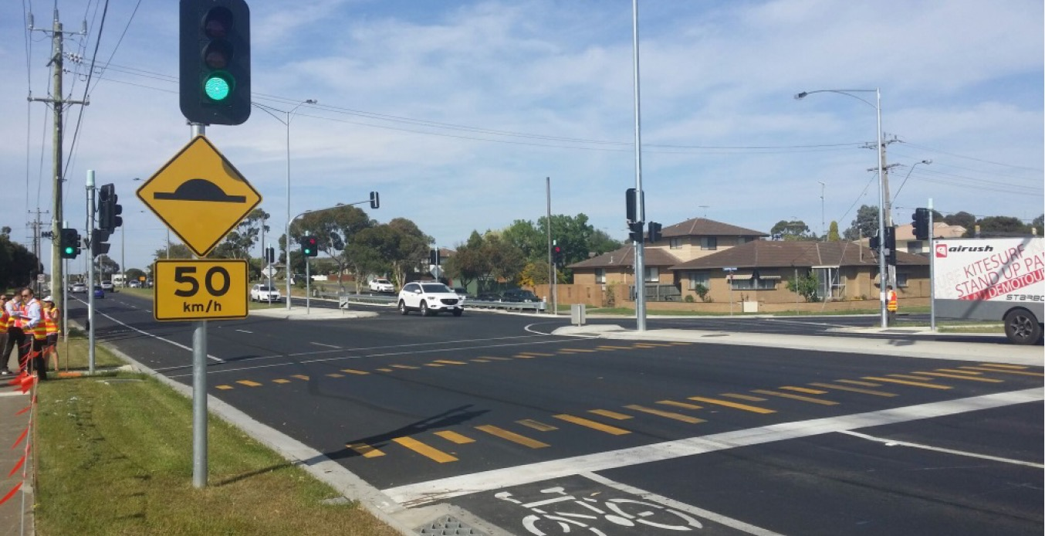

Raised Safety Platforms at Traffic Signals
Fabian Marsh - Lead Advisor Safety
SNUG - 2 November 2018

Slide 2
A Raised Safety Platform is not the same as a traditional “Speed Hump”
The ramp profile is generally much softer and designed to match Safe System speed thresholds

Slide 3
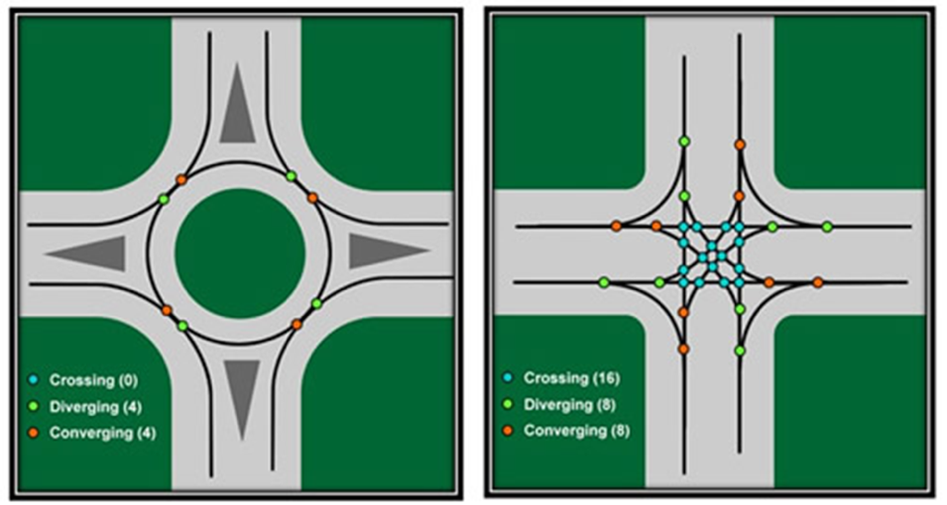
Intersection Safety
Why are roundabouts better aligned with Safe System?
Roundabout
  8 conflict points
  Entry speed is reduced
  Shallow impact angle
Traffic Signals
  32 conflict points
  Entry speed is not reduced
  High impact angle
Potential for impact forces to exceed Safe System boundary conditions, i.e. injury tolerance limits

Slide 4
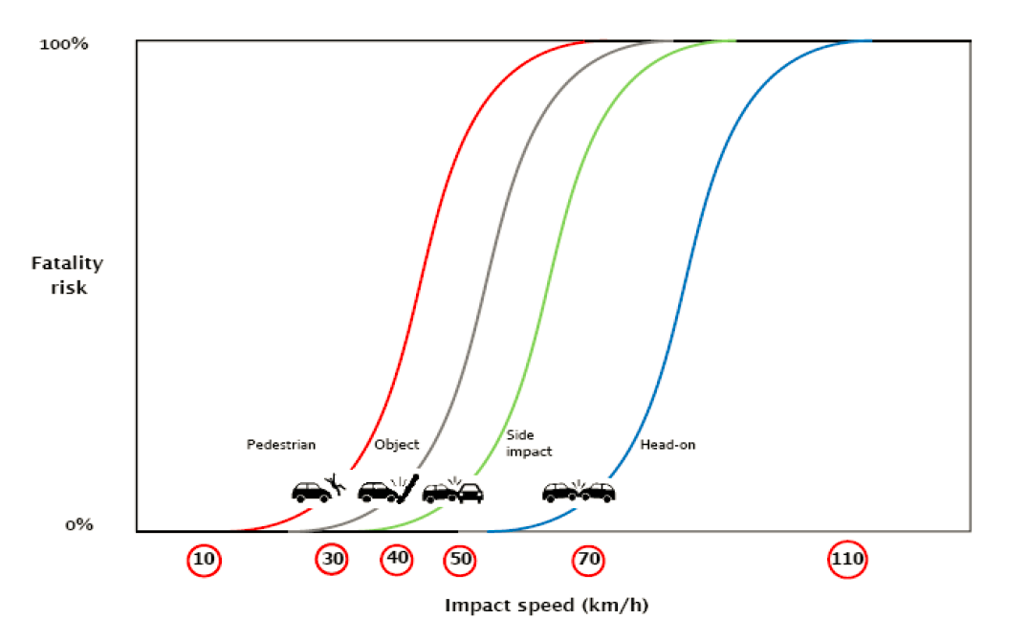
Safe System Biomechanical Injury Limits
Boundary Conditions
Vehicle speeds should be kept below the following for each conflict type:
  Side Impacts ≤50km/h
  Pedestrians ≤30km/h
80%
50
70
10%

Slide 5
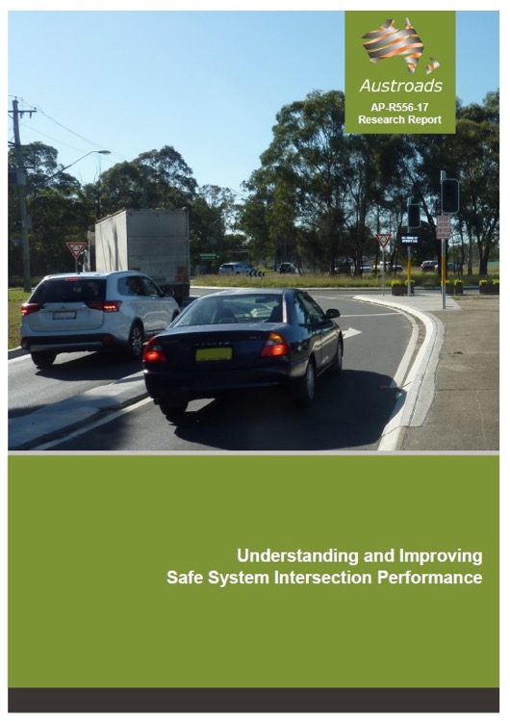
Intersection Safety Performance
Can traffic signals be made as safe as roundabouts?
Roundabout
  Fatal crash reduction 37-90%
  Serious crash reduction 63-100%
  considered Safe System aligned
Traffic Signals
  50% DSI reduction
Raised Platforms
  Additional 40-50% casualty reduction
Traffic signals fitted with raised safety platforms not as safe as well-designed roundabouts but can be expected to reduce serious casualty risk by around two-thirds.
Fully-controlled right turns (Full-time control)
  69% DSI reduction (up to 90% opposing / turning casualties)

Slide 6
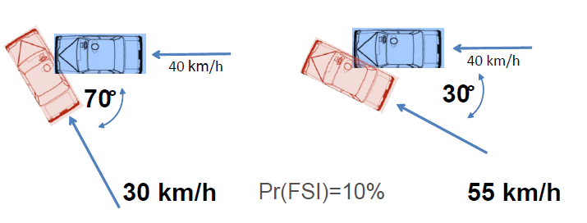
Crash energy variables
Speed → Energy → Severity
Energy is a function of:
  Speed
  Mass
  Impact angle / configuration
KE = ½ m v²
X-KEMM-X
  Tool to analyse crash severity at conflict points
  Probability of DSI for a given speed (equal) and impact angle
Source: Austroads (2018)

Slide 7
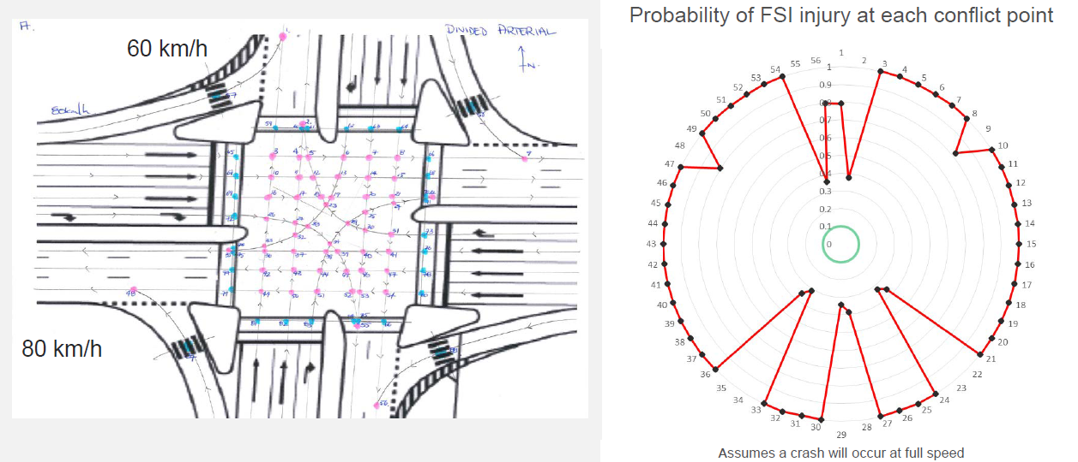
X-KEMM-X Examples
Traffic signals
Source: Austroads (2018)

Slide 8
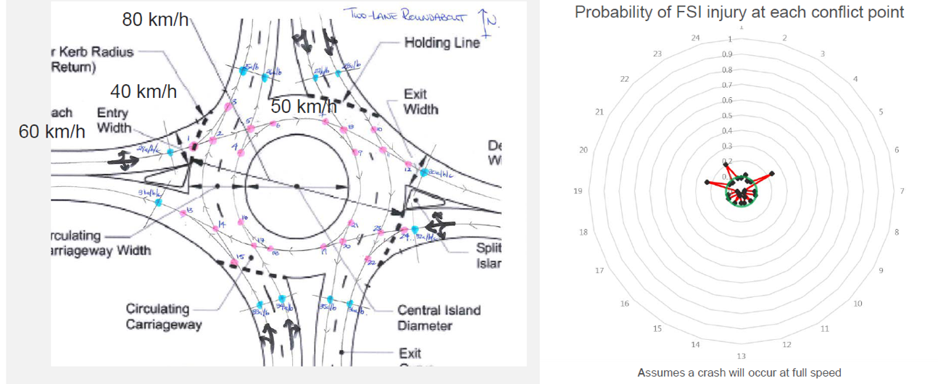
X-KEMM-X Examples
Roundabout
Source: Austroads (2018)

Slide 9
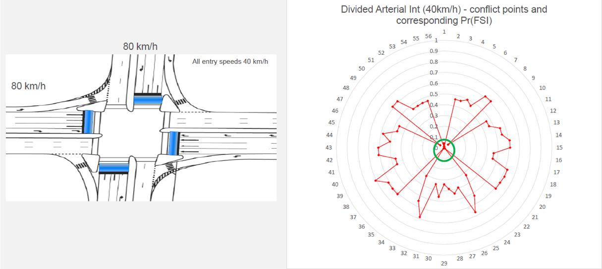
X-KEMM-X Examples
Traffic signals with raised safety platforms
Source: Austroads (2018)

Slide 10
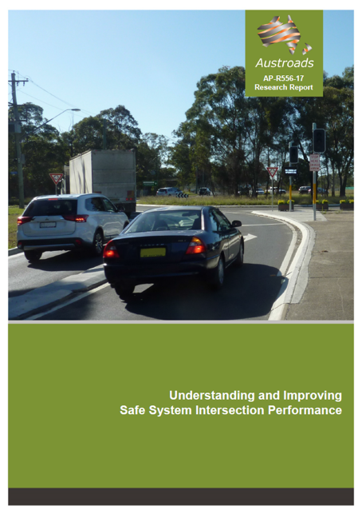
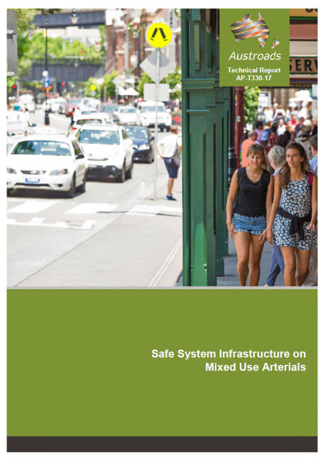
Safe System Intersections
Managing crash energy
  Raised safety platforms are increasingly seen as a road safety treatment to manage speeds at potential conflict points towards Safe System levels:
  intersections
  mid-block (pedestrian crossings)
  traffic calming

Slide 11
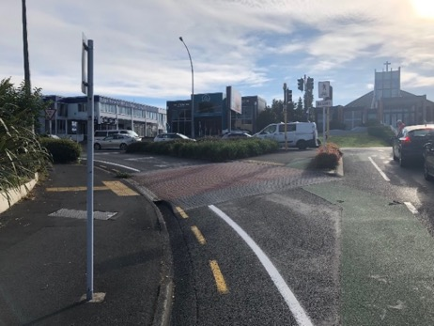
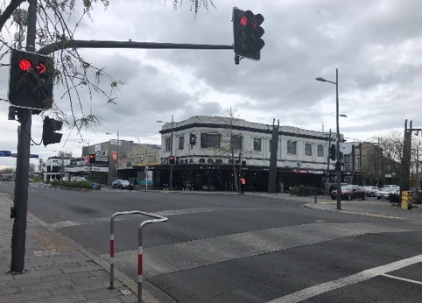
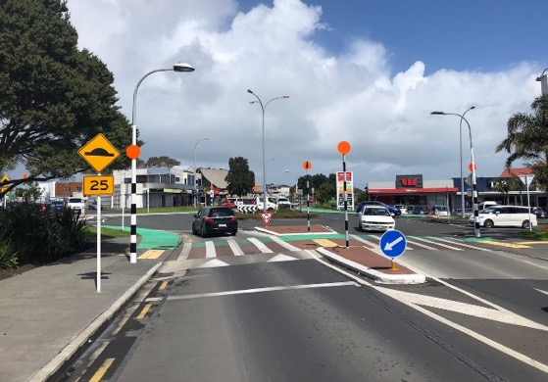
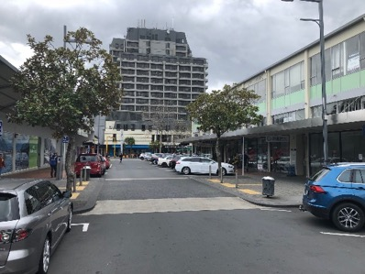
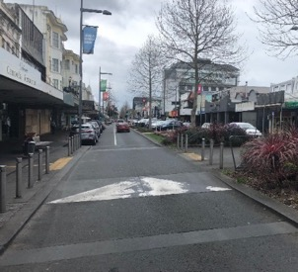
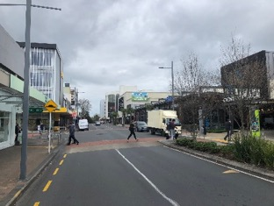
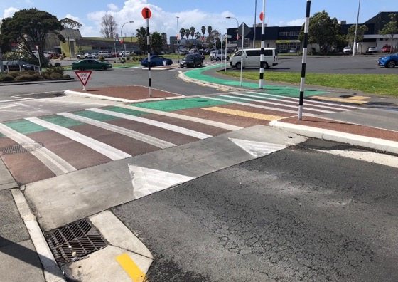
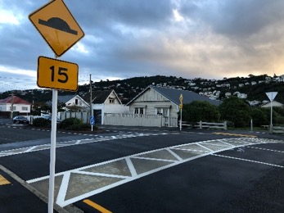
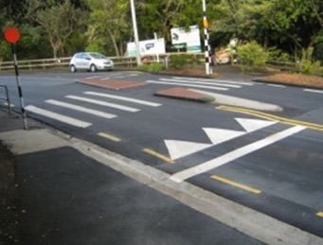
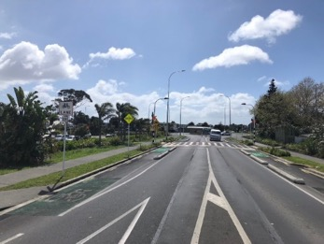

Slide 12
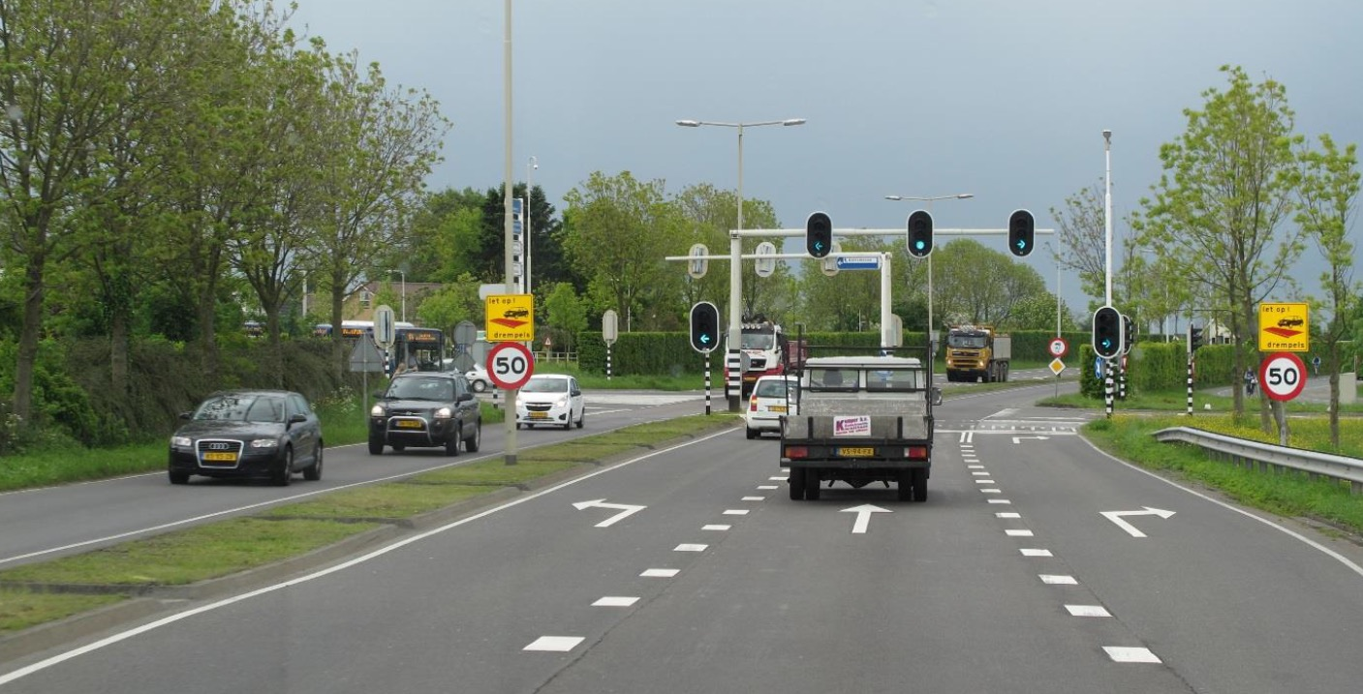
The Netherlands
Notes:
The use of safety platforms has been pioneered by the Province of South Holland on a significant scale. Safety platforms, accompanied by 50 km/h intersection speed limits, have been constructed at more than forty signalised intersections, mostly on 70 km/h roads. A large-scale evaluation conducted in the Netherlands showed that injury-producing crashes fell by a statistically reliable 40-50%4. Safety platforms were developed as a design concept to enhance safety, especially for cyclists and pedestrians crossing major roads at (or near) these intersections. It had been found that conventionally designed traffic signals were not providing the level of protection sought by the Dutch Sustainable Safety road safety vision, which is highly compatible with the Safe System aspiration.
Therefore, to produce Safe System performance at an intersection that is inherently risky, additional safety features are needed. By including safety platforms, the final design will not be as safe as a well-designed roundabout but can be expected to reduce serious casualty risk by around two-thirds.

Slide 13
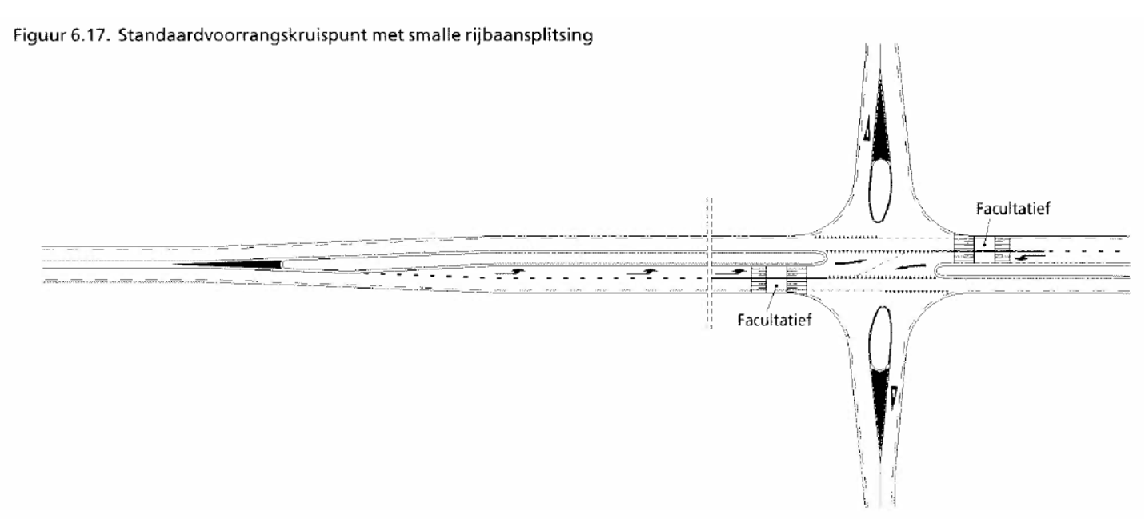
Raised Safety Platforms
Rural unsignalised example
Dutch guidelines for 80km/h roads recommend use of RSPs at signalised intersections. Recommeded:
Raised safety platforms
Localised speed limit reduction
red-light / speed cameras.
The concept shown is for an unsignalised intersection extracted from Dutch guidelines
Sourced from: Corben, B. F. (2014). Criteria for the use of elevated stop lines at traffic signals. Contract report for VicRoads prepared by Corben Consulting, August 2014.

Slide 14
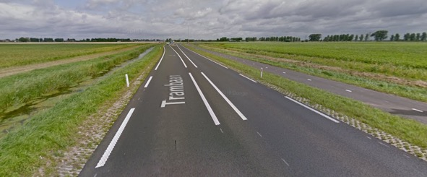
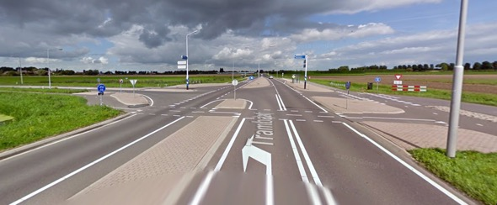
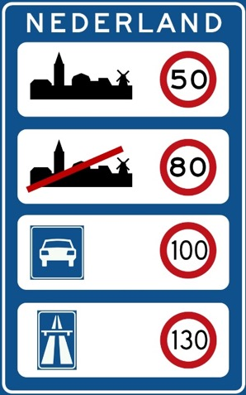
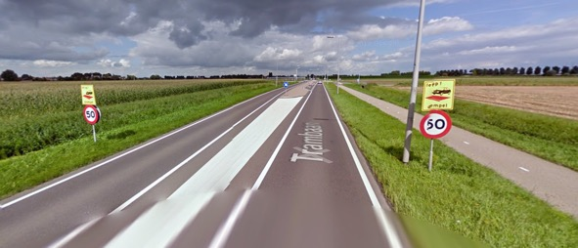
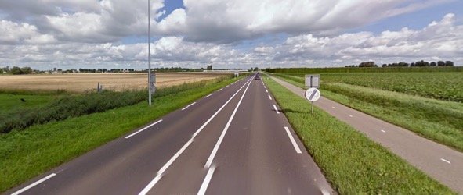
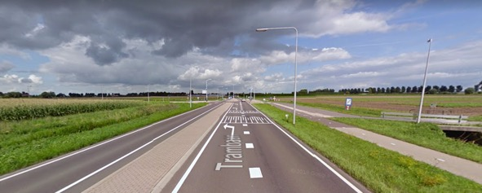
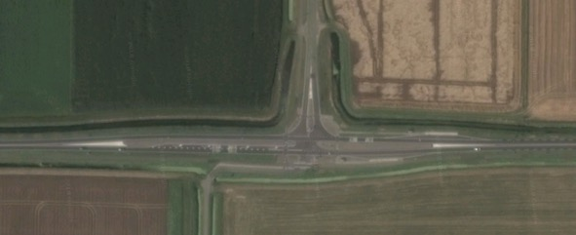
1
4
2
5
3
6
Notes:
The default speed limits in the Netherlands are 50 km/h inside built-up areas, 80 km/h outside built-up areas, 100 km/h on expressways (autowegen), and 130 km/h on motorways (autosnelwegen)

Slide 15
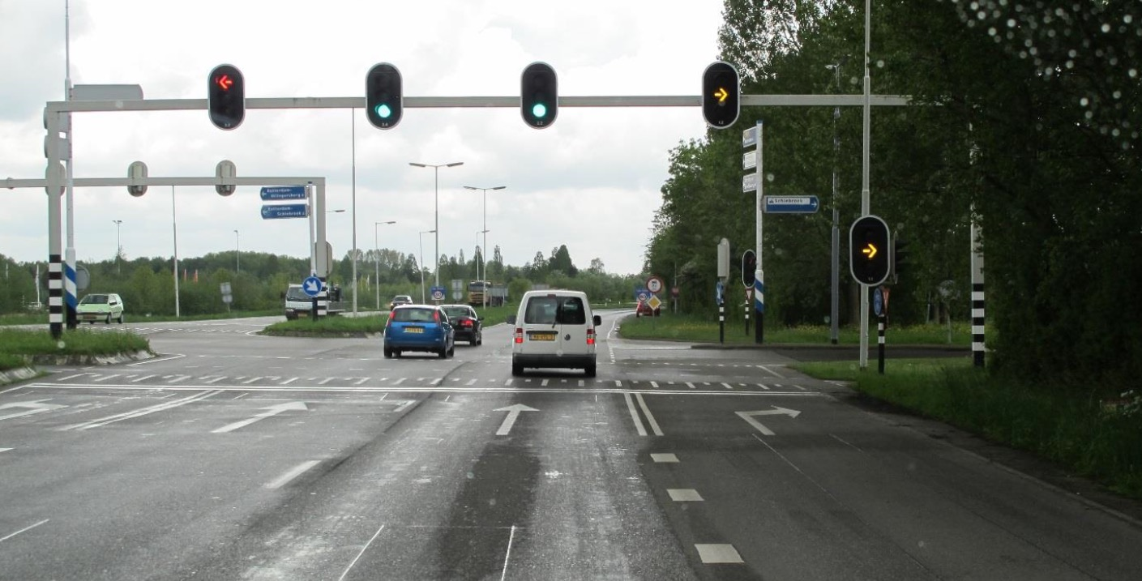

Slide 16
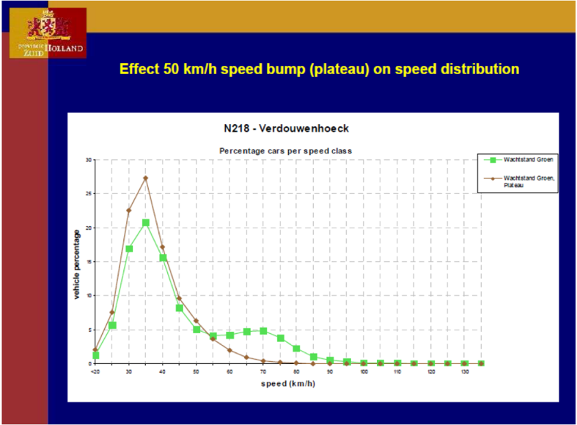
Raised safety platforms
Effectivess
Change in speed distribution at an example treated intersection
“In very busy intersections an increased capacity can occur.”
Sourced from: Corben, B. F. (2014). Criteria for the use of elevated stop lines at traffic signals. Contract report for VicRoads prepared by Corben Consulting, August 2014.
Notes:
Chart shows the change in distributions of travel speeds through a treated intersection, before and after the installation of the ESLs. It is most encouraging in safety terms that the proportion of vehicles travelling above 50 km/h after the installation of the ESLs (red line in the graph) has fallen markedly, when compared with the distribution on speeds before the treatment (green line).

Slide 17
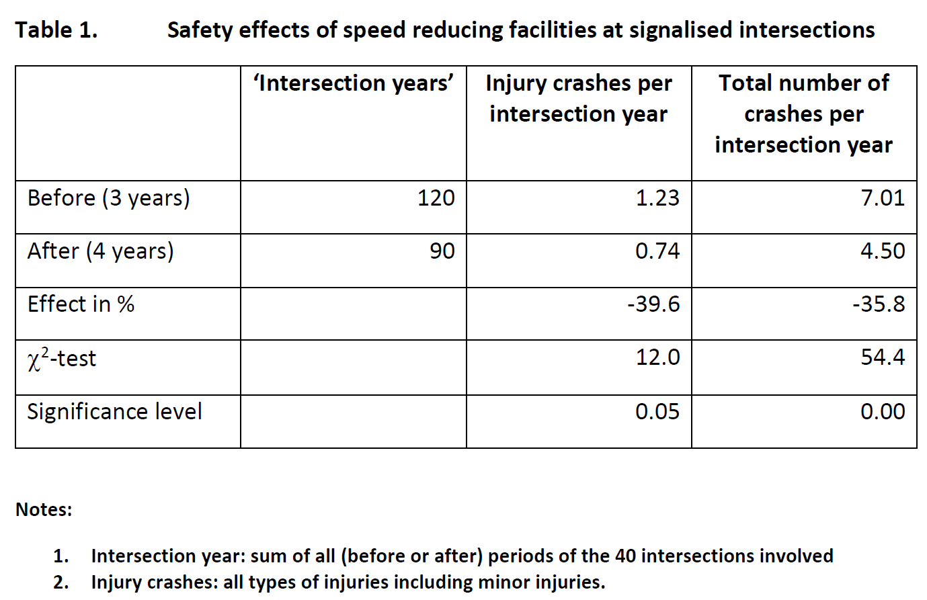
Raised safety platforms
Effectiveness
40-50% reduction in injury crashes (statistically significant)
When two highly-congested intersections were removed from the sample of 40 intersections being evaluated, the reduction in casualties increased from 40% to 50%.
Sourced from: Corben, B. F. (2014). Criteria for the use of elevated stop lines at traffic signals. Contract report for VicRoads prepared by Corben Consulting, August 2014.
Notes:
Fortuijn et al. (2005) reported a statistically reliable reduction in casualties of 40% for a sample of 40 intersections treated with raised stop bars (see Table 1 below). When two highly-congested intersections were removed from the sample of 40 intersections being evaluated, the reduction in casualties increased from 40% to 50%.

Slide 19
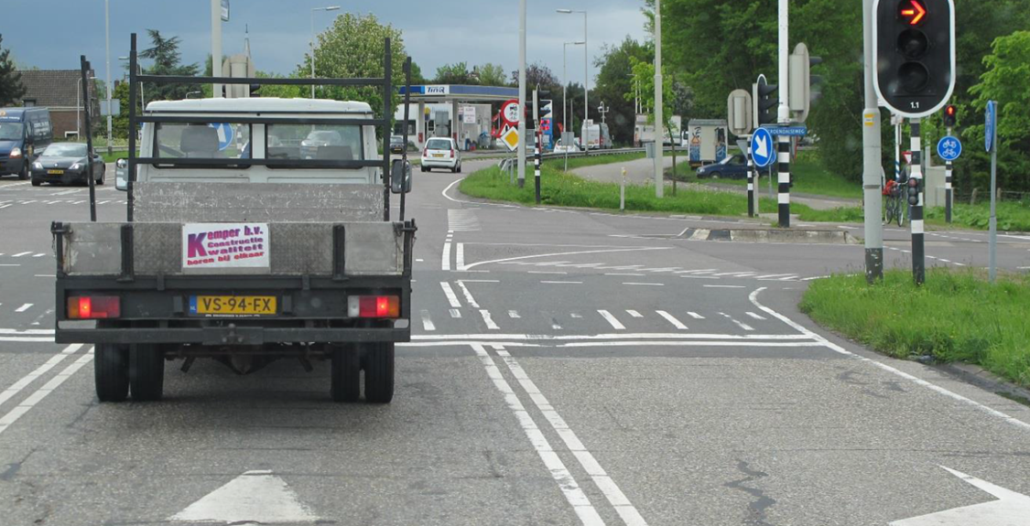

Slide 20
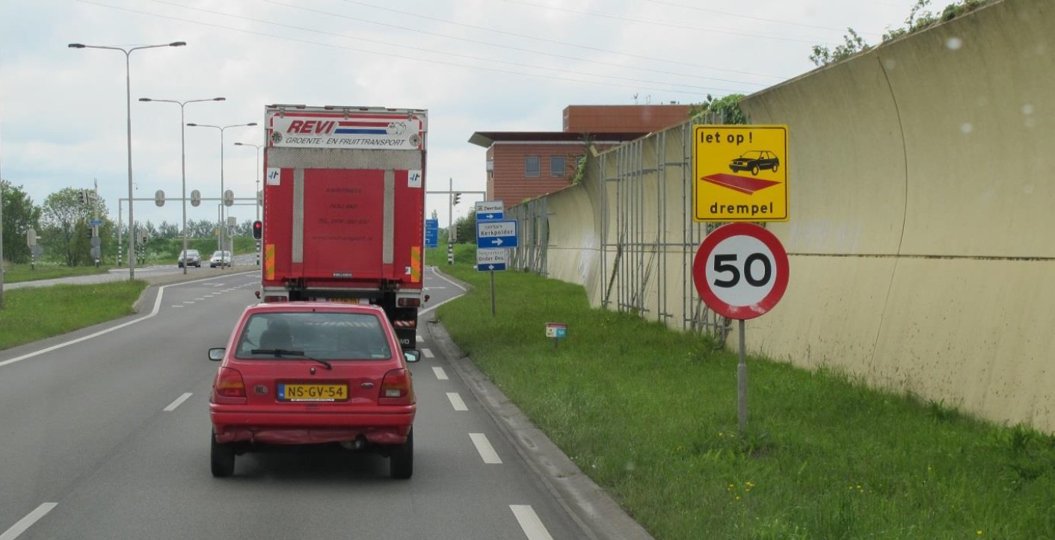

Slide 21
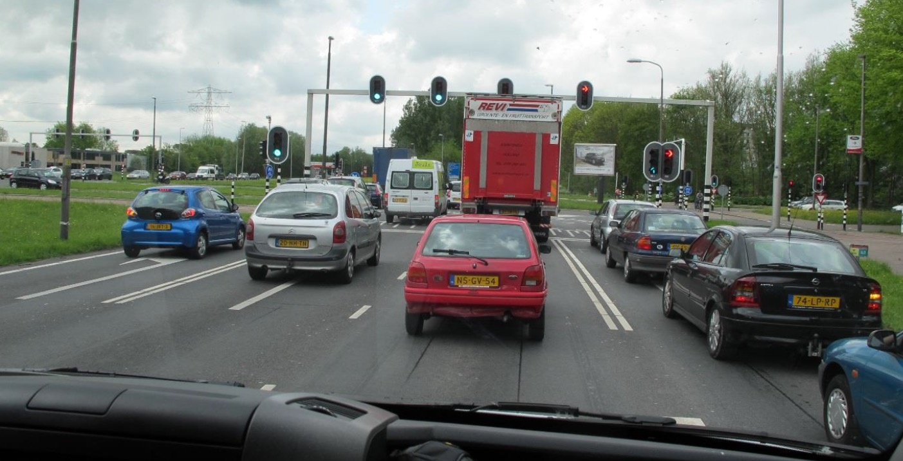

Slide 22
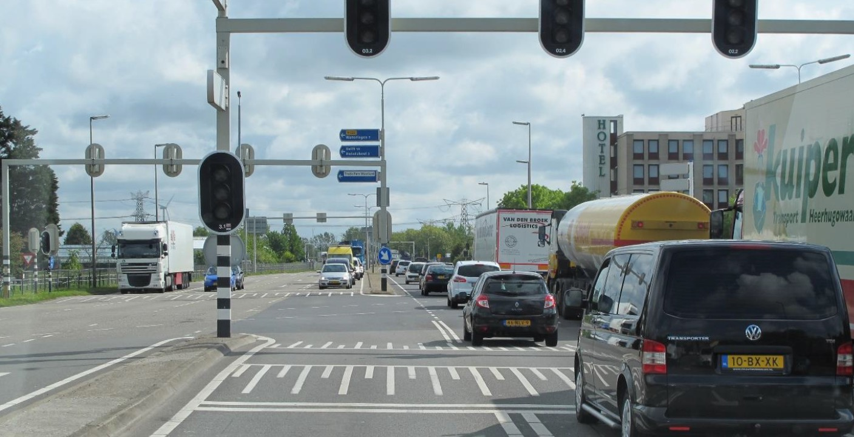

Slide 23
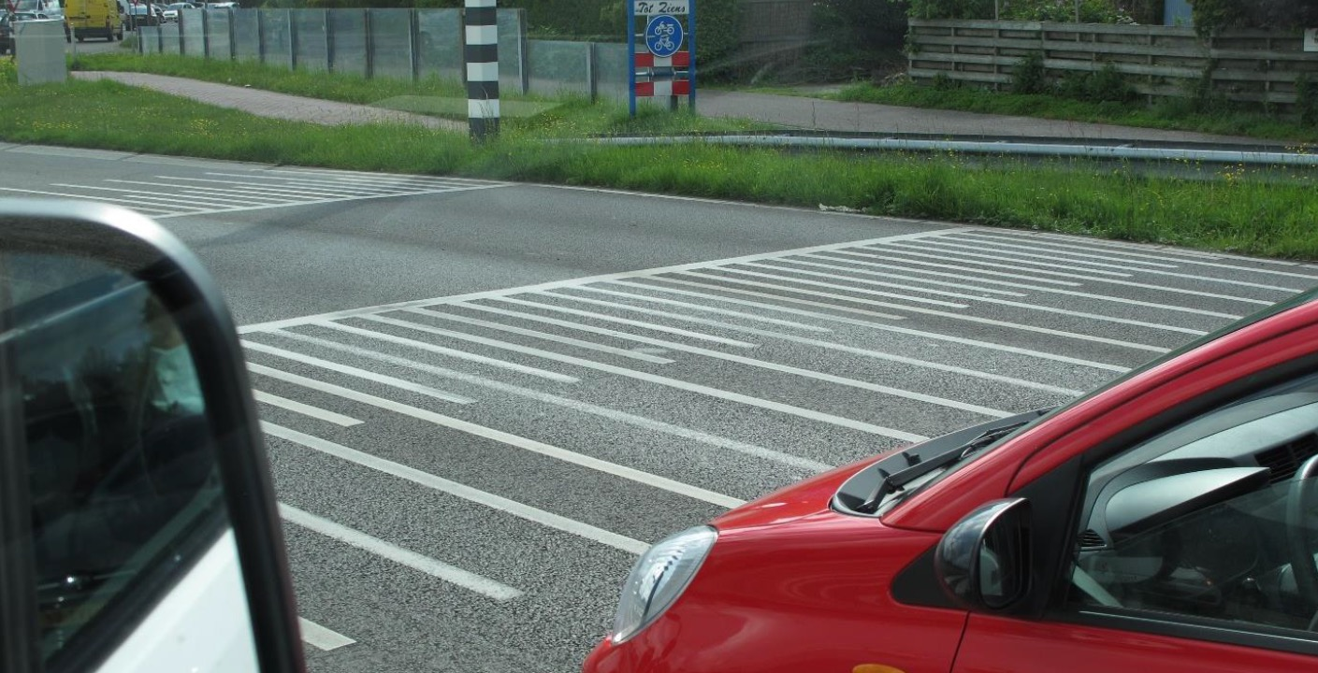

Slide 24
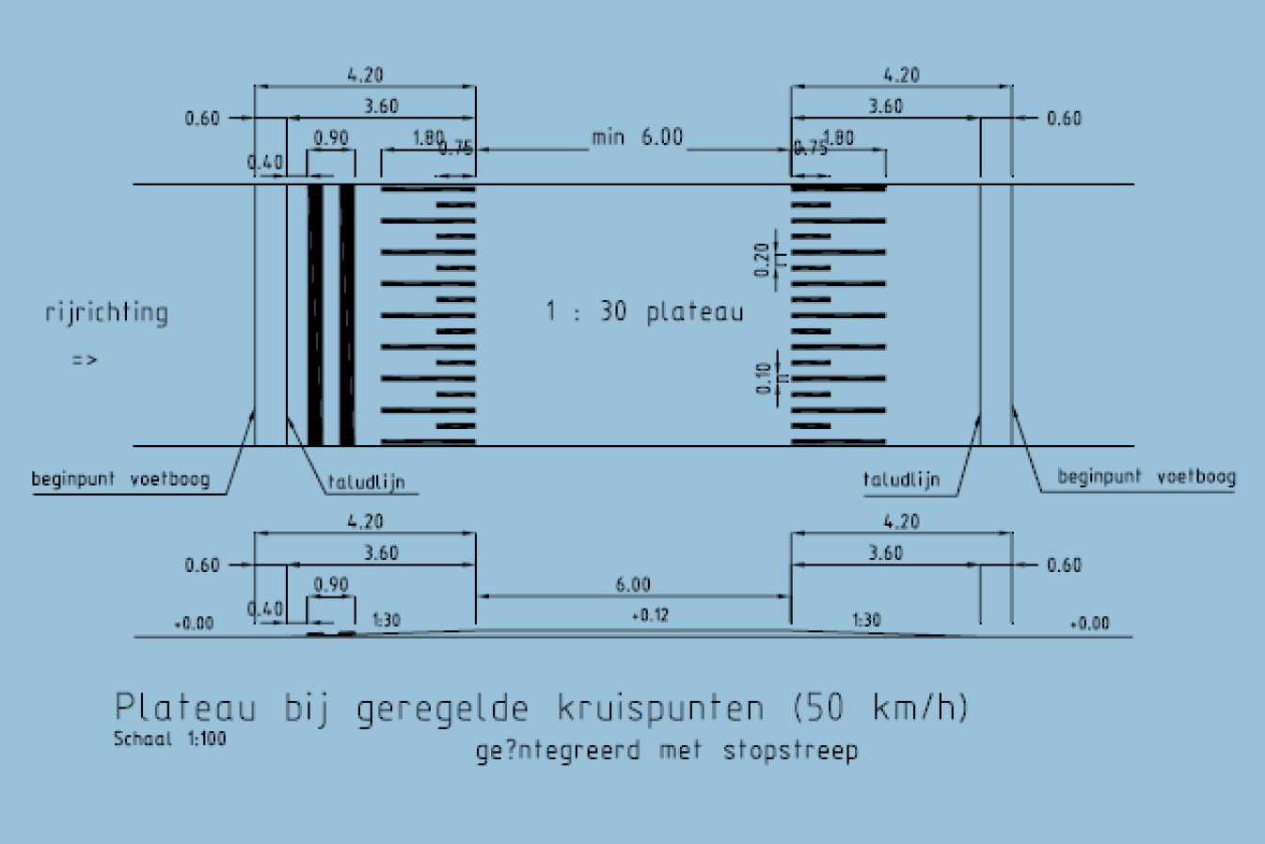

Slide 25
Victoria, Australia

Slide 26
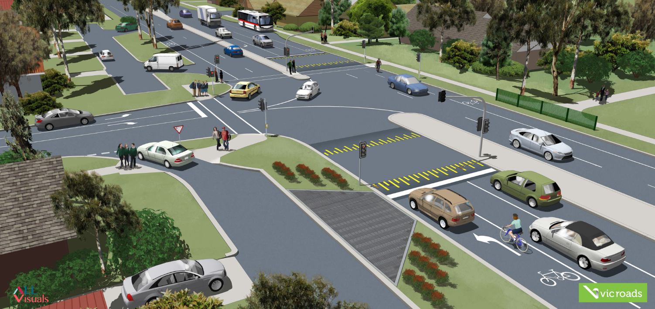

Slide 28
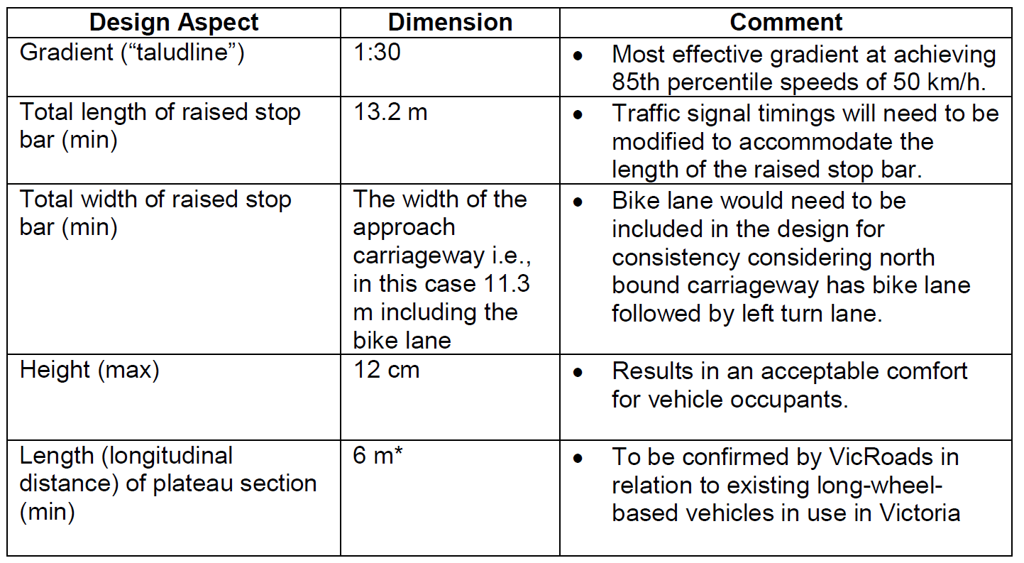

Slide 29
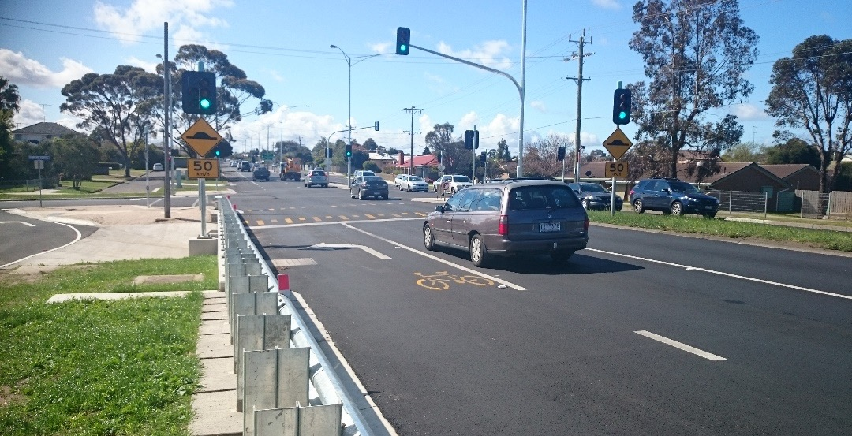

Slide 30
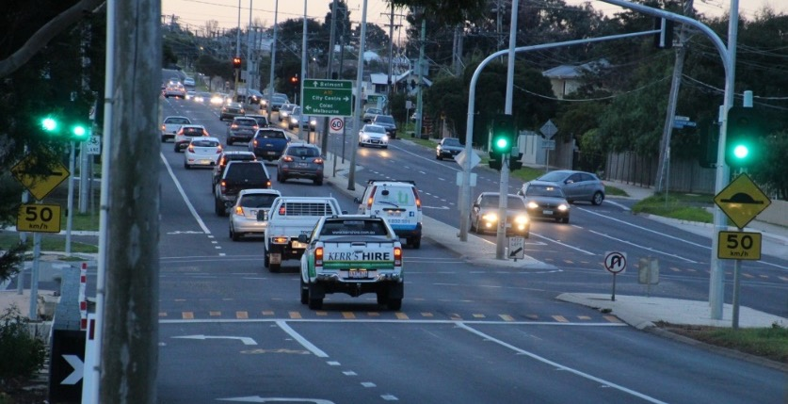

Slide 31
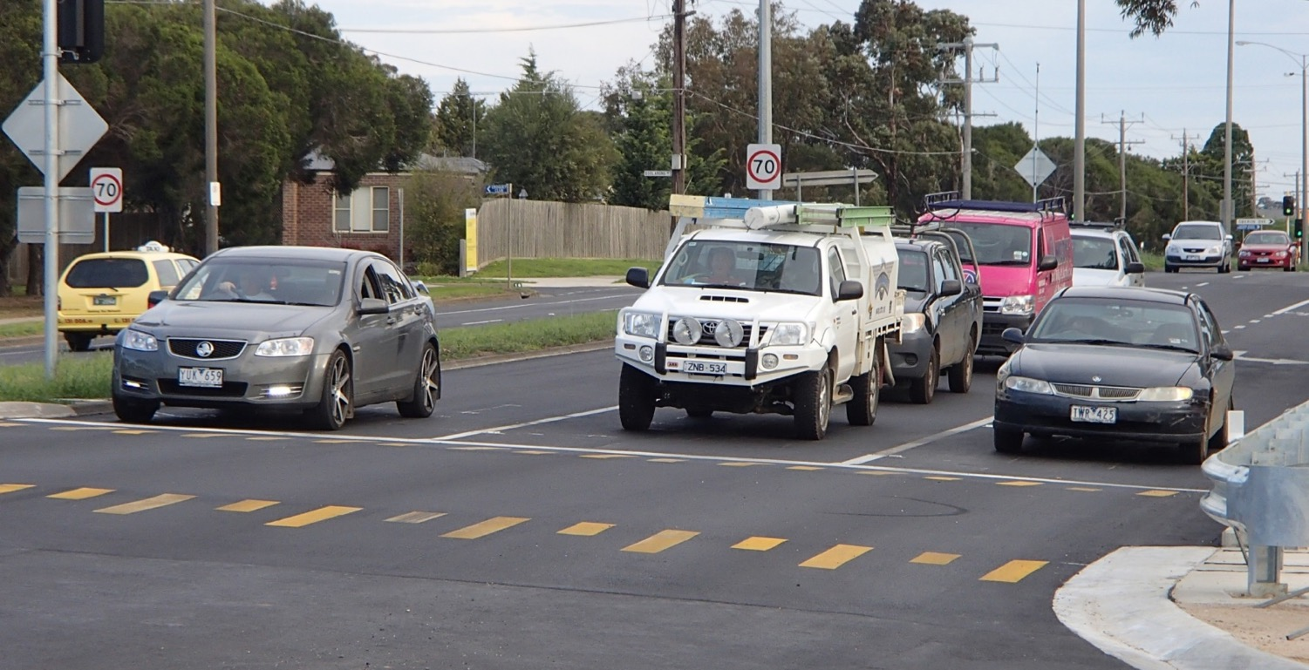

Slide 32

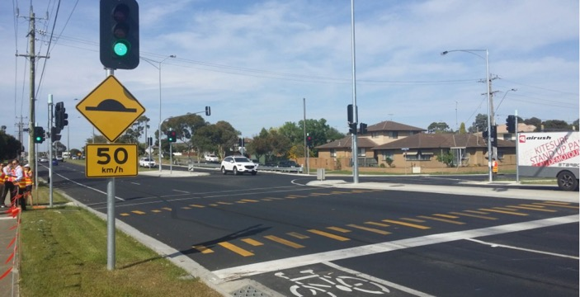
Belmont Site
Deemed a success
  Previously unsignalised (70km/h)
  RSPs implemented in combination with new traffic signals and 60km/h
  Before speeds around 64 km/h (mean) and 69 km/h (85%ile)
  After speeds around 43 km/h (mean) and 55 km/h (85%ile)
  Compared to signalised control site:
    12.3km/h (mean) & 12.6km/h (85%ile) less
  Compared to unsignalised control site:
    20.5km/h (mean) & 15.2km/h (85%ile) less
  Some initial overshooting of stop line (calmed down over time)
  No significant noise issues raised
  Anecdotal positive public response

Slide 33
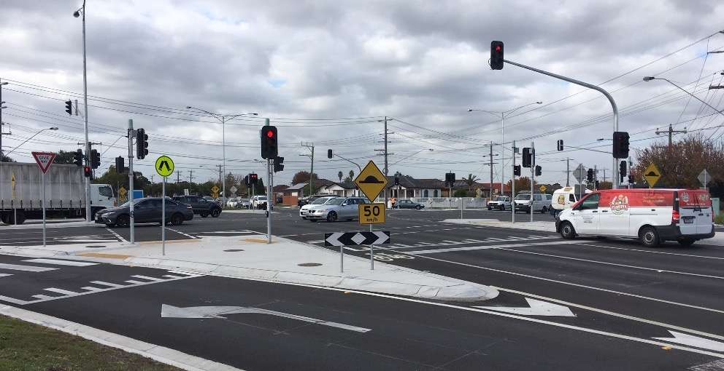

Slide 34
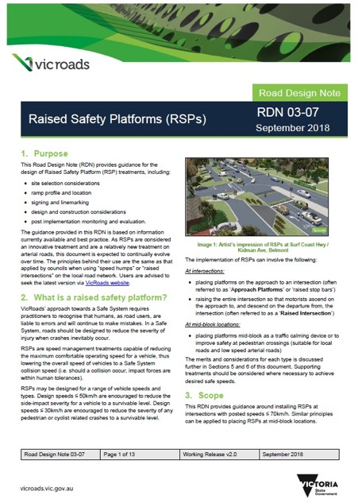
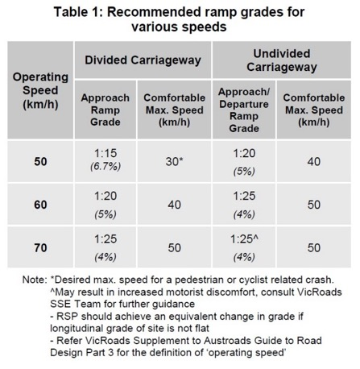
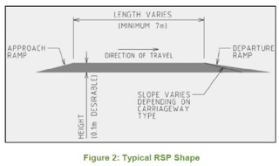
Victoria
Design Guidance
  Raised safety platforms (RSPs)
  Road Design Note RDN 03-07
  https://www.vicroads.vic.gov.au/-/media/files/technical-documents-new/road-design-notes/road-design-note-0307-raised-safety-platforms-rsp-oct-2018.ashx

Slide 35
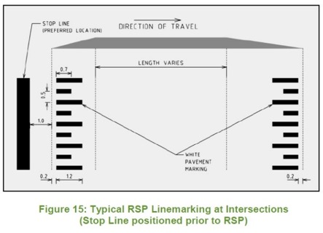
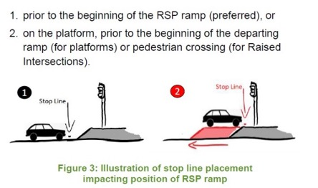


Victoria
Design Guidance
  Raised safety platforms (RSPs)
  Road Design Note RDN 03-07
  https://www.vicroads.vic.gov.au/-/media/files/technical-documents-new/road-design-notes/road-design-note-0307-raised-safety-platforms-rsp-oct-2018.ashx

Slide 36
New Zealand
Notes:
The use of safety platforms has been pioneered by the Province of South Holland on a significant scale. Safety platforms, accompanied by 50 km/h intersection speed limits, have been constructed at more than forty signalised intersections, mostly on 70 km/h roads. A large-scale evaluation conducted in the Netherlands showed that injury-producing crashes fell by a statistically reliable 40-50%4. Safety platforms were developed as a design concept to enhance safety, especially for cyclists and pedestrians crossing major roads at (or near) these intersections. It had been found that conventionally designed traffic signals were not providing the level of protection sought by the Dutch Sustainable Safety road safety vision, which is highly compatible with the Safe System aspiration.
Therefore, to produce Safe System performance at an intersection that is inherently risky, additional safety features are needed. By including safety platforms, the final design will not be as safe as a well-designed roundabout but can be expected to reduce serious casualty risk by around two-thirds.

Slide 37
Design element | Dimension | Comment
Approach ramp gradient | 1:15 for 30 km/h platform speed 1:20 for 40 km/h platform speed 1:25 for 50 km/h platform speed | Suggested ramp grades to achieve the target speed limit/advisory speed, based on the comfortable maximum ramp speed
Departure ramp gradient | 1:35 (maximum) | Can be flatter, but consideration needs to be given to how far this would set the RSP back from the intersection
Platform length (minimum longitudinal length of plateau section) | 6 m | Length to be confirmed to ensure it suits long-wheelbase vehicles typically used in NZ
Height of platform (maximum) | 100 mm (above pavement). (Generally to top of kerb). | Platforms over 100 mm high may damage low-floor vehicles 150 mm may be considered for low speed (less than 50 km/h) and low traffic volume environments
Total width of raised platform | Width of the approach carriageway, including any shoulders and cycle lanes.

Slide 38


Ramp profiles
Auckland Transport

Slide 39





Slide 40



Focus Group Survey
Developing NZ Guidance
  overall support for the raised traffic signal concept and appreciation for safer speeds through intersections;
  Sharks Teeth markings were clearly preferred over Piano Key markings;
  participants clearly understood the meaning of the signs approaching the intersection
  the lower speed limit and advisory signs seemed reasonable
  some had issues with the speed limit and advisory speed being the same

Slide 41

Thomas / Gordonton
Hamilton City Council - WSP Opus
  First NZ trial being developed:
  New signals
  Raised safety platforms (50km/h)
  Supported by:
  New road environment
  Lower speed limit (60km/h)
  Speed thresholds
  Warning signs
  Electronic feedback signs

Slide 42

Heavy Vehicle Stability
Simulation
constant speed: RSP had negligible effect on changing the critical rollover speeds
constant acceleration from a stationary position: RSP had negligible effect on changing the critical rollover accelerations
When two highly-congested intersections were removed from the sample of 40 intersections being evaluated, the reduction in casualties increased from 40% to 50%.
Opus Research Report 18-232499.26

Slide 43
Raised Safety Platforms
Ongoing Monitoring
  Safety Performance
  Speed Management
  Public Acceptance
  Traffic Flow / Capacity
  Noise
  Large Vehicle Stability
  Drainage
  Constructability
  National Safer Intersection Working Group
  Looking for more trial sites !!!
  Contact: fabian.marsh@nzta.govt.nz

Slide 44

Thank You

Slide 45
Intersection Safety Performance
Can traffic signals be made as safe as roundabouts?
Overview
  What is a Raised Safety Platform?
  Roundabouts vs Traffic Signals
  Safe System Injury Limits
RSP Examples
  The Netherlands
  Victoria, Australia
Layout
  Ramp gradients, signs & markings, etc
  Focus group survey
Issues and considerations
  Heavy vehicle stability
  Noise

Slide 46



Notes:
The use of safety platforms has been pioneered by the Province of South Holland on a significant scale. Safety platforms, accompanied by 50 km/h intersection speed limits, have been constructed at more than forty signalised intersections, mostly on 70 km/h roads. A large-scale evaluation conducted in the Netherlands showed that injury-producing crashes fell by a statistically reliable 40-50%4. Safety platforms were developed as a design concept to enhance safety, especially for cyclists and pedestrians crossing major roads at (or near) these intersections. It had been found that conventionally designed traffic signals were not providing the level of protection sought by the Dutch Sustainable Safety road safety vision, which is highly compatible with the Safe System aspiration.
Therefore, to produce Safe System performance at an intersection that is inherently risky, additional safety features are needed. By including safety platforms, the final design will not be as safe as a well-designed roundabout but can be expected to reduce serious casualty risk by around two-thirds.

Slide 47

Notes:
The use of safety platforms has been pioneered by the Province of South Holland on a significant scale. Safety platforms, accompanied by 50 km/h intersection speed limits, have been constructed at more than forty signalised intersections, mostly on 70 km/h roads. A large-scale evaluation conducted in the Netherlands showed that injury-producing crashes fell by a statistically reliable 40-50%4. Safety platforms were developed as a design concept to enhance safety, especially for cyclists and pedestrians crossing major roads at (or near) these intersections. It had been found that conventionally designed traffic signals were not providing the level of protection sought by the Dutch Sustainable Safety road safety vision, which is highly compatible with the Safe System aspiration.
Therefore, to produce Safe System performance at an intersection that is inherently risky, additional safety features are needed. By including safety platforms, the final design will not be as safe as a well-designed roundabout but can be expected to reduce serious casualty risk by around two-thirds.

