Slide 1
Tauranga Transport Operations Centre

Slide 2
Network Management Information Centre

Slide 3
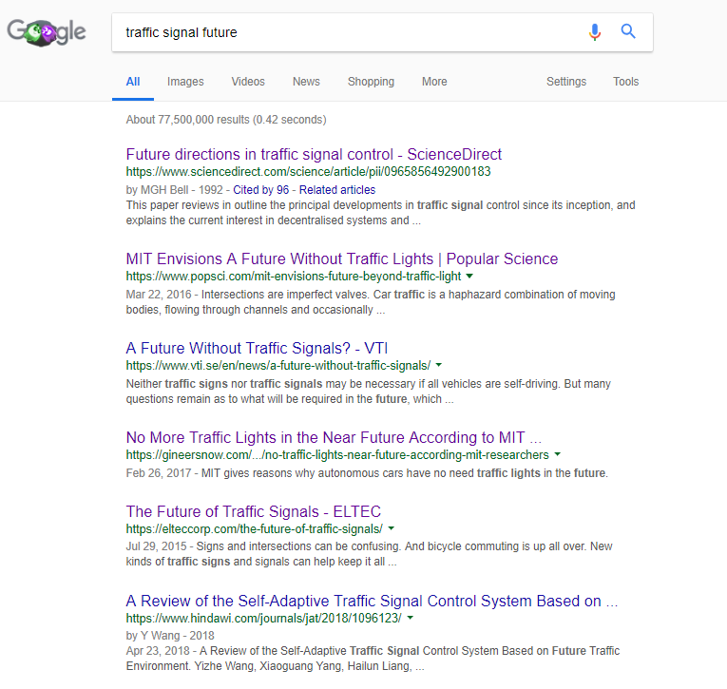

Slide 7
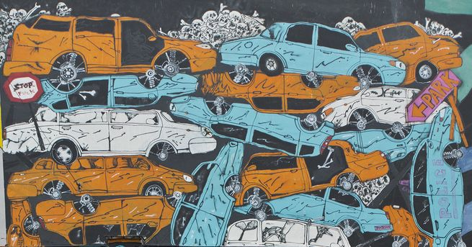
MIT Envisions A Future Without Traffic Lights
Where we’re going, we don’t need signals
“If you think of traffic, not as people and goods in cars, but as a fluid, it makes no sense that cars spend so much time standing still.
So we have traffic lights, and we have cars idling at traffic lights….
But with autonomous cars, the future doesn’t have to be that way.”
https://www.popsci.com/mit-envisions-future-beyond-traffic-light

Slide 8
T… who ever we are.. Update…
SNUG 2018 – Hamilton
haydn.wardley@tauranga.govt.nz

Slide 9
TTOC Team
5 Operators 24/7 – Signal faults and SCATS Ops, Street Lighting, Crime, CCTV, Incident Management.
Traffic Management, 2 TMC and 1 Auditor
Contracts Manager, Mark Hollows - Signals and SCATS Operations
Traffic Systems Specialist, Richard Eaton - CCTV / ITS
Contracts Manager, Michael Jones - Street Lights and Central Management System (CMS)
Traffic Signals Specialist, Haydn Wardley - SCATS Management, Projects and Designs
Traffic Engineer Graduate, Bryson Huxley – Signals/Ops
Team Leader, James Wickham

Slide 10
TTOC Assets
Traffic Signals – WBOP 25 TCC, 17 NZTA (Total 42)
Traffic Signals – EBOP 2 RR, 24 NZTA (Total 26)
Transport CCTV – 200
Facilities CCTV – 300
Transport ANPR – 8
Transport Analysis - 4
Bluetooth / WiFi counters – 30
Ped / Cycle counters - 30
Street Lighting – 22,000

Slide 11
TTOC Proposed Projects
Type | Year | Expected Growth
New Signals | 2019 | 11
 | 2020 | 10
Upgrade Signals | 2019 | 6
 | 2020 | 4
Cameras | 2019 | 40
 | 2020 | 60
Counters | 2020 | 25

Slide 12
TTOC challenges experienced, and looking forward to!
Growth, population 11% increase, Port 30%pa, Highest GDP in NZ up 6.6%
Traffic congestion, expectations for us to wave the magic wand, again.
Bus, Freight, Emergency Services Priority.
Roundabouts and more roundabouts.
Cycle infrastructure and facilities.

Slide 13
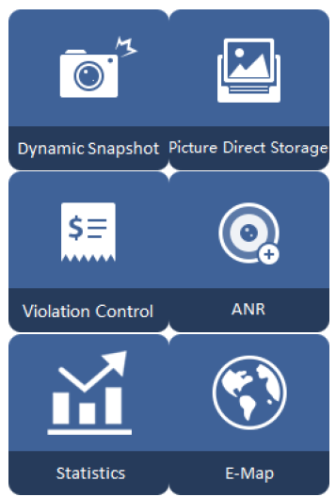
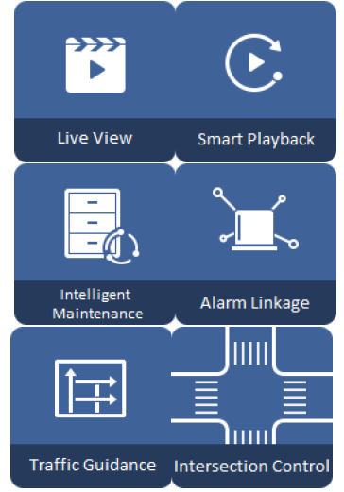
TTOC Cameras
Flow analysis and prediction
ANPR Blacklist to police
1 camera multi views
Vehicle feature detection
People counting

Slide 14
TTOC challenges experienced, and looking forward to!
User data and movement statistics.
Testing Siemens Sx controller early 2019.
Project scope, feasibility and detailed design.
Scats can solve it, designed on paper but where is the system design?
Inefficiencies, Cost of the user.
Street lighting CMS / Smart City.

