Slide 1
Roundabout metering
Tauranga Experience
2 November 2018

Slide 2
The Problem
The NZTA Minor Efficiency Programme for 2017 and 2018 identified two SH roundabouts in Tauranga where efficiency gains were sought to reduce peak hour queuing.
Through investigation, modelling and stakeholder workshops, signalised metering was recommended as the solution to be designed and implemented.
This presentation relates to Barkes Corner – a 5 leg roundabout at the intersection of SH 29A, Pyes Pa Road, Cameron Road and Marshall Avenue.

Slide 3
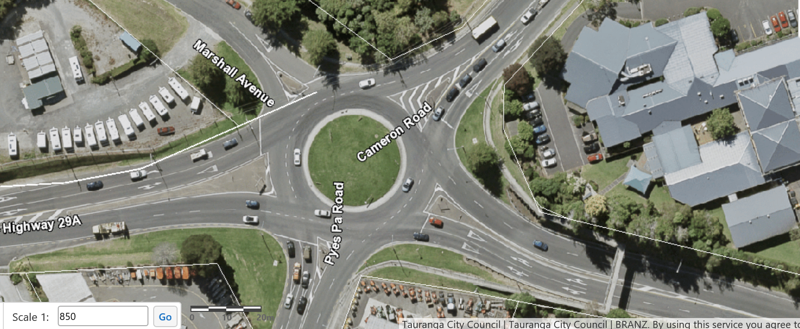
Marshall Avenue – no exit street
Pyes Pa Road and Cameron Road – TCC Arterials
State Highway 29A – a National Freight Route

Slide 4
Issue being addressed
Evening peak queues on SH 29A eastbound extend back through the SH 36 (Takitimu Dr) / SH 29 Tauriko roundabout resulting in queuing before the Barkes Corner roundabout and on Takitimu Dr Toll Road (TDTR);
Cameron Road also experiences queuing in the evening peak that extends through Greerton;
Proposed solution is not to make queuing on Cameron Road in the evening peak worse.

Slide 5
Traffic Modelling
Base SIDRA model made available by WSP-OPUS;
Tested metering of Pyes Pa Road in the evening peak with positive results indicated;
Metering of 2 approaches is not achievable in SIDRA;
BECA extended their AIMSUN model and metering of Pyes Pa Road and SH 29A westbound tested with positive results indicated;
Changes to lane configurations were also tested - capacity of roundabout improved but issues with 3 lanes circulating and roundabout geometry;
As both the isolated SIDRA model and the AIMSUN model indicated that there were potential efficiency gains, the decision to meter Pyes Pa Road and SH 29A westbound was made.

Slide 6
Design
The metering design complied with the TCD Rule with guidance from Traffic Note 60 (Roundabout metering signals – information);
Signals limit line 30m from roundabout give way limit line;
3 aspect display – lanterns on 24/7;
Primary display with overhead mast arm;
Secondary display - on the SH 29A approach the secondary was installed closer to the roundabout than the design.
On the Pyes Pa Rd approach a secondary was installed on the other side of the road as there was no central splitter island.

Slide 7
What happened
Metering signals commenced operation on 17th Sept
Before and after travel time information indicated travel time improvement in the peak in the first couple of days;
Some drivers assumed that the green light meant they could enter the roundabout without giving way;
Bus company raised H&S issue with fear of someone driving into the side of the bus;
Day 4 (Thursday 20th Sept), crashes occurred from drivers not complying with the roundabout give way rules.

Slide 8
What happened next
Signals turned to flashing yellow;
Signals turned off and signals heads removed;
Media release to explain situation – customer safety a priority;
Research to determine why they work in other parts of NZ with no reported crashes.

Slide 9
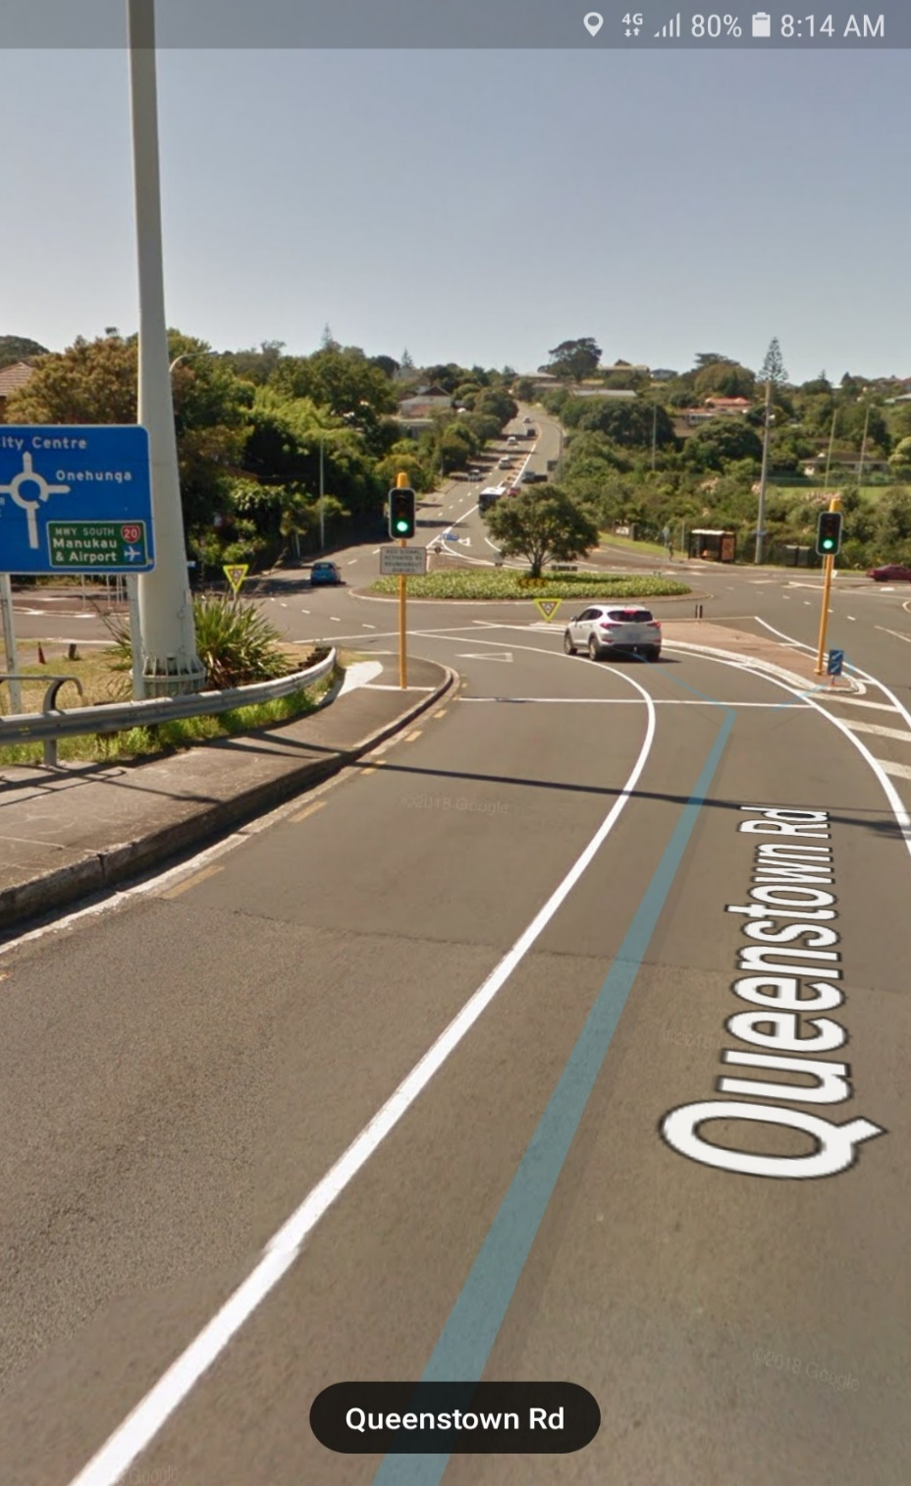
Auckland example
No crashes recorded that relate to the metering at Queenstown Rd.
Other metered roundabout sites in Auckland and in Christchurch do not exhibit the driver behaviour noted in Tauranga.
SH 5 Ngongotaha.

Slide 10
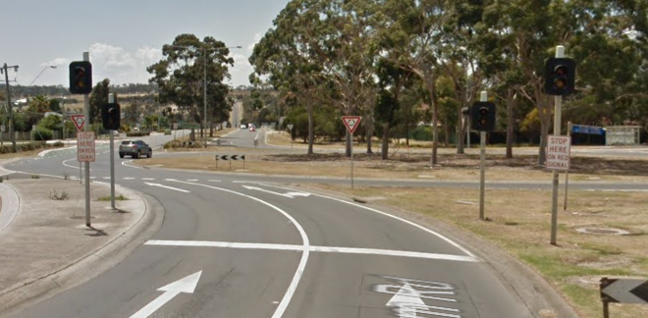
Australian example installation

Slide 11
Potential reasons for assuming right of way to enter the roundabout
There are 3 existing signalised roundabouts in Tauranga, 2 of which are on the same SH. The 3rd is on local road. Has the metering confused drivers?
Local drivers know how to negotiate the signalised roundabouts. Pole positions are at the intersection limit line and within the roundabout. Green means you can go;
At the metered roundabout approaches, some drivers interpreted the green signal to mean they could enter the roundabout unopposed, despite the signs and pre-commissioning comms;
On the SH 29A approach, the secondary pole was closer than 30m (approx. 15m) and offside give way sign at limit line was to far to the right;
Overhead signals on the primary poles on both approaches reinforced the green;
General consensus from NZTA/TCC/Aurecon, that in the Tauranga context – the green needs to go.

Slide 12
Options to resolve
Adjust the existing legal displays to “hide” the green;
Add signs and emphasise road markings;
Move the secondary pole on SH 29A away from the intersection or remove it if moving back not achievable.
Alternatively:
Seek a trial for the Australian system of roundabout metering with yellow and red signals only operating OFF/YELLOW/RED/OFF. Most of the day they are off except when triggered by the queue detectors;
Undertake physical works narrowing traffic lanes and widening and installing central splitter islands.

Slide 13
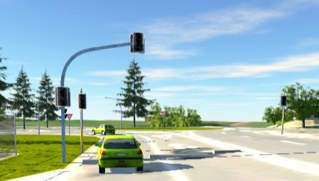
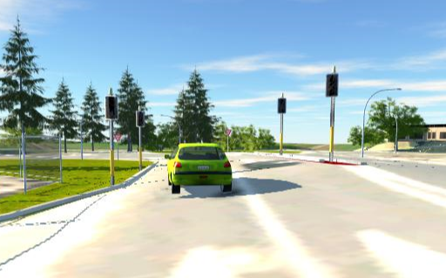
Pyes Pa Road
Initially installed
Ideal

Slide 14
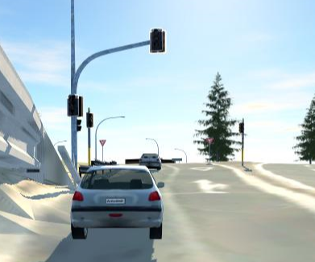
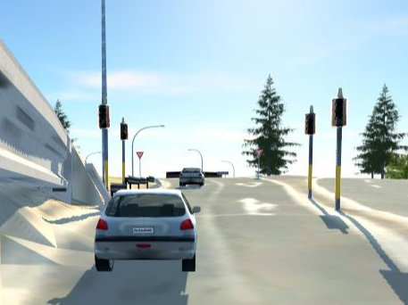
SH 29A
Initially installed
Ideal

Slide 15
Current design (in progress) for trial

Slide 16
Where we are now
Trial approved an gazette advertised;
Amended drawings “being finalised”;
Amended programming;
Due for implementation in November 2018.

Slide 17
Discussion

Slide 18
Thank you to NZTA, TCC (TTOC)

