Slide 1
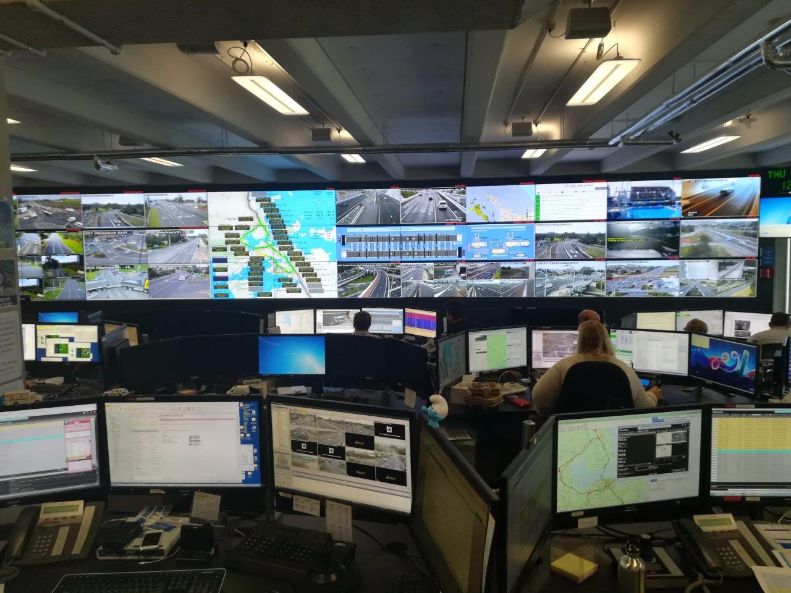
Auckland Transport Operations Centre
ATOC Smales
SNUG Regional update – November 2018
Rogan Parker
Snr Traffic Signal Engineer

Slide 2
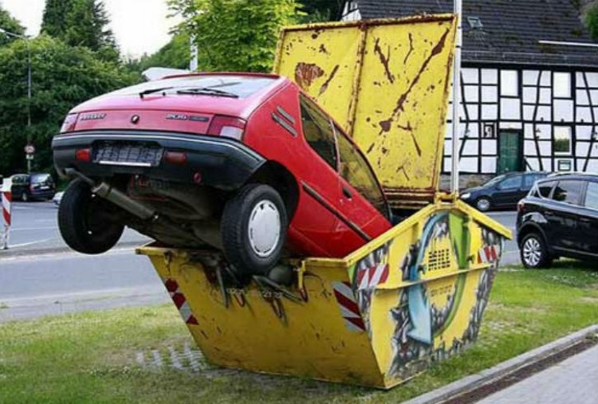
Safety vs Efficiency
Balance has changed
Removal of filter right turns
Increased focus on vulnerable users
Intersection upgrades – Bus priority / Transit lanes / Cycle lanes
Red Light cameras
30kmh speed limits

Slide 3
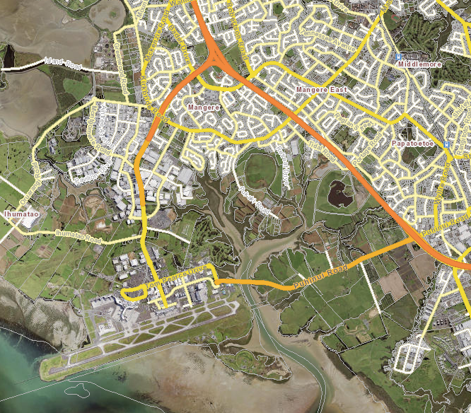
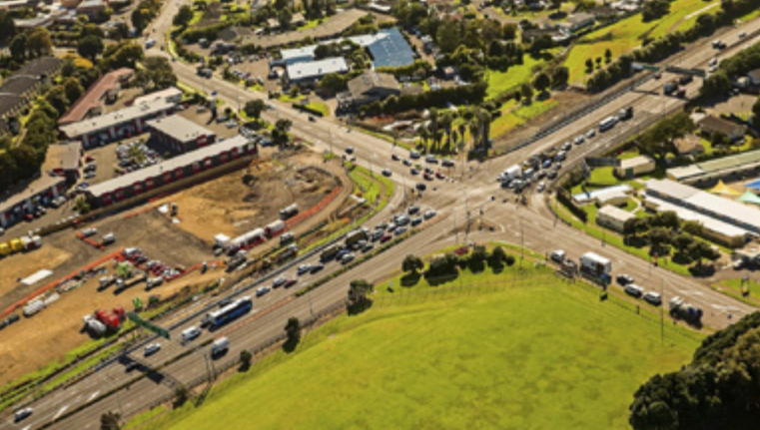
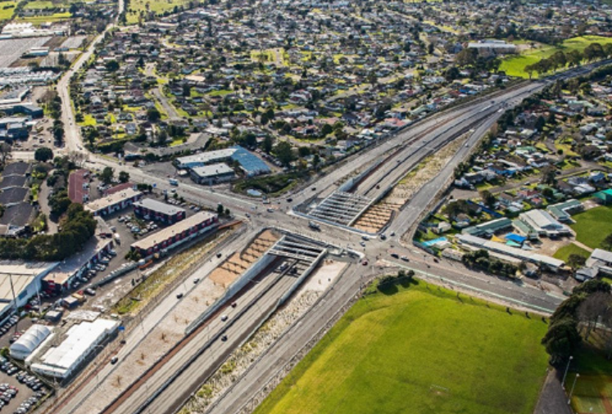
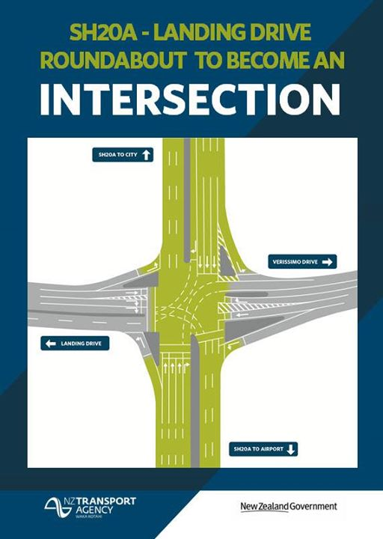
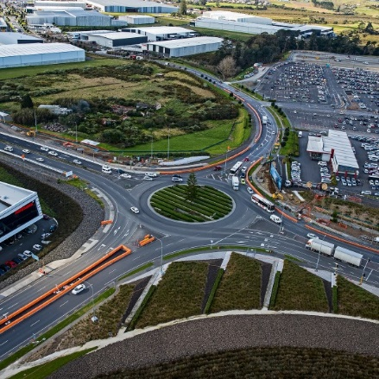
Auckland Airport

Slide 4
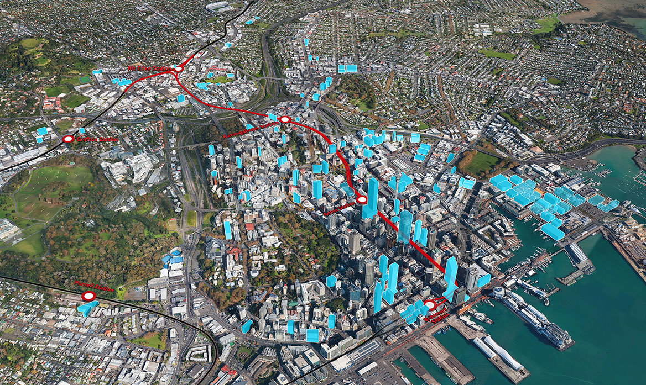
CRL
Albert St trenching
Completion late 2019
Tunnels and Stations
Completion 2024

Slide 5
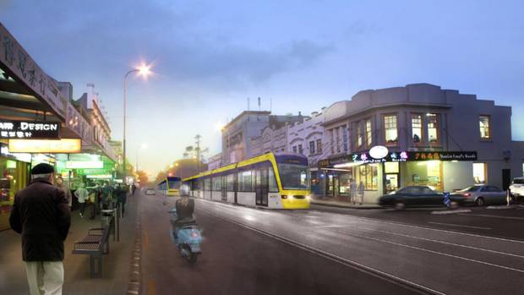
Light Rail
New signalling experience for Auckland Transport
What will signalling look like?
Right turn options
Tram advanced detection
Headway between trams

Slide 6
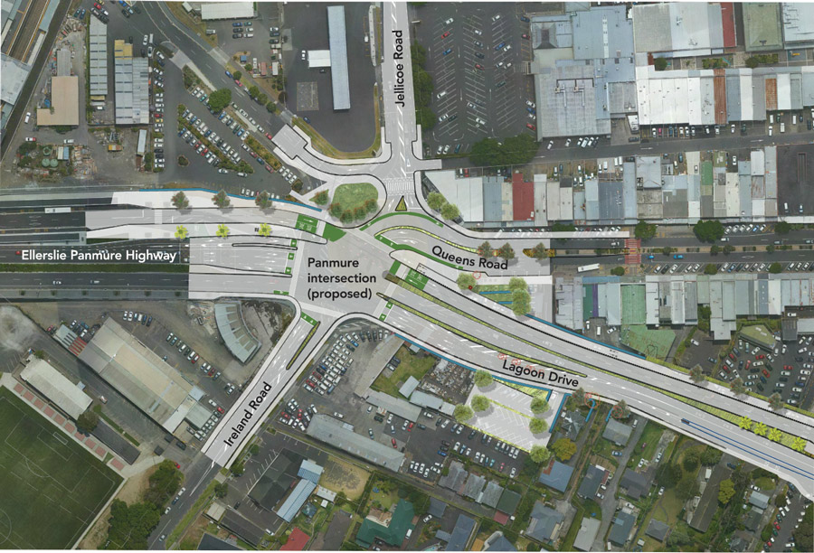
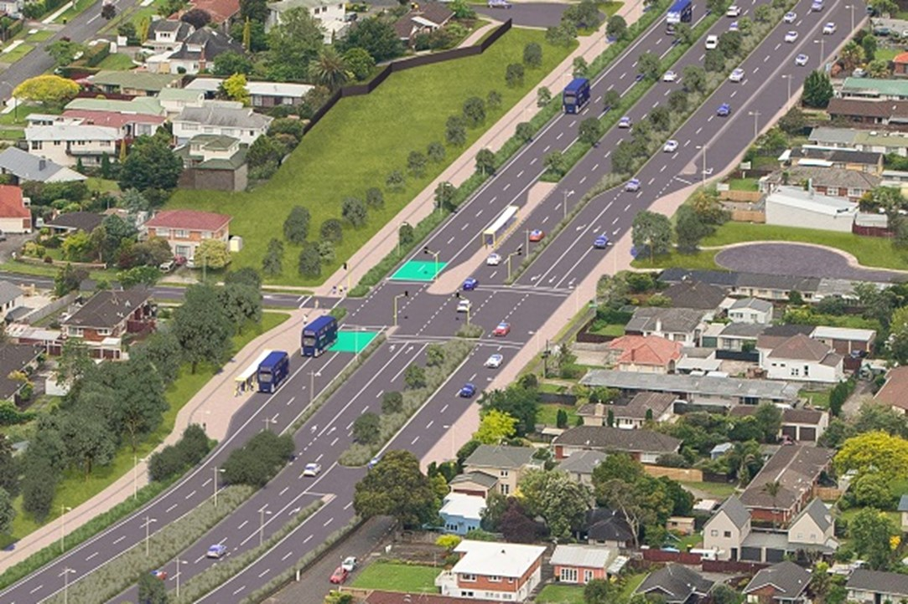
AMETI

Slide 7
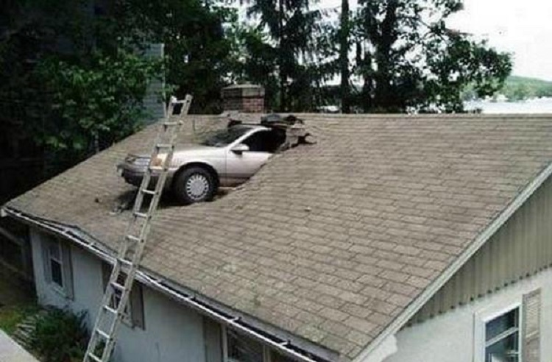
ATOC Smales & ATOC Central
Amalgamation project is underway
Central: Trains, Ferry, Major events, Parking, CBD signals (CRL)
Smales: Traffic Signals (except CBD), regional transport operations.
Physical or virtual integration?

