Slide 1
Rogan Parker
Senior Traffic Signals Engineer
ATOC Smales
Janine Pringle
Traffic Signals Contract Manager
ATOC Smales

Slide 2
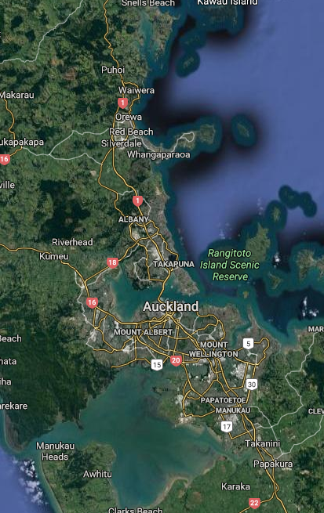
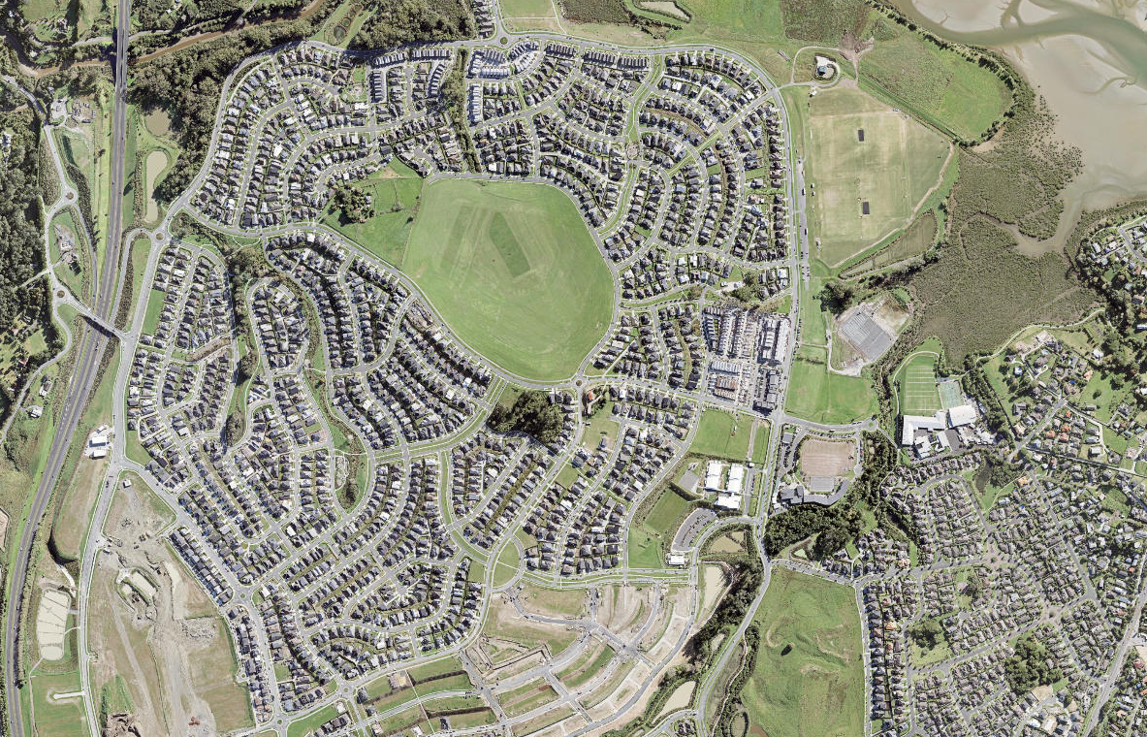
Millwater Parkway / Bankside Rd/ Longmore Lane intersection
2010
Millwater
2018 Population: ~10,000
Average house price $1.134m
2017

Slide 3
Project purpose
Provide a safe environment for schoolchildren by reducing red light running and improving pedestrian facilities
Timeframe – went live on 15 June 2018 with trial extended to End of 2018
Team
ATOC Technical Services
ATOC Assets & Contracts
AT Traffic Engineering
CSLI
Stakeholders
2 x Senior Schools
1 x Junior School
1 x Kindergarten
Parent volunteer group
Ritchies Bus Company
NZ Police
AT Road Corridor Access
AT Walking Cycling & Safety
Comms
Community website
School website
More FM
Police facebook
Local paper

Slide 4
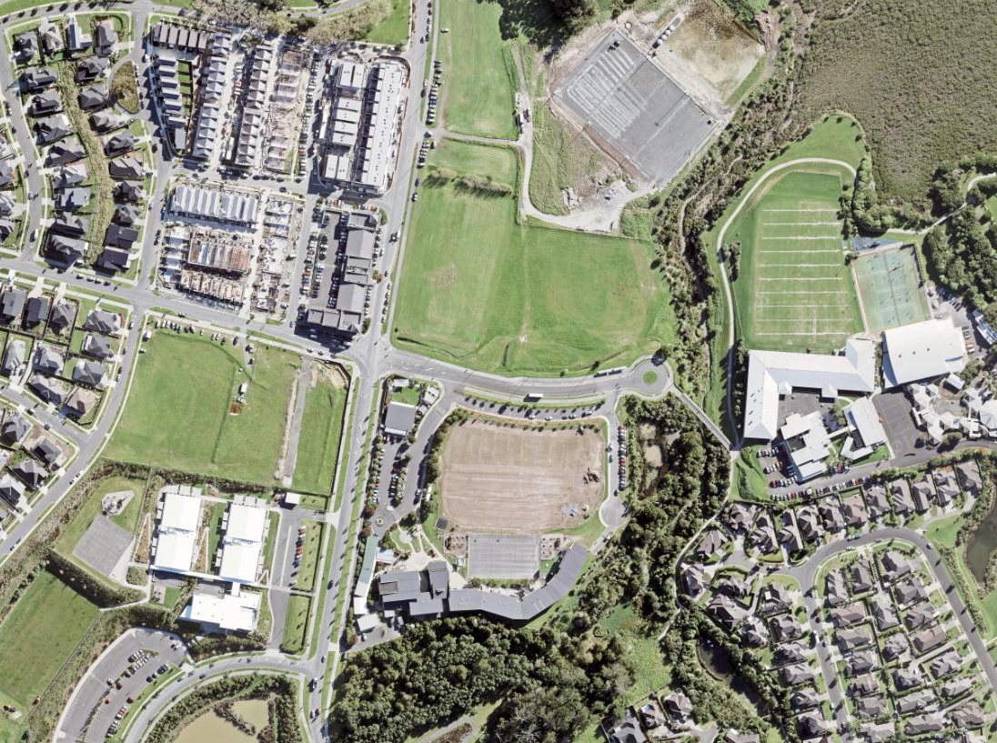
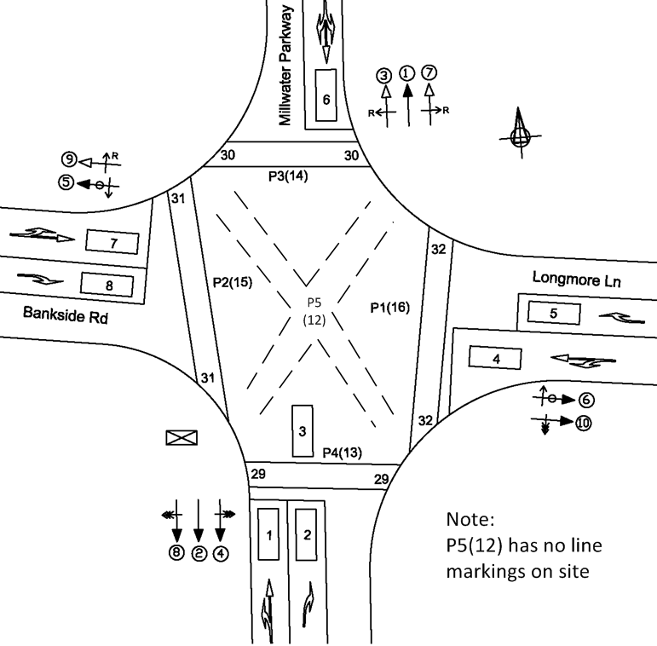
AM
PM

Slide 5
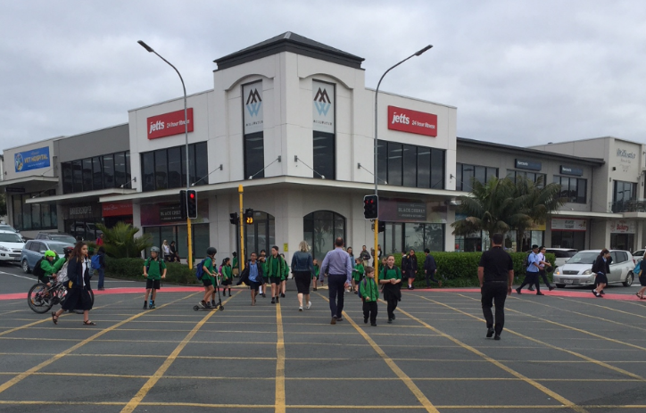
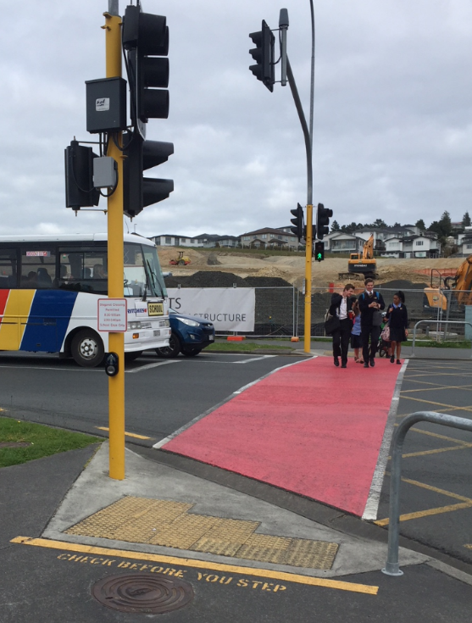
Standard parallel operation with partial protection
Barnes Dance

Slide 6
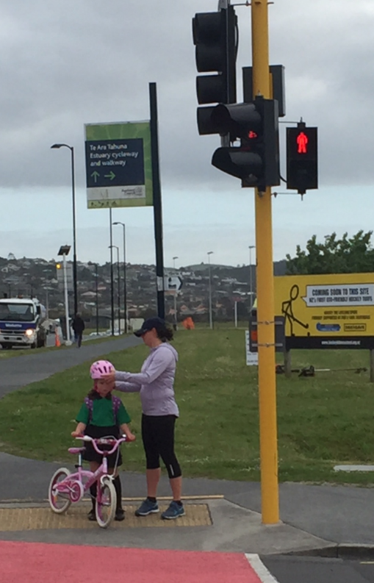
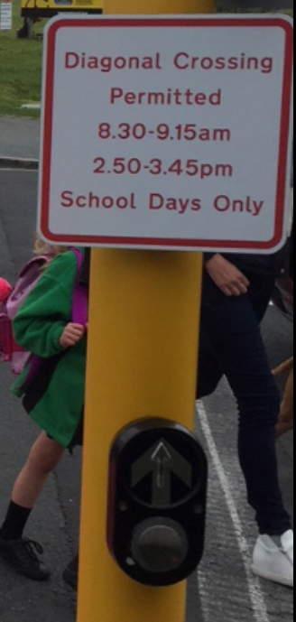
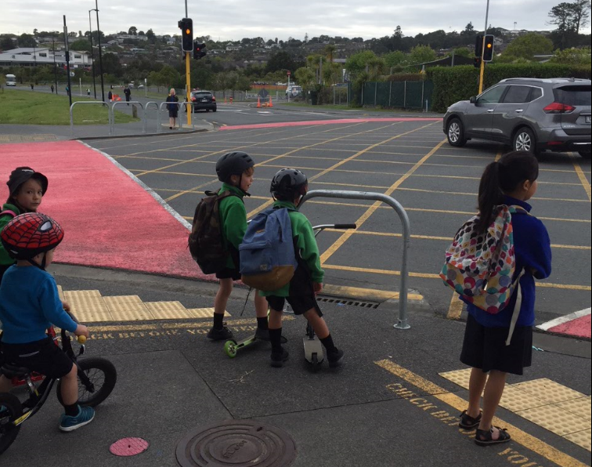
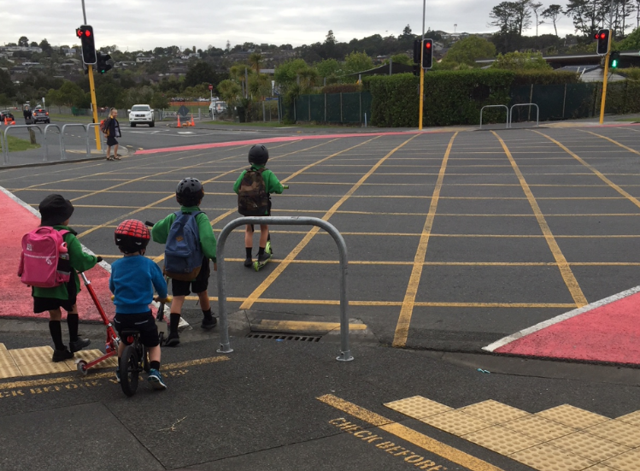
Considerations / Challenges: Countdown v standard pedestrian aspects Signage and communication with schools Barriers for pedestrian direction and hazards

Slide 7
Feedback from customers

