Slide 1
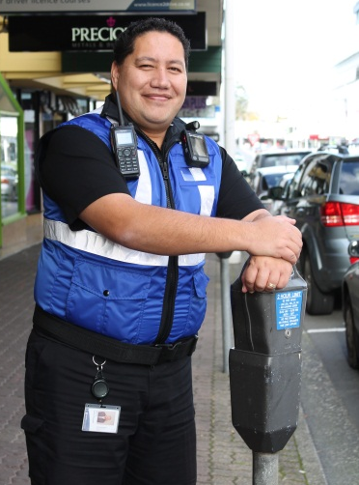
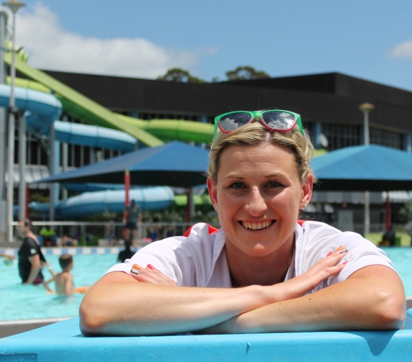
SNUG 2018 Regional Update – Hamilton City

Slide 2
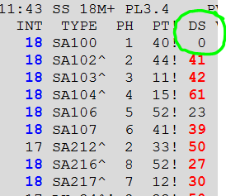
Challenges
Cyber security audit
Could someone hack into SCATS?
Primarily IS
Identify/monitor for it
Documentation for consultants
Site monitoring/alerts
Loss of power (via alternative comms)
Cabinet door opening (contractors that aren’t ours)
Display rotation: biggest risk?
SCATS DS
Random zeros
Need to investigate more (possibly comms>phase change)

Slide 3
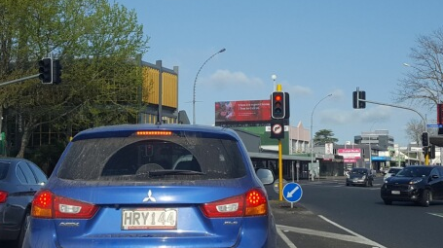
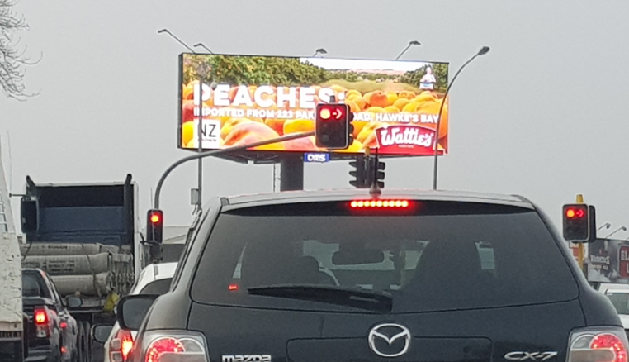
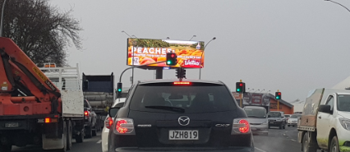
LED Signage vs Traffic Signals
Notes:
25. The maximum light emissions from any illumination pattern shall not exceed 3 lux.
26. No illumination pattern shall consist of more than 20% of either red or green colours that are similar to the red and green lights of the nearby traffic signals. Bands of red and green should not be paired together.
27. The transition between either colour or brightness for any individual LED fixture shall be more than 1.5 sec to change colour, fade in/out or both.
28. Where the patterns and transitions are set so that the pattern appears to move or scroll along the wall, the pattern shall take more than 10 seconds to traverse the building and shall be a predictable pattern of change.

Slide 4
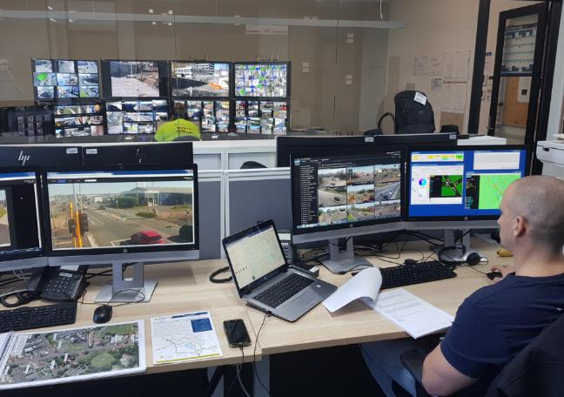
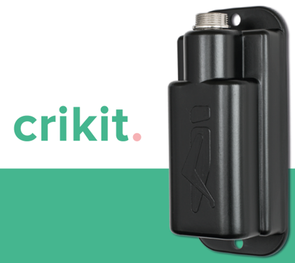
What’s new in the Tron?
TOC Business Case
Operations room active for events
SCATS operators, better tools (e.g. dashboard)
Virtualisation of the SCATS server
Easy! (if your network is configured right)
Technology
VC6 controllers for all renewal/new sites (10 so far)
Extra Low Voltage controller/dim by wire (x2)
More Above Ground Detector tests (Vivacity)
Display rotation sensor (Crikit)

Slide 5
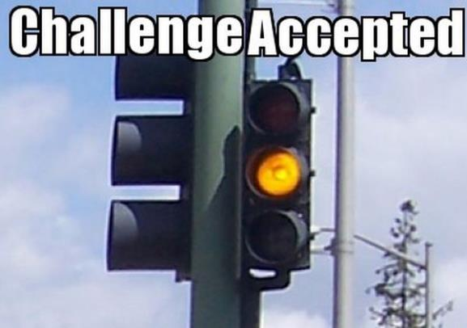
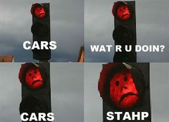
The end
John.Kinghorn@hcc.govt.nz

