Slide 1
Signals NZ User Group
Conference Hamilton 2018
Philip Manning
Siemens Mobility ITS - ANZ
siemens.com/traffic
Unrestricted © Siemens AG 2018

Slide 2
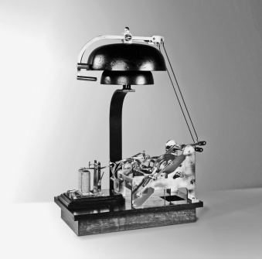
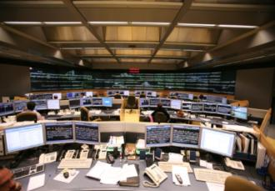
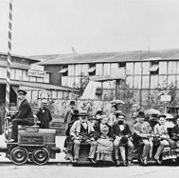
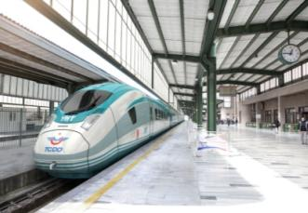
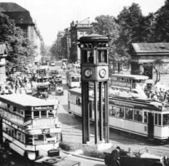
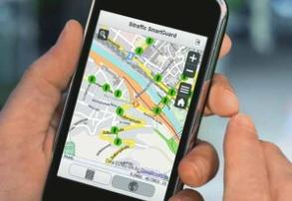
About Siemens shaping mobility as a technical pioneer since 1847
6_84 7_84 9_84
1847
Werner von Siemens and
Johann Georg Halske create
the first alarm bell system
Trainguard MT
Driverless metro
Railway signaling technology
Copyright: Stadtwerke München
1879
Siemens presents the first electric railway at the Berlin Trade Fair
Velaro
One of the most efficient high-speed platforms in the world
Rail vehicles
1924
Siemens installs the first automatic traffic signal system at Potsdamer Platz in Berlin
smartGuard
Web-based mobile traffic control center
Road traffic engineering

Slide 3

Siemens Divisions
Global presence and go-to-market of our businesses
Americas
Europe and Africa
C.I.S.¹ and Middle East
Asia and Australia
Power
and Gas
Wind
Power and Renewables
Energy
Management
Building
Technologies
Mobility
Digital Factory
Process Industries and Drives
Healthcare
(separately managed with
global supply chain)
Financial
Services
Power Generation
Services
Managing Board
Corporate Services
Corporate Core

Slide 4
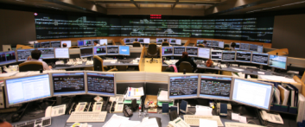
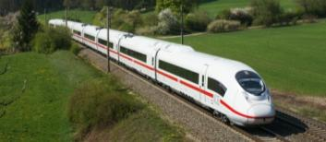
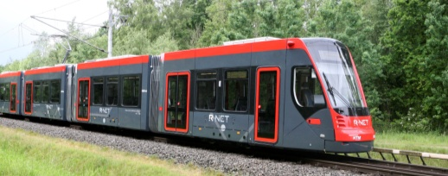
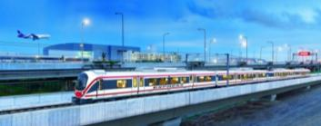
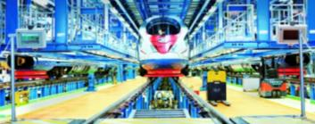
Mobility Division is divided in five Business Units -
Mobility Management takes care of Road & Rail automation
39_84
Business Units
Mobility Management
Mainline Transport
Urban Transport
Turnkey Projects & Electrification
Customer Services
Products, solutions and turnkey systems for road and rail automation and optimization
Short-distance, regional and long-distance rolling stock, and product and system solutions for passenger and freight transport
Railbound urban public transport vehicles, eBuses and passenger coaches
Complete road & rail electrification solutions
Services and tools for road and rail infrastructure and rolling stock

Slide 5
Real Time Optimiser (RTO)
The next generation of Urban Traffic Control System
Philip Manning
Siemens Mobility ITS - ANZ
siemens.com/traffic
Unrestricted © Siemens AG 2018

Slide 6
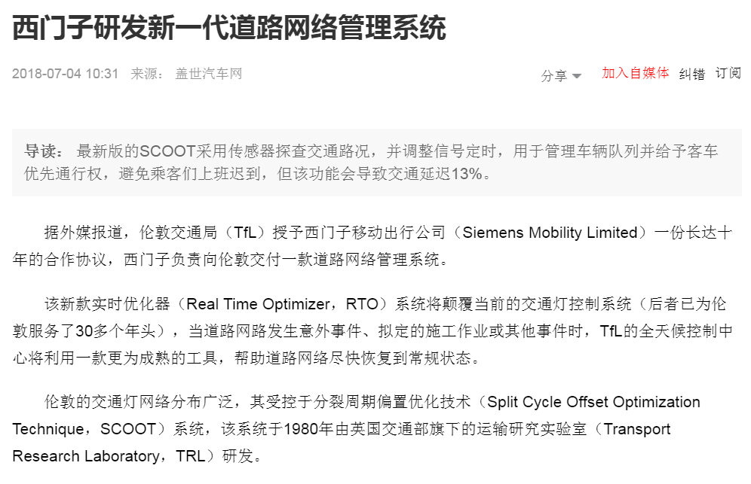
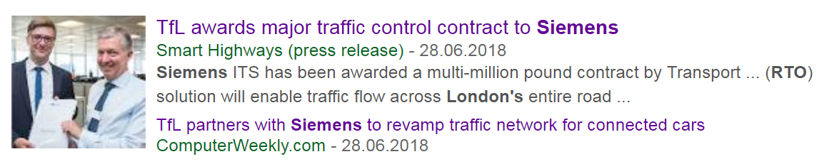
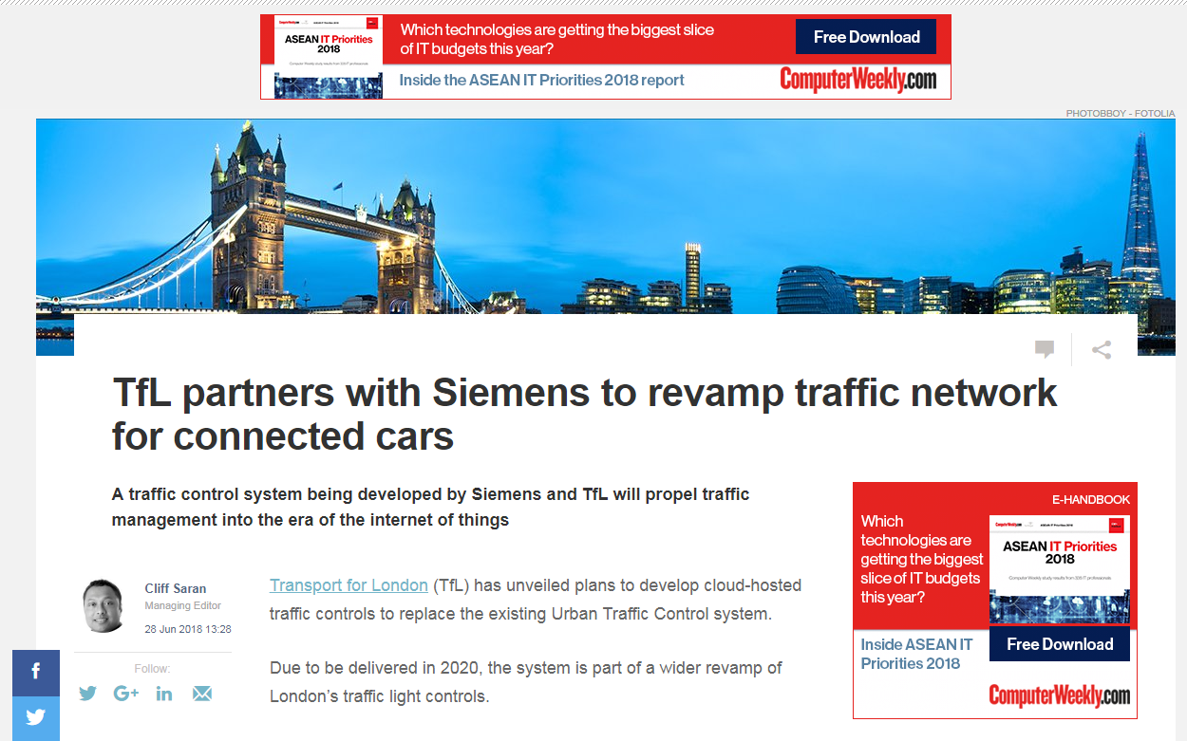
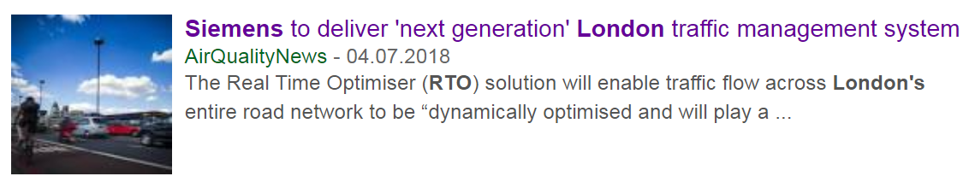
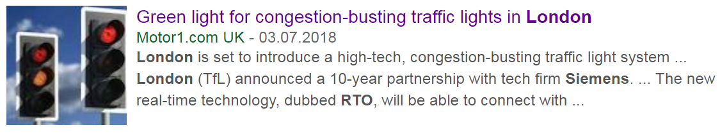
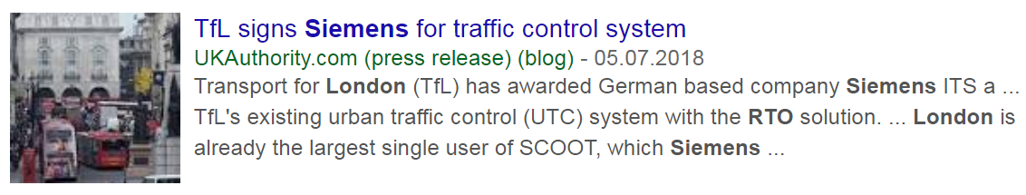
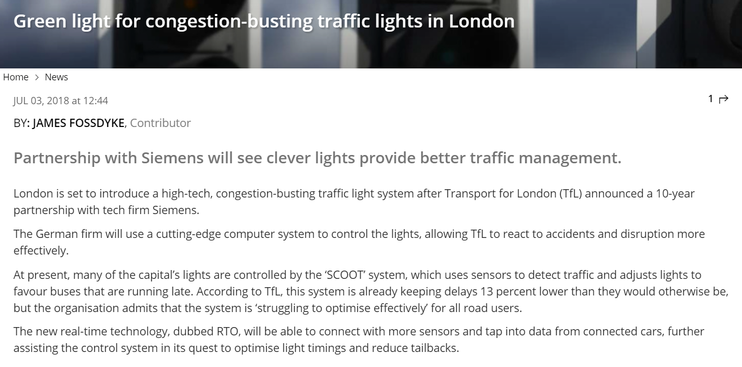
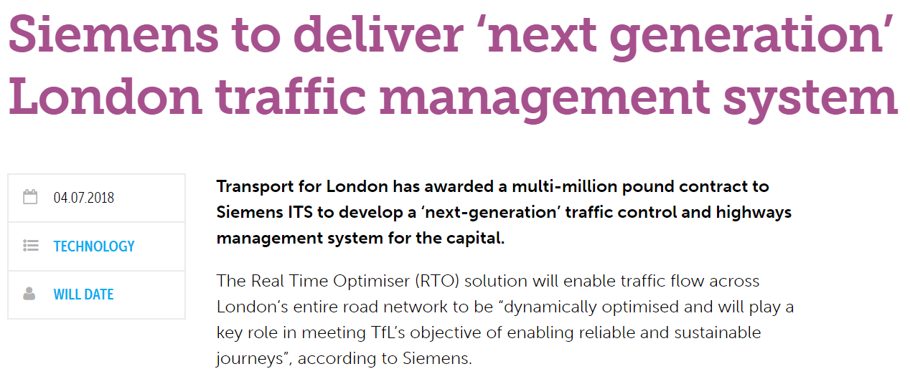
Siemens to deliver ‘next generation’ London traffic management system

Slide 7


News highlights
SCOOT
RTO

Slide 8
What is SCOOT?

Slide 9
SCOOT is a global UTC system, jointly developed by
TRL, Siemens and Dynniq from the 1980’s onwards
SCOOT¹ is a real-time adaptive traffic control system for the coordination and control of traffic signals across an
urban road network
SCOOT is marketed worldwide and Siemens has an install base of ~130 PC SCOOT Systems
Jointly and equally owned by TRL, Siemens and Dynniq
SCOOT has a worldwide market share
of 30%²
Transport for London (TfL) has the
biggest SCOOT deployment
~6,000 intersections
1 SCOOT = Split Cycle Offset Optimisation Technique; 2 Siemens estimation

Slide 10
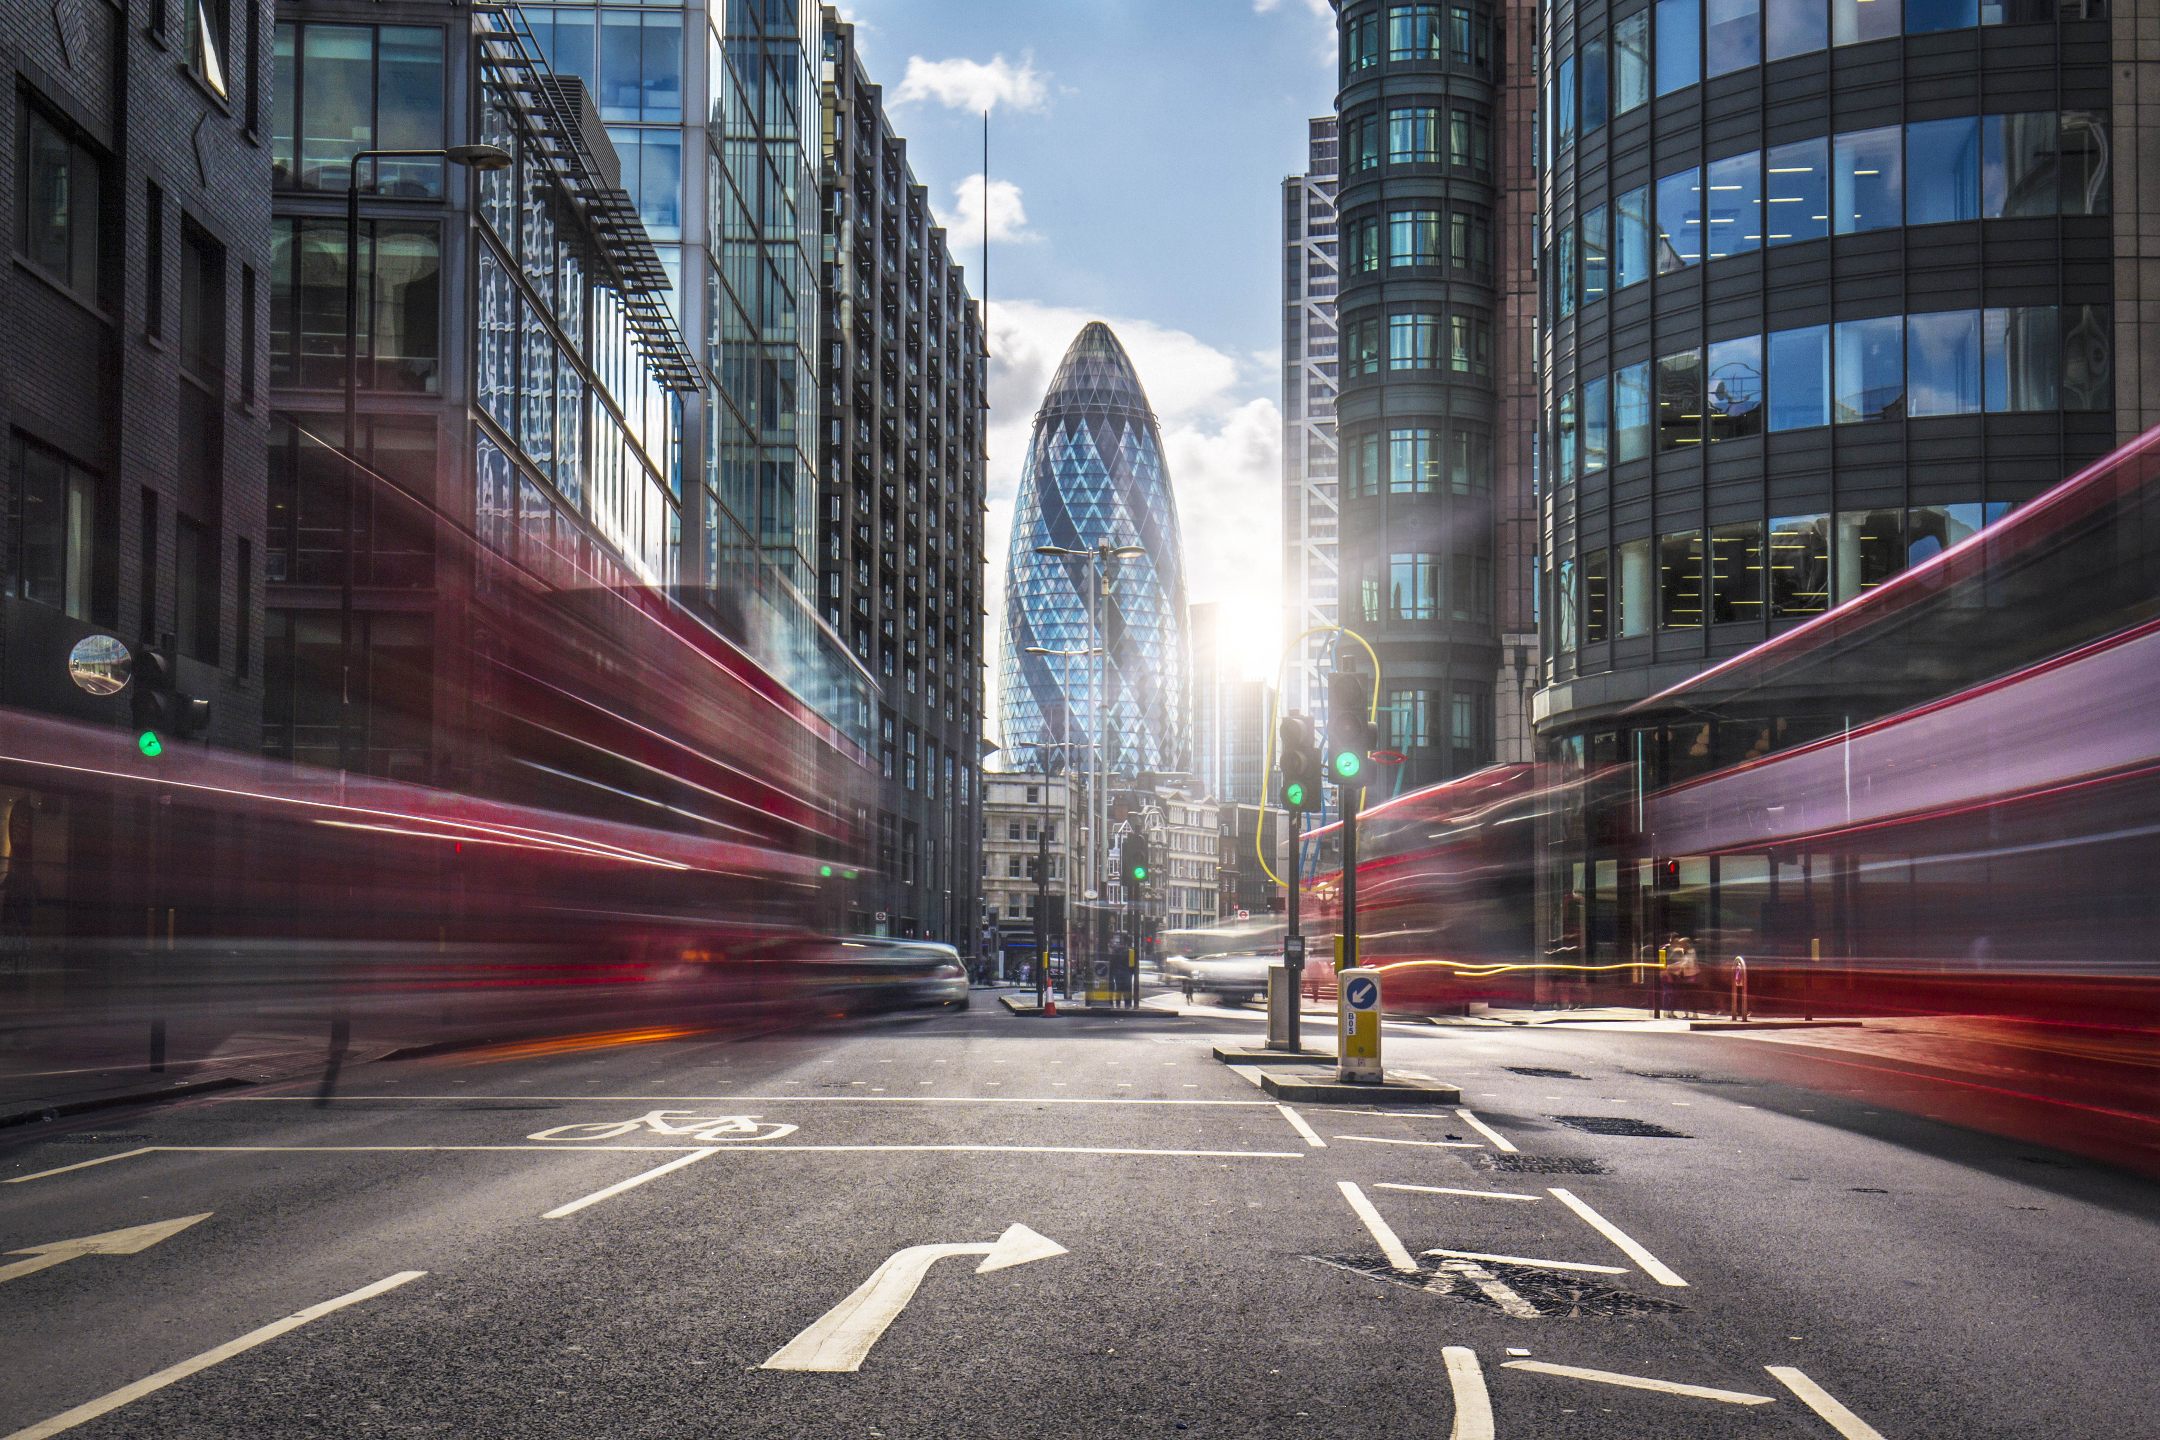
What is
Real-Time Optimiser (RTO)?
Notes:
London's road space is becoming increasingly constrained with more people using the existing road space.
With an additional five million road trips a day by 2030 and continued growth in demand, the cost of delay in 2036 is estimated to be £13bn, up from £5bn in 2014. To meet this challenge, TfL needs to be more proactive in the way it manages its road space.
Currently TfL operators monitor road space using CCTV cameras.
A typical road incident, such as a collision and the congestion that results from it, can take up to 20 minutes to detect and respond to. This exacerbates delay.
TfL operators managing the delay have to use multiple systems, many of which are approaching end-of-operational life. This provides an opportunity to replace, upgrade and integrate many of these systems.
Siemens in partnership with TfL will upgrade the RTO to help improve traffic flows across the capital’s road network - through faster, automated responses to live road conditions using an enhanced signal control system with a predictive capability.

Slide 11
RTO is a network adaptive control system that is jointly developed by Transport for London (TfL) & Siemens
What Siemens brings
Significant ITS and
Mobility knowledge
Local and global footprint
Financial commitment
Data analytics expertise & traffic domain know-how
Agile development & rapid prototyping team
Joint development
of a new
network adaptive
control system
in an agile
development process
and co-ownership
What TfL brings
Operational experience
Huge install base
Financial engagement
Commitment to co-creation processes
Vision for the
future of London

Slide 12









Real-Time Optimiser (RTO) Project
FVD / Big Data
Simulation
Real-Time Optimiser
Strategy Management
Option 1
Cycle
Split
Offset
Option 2
Data acquisition from V2X and IoT
UTC basic system
Option 3
Self-optimisation
Multi Modal Priority
Auto Configuration
Machine Learning Approaches (FVD)
Pro-active Traffic Light Control
Prediction Engine (e.g. Simulation)
Notes:
The 10 year program is expected to provide Londoners with an improvement in responses to incidents as well as better data and cusomer information.
Initially Siemens will replace TfL‘s UTC System with a cloud-based traffic control solution.
New features will be added to migrate traffic control into a cloud environment.
For the second phase, new adaptive control algorithms, referred to as Future SCOOT will be developed in stages.
Future SCOOT is expected to help TfL manage most of the city‘s 6,000 traffic intersections. The system will monitor appraoching traffic and develop indicators of congestion.
Siemens will be responsible for maintaining the system once it goes live in 2020.

Slide 13
Lighthouse project with key customer Transport for London – “Real Time Optimiser” Project
Common system design
RTO work at a glance
Future-Roadmap
TfL Common Operational overview
Top Level Features
Optimise Traffic flow with
adaptive control mechanisms
Ensure efficient monitoring and operation of ~6,000 intersections
Automation
Automatic SCOOT validation tool
Predictive profiling
Suggestion engine
RTO
Based on SCOOT
Incidents
Multi Modal Incident Mgt.
Prediction
Further
City Systems
Data Mgt.
and Analytics
Further City Systems
Innovations
Develop a new adaptive
system, building on SCOOT
Develop new database structure
Predictive Capabilities
Predict events and likely
scenarios and manage
traffic prior to issues arising
Integrate simulation and modeling
New Features
Strategy Manager wraps
around core UTC
Monitors network performance
and adapts to suit conditions
Data Warehouse and Analytics
Integrate new traffic data sources such as floating car data and V2X
Making full use of many
new data sources
TfL field devices
Traffic Control Devices
Variable Message Signs
Road works
CCTV
Busses
Parking facilities
New Adaptive Algorithm
Integrate new traffic data sources such as floating data and V2X
Focus on people journeys
not vehicle journeys
Connected Mobility
Leverage real-time data from connected users of the transport network

Slide 14

Siemens - the ITS partner with the right capabilities for Customer Co-Creation
  MindSphere, open IoT operating system
  ITS & service domain know-how
1000101101101010011011001001101010110110001101
100010110110101010101101011011010101011011010100101001011010011011001001101010110110001101
010110010110101011100101101101010101001011011010100101101001010110101101
  Simulation, forecasting & prediction capabilities
010110110101010110110101010101010010110110101011001010101010110101111010001001001101
  Data Analytics Expertise
  Customer
  value
  Data service & IT security expertise
  Connected Mobility Solutions
  Strong installed base
  Global footprint

Slide 15
How does RTO help address the ambitions of London?

Slide 16
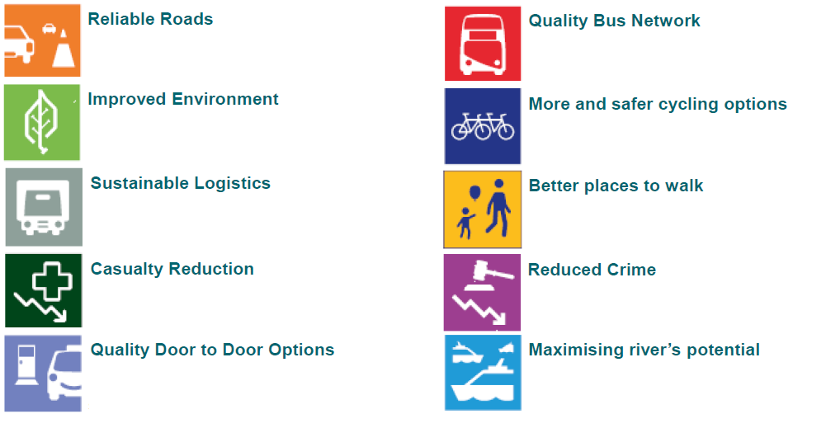
London’s ambitions
SCOOT is marketed worldwide and Siemens has an install base of ~126 PC SCOOT Systems

Slide 17
Philip Manning
Siemens Mobility ITS - ANZ
Ph. +61 448 262 040
Email: philip.manning@siemens.com
siemens.com/traffic
Unrestricted © Siemens AG 2018

