Slide 1
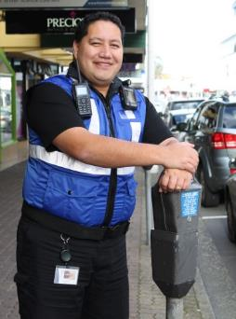
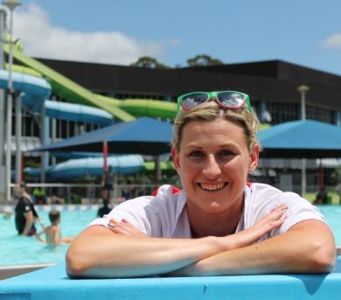
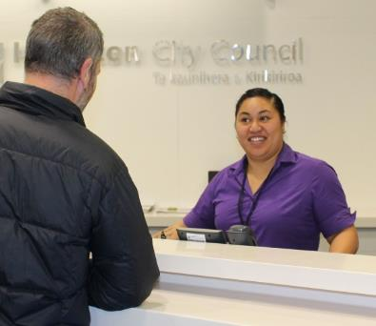
Tron Topics

Slide 2
Hamilton Operations

Slide 3
Growth

Slide 4
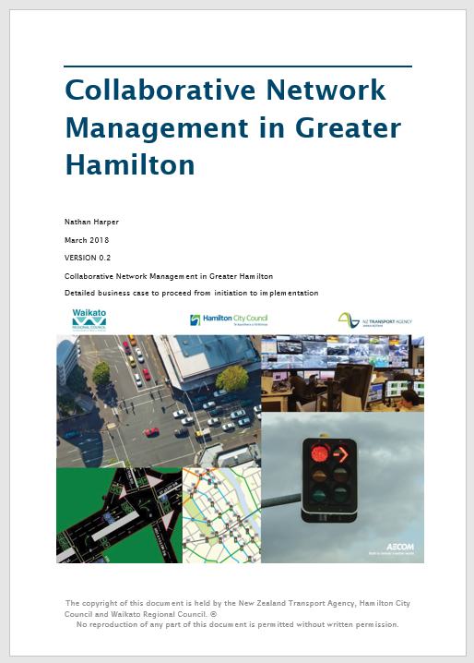
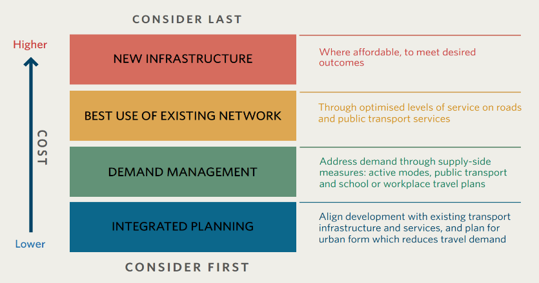
The Case for Advanced Network Management
Focus is on moving from reactive to proactive, by focusing on:
The collection of good data to inform decisions
Real-time monitoring and management of events
Optimisation of the network
Better informed customers
Economically easy to justify

Slide 5
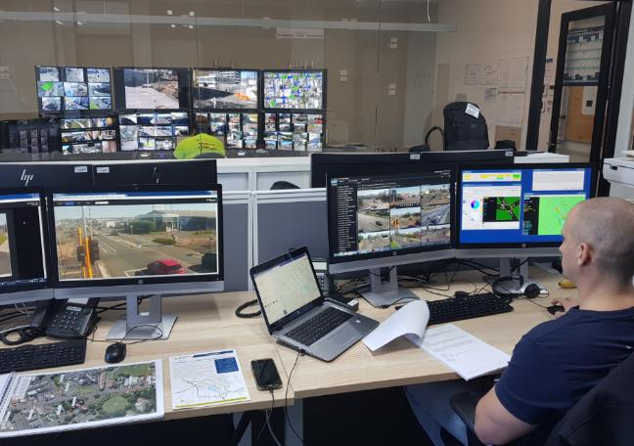
Current Situation
Business Case with NZ Transport Agency
Partnered with CitySafe team for operations room
Working on implementing the obvious stuff like
Better data
Systems
Resourcing
Resilience
Optimisation

Slide 6
Things We Do Differently (because we’re special)

Slide 7
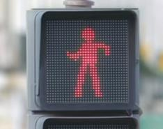
Pedestrian Priority
At mid-block crossings, we give pedestrians an immediate cross phase (50k zones or less)
Approach gap set to zero
Minimum road phase set to say 25s
Why?
If we replace a zebra with signals, pedestrians end up with a worse LoS if they now have to wait for a gap (and road phase usually runs to max)
Why look for a gap when our intersections don’t in Mlink anyway?
Confirmation, ped approach and signals change
No need for walk cancellation
It’s the only way to ensure your staggered SIMPED crossings run properly!!
Increased compliance from vehicles and pedestrians

Slide 8
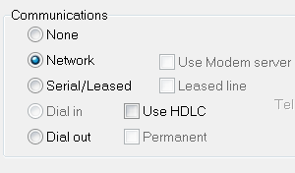
SCATS Communication
We run all our sites network (i.e. we don’t use Eltima)
A local ISP built us a private Layer 2 network
“Star of stars” design
Fibre backhaul (~1/3rd are fibre sites)
Point to point wifi links between close sites
75% cheaper than our previous copper network!
(and it supports CCTV cameras)
A managed router is located in each traffic signal cabinet
Polls the controller for it’s site number
Converts analogue comms to digital
Establishes the network link to SCATS

Slide 9
Current Initiatives

Slide 10
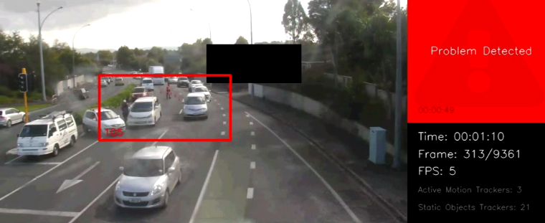
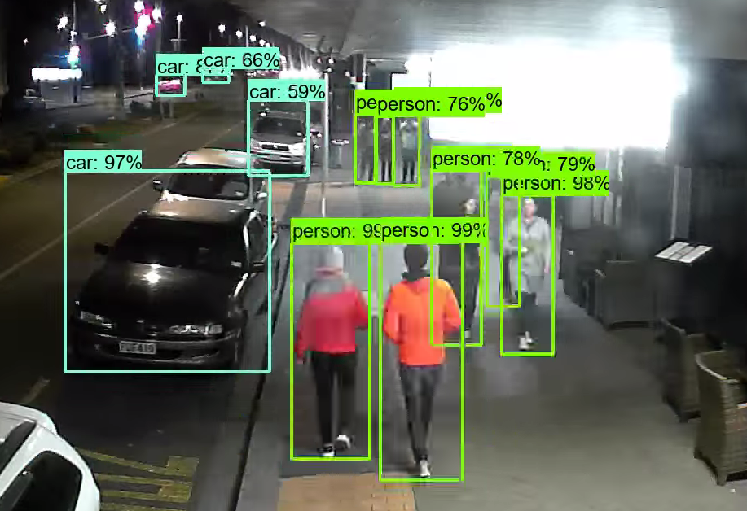
CCTV analytics
Incident alert (broken down vehicles)
Works in principle, but too much bandwidth and it’s not quite there
Pedestrian and vehicle classification/counting
Works well, scan image every 30s, low bandwidth
Intend to use for alerting of groups of pedestrians
Now testing edge devices

Slide 11
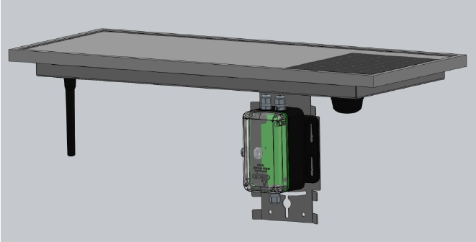
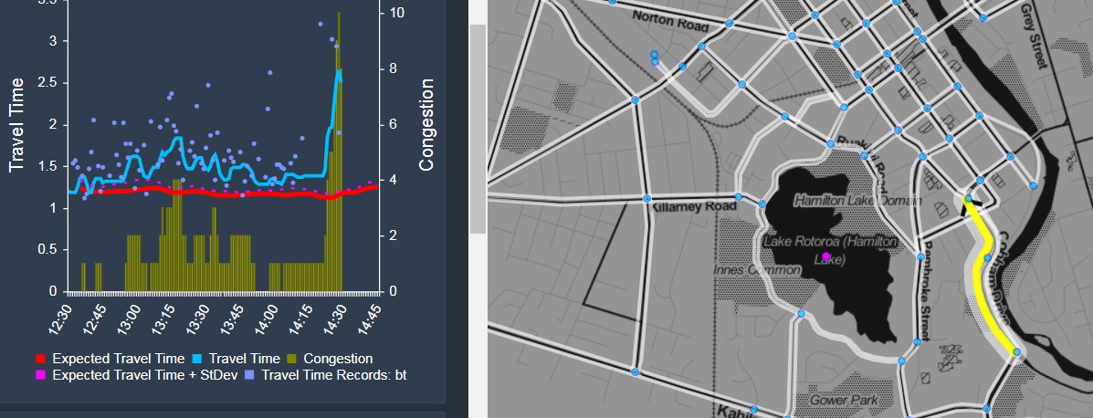
Addinsight (travel time)
Easy way to get good visibility of network operation
Learns what is ‘normal’ and only alerts you to abnormal
Offers historical insights for optimization
Shows effects of road closures & traffic management
Cheap & fast deployment (leased solution)

Slide 12
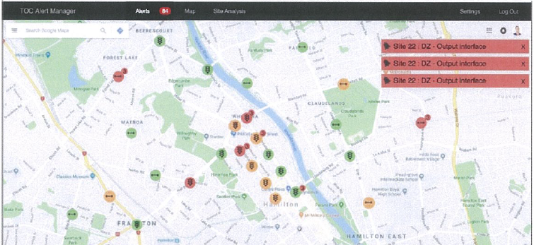
Transport Dashboard MVP
Situational awareness via “single pane of glass”
Combines Addinsight, google, customer complaints, bus locations, and SCATS (alarms and unusual volumes, based on scenarios – incl pulsing)
Removes the need to monitor multiple windows
Smarter by combining multiple data sources (e.g. text alerts)
Machine learning to get better at sending the right alerts

Slide 13
Questions?

Slide 14
Name Change?
VOTE on Slido:
No – keep it SNUG
Yes but different name
Yes – Traffic Signals NZ
Why should we change our name?
To better reflect what we do
Develop standards (P43)
Advise and submit on rules e.g. TCD
Much more than just a user group
To align better with Engineering NZ (recent name change)
Australia has recently done the same with SMUG
Because it means nothing to those who don’t know the acronym (and always gets some ribbing)
Suggested name: Traffic Signals NZ

