Slide 1




NZTA Shared Pedestrian and Cycle Lantern Trial
Oliver Brown | Stantec | Peloton – Lead Traffic Engineer
Alex Lumsdon | Beca | Peloton – Traffic Engineer
Image
placeholder
Image
placeholder
Image
placeholder

Slide 2
What is proposed and Objectives 31 March 2018 to 2020
Install two-aspect shared cycle and pedestrian signals as an alternative to three-aspect cycle signals
Evaluate the safety and effectiveness of combined two-aspect cycle and pedestrian signals
Assess pedestrians’ and cyclists’ understanding of and compliance with combined lanterns
Assess the behaviour of cyclists approaching two-aspect signals
Investigation whether separate call buttons for pedestrians and cyclists is required, including any independent signal phasing.
What detection requirements are needed for pedestrians and cyclists
Investigate safety and efficiency
Notes:
The trial was to install shared two-aspect lanterns at possible locations on Quarrymans Trail MCR
In accordance with the NZTA Traffic Note 10 – Trials of traffic control devices guidelines

Slide 3
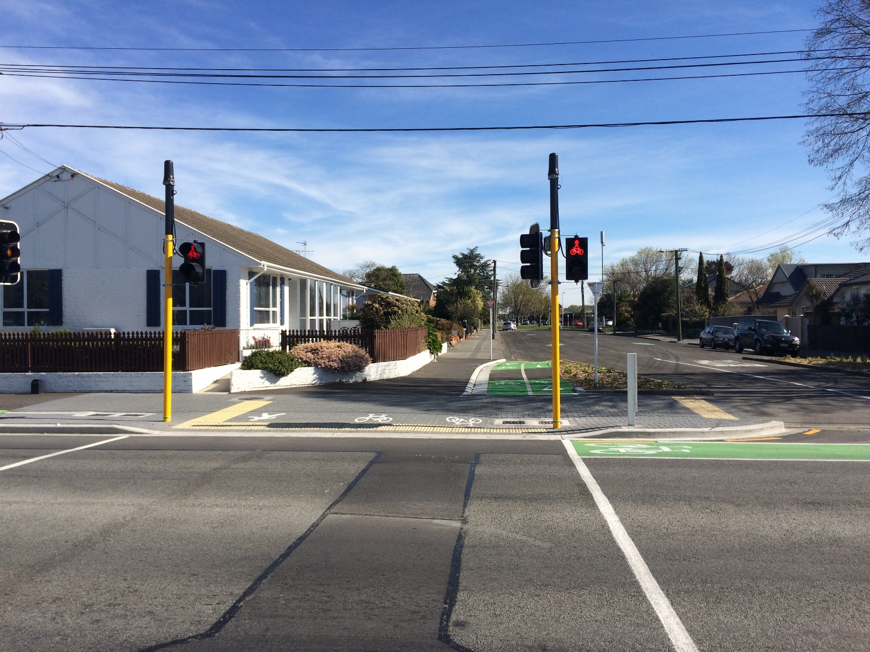
Trial Benefits
Reduce traffic signal hardware
Reduction in street furniture
Using a shared button for pedestrians and cyclists
Improve pedestrian and cyclist interaction
Improve lantern displays
Notes:
1. Reducing capital cost and signal maintenance costs.
2. Improving streetscape and amenity
3. Likely to ease confusion associated with cycle call accept buttons and intermittent detection at signalised intersections
4. Improve interaction with removal of white line that determines this is ped space, and that is cyclists space

Slide 4
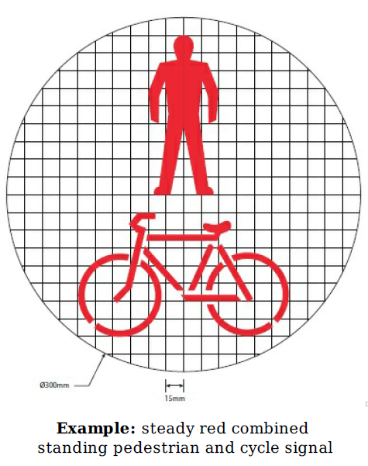
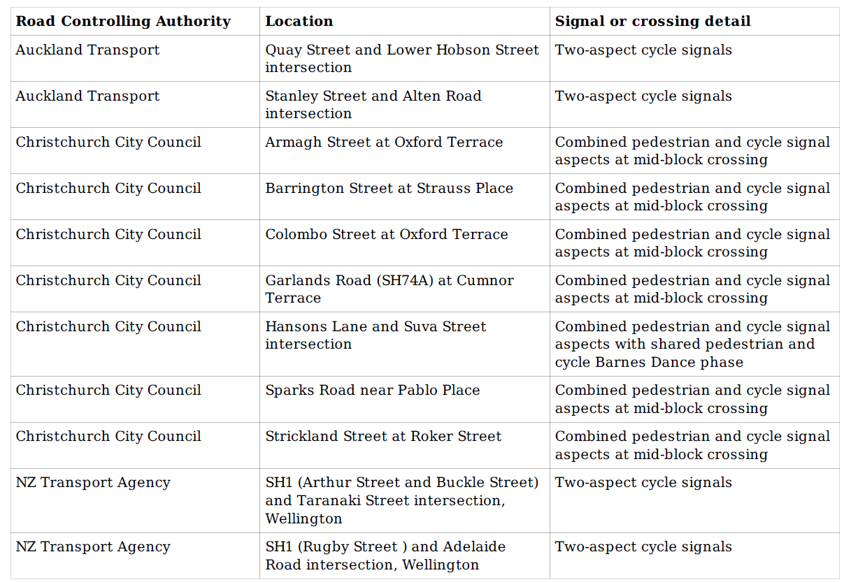
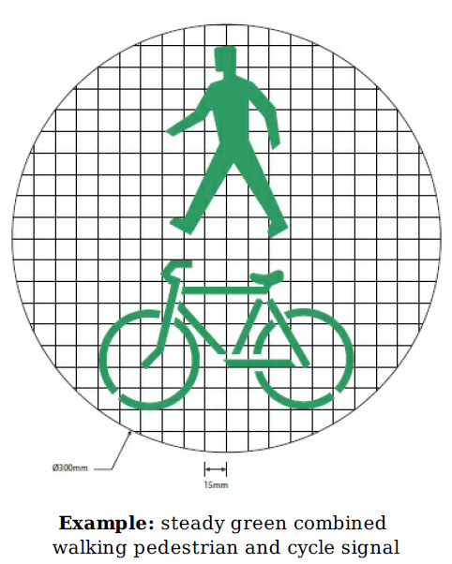
Selected Trial Locations
Notes:
Formal trial location can be seen in the gazetted table on the slide. Auckland and Wellington have installed two-aspect cycle signals, however Christchurch have combined the ped/cycle signal within a two-aspect lantern. It is understood Dunedin City Council and Tauranga City Council have shown keen interest to adding to the trial at signalised intersections.

Slide 5
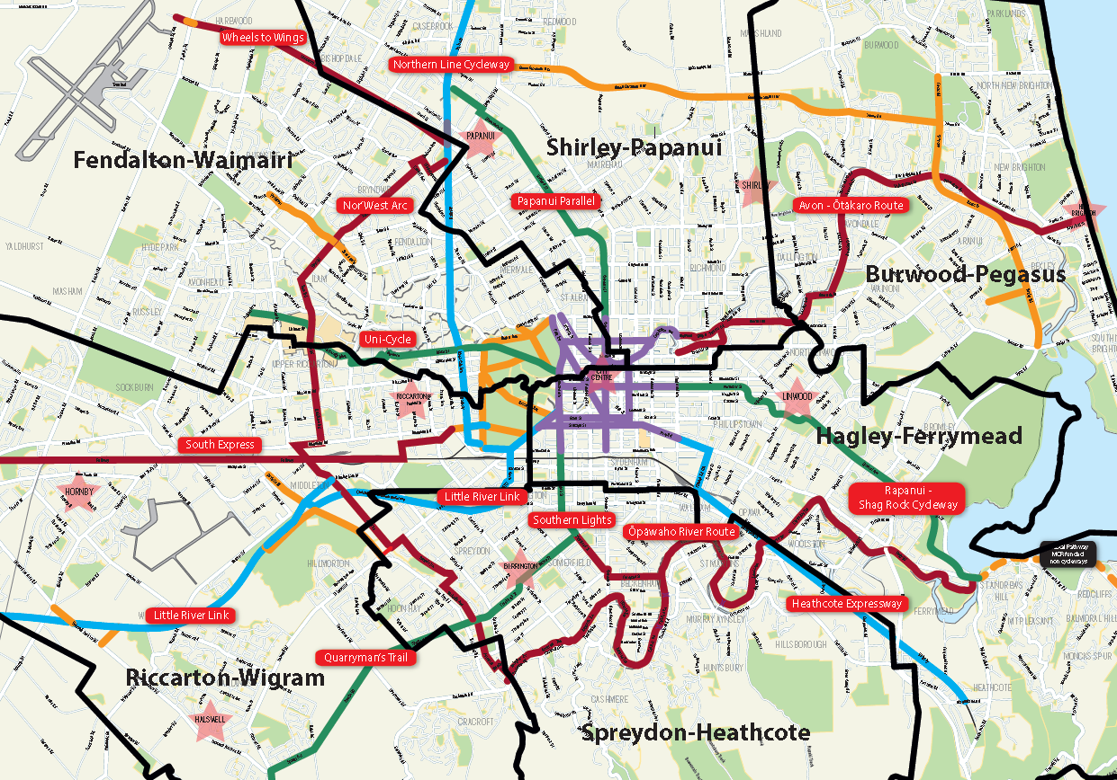
CCC MCR Routes
13 Major Cycleway Routes
101 km of cycleway for the ‘interested but concerned’ demographic to give cycling a go.
$206 million committed over 10 years
Peloton has designed 8 routes
Notes:
Extensive MCR network within Christchurch City.
Mention MCR’s that have already been built and currently operating.
Quarrymans Trail MCR section 2 and 3 have been built which were completed by two different contractors FH & Isaac

Slide 6
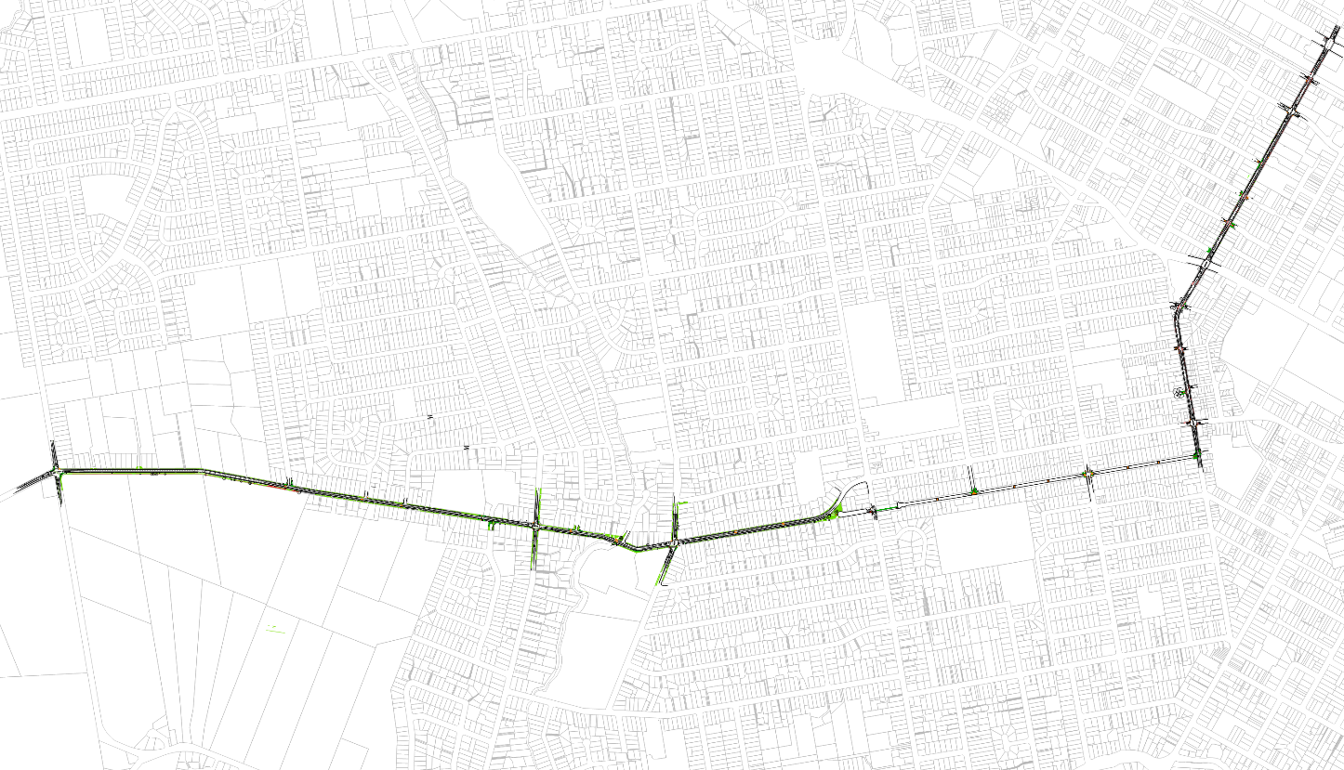

Quarryman’s Trail Major Cycle Route
Moorhouse Ave
Quarryman’s Trail Section 1 & 2
Antigua St
Brougham St
Hendersons Rd
Barrington St
Strickland St
Hoon Hay Rd
Milton St
Sparks Rd
Sparks Rd
Roker St
Frankleigh St
St
Lyttelton
Southern Lights
Tennyson St
Colombo St
Notes:
Focus of ‘The Trial’ area Quarrymans Trail MCR
Section 3 completed by FH
Section 2 completed by Isaac
Southern Lights will eventually tie into Quarrymans Trail once built
Trial Crossing 1 – Strickland St / Roker St
Trial Crossing 2 – Barrington St / Strauss Place

Slide 7
Site Selection
Characteristic | Barrington Street | Strickland Street
Road Classification and AADT | Minor Arterial 14,970 vpd (August 2016) | Collector Road 6,667 vpd (July 2017)
Nearby Amenities | Barrington Mall and corner shops are located approximately 200m northwest of the site. | An entrance to Bradford Park is located on the north-eastern side of Strickland Street, adjoining the signals.
Adjacent Land Use | Predominantly residential | Predominantly residential
MCR | The Quarryman’s Trail MCR runs from Roker Street via a shared path to Barrington Street. The route crosses Barrington Street midblock and continues west on Strauss Place via a neighbourhood greenway. Predicted to cater for 1,900 cyclists per day (2031). | The Quarryman’s Trail MCR runs along Strickland Street via a one-way separated facility. The route crosses Strickland Street midblock and continues west on Roker Street via a neighbourhood greenway. Predicted to cater for 1,900 cyclists per day (2031). Strickland Street is a popular cycle commuter route and forms part of the future potential Southern Lights MCR which is predicted to cater for 900 cyclists per day (2031).
Signal | Two-aspect with combined pedestrian and cycle aspect, dia. 300mm. Co-ordinated with Barrington/Milton traffic signals. | Two-aspect with combined pedestrian and cycle aspect, dia. 200mm. Co-ordinated with Strickland/Milton traffic signals.
Signal Phasing | Two phase intersection, Barrington Street and the pedestrian/cycle phase. There is also an All Red phase. | Two phase intersection, Strickland Street and the pedestrian/cycle phase. There is also an All Red phase.

Slide 8
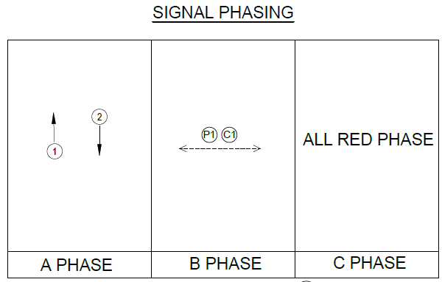
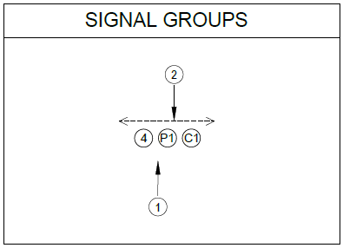
Traffic Signal Operation & Effects
Combined two-aspect signals are based on the traditional pedestrian signals
Green time for cyclists will be based on pedestrian walking speeds and less than the traditional cyclist green time
The effect of this reduction in green time will reduce cyclist crossing time from around 10 seconds to 6 seconds
This results in a reduction in level of service due to cyclists not being permitted to start crossing the road at commencement of the flashing red phase
Notes:
Where are we?
We employ more than 6000 people in an integrated network of offices throughout Australia, New Zealand, Asia, the Middle East, the Americas and Europe

Slide 9
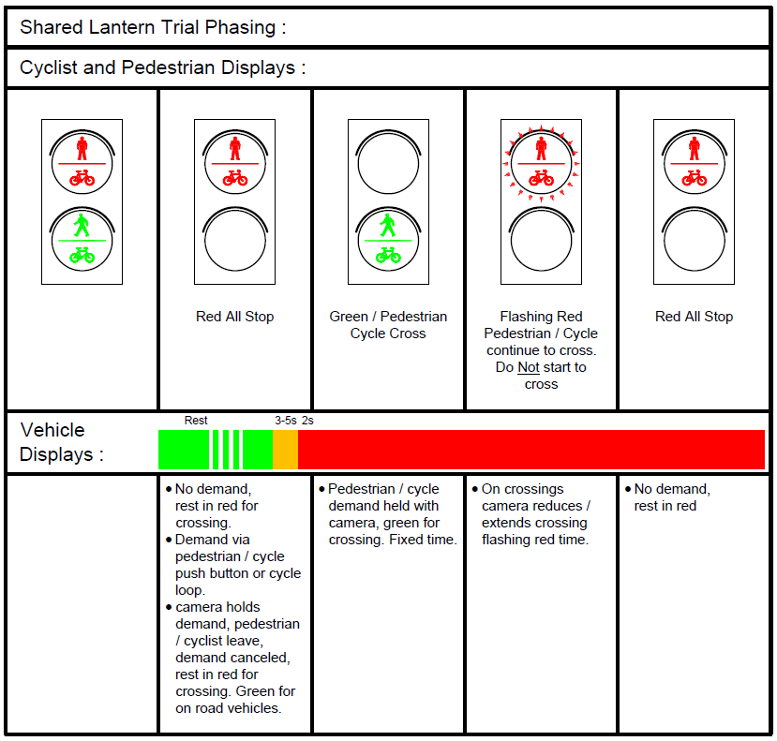
Notes:
Where are we?
We employ more than 6000 people in an integrated network of offices throughout Australia, New Zealand, Asia, the Middle East, the Americas and Europe

Slide 10
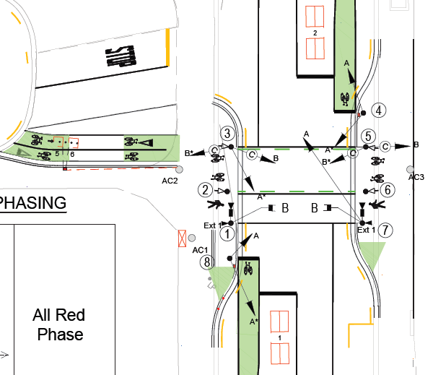
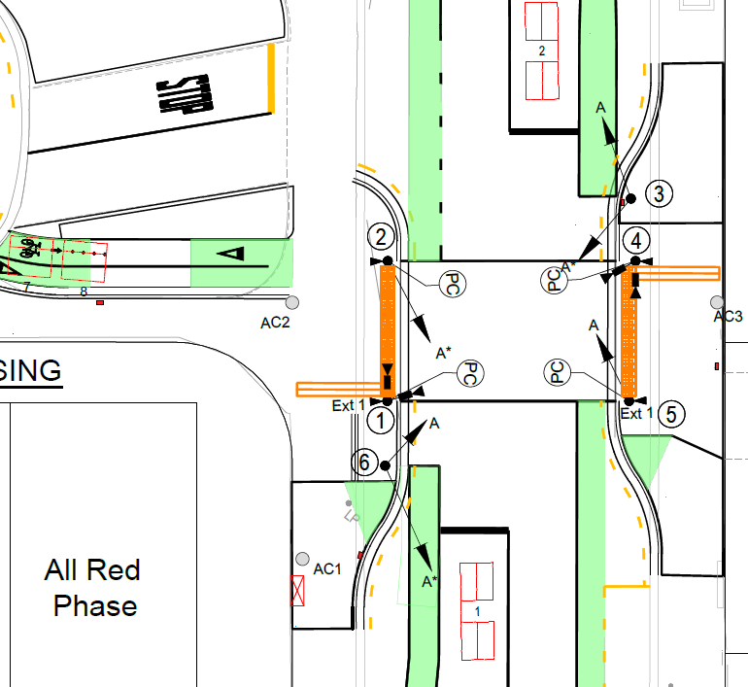
Design
Traditional Layout
Trial Layout

Slide 11
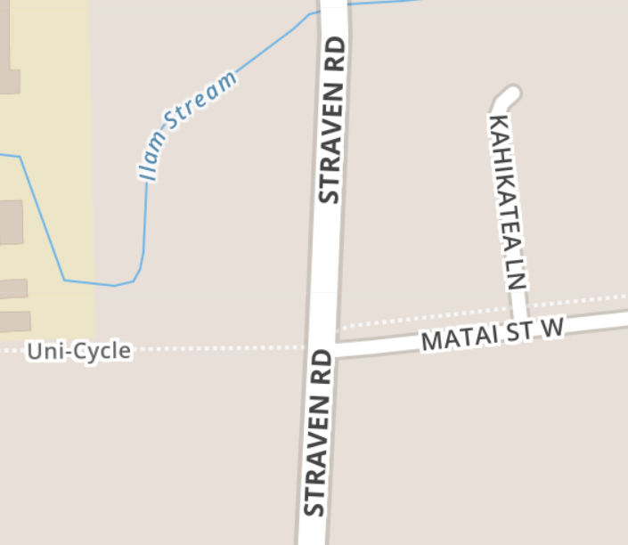
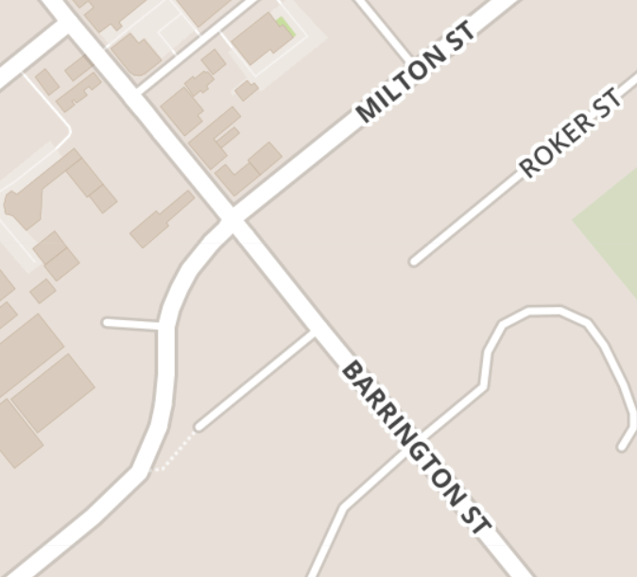
Site Evaluations
Traditional Layout Straven Road
Surveys were undertaken as part of the pre and post installation evaluations
The surveys involved observing users at both a combined two-aspect trial site and benchmark site with the traditional separated cycle and pedestrian lanterns
Straven Road is the traditional layout, Barrington Street the trial layout
Peak demand periods were obtained from Christchurch Transport Operations Centre (CTOC) by looking at the number of push button demands at the crossing
Survey data was collected manually onsite
A video camera was also installed for the duration of the survey for any post analysis reviews and quality control.
Trial Layout
Barrington Street
Notes:
Straven Road 25,000 vpd, 700 cyclists per day on Uni-Cycle route near Dean Ave

Slide 12
Survey Findings
Modal Split
Notes:
During the survey, a total of 238 users were observed at the Straven Road crossing and 105 users at the Barrington Street crossing.
The modal split was similar across the two sites with 69% of observed users being on bicycles at the Straven Road crossing, compared to 70% at the Barrington Street crossing.

Slide 13
Survey Findings
User Compliance (Pedestrians)
Notes:
The surveys recorded the compliance of pedestrians using both crossings
At both sites, approximately 85% of pedestrian users crossed on the green phase.
A greater number of pedestrians commenced crossing on the flashing red phase at the Straven Road crossing than at the Barrington Street crossing (13 compared to one).
This included two groups of school children, one group of three and one group of nine, who crossed as groups and, therefore, group behaviour psychology would have had an impact.

Slide 14
Survey Findings
User Compliance (Cyclist)
Notes:
A concern of the trial was that a cyclist who commence the crossing when the signals are flashing red will not know if they have sufficient time to clear the crossing safely. However, the same is true for a cyclist who commences crossing when the signals are amber at a traditional site.
Of the cyclists who arrived on amber (Straven Road), 71% crossed anyway with the remaining pressing the pedestrian call button to wait for a green phase.
Of the cyclists who arrive on flashing red (Barrington Street), 43% crossed anyway with the remaining pressing the call button to wait for a green phase.
This interim result indicates the use of pedestrian sequencing reduces the level of non-compliance by cyclists, however, this result should be reassessed once cyclists are more familiar with the Barrington Street signals.

Slide 15
Survey Findings
User Interaction (Pedestrians & Cyclists)
Notes:
62% of users did not interact with the signals at Straven Road
One cyclist did not activate the loops and waited at the signals which were activated by a following cyclist crossing the loops
Pedestrians on two occasions did not press the pedestrian button and waited for a cyclist to activate the call
One pedestrian did not press the pedestrian button but was picked up by the camera
The remaining users arrived once a demand had already been put in
36% of users did not interact with the signals at Barrington Street
Pedestrians on three occasions did not press the button and just crossed when there was a gap in the traffic
Cyclists on four occasions were northbound on Barrington Street and used the signals to cross right into the MCR. There is no facility for these users to activate the signals without riding up onto the footpath.

Slide 16
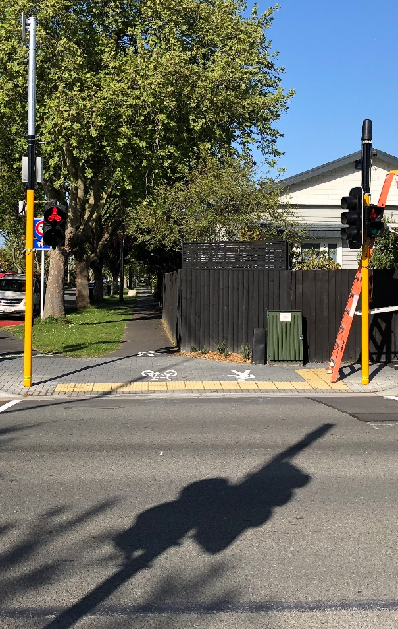
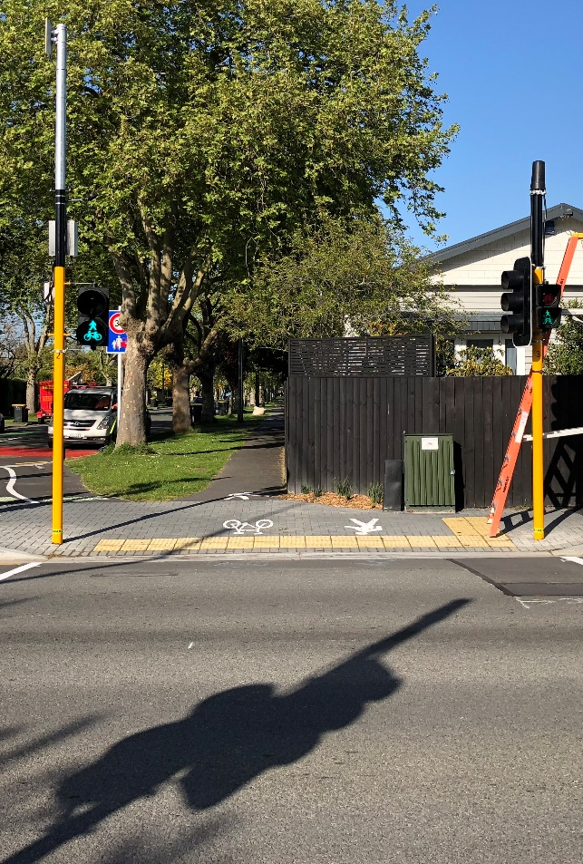
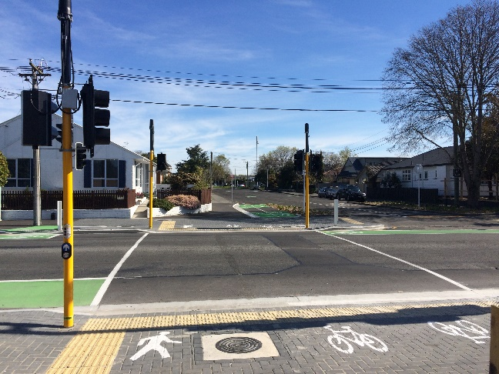
Survey Findings
Infrastructure
NZTA Trial Site 1
Barrington Street crossing had 300mm diameter two-aspect lanterns (similar to pedestrian countdown timers)
NZTA Trial Site 2
Strickland Street crossing had 200mm diameter two-aspect lanterns (similar to pedestrian lanterns)

Slide 17
Survey Findings
Utilization of Crossing Space
Notes:
The survey found that 45% of users at the Straven Road crossing either crossed with a diagonal action (i.e., started crossing on the space for one user type and exited the crossing on the space for the other user type) or used the ‘wrong’ crosswalk (i.e., used the crosswalk lines for the other user type). This was evitable during the surveys, with cyclists being particularly at fault.
This indicates that users will use the crossing as it best suited to them, regardless of the pavement markings. However, as shown by the behaviour at Barrington Street with the shared crossing, users are able to navigate the crossing without specific user areas. It was also observed that the stub pole installed to separate the pedestrians from the cyclists at the Straven Road crossing is resulting in cyclists using the pedestrian crosswalks because manoeuvring around the pole is inconvenient / awkward.

Slide 18
Conclusions (interim)
Traditional site:
  Higher number of pedestrians crossing on flashing red compared to trial – likely due to group behaviour.
  Comparable number of cyclists crossing on red or flashing red / yellow at both sites
  Higher number of pedestrians and cyclists crossing without demand input
  Cyclists cross using the pedestrian area, partially due to stub pole being located in manoeuvring space
Trial site:
  More pedestrians and cyclists use push button – possibly due to new site
  Shared pedestrian / cyclist lanterns must be 300mm diameter
  No notable safety issues or confusion of users
  Shared pedestrian / cyclist button is well used by cyclists

Slide 19
Moving Forward / Lessons Learnt
Second survey proposed at trial site in early 2019, end of summer period, when user volumes and familiarity will be greater
Appears to be benefit in combining the crossing area (removal of central white line) and removal of the stub pole with majority to cyclists traversing the pedestrian area
Shared pedestrian and cyclist lanterns and combined push buttons warrant ongoing evaluation.

