Slide 1
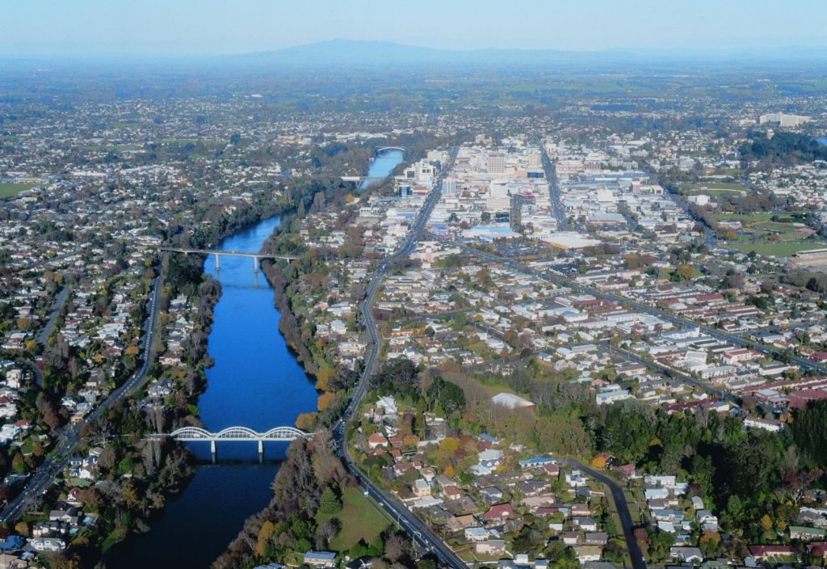
Annual Workshop
November 2018
Novotel
Hamilton

Slide 2
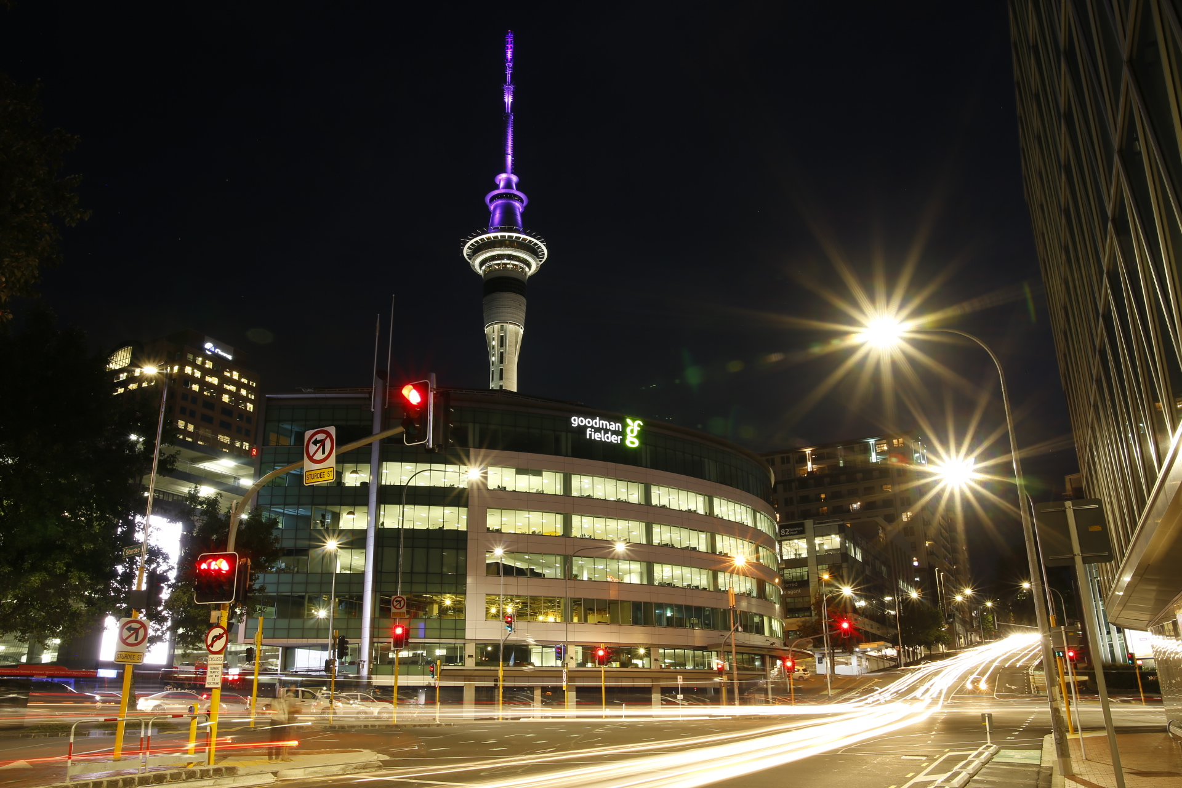
https://trafficsys.co.nz/
We…Supply
We…Install
We…Maintain
www.trafficsys.co.nz

Slide 3
SAFER…SMARTER…MORE RELIABLE
https://trafficsys.co.nz/

Slide 4
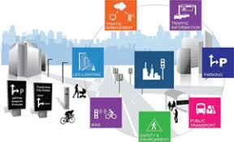
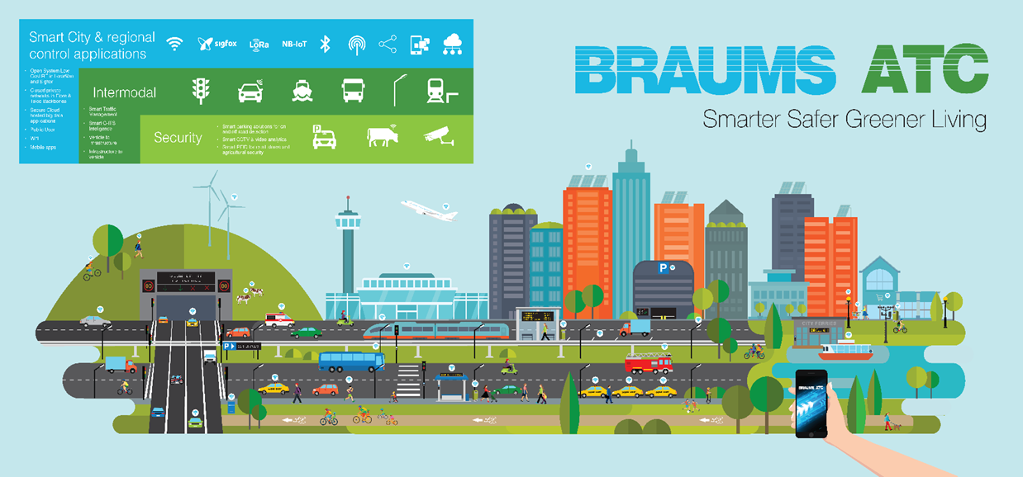
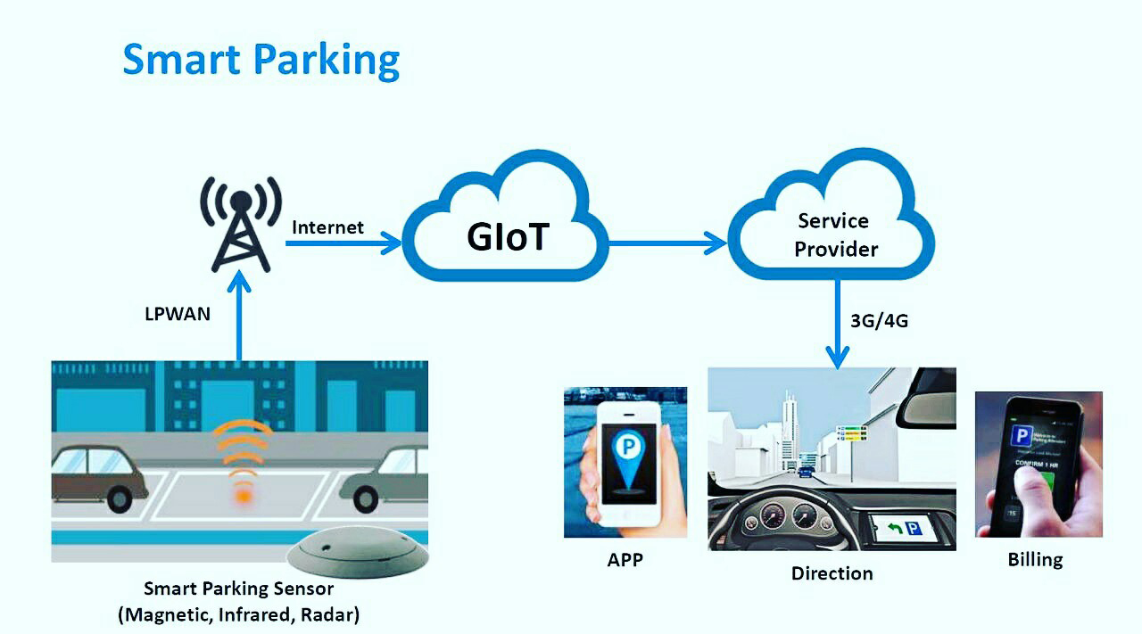
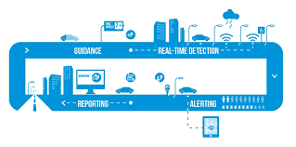
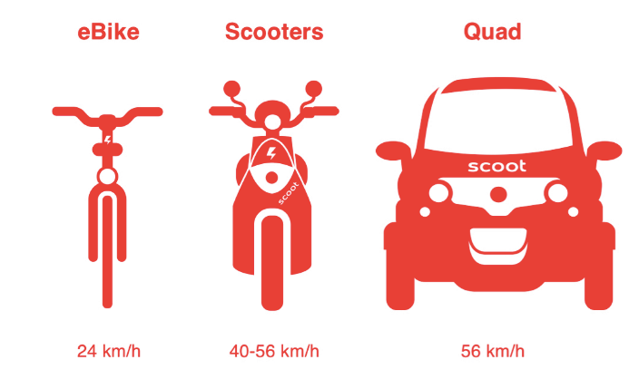
Complete Eco System Solution
Notes:
Smarter approach to intermodal transport corridors include cars, cycles, motrobikes, light rail, buses, taxis and future on demand autonomous electric shuttles

Slide 5
First VC6 Approved
Full SCATS Compliance
Full SCATS Functionality
Full RMS Compliance to Amendment 3,4,5

Slide 6
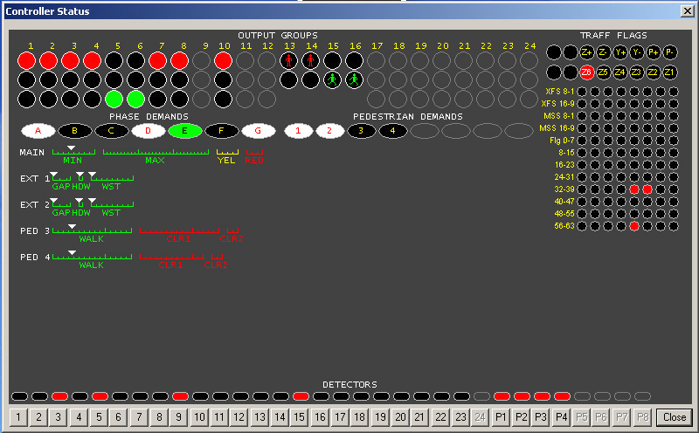
RAMS
Remote Access Management Software ATC application to provide access to ATSC4 controller status through local and remote versions of ATSUI.
PIC TBC

Slide 7
Vibrant optics and lens technologies best in class
Full range from pedestrian, vehicle to light rail
Low power requirement
240v, ELV and ELV DIM by wire versions
IN use NZ, RMS, VicRoads, WAMR, QLD, ACT, SA and NT
Highest MTBF rates in class
Modular design easily configurable for each traffic authorities preferences
Manufactured for BRAUMS by Swarco Austria

Slide 8
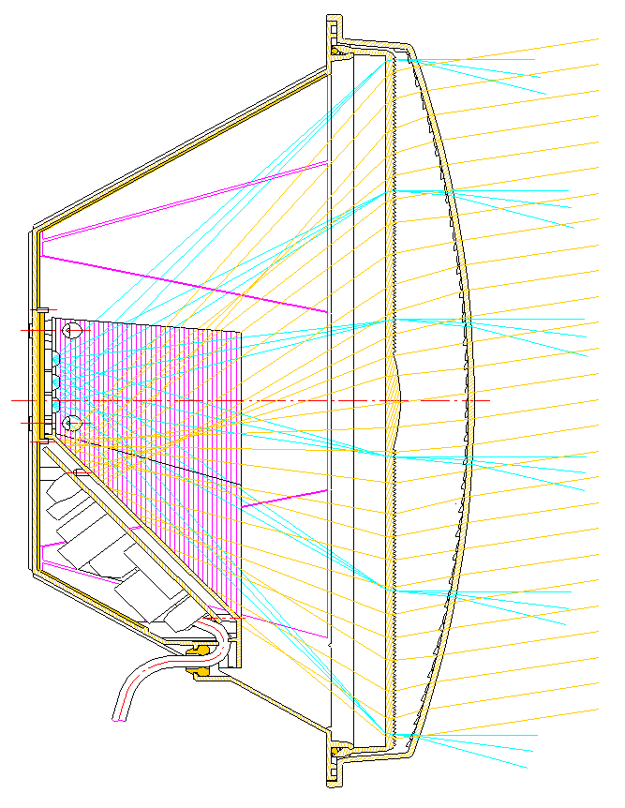
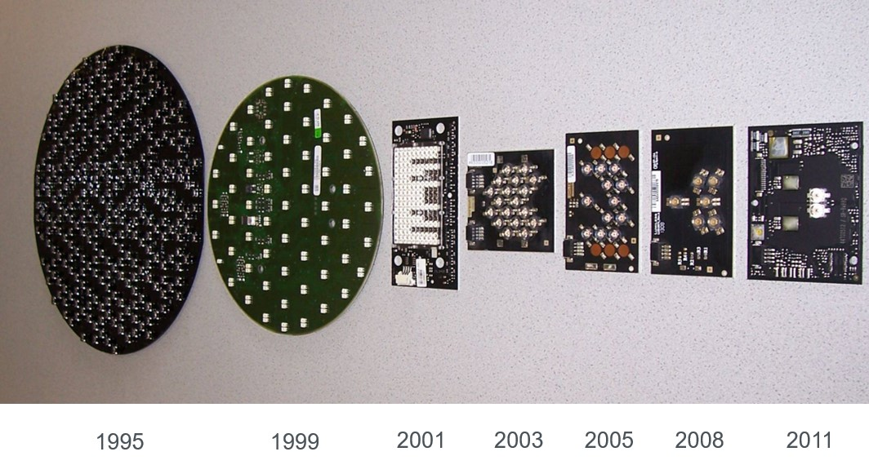
Optics Have Evolved
Evolutional change from through hole to single source technologies
SWARCO were first in Single Light Source Technology

Slide 9
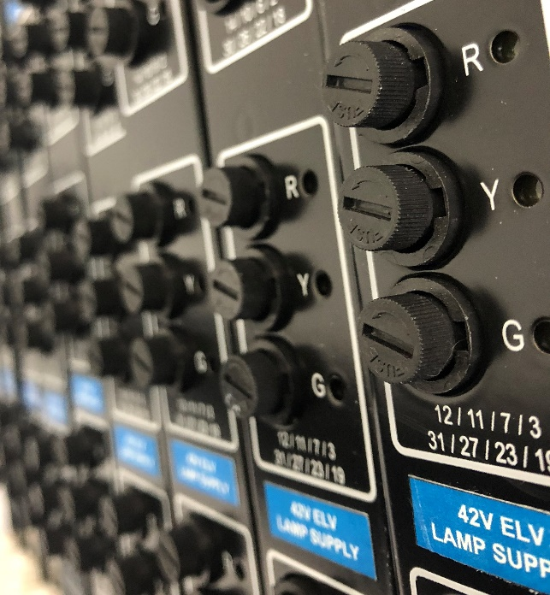
ELV Lanterns
BRAUMS bring to market extra low voltage DIM by wire advancements for safer and smarter traffic signal lanterns. Currently being adopted by RMS Newcastle Smart City for improved public safety.

Slide 10
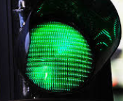
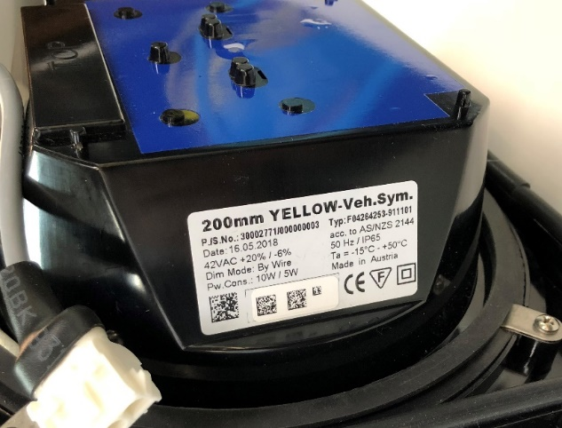
ELV / Dim-by-Wire…BENEFITS
Safety
SAFER…for public, first responders, and field technicians. Removes hazardous mains voltage in the event of an accident.
SAFER…eliminates risk of electrocution whilst working at height
MORE RELIABLE…vastly reduces possibility of false lamp faults
SMARTER…reduces working at height and traffic management.
SMARTER…eliminates need for earth loop impedance testing.
SMARTER…TSC/4 Spec. Amendments 3, 4 and 5 Approved
BETTER VALUE…Lifetime of less maintenance & operational cost

Slide 11
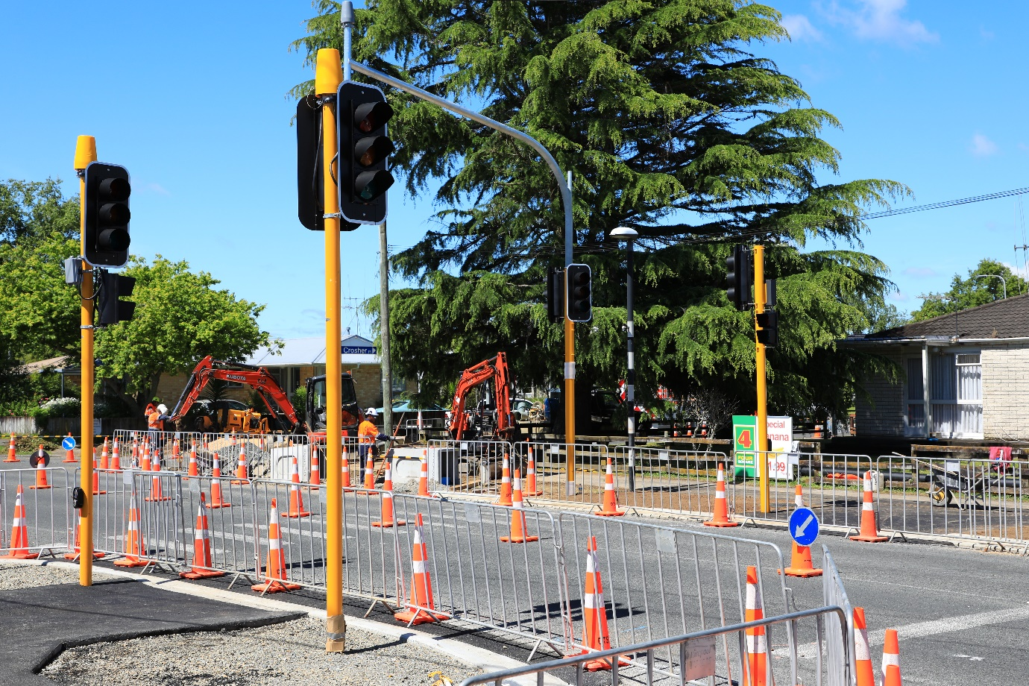
HAMILTON – LEADING THE WAY
First Extra Low Voltage install in NZ
Silverdale Road, Pedestrian Crossing.
TSL Streetlight solution.
All new BRAUMS ELV & Dim-by-Wire componentry

Slide 12
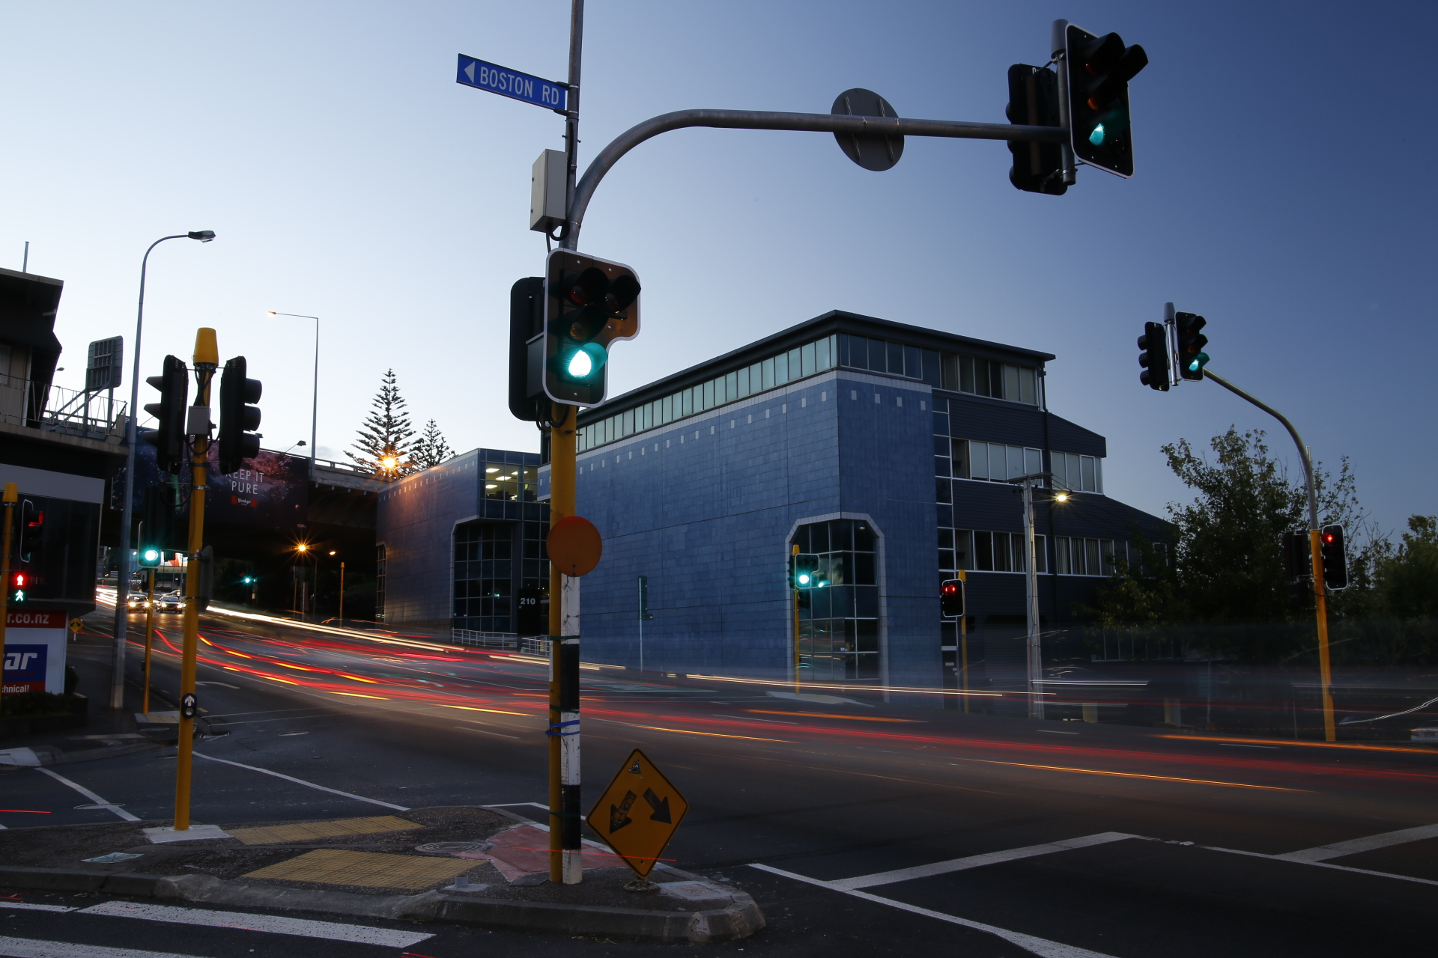
Best Technology. Best Service.
Your Solution Focused Team.
www.trafficsys.co.nz

