Slide 1
Pedestrian Signal Rest States
Ming Wang

Slide 2
Pedestrian Signal Rest States
ON
or
OFF
Notes:
As you know, the current pedestrian signal system we are using in NZ doesn’t show a red man in default, it only comes up when the push button is pressed.
Today, I’m going to challenge this, why is it off in default? Can it be constantly on in rest states?
But it is not a straight forward answer
Rather to come up with a solution today, we would like to bring this topic on to the table and people can have a debate or discussion on it.

Slide 3
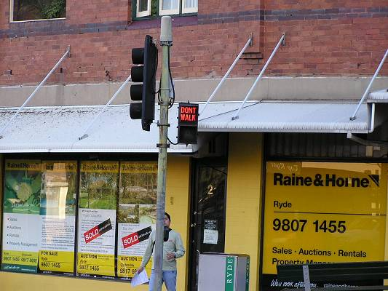
Background:
1970’s energy crisis
Power saving
Pedestrian signal stays on in prior to it
This 1970s pedestrian signal in Australia is still doing it's job in 2004.
Notes:
Why it is off?
We did a bit of digging and find out,
that needs to be back to 1970’ when there was an energy crisis and it was an innovative solution for a power saving measure.
And before that, the pedestrian light was consistently on.
The image on RHS showing the pedestrian signal installed in 1970s in Australia. Just for your information.

Slide 4
Question: Does it still suit today’s situation?
Lower power consumption Pedestrian aspect LED costs - 9.8 Watts!
More population & vehicle numbers
More distraction e.g. smart phone
New technologies
Safety concerns
Notes:
We come up with a question:is this still the best solution in the environment we are living now?
After nearly 40 50 years later, the change is big.
As today, we have a lower power consumption as the new pedestrian LED light only cost 9.8w.
We have more population and vehicles, more complicated road layout. we even have new vehicles like e-scooter, they will use the pedestrian crossings as well.
We have new distractions. People are increasingly distracted by the smartphone, social media and music. The attraction of social media, games, WhatsApp and music is great and comes at the expense of attention to traffic.
We now have new technologies. In the past decades, there are few new technologies have been used for providing extra information to vehicle drivers such as
Variable message signs, advanced warning signs. However, the information for pedestrians crossing are likely stay the same as in old days.

Slide 5
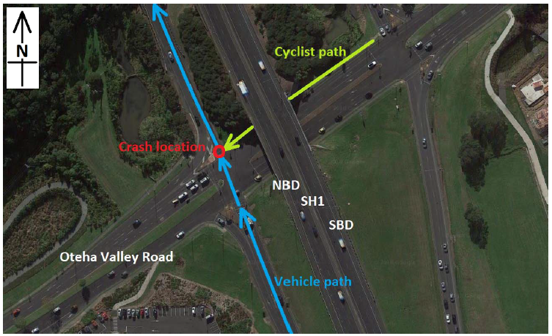
What happened
SH1 Oteha Valley Rd NB On Ramp
18th May 2018
Notes:
This is a sad news about a car versus a cyclist happed in early this year, it happens on Friday night 11 pm, on SH1 Oteha Valley Rd NB on ramp. One vehicle was travelling northbound on State highway 1 off ramp and continuing straight ahead onto on ramp. This is a permitted movement.
At the same time, a cyclist was travelling on westbound across the on ramp via the footpath and has been struck by this vehicle. The crash happened on late Friday night during low traffic volumes.
Based on the assessment of the available phasing data and CCTV footage, it is almost certain that the cyclist has not activated the signalised crossing call button before crossing. the pedestrian signal was off and no attention was draw.
the cyclist wasn’t anticipating the oncoming vehicle.
We are not going to discuss the detail here. But one of the things we were thinking is,
What if the pedestrian signal was on and display in red even if it was not activated, if the cyclist saw the red light hesitated to cross or even slow down and have a second look at the intersection and vehicle before crossing.
We therefore come up with this question: why pedestrian signal is off in rest state?

Slide 6
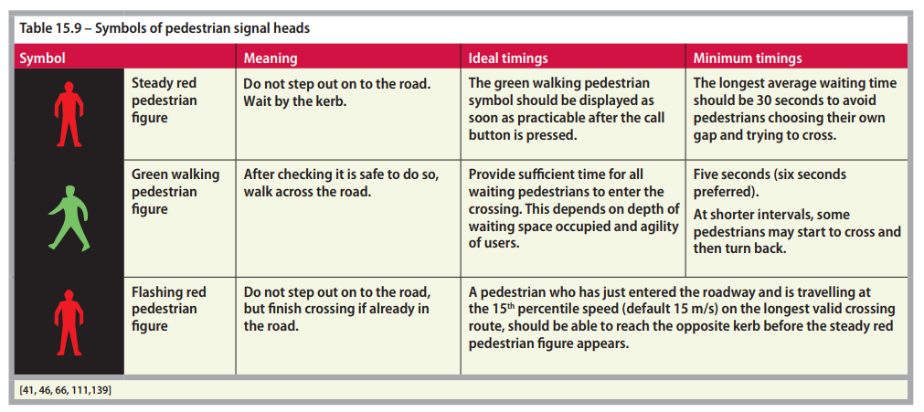
Standard
Notes:
This is a table from a design guideline, it shows the action required for pedestrian under different displays such as steady red, green man and flashing red. However it didn’t clearly say what pedestrian should do when there is a blank message.

Slide 7
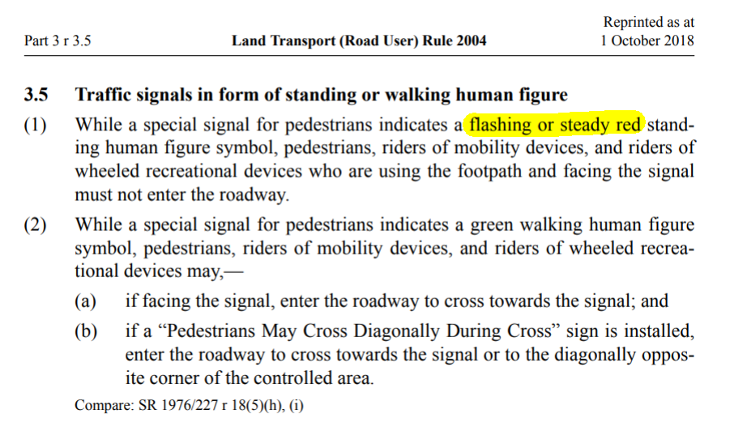
Notes:
Also from legal perspective, the land transport rule only states pedestrian shouldn’t cross when a flashing or steady red is on, it not illegal for pedestrians to cross the road if the red light was off.

Slide 8
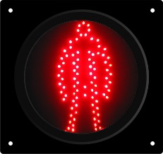
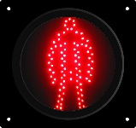
Does equal to ?
Safe crossing time not guaranteed
No conflict not guaranteed
Do not step out on road
Actively provide message
Notes:
So are steady red man and blank message same?
Both of them are not giving the information of safe crossing time and conflict movement.
The ready red man does deliver a message saying do not step out on road.
And the last, the steady red man actively provide information to pedestrian while with the blank message doesn’t it shows up passively.

Slide 9
Human Behaviour
Pedestrian often cross based on their judgement , without pressing the call button.
Current system doesn’t provide sufficient safety information by default. No crossing information provided until call button is pressed.
It may encourage pedestrian to do unsafety crossing as a lack of information stating that they cannot cross.
Notes:
From human behaviour perspective.
Pedestrians often cross intersections when they judge it to be safe to cross without pressing the call button, this presents a greater problem when the intersection is not self-explaining.
Back to case that we talked before, the cyclist wasn’t anticipleting there was a vehicle through movement from off ramp straight onto on ramp.
The current system doesn’t provide sufficient safety information by default. The information only will be provided when the call buttons is pressed.
As said above, It is quite different between actively providing information to pedestrian and pedestrian ask for information by pressing buttons.
It may encourage pedestrian to do unsafety crossing as a lack of information stating that they cannot cross.

Slide 10
Examples in Overseas
Notes:
We’ve picked a few examples from other countries.
They have a steady red man in rest state.

Slide 11
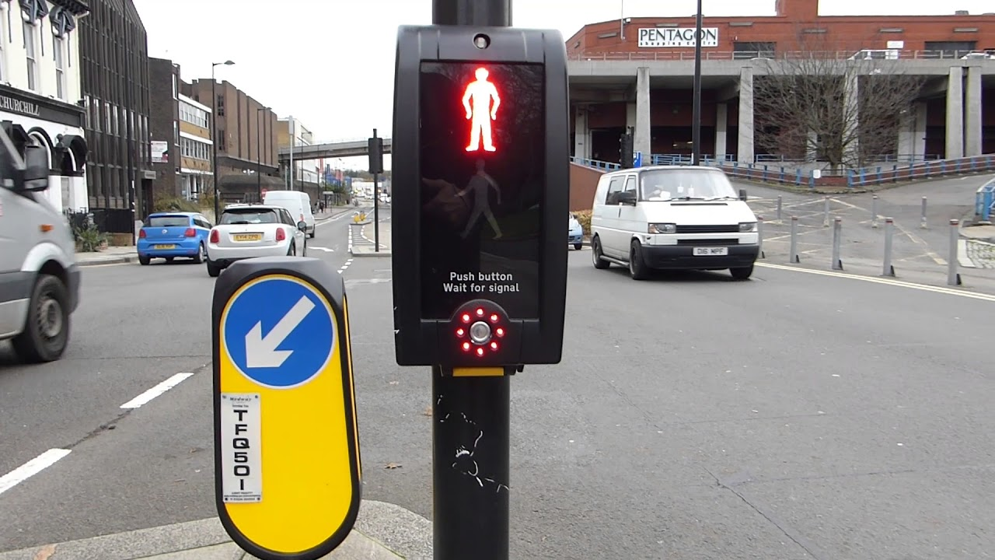
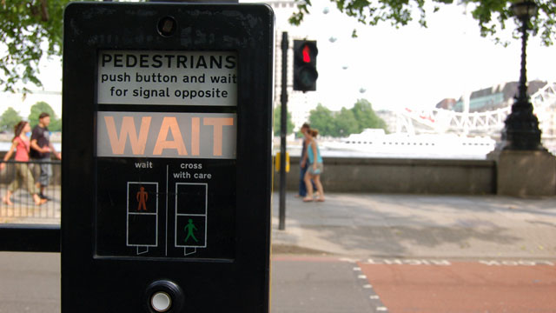
UK
Pedestrian light is on in rest states and have a call feedback indicator at near side of pedestrian waiting area.
Notes:
This UK, the pedestrian signal is constantly on, on the right hand side showing a call indicator device that gives you a feedback after pressing the button.
The image on the LHS is a new type of pedestrian signals, it is mounted next side of pedestrian waiting area.
To expand it, this one is mounted on the side of approaching vehicles, therefore when people is looking at the signals, they can see the oncoming vehicles at the same time.
so when people see the green man and about to go, they can see if the vehicle is stopped at the same time.

Slide 12
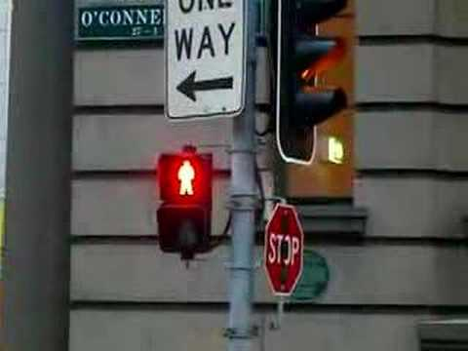
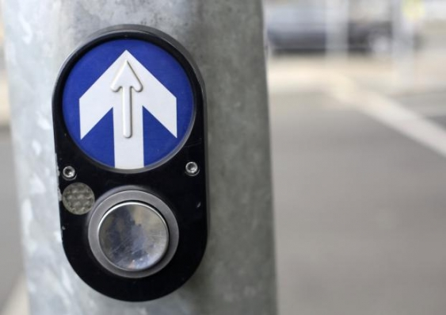
Australia
Pedestrian Push Button Layout
Embossed arrow showing direction of cross walk with audio tactile unit behind the face plate
Demand indicator
Large push button
Notes:
Same as Australia, they have pedestrian red man on in rest state and a similar call button with ours but have an extra indicator near the push button.
Same as cycle push button here.

Slide 13
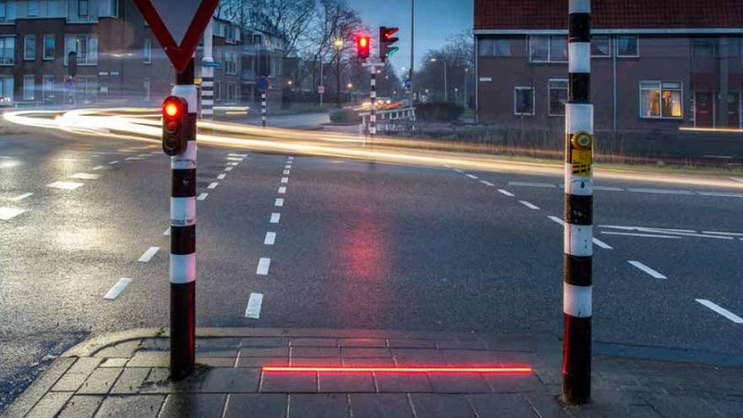
Netherlands - Bodegraven
Far end pedestrian signal
Call button
Pedestrian in ground lighting
Near end indicator
Even more information is provided for pedestrians!
Notes:
Netherland, this is trial of in ground light in Netherland, they provide even more information to pedestrians on top of a steady red man and a feedback indicator.

Slide 14
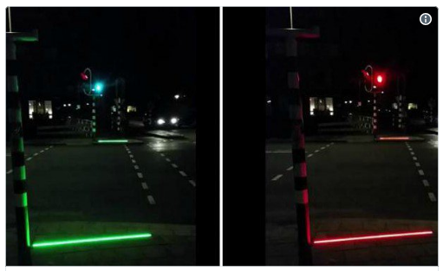
Netherlands - Bodegraven
Night Look
Notes:
And this is the night looking. The light is outstanding, it provide clear safety message to pedestrian.
It might be a bit departure from our topic, but what I’m trying to say is, the trend is giving more information to pedestrians.

Slide 15
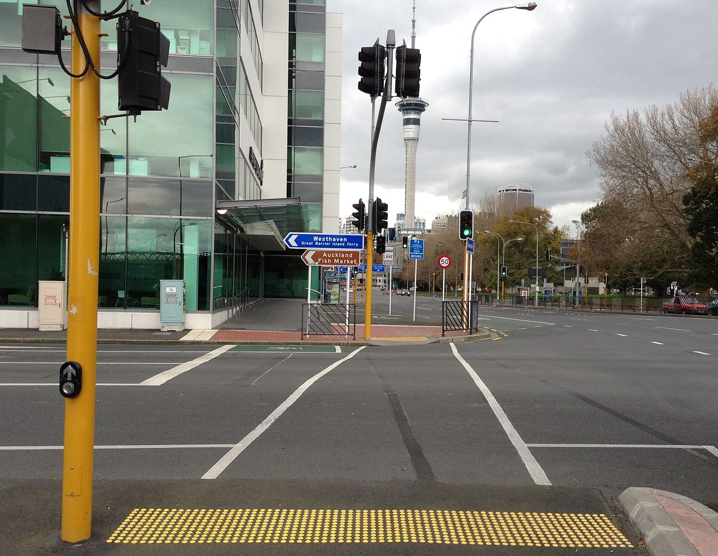
What we can do?
Provide a continuous ON pedestrian aspect.
A call accept indicator to inform people whether demand is called or not.
Education through signs and broadcast.
Notes:
Back to New Zealand.
What we can do in NZ?
As a starting point.
We can provide same thing with a steady red man on in rest states and a call feedback indicator.
During first a few weeks or months, it might cause a few confusions, but with education going and people should be getting used to new system.

Slide 16
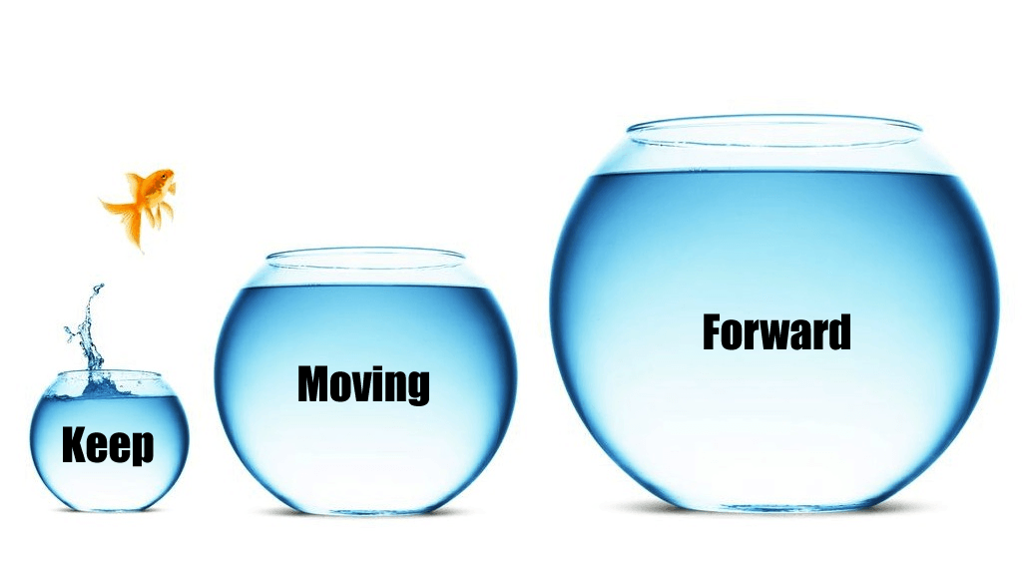
Future Outlook
More facilities
Safer Crossing
More information
More technologies
Notes:
Looking forward, the trend is to provide more information to road users including pedestrians.
We have done so many great jobs here, and I do think it is a good time to provide more facilities and extra information for pedestrian crossings.
As mentioned earlier, I’m not going to give you the answer, but would be good make everyone thinking.
Please fill out the form and I will collect them up. Thank you!

Slide 17
Questions?

Slide 18
Thank you!

