Slide 2
What’s MY problem…
SNUG 2018 - Hamilton
Notes:
I am here to talk to you about the wonders of traffic signal roundabouts and how they have transformed our design by thinking outside the box.
However we are limited to their full potential due to technical deficiencies that I am hoping you can assist with me today.

Slide 3
What MY problem…
Designs and drawing standards..

Slide 4
Detailed Design
“Indicative….”
Pole positions
Pram ramps
Tactile pavers
“Engineer and contractor to agree locations”
“Contractor to install tactiles to RTS14 Guideline”

Slide 5
Do we understand / read OUR specifications?
“Existing controller to be upgraded and is TSC/4 compliant”

Slide 6
Do we understand / read OUR specifications?
“Existing controller to be upgraded and is TSC/4 compliant”
“Traffic signals equipment and installation shall comply with the national P43 specification..”

Slide 7
Design on the job..
“Contractor to assess existing ducts and chambers and utilize infrastructure where possible. If existing ducts to be used, a condition survey is to be undertaken…”

Slide 8
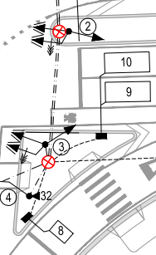
Detailed Design or Design with No Details?

Slide 9
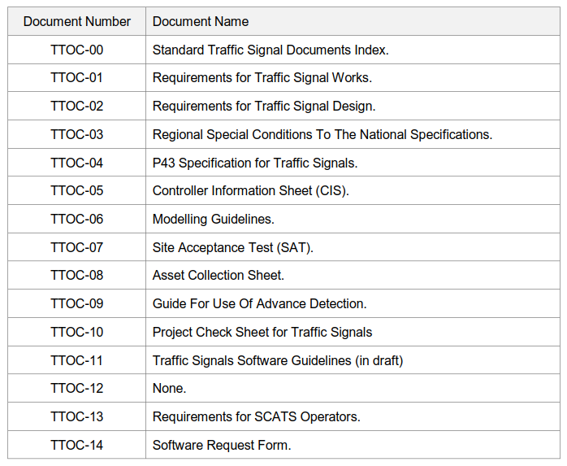
TTOC - 00

Slide 10
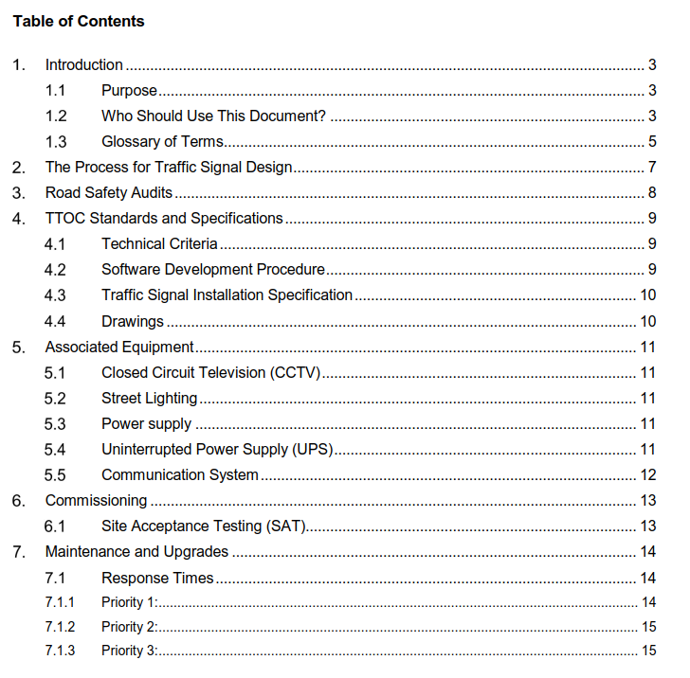
TTOC - 01

Slide 12
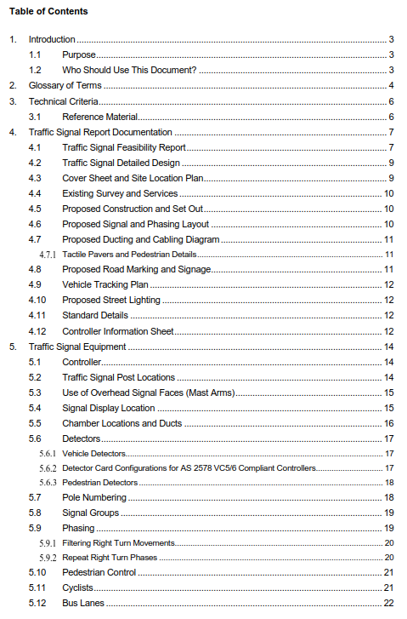
TTOC - 02

Slide 13
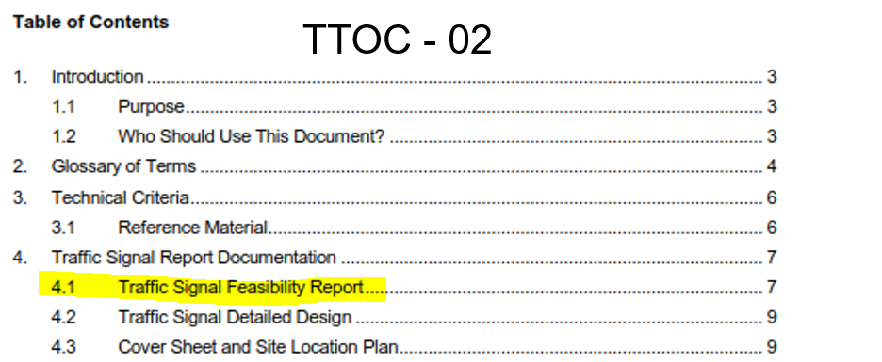
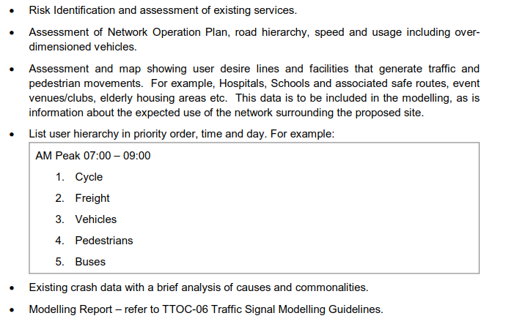

Slide 14
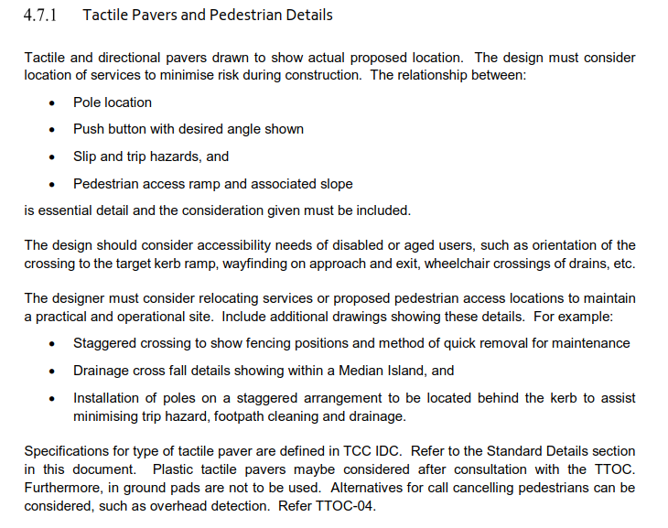

Slide 15
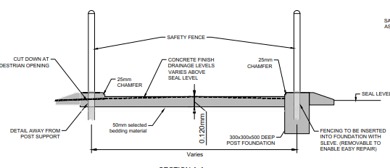
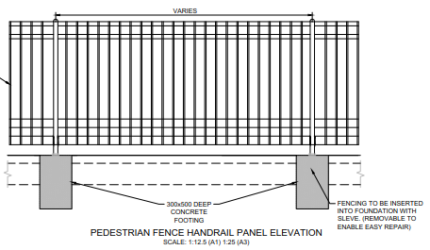
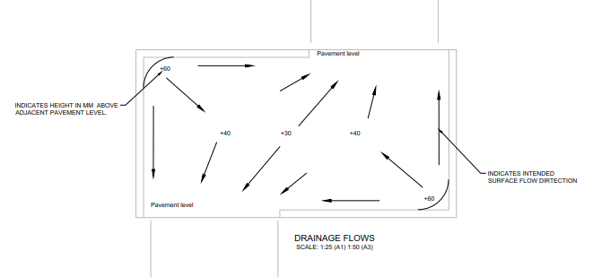
Stagger Islands

Slide 16
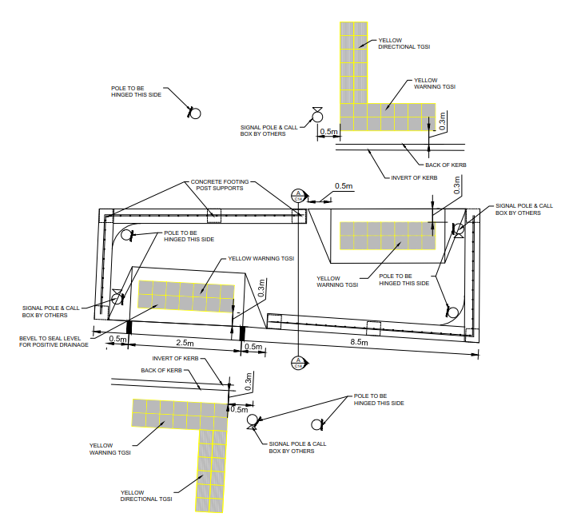
Staggered Islands
Notes:
We have some of these.
Now this one has no peds on it, fairly easy to operate.

Slide 17
Magic Roundabouts’
Thinking outside the Box Circle
SNUG 2018 - Hamilton
Notes:
I am here to talk to you about the wonders of traffic signal roundabouts and how they have transformed our design by thinking outside the box.
However we are limited to their full potential due to technical deficiencies that I am hoping you can assist with me today.

Slide 18
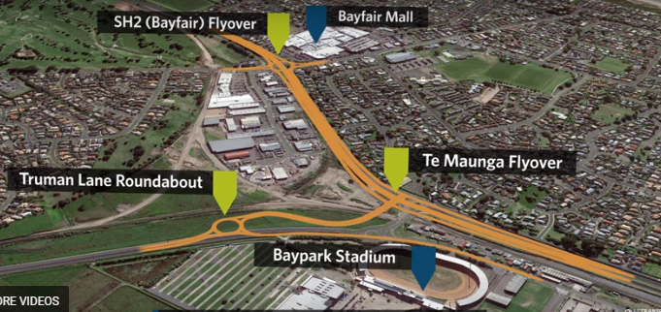
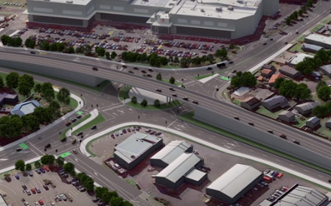
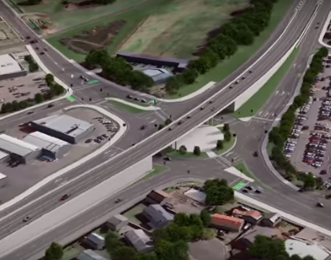
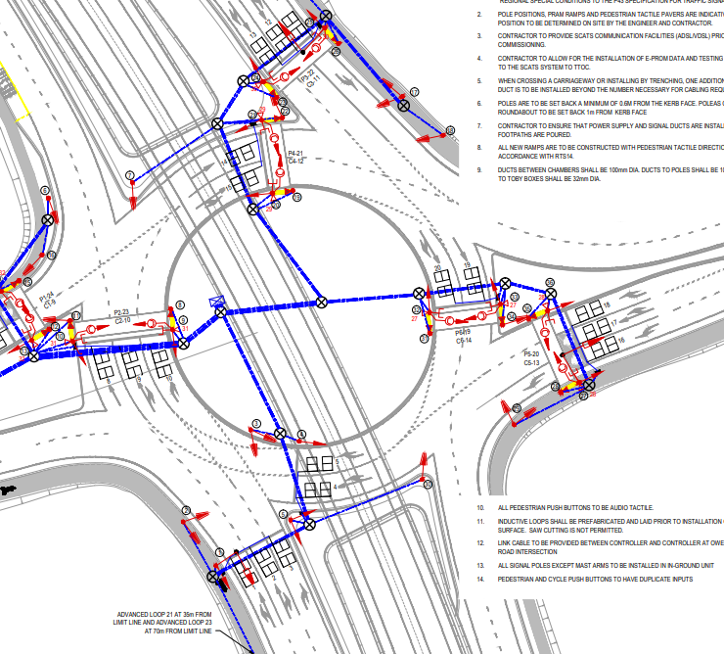
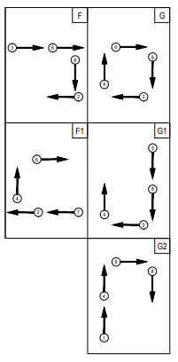
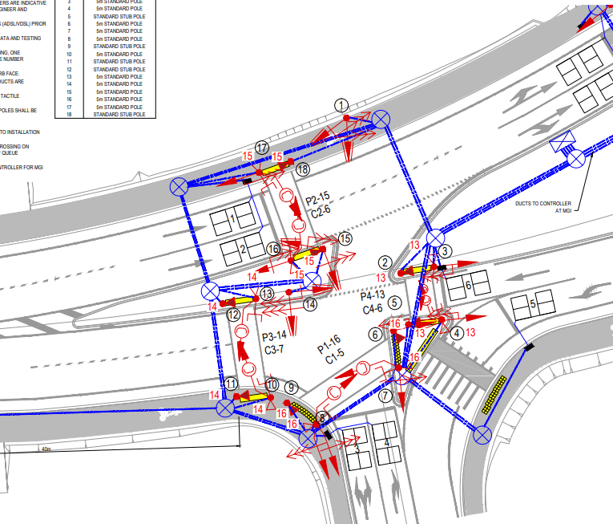
Proposed 2020
Notes:
So this is our Forth and most complicated, expected completion 2020.
Signal design - for all users, peds, cycle, vehicles. Looks good on paper
Detailed Design – Is this detailed design? Indicative positions, designer walks away from construction. Cyclist lanterns, PB’s.
System Design - Scats will get it going. Efficiency depending on control method.

Slide 19
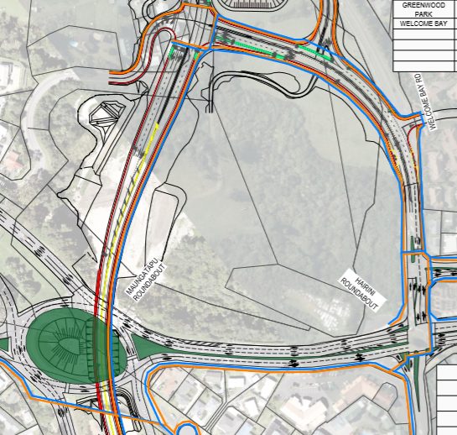
Replace Signal Roundabout

Slide 20
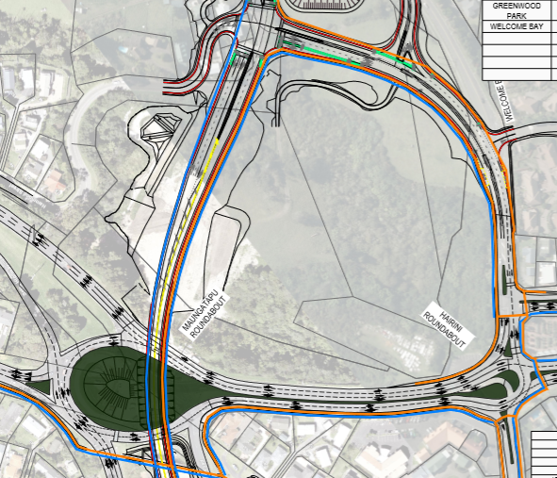
Replace Signal Roundabout

Slide 21
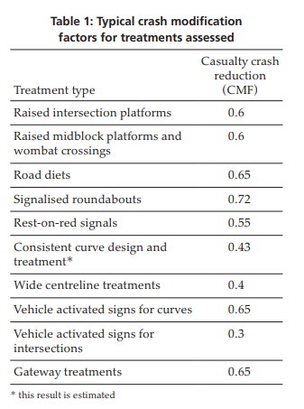
Why to we keep building more?
“Conventional at-grade intersection designs present a significant challenge in the context of meeting the Safe System vision of preventing fatal and serious injuries.” ARRB
Vol 26 No 3 September 2017 Road & Transport Research
Notes:
Latest research suggests we need to rethink our design strategy,
And roundabouts help us do that

Slide 22
Why to we keep building more?
“Conventional at-grade intersection designs present a significant challenge in the context of meeting the Safe System vision of preventing fatal and serious injuries.” ARRB
“roundabouts and their derivatives (e.g. signalised roundabout, flower roundabout) had the greatest potential to deliver Safe System outcomes” Austroads AP-R556-17
How can we improve?
Vol 26 No 3 September 2017 Road & Transport Research
Notes:
For example rest on red I would need to use advance detectors to call the phase, resulting in a vehicle to slow down on the approach before signals change.
Measuring their approach speed using advance detection loops can assist in some decisions we make at the intersection by extending the all red, especially if we have a lamp fault on a ped crossing. We have the monitoring to give us better choices for safety in our software.

Slide 23
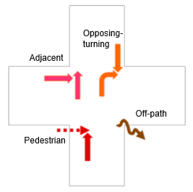
Safety Design
Development of an analytical method for safe system assessment of intersection design
C Jurewicz - ‎2016
Notes:
Here are the common conflict scenarios we to mitigate in our designs

Slide 24
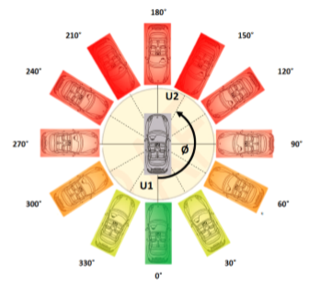
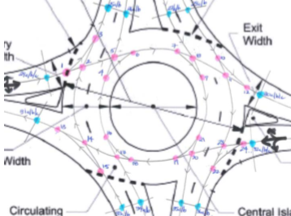
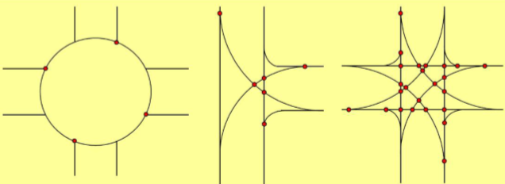
Safety Design
Kinetic Energy Management Model
X-KEMM-X, and the evidence behind it, suggests a need to shift the Safe System intersection design focus towards:
Control of impact speeds through regulatory and geometric means, e.g. speed limits, approach traffic calming, geometry of the intersection.
Control of impact angles through geometric design.
Greater control of critical movements, e.g. turn bans, simplification of decision making.
Development of an analytical method for safe system assessment of intersection design
C Jurewicz - ‎2016
Notes:
Capacity vs safety is always a difficult decision to make on our designs.
On the last slide showing manugatpu roundabout we have removed the major movement to force them to the underpass.

Slide 25
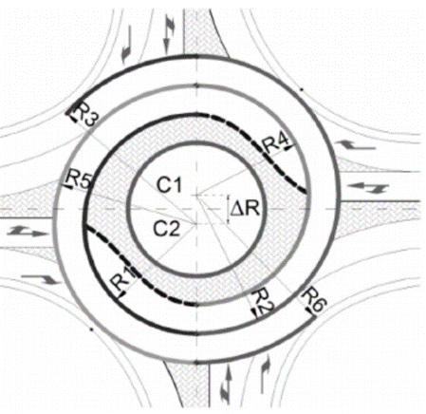
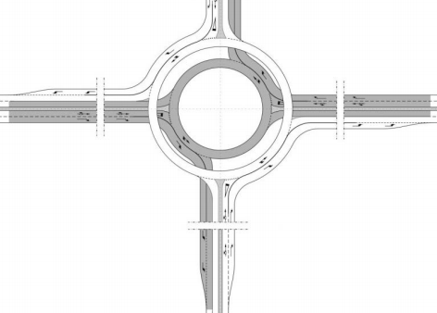
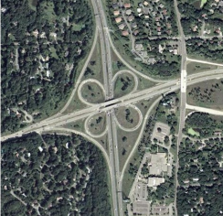
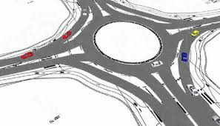
Examples - Uncontrolled
Flower
Target
https://absrs.org/sajt/doc/File/B-1_%20Tollazzi_Banja_luka_2014.pdf
Notes:
Lets looks at some roundabouts without signals
Where the geometric design assist in potential impact areas, changing the angles and improving efficiency of the design.

Slide 26
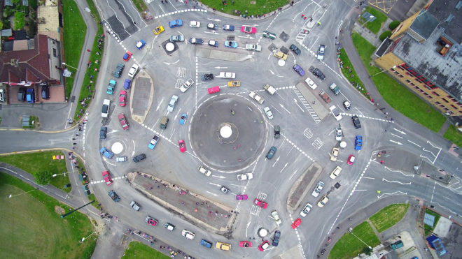
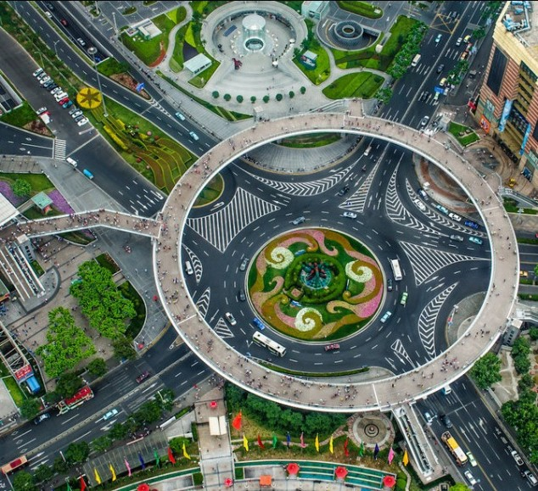
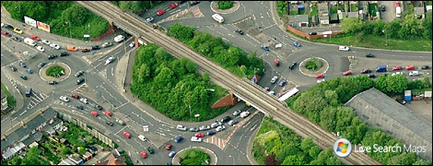
Examples – Uncontrolled, peds on outside
Notes:
Swindon, Shanghai, London

Slide 27
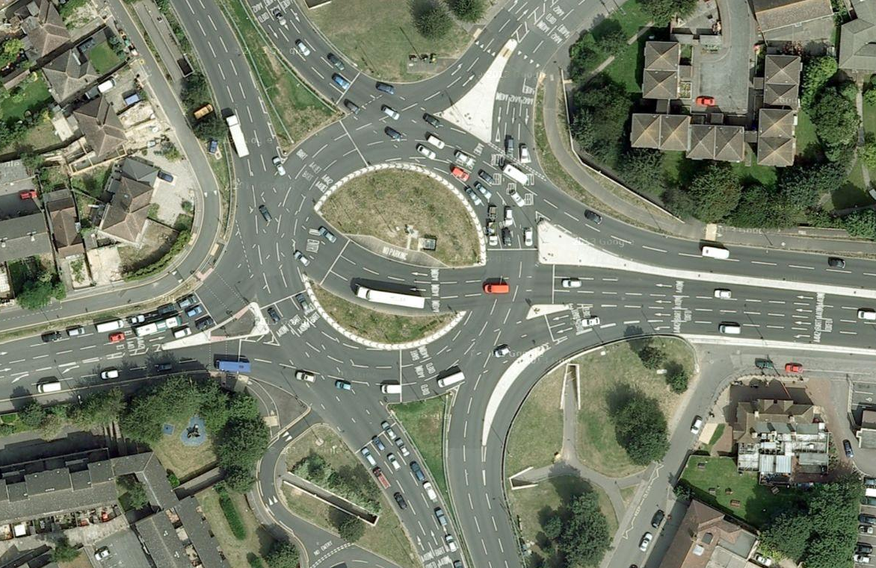
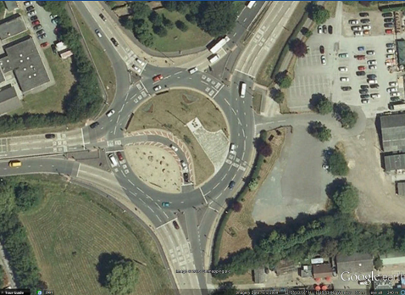
Examples - Controlled
“Hamburger”

Slide 28
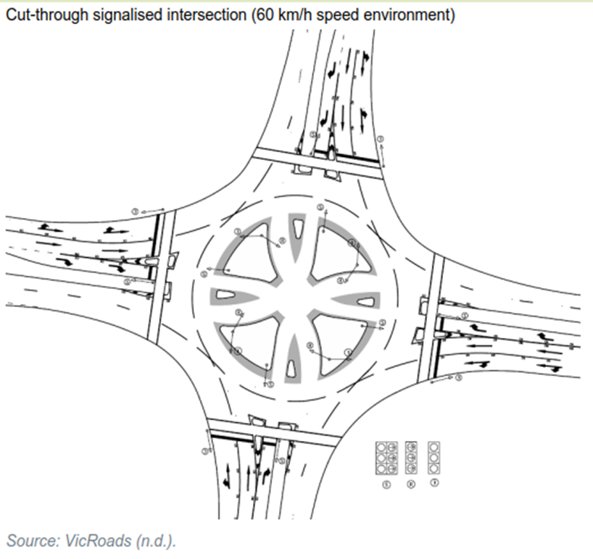
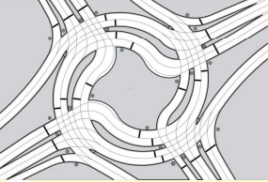
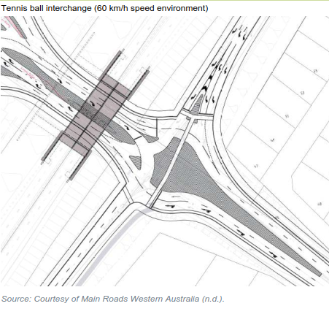
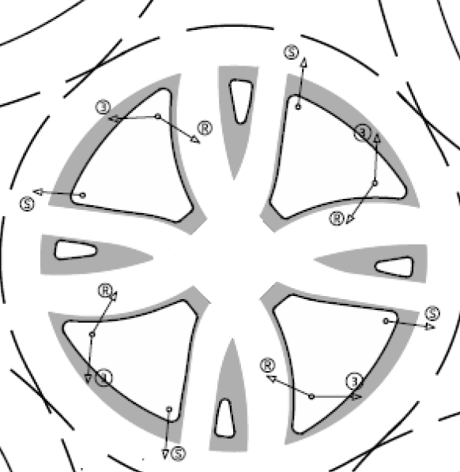
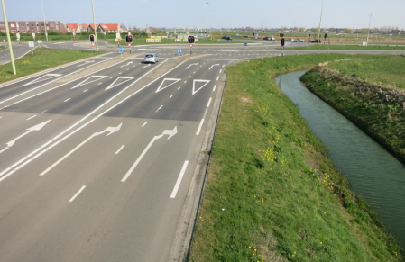
Examples - Controlled
Mag Wheel
Turbo Square
Tennis Ball

Slide 29
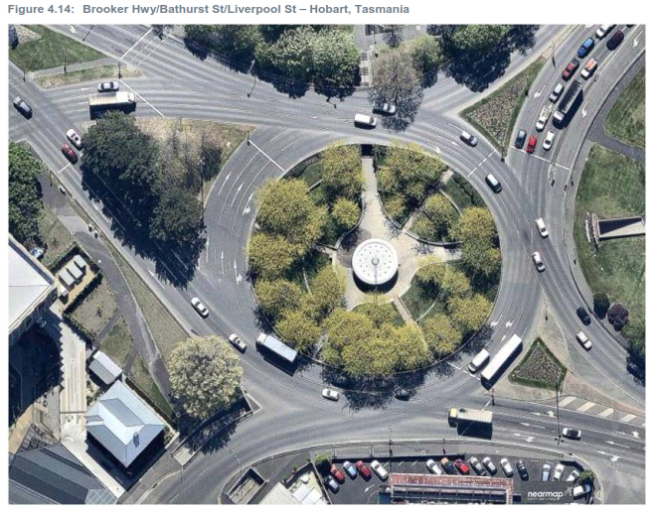
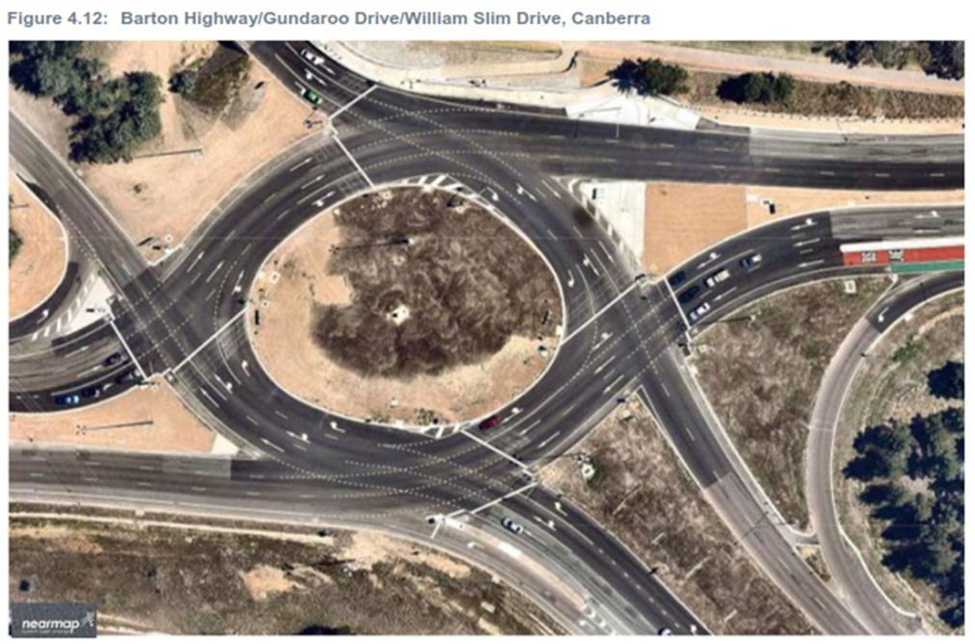
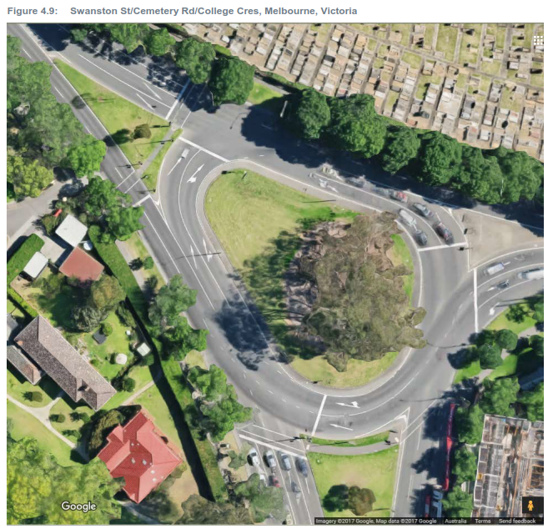
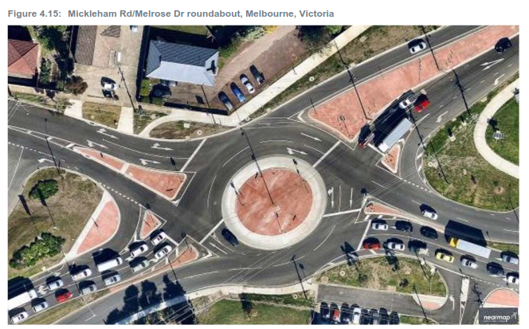
Examples - Controlled

Slide 30
Guidelines / References
Very little exists in relation to roundabout signals, however these documents are available:
Department For Transport (UK) 1/09 signalized roundabouts.
Austroads Guide to Traffic Management Part 6: Intersections, interchanges and Crossings. Section 3.6 discusses metering options only.
Austroads Research - AP-R556-17 Understanding and Improving Safe systems.
Do traffic signals at roundabouts save lives? http://content.tfl.gov.uk/signalsatroundabouts-transportationprofessional-article.pdf
Road markings and signage also need careful consideration too, for example lane destination in advance of the roundabout and spiral markings to assist.

Slide 31
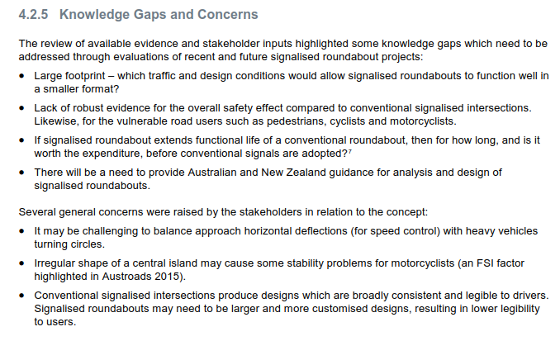
Guidelines to come?
AP-R556-17_Understanding_and_Improving_Safe_System_Intersection_Performance.pdf
Notes:
From ARRB
Shows more research and documentation is needed.

