Slide 1
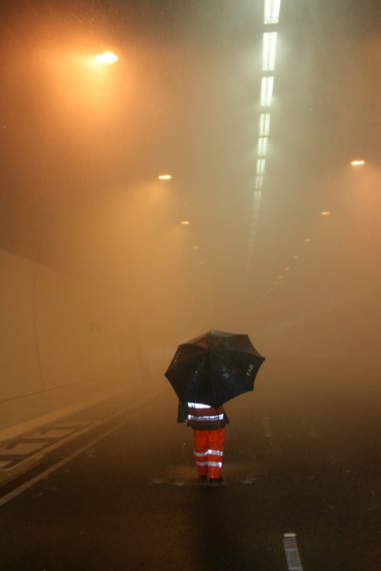
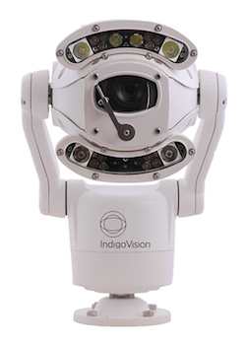
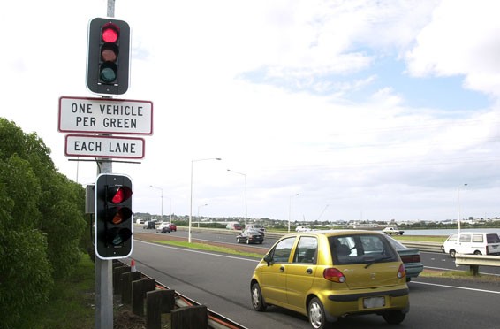
AMA Intelligent Transportation Systems

Slide 2
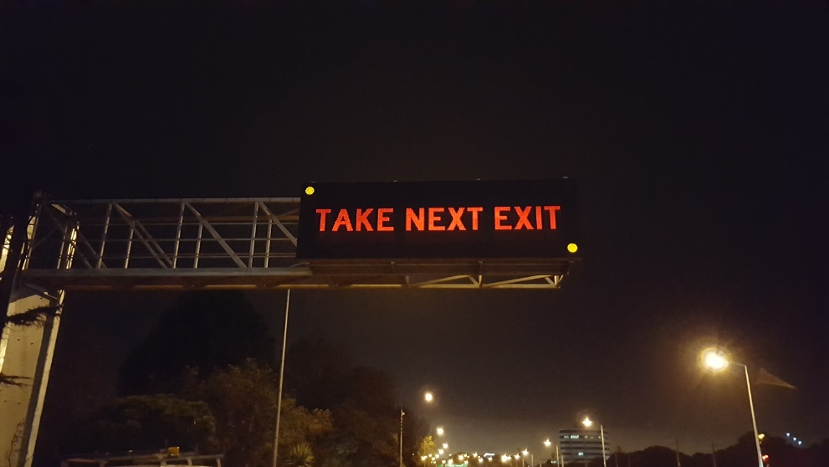
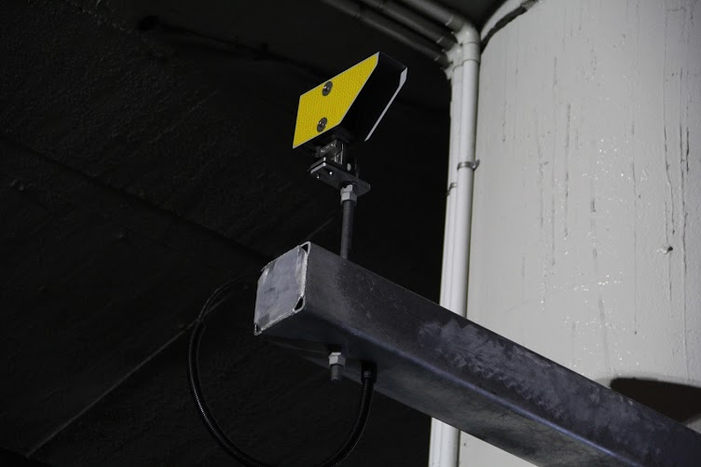
Over Height Detection System
Notes:
New system installed to replace the old system at Penrose Bridge which originated in the late 80’s
6 new full colour VMS installed
6 New sensor sites with new conspicuous static signage
System designed with support from human factors engineer
New system has identified hundreds on illegal vehicles in the 4 months its been operating
1 potentially disastrous vehicle strike already avoided.
Many vehciles have been stopped and loads adjusted to get under bridge.

Slide 3
SYSTEM LAYOUT - SOUTHBOUND
The composition of the OHDWS shown in plan view below:
VMS
VMS
VMS
Direction of travel
Main Hwy overbridge
Findlay St cantilever
Penrose Rd overbridge
Ellerslie Panmure
OverHeight Sensors
OverHeight Sensor
Critical Height Sensor
Notes:
New system installed to replace the old system at Penrose Bridge which originated in the late 80’s
6 new full colour VMS installed
6 New sensor sites with new conspicuous static signage
System designed with support from human factors engineer
New system has identified hundreds on illegal vehicles in the 4 months its been operating
1 potentially disastrous vehicle strike already avoided.
Many vehciles have been stopped and loads adjusted to get under bridge.

Slide 4
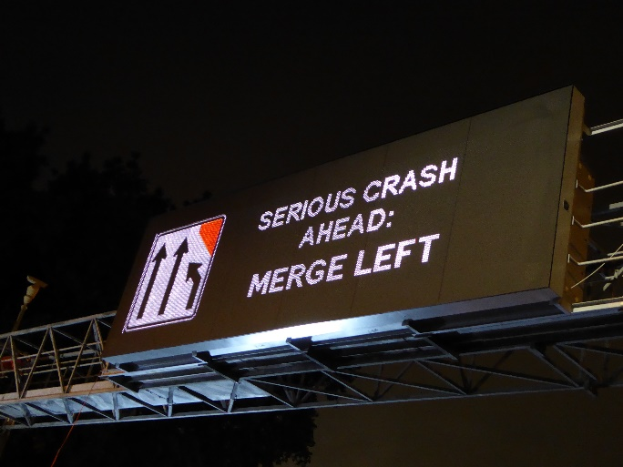
Colour VMS
Notes:
13 Full Colour Full size motorway VMS installed by AMA
Waterview Connection now installing colour signs
All other capital project in Auckland now delivering colour signs.

Slide 5
Traveler Information
Helping our customers make smarter journey choices
Notes:
Traveller information screen
AMA have developed traveler information feeds for major transport nodes to provide traveler information based on NZTA traffic feeds.
This will be free to use and will initially be installed at Auckland Airport
Screens will provide trending information along the normal times
Addinsight has now been rolled out across the Auckland motorway network and working with AT to install on local roads, AT sites being installed over the next 6 months to provide a broader web of Bluetooth sourced traffic information.
Roadside hardware is a consumer Raspberry PI which costs around $60, a complete install is less than $400 per site.
Used to beam location specific messages to vehicles running the app
The App is available on Google and Apple App stores.

Slide 6
Wrong Way Vehicle Detection
Wrong Way Vehicle Detection
Notes:
Sites located across Auckland network
Sites use radars and loops to detect vehicles driving on the off ramps in the wrong direction and flash up warnings to drivers and to ATOC

Slide 7
Wrong Way Vehicle Detection

Slide 8
Travel Advisory Radio Trial
102.2 FM
Notes:
Aaron to supply notes
six month proof-of-concept of the use of short-range radio for providing information to motorists on route within the broadcast area
better inform drivers about unplanned/planned events - Impact on current or future journeys by broadcasting relevant updates
PARTNERS Transport Agency, Auckland Transport (AT), plus trial partners NZ Police, Civil Defence and Auckland Airport
pre-recorded messages on-air 24/7 – updates 6am – 7pm 5 days
The National Travel Information Services (NTIS) team to operator this

Slide 9
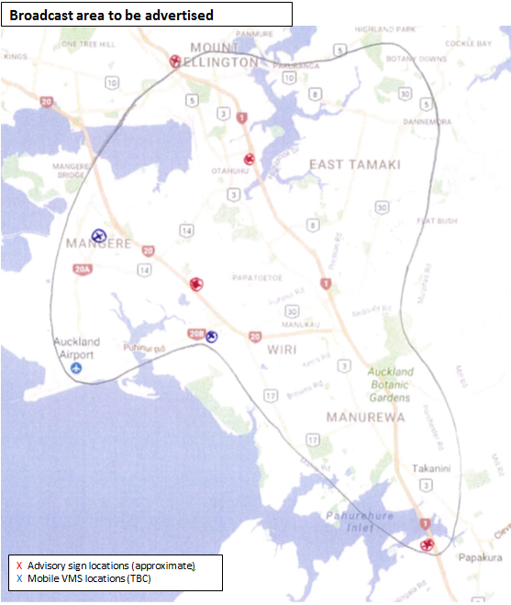
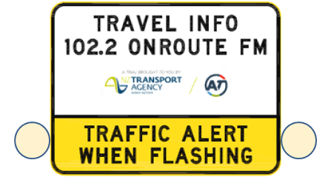
TAR - Coverage

