Slide 1
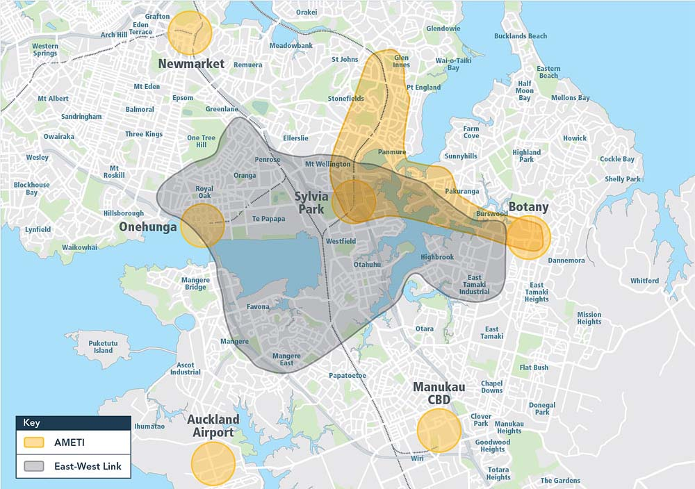
Project area
Major freight transport hub, home to major manufacturing sectors and commercial centres
Employs 60,000 plus - second largest employment area
MetroPort at its heart, NZ’s third largest container port

Slide 2

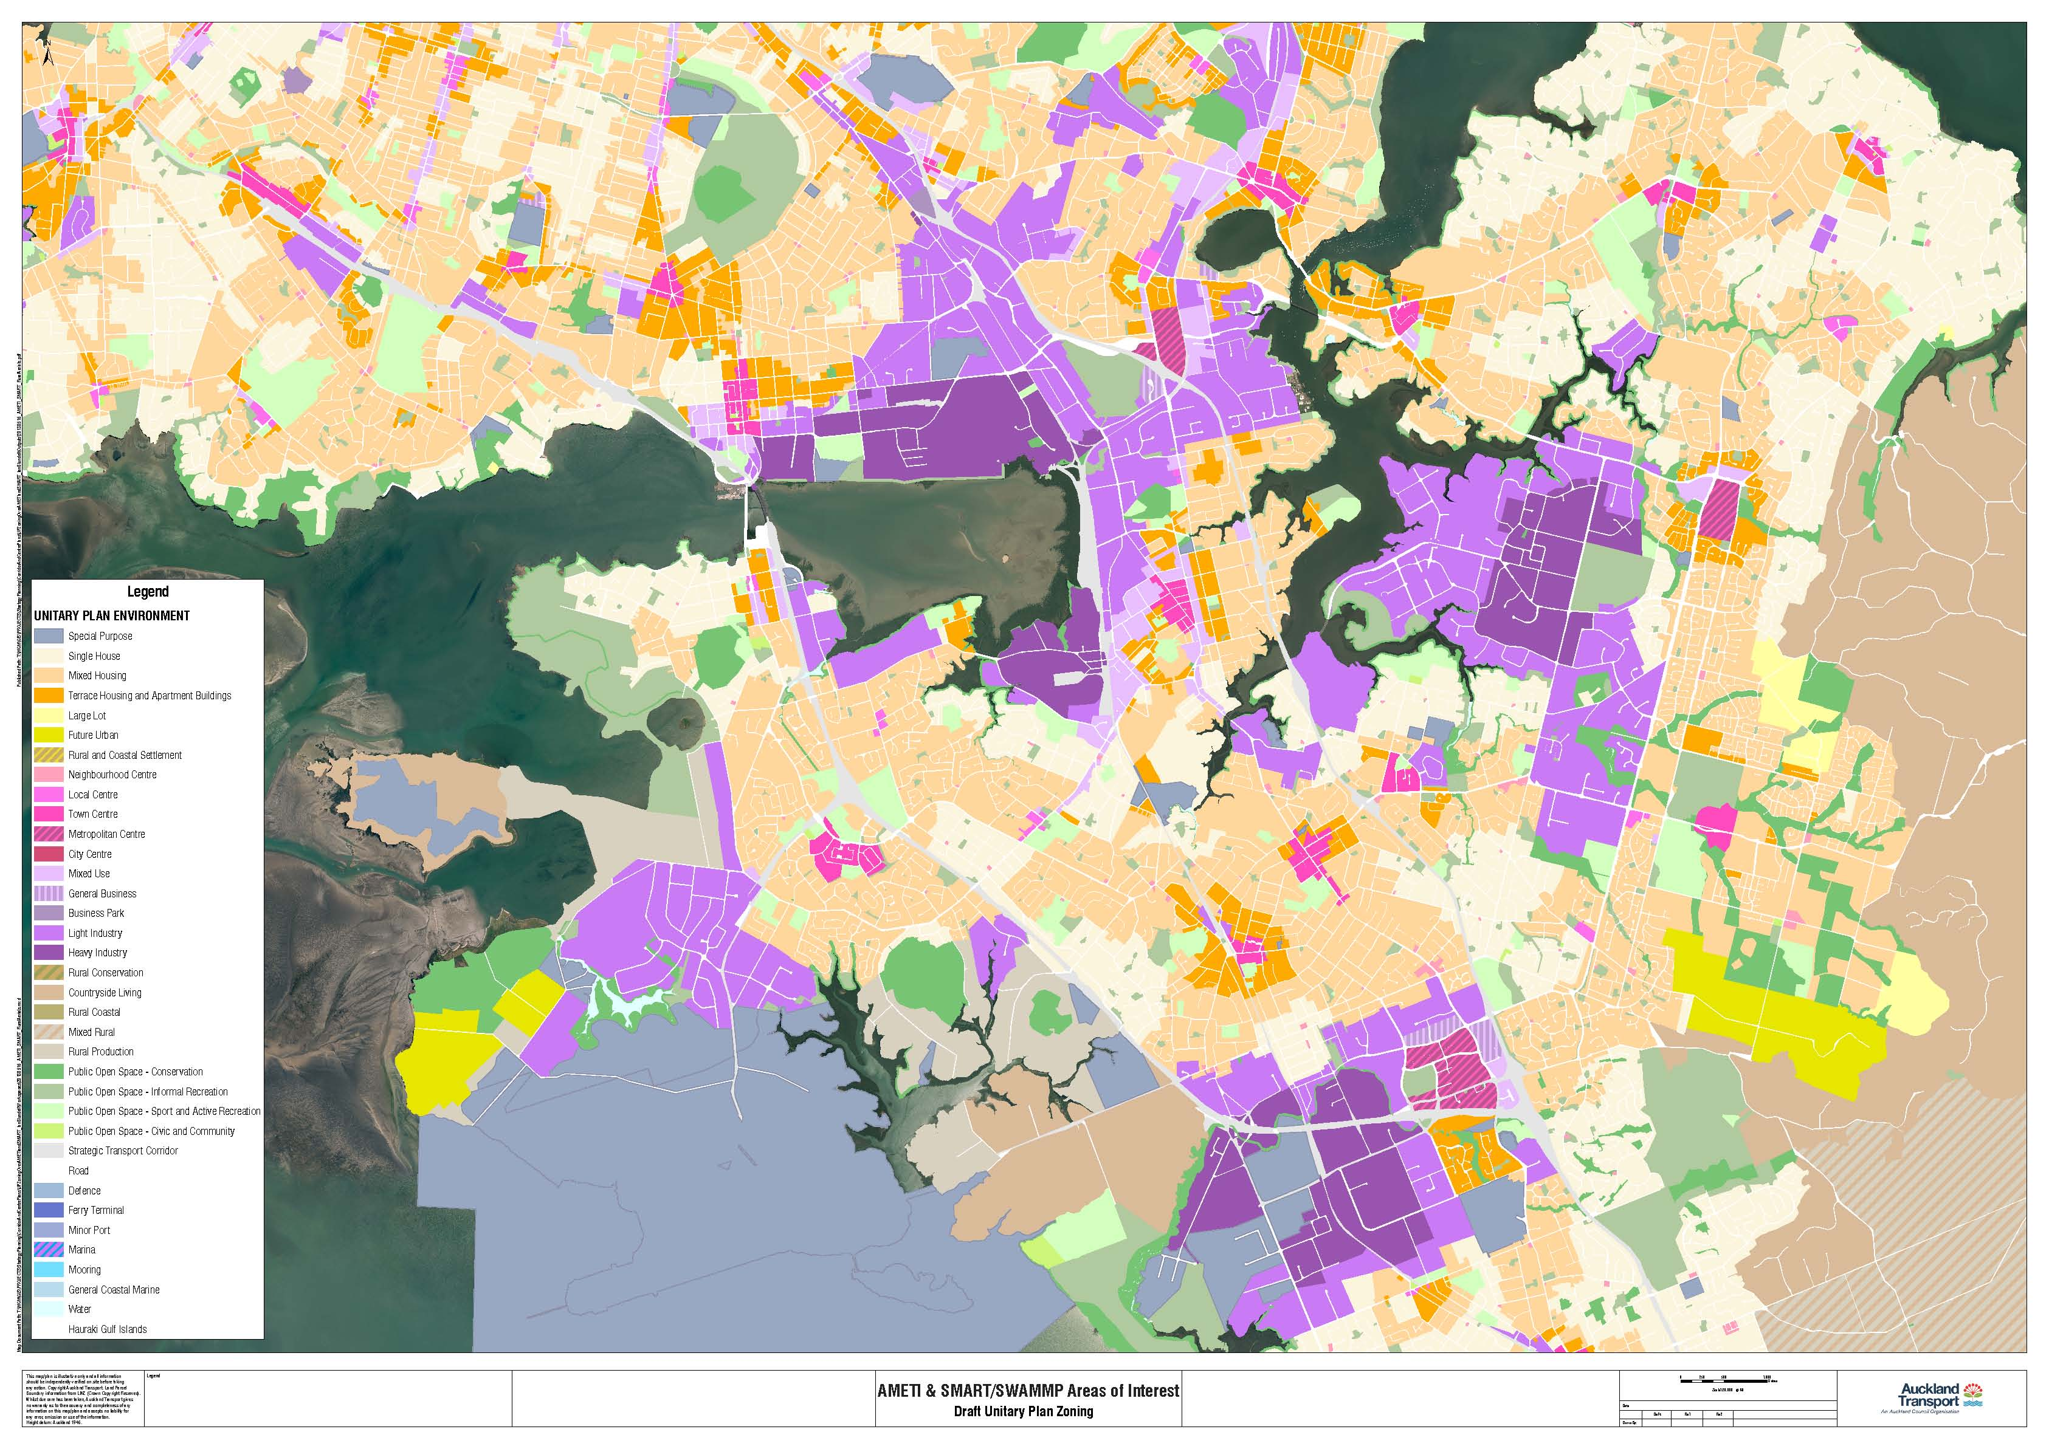

Growth of major employment areas
Recognising the importance of the area to the economy
Growth in jobs at airport, Sylvia Park, East Tamaki
Planned growth at MetroPort could see an extra 3-4000 trucks in the area
Sylvia Park
Onehunga
Highbrook & East Tamaki
Botany
Auckland Airport
Manukau CBD

Slide 3
The Issues
  Poor connections to state highways from employment areas and ports
  Poor connections between employment areas
  Over 6000 heavy freight vehicles per day travel along Neilson and Church Streets - more freight than most of the State Highways in New Zealand
  Road freight through the area is expected to increase by 60 per cent in the next 30 years
  Neilson St, the current strategic freight route, is heavily congested with 20-30% through traffic
  It also has a significant traffic safety problem with 138 crashes in four years
  A truck every 15 seconds enters the South Western Highway from Neilson Street alone
  Massey Rd heavily used by freight & through traffic, impacting on quality of residential areas and town centres

Slide 4
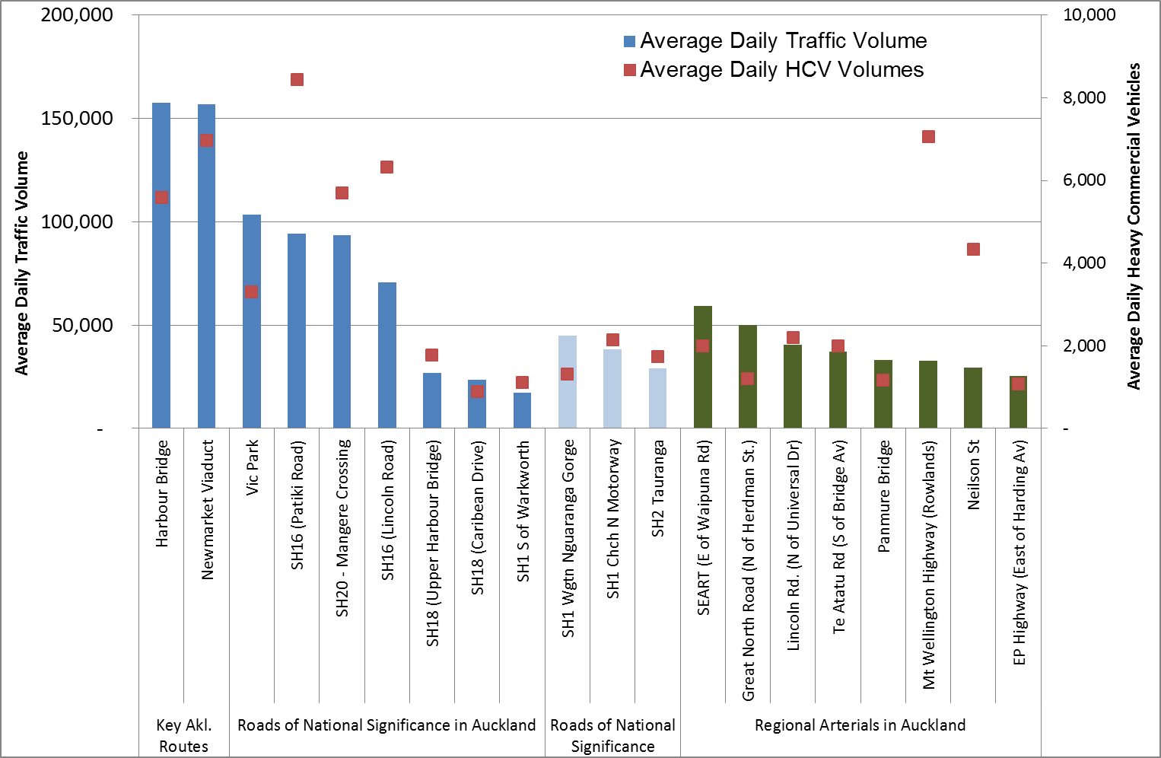
High freight volumes in study area
Neilson St (near Southdown)
Church St (Gt South Rd)
Auckland State Highways
Other
Auckland Arterial Roads

Slide 5
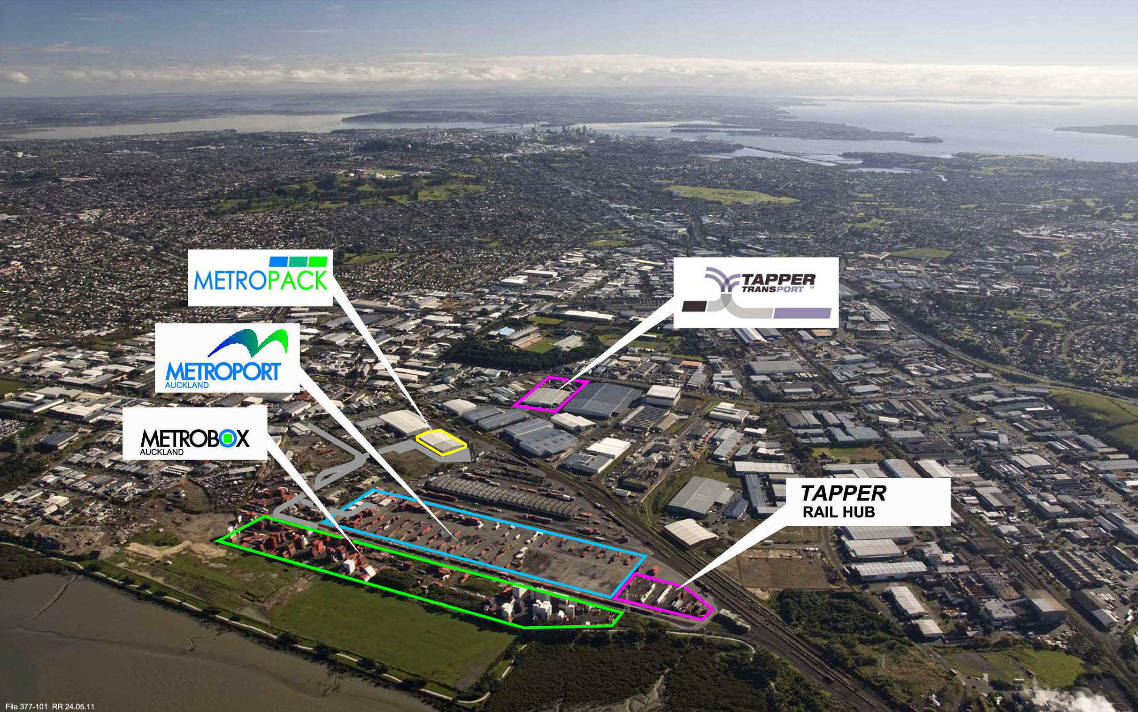
Growth at Port of Tauranga means growth at Southdown
Planned expansion: Increase from 6 currently to 15 trains per day
Additional 3-4000 trucks per day on Neilson St
Neilson/Church Street
Penrose/Onehunga

