Slide 1
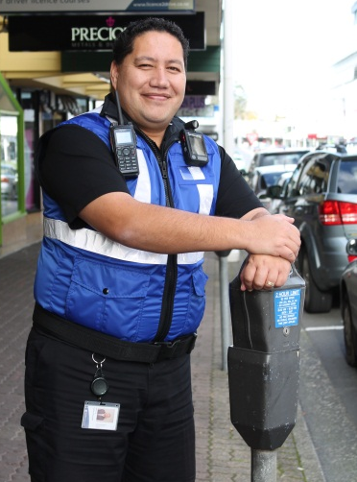
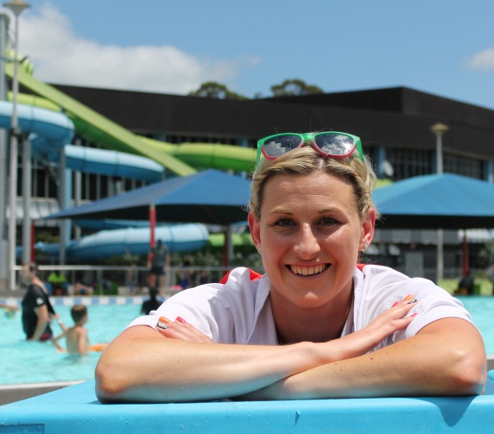
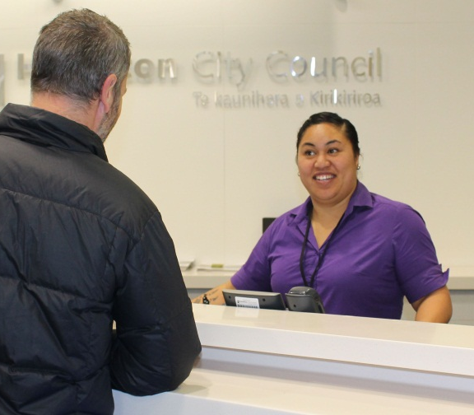
SNUG 2017 Regional Update – Hamilton City

Slide 2
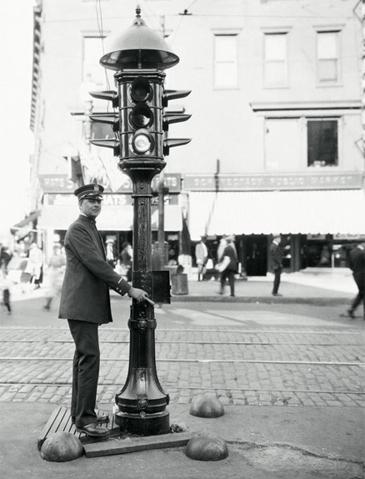
POP QUIZ!

Slide 3
POP QUIZ!

Slide 4
POP QUIZ!

Slide 5
What’s new in the Tron?

Slide 6
What’s new in the Tron?
Maintenance budget for signals

Slide 7
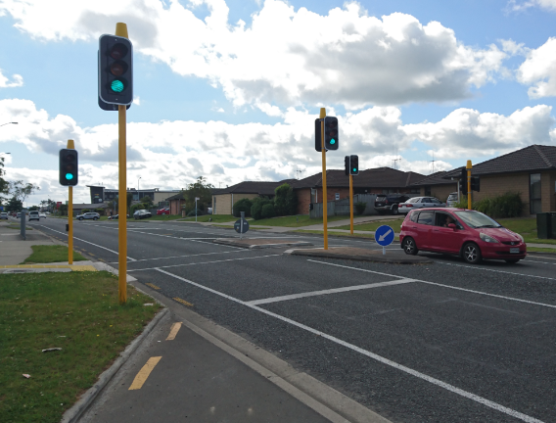
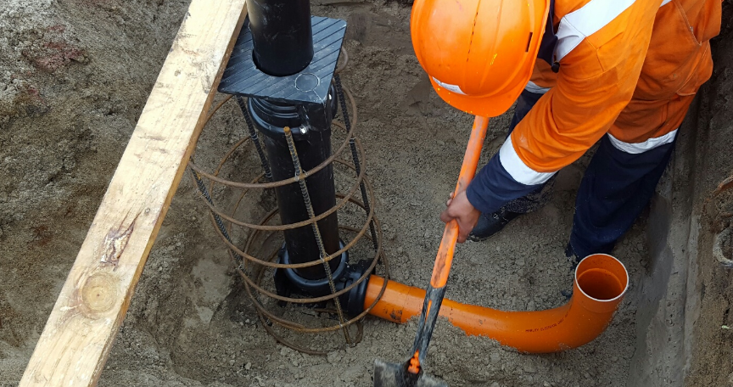
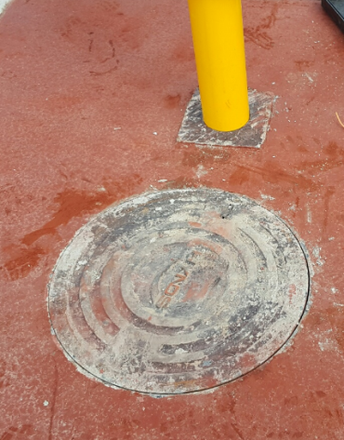
What’s new in the Tron?
100% LED lanterns
More mid-block crossings
V6 controller
Sockets for poles in medians

Slide 8
Christmas vs Safety

Slide 9
City of the future.. what’s next?
Complete communication upgrade to digital
Virtualise the SCATS server
WaiTOC ?
Business case almost complete
Building complete around August 2017
Operational 2018?

Slide 10
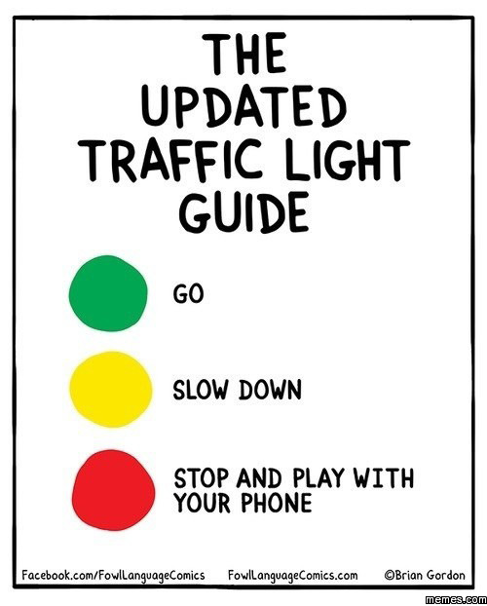
The end
John.Kinghorn@hcc.govt.nz

