Slide 2
MAIN THEMES
SMART CITIES
CONNECTIVITY AND BIG DATA
MOBILITY AS A SERVICE
AUTOMATED AND CONNECTED VEHICLES

Slide 3
THEMES
Population growth outstripping infrastructure
Freight traffic is predicted to increase by 50% by 2030
Digitalisation of societies is growing fast: intelligent mobility
Sustainability: current model not viable. Singapore 12% land use for roads
Partnering and collaboration
New players in the transport sector Mastercard, Telecoms
Behaviour change: Motivate & Incentivise don’t penalise
Mobility as a Service – MaaS
Whole new funding model and pricing schemes to be worked out
Every city/country is in the EXACT same place but driven by slightly different needs/visions/problems but similar technologies the enabler

Slide 4
Connectivity and big data – challenges in capturing, securing and connecting big data
Notes:
Data Availability – through crowd sourcing, partner data and AV, Intelligent infrastructure.
Real time data analytics – so we can move into a predictive model, always agile – learning – TESLA example
MaaS has the potential to change everything – MaaS operating system
Data rich – all kinds of data we didn’t use before for transport decisions

Slide 5
Connectivity and big data – challenges in capturing, securing and connecting big data
Notes:
Built in collaboration with MasterCard, the tool will help urban planners and commercial developers better understand the relationship between how people travel and what they buy to inform growth strategies and improve the quality of life for citizens of the world’s premier cities.
They used an example of the Light Rail Sydney Project – spending data around the project – found that it drops at the first few initial stages and then returns to normal – tie back in with Chch exmaples – economic benefits.

Slide 6
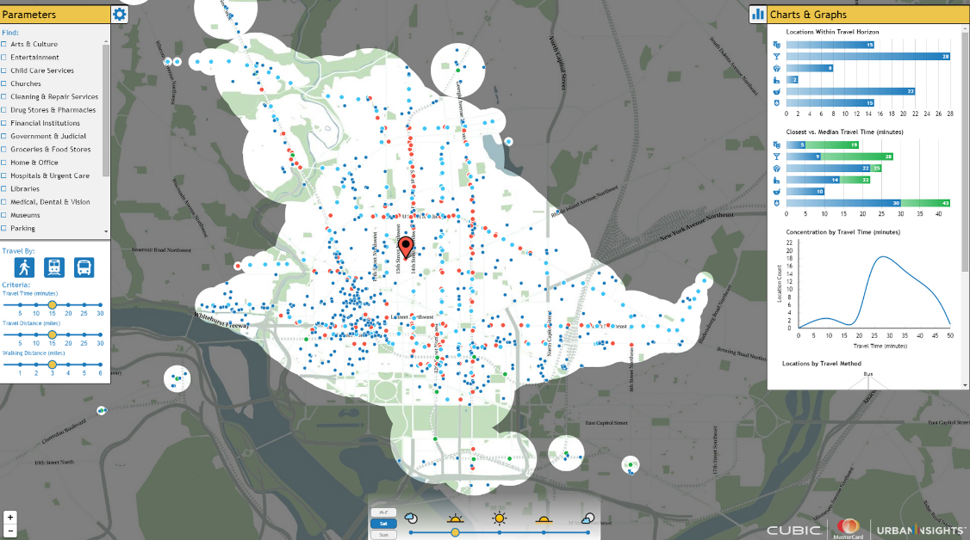
Notes:
Dashboard – analytics – how people are accessing commercial services – hospitals etc;
“By combining our respective analytics and insights, we’ll be able to deliver a more holistic, up-to-date picture of how well an urban transport network enables access to services, retailers and attractions, making life better for residents and visitors.”own travel by mode – travel time – what the weather was doing that day and what kind of commercial entities.
Cubic big transportation player and Mastercard – Washington DC – Urban insights
Pictured above is a map of Washington D.C. populated with accessible services based on individual travel preferences for a given time of day and starting location.
By combining our respective analytics and insights, we’ll be able to deliver a more holistic, up-to-date picture of how well an urban transport network enables access to services, retailers and attractions, making life better for residents and visitors.”

Slide 7
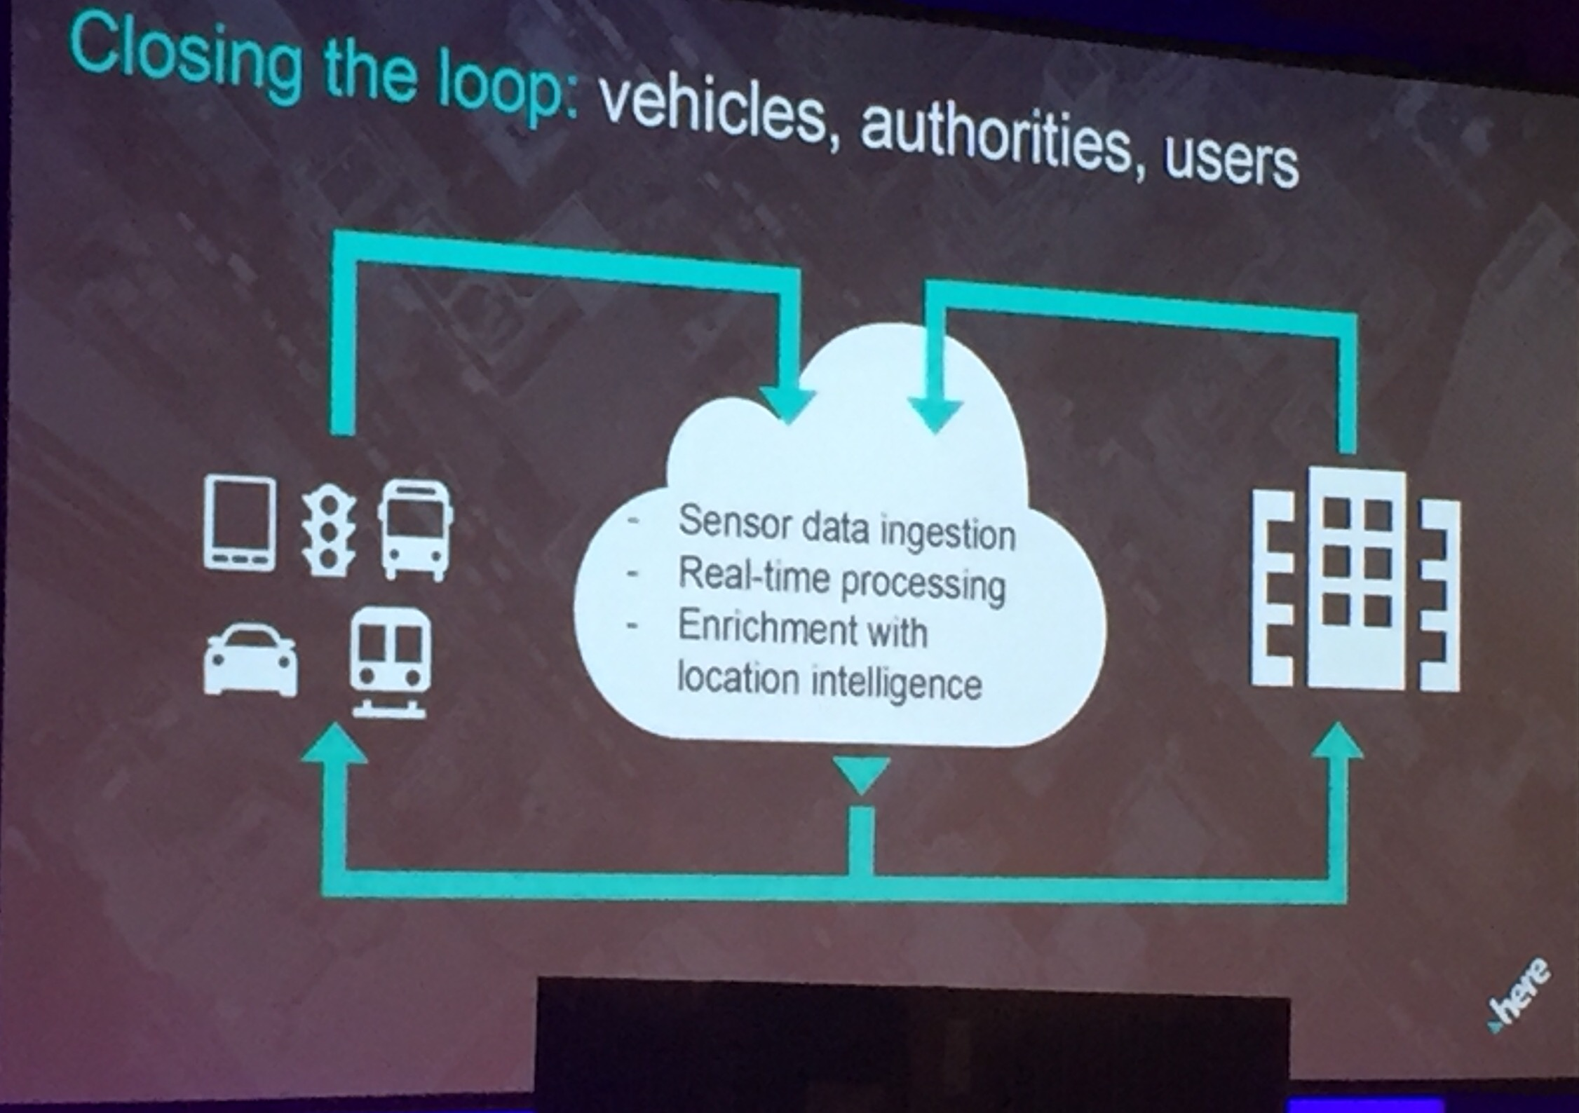
Connectivity and big data – challenges in capturing, securing and connecting big data
Conclusions
We are only getting started on unlocking the potential of data to innovate user experience and operations
Data and systems integration via open architectures will enable many new user cases
Cloud based data management is a critical
Building trust is critical to unlocking the potential
Trust around the collection of data –“big brother”

Slide 8
Mobility as a Service
New technology-enabled transport services that provide choice and on demand different modes of transport. (Private and Public)
MaaS has the potential to contribute to solving many of society's mobility problems – less cars on the road, car ownership, the need shifts from having to invest heavily in infrastructure and instead into new mobility services.
MaaS relies on a change of thinking about the whole system:
Regulation v deregulation
Private sector thinking and its business models v public transport provision
MaaS impacts on land-use planning
Behavioural change (its about me/us/you)

Slide 9
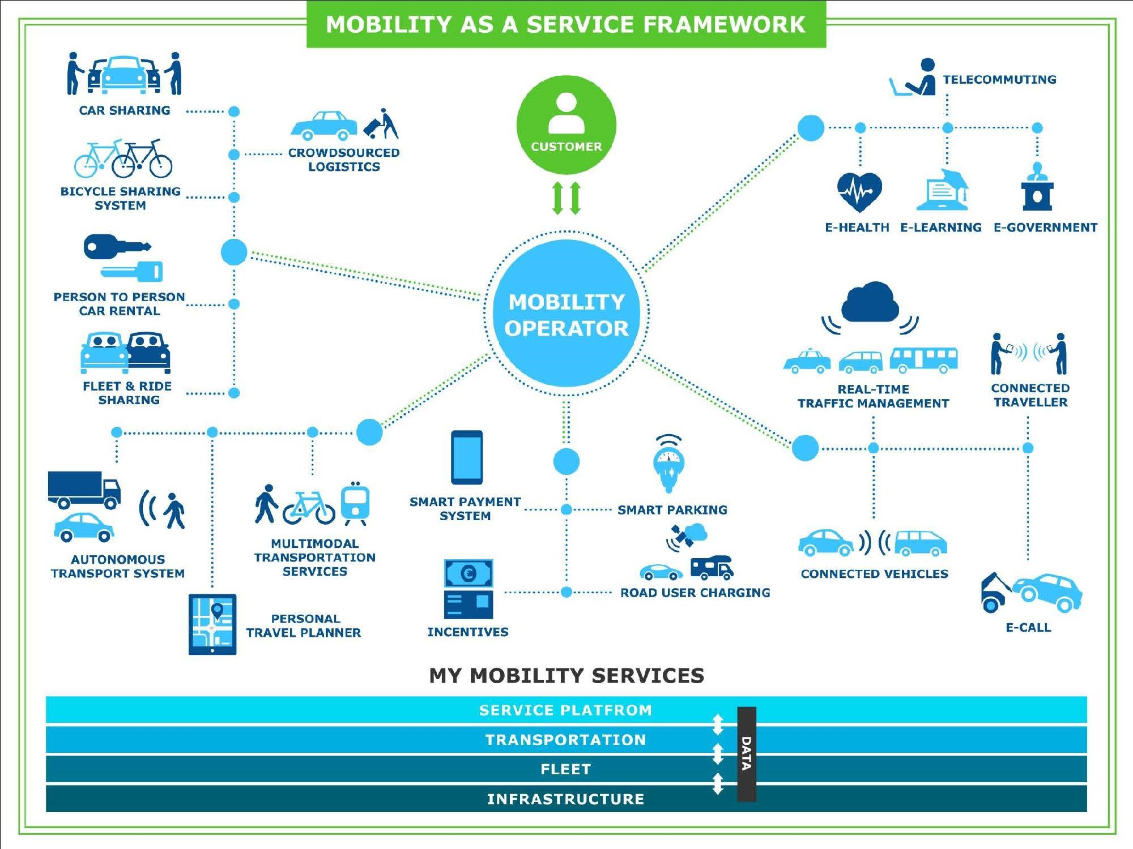

Slide 10
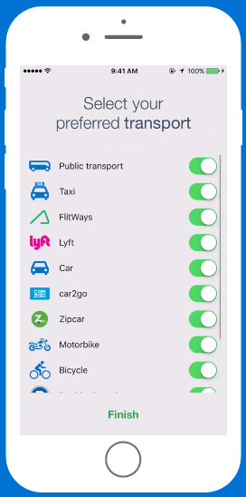
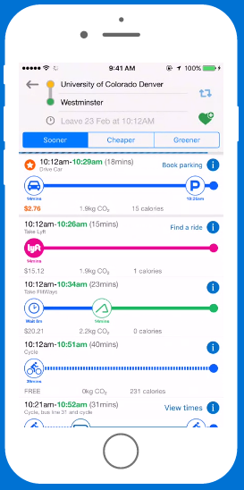
MaaS Example: godenverapp.com
DENVER Example
Single Account/Ticket platform
Single Back end for all Operators - Open Payment System
Anyone can become a transport operator – same access to all customers
Equitable for commuters and operators
Trip Planning
Incentives for alternate modes

Slide 11
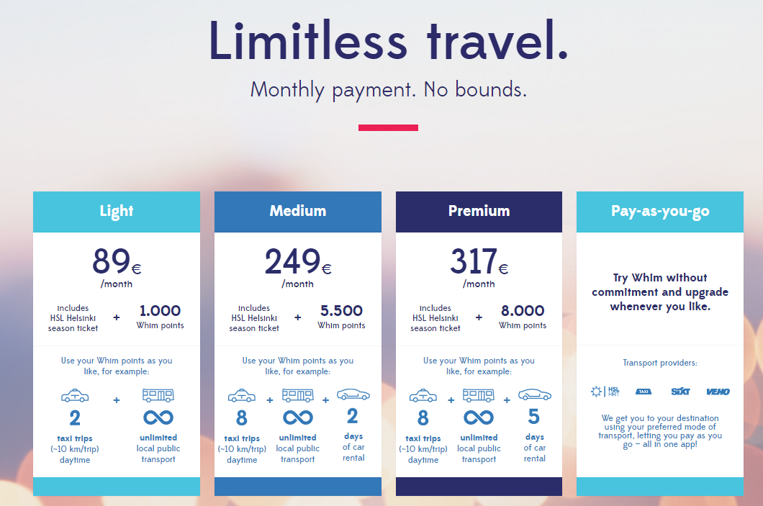
Finland MaaS Funding example: whimapp.com

Slide 12
Real time Optimisation of the whole system

Slide 13
Traveller Information Themes
Big Data – using data to utilise Travel Information – part of the eco systems with other data (Weather/GPS).
Crowd Sourcing – WAZE/Google/NZTA example/Connected Citizens Program

Slide 14
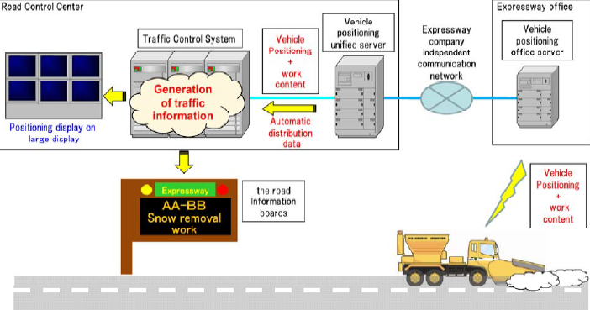
GPS Sensor Data – Cars become the sensors
Using GPS location tracking like public transport operations provides weather road trucks as sensors that interact with infrastructure to provide Traveller information to Variable Messaging signs on the highways. (Japan)

Slide 15
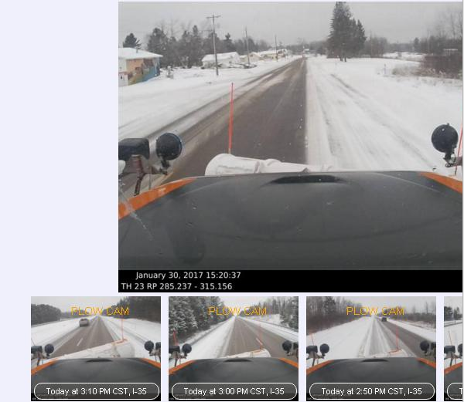
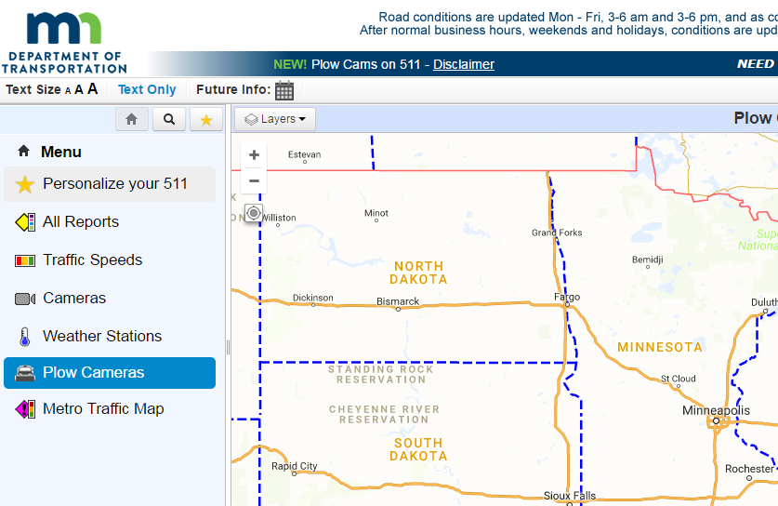
Plow Cams – Minnesota DoT
Live cameras in snow storms complimenting forecasted weather conditions – seeing is believing.

Slide 16
Crowd Sourcing – Winter trial NZ Transport Agency
Trial completed in Queenstown over winter and then the next year over the South Island in conjunction with NZ Transport Agency (one-network)
Regional council verifies reports
Public road reporter function
Conclusion - value in combining crowd sourcing with RCA website becoming a single source of truth.

Slide 17
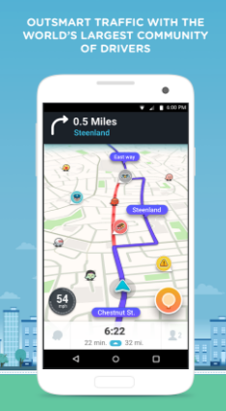
Crowd Sourcing – People are the answer
Waze
Connected Citizens program
Two-way exchange of data
Community driven – takes away authority
Gain insights into frequent locations/incidents to
drive smarter planning.
Reroutes users (using Google maps)
Requires numbers of users to be effective
Notes:
Know what’s happening on your roads
Partners receive real-time incident information faster than other reporting methods
Increase the efficiency of incident response
Waze accurately pinpoints and verifies where incidents occur, creating faster response and clearing times
Reduce traffic congestion in your area
Reroute Waze users around road closures and incidents in real time
Make data-driven infrastructure decisions
Gain insights into locations with frequent congestion or hazards to drive smarter urban planning
Benefits:
To Wazers: The Waze map evolves with every driver and data point added. CCP yields more data, giving Wazers a greater ability to circumvent road closures and traffic jams.
To CCP Partners: Partners receive real-time incident information faster than other reporting methods.
Incident verification: Waze accurately pinpoints and verifies where incidents occur, creating faster response and clearing times and potentially saving lives.
Infrastructure planning: Insights into locations with frequent congestion or hazards yields smarter urban planning.
Bridging connections with other partners: Waze gathers partners via in-person summits and an online forum to discuss case studies and exchange ideas to further impact communities globally.
Streamlining data inputs: Partners can utilize data standards designed by Waze for closure and incident reporting to reduce data fragmentation and promote transport and government data aggregation.

Slide 18
What is next?
NZ Transport Agency Connected Journeys Program
Deliver MaaS
Innovation Hub
Digital Transport Systems
Notes:
There is a growing international consensus that transport is on the cusp of disruptive change driven by new technology. However, the timing and detailed impacts of these technologies are very uncertain
Given a high degree of uncertainty and the scale of potential impacts of emerging transport technologies, a flexible approach to infrastructure planning and funding decisions is crucial however what is certain in that there is a degree of preparation and implementation required now to take full advantage of the current transport infrastructure as well ensuring delivery of any future technologies.
The publication of ATAP outlines what the future needs to look like the next exciting challenge is to rise to the challenge to deliver the network outcomes we need going forward to support Auckland and New Zealand’s economic growth.

Slide 19
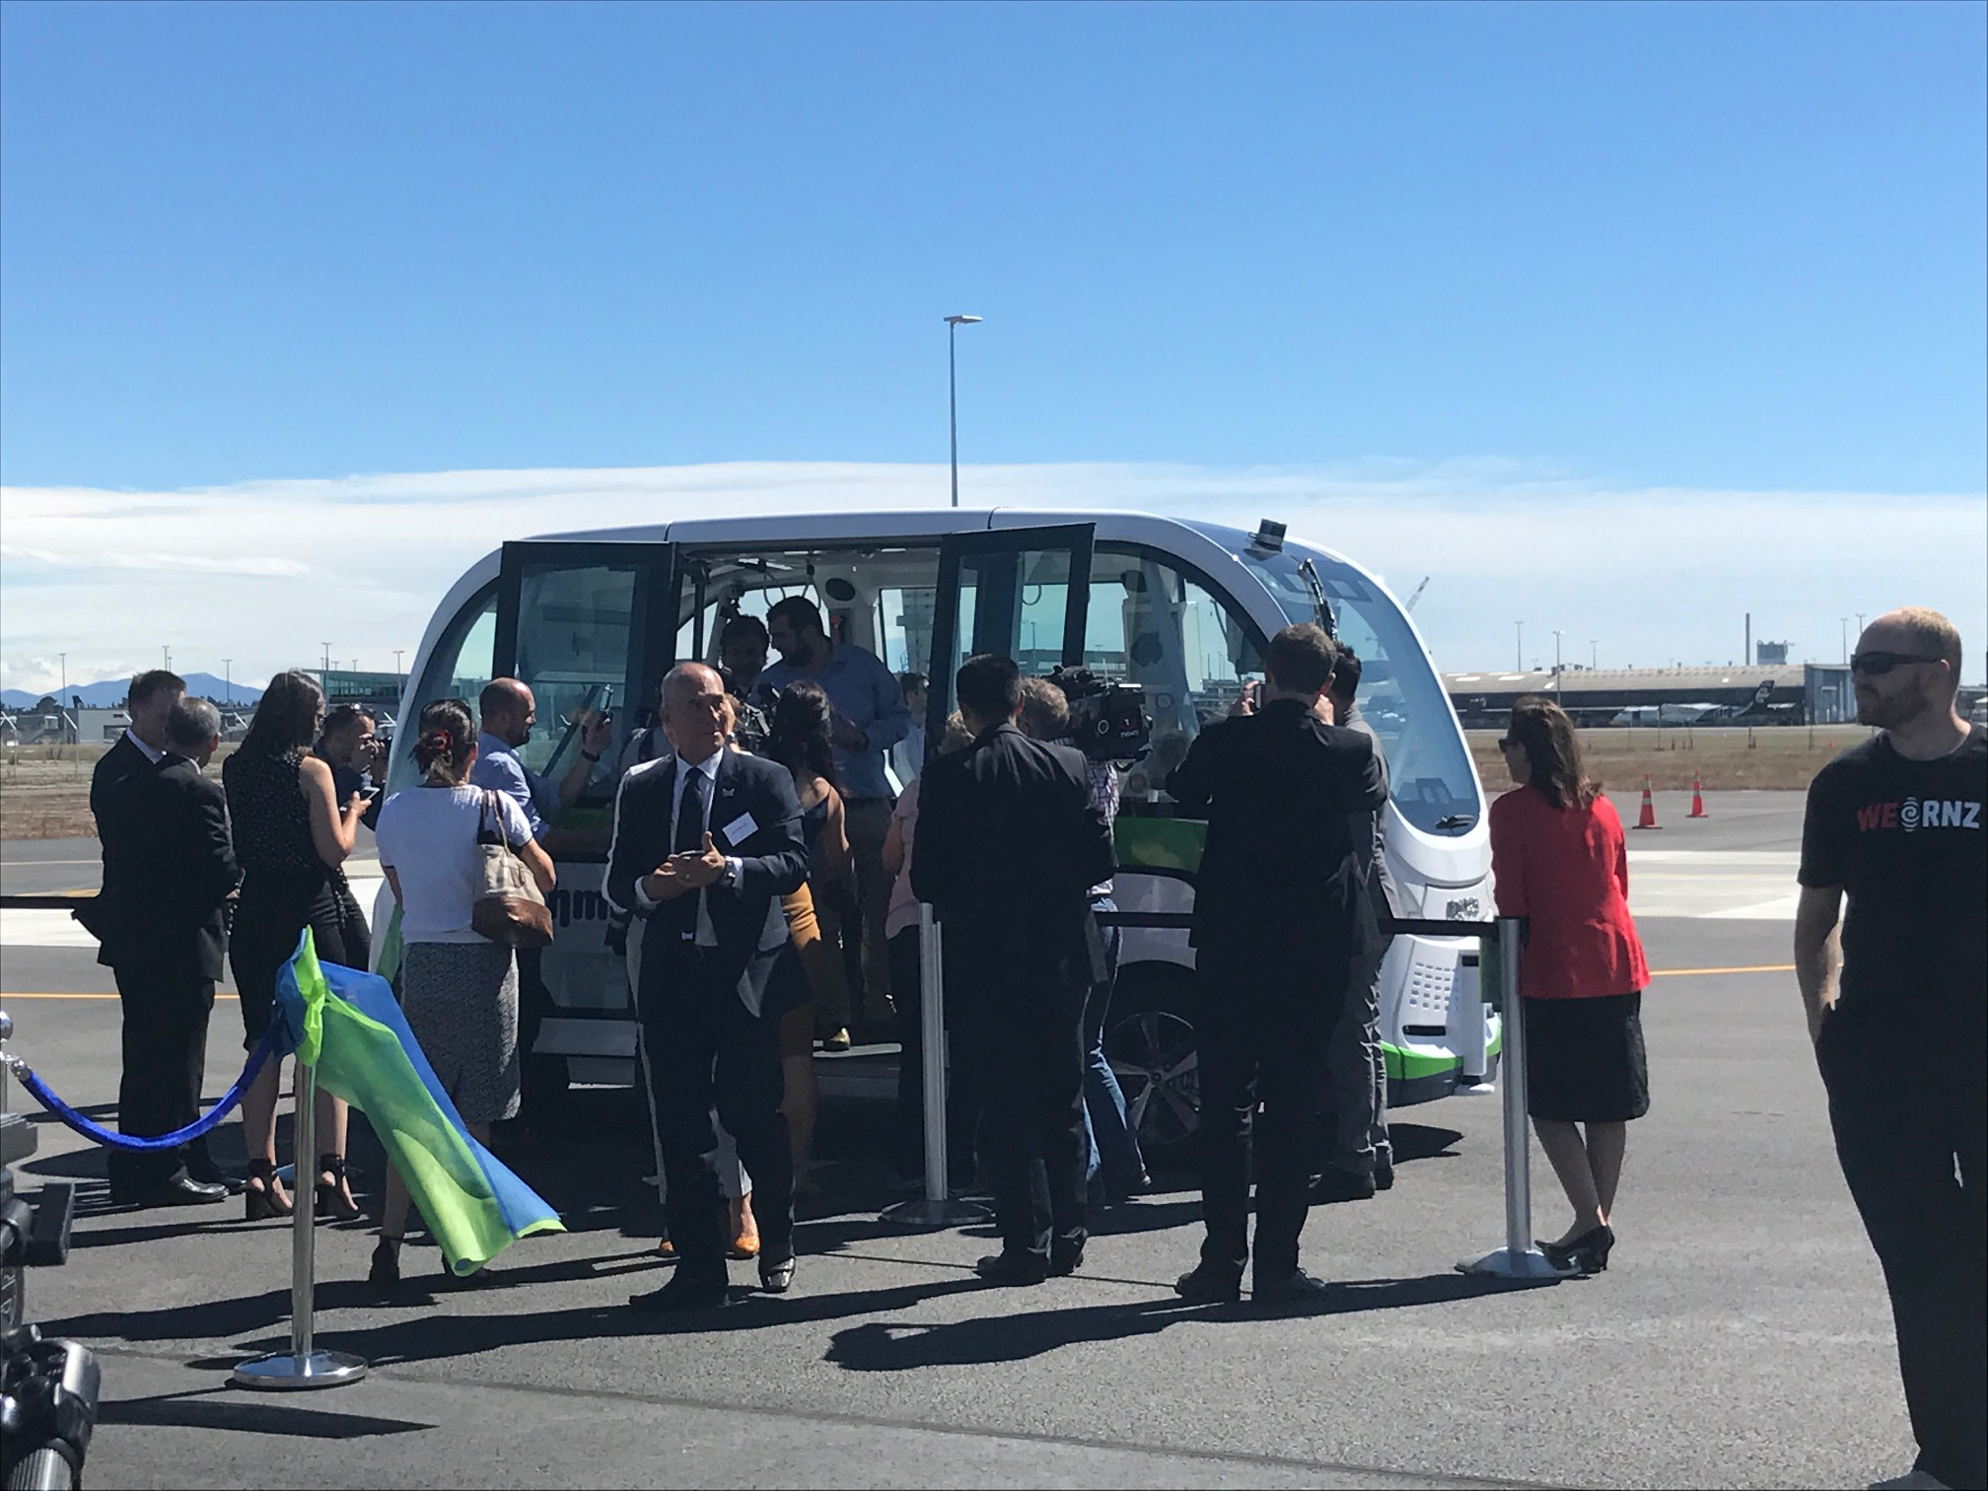
Autonomous Vehicle Trial Christchurch

