Slide 1
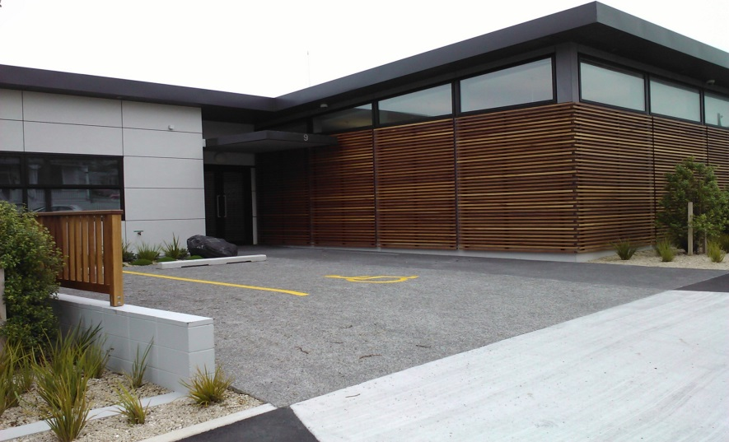
WTOC
WTOC (Signals)
5 SCATS Operators
Monitoring 6am-8pm
7 days a week
SCATS version 6.9.3
Pic of area
Currently look after 98 intersections on our SCATS server but monitor more on other councils servers as well.
Partnered with local councils to undertake operation of all signals under ‘one network’ and for NZTA maintenance and renewals.

Slide 2
Combining SCATS
We have now combined SCATS system with the following areas and also assist Dunedin who retain there own SCATS system.
NZTA
New Plymouth
Wanganui
Kapiti
The Hutt’s
Porirua
Richmond
Kaikorua
Queenstown
+ Dunedin
+various one way bridges

Slide 3
New Plymouth
Fusion lines back to TOC
7 New cameras installed late last year
Monitoring 6am-8pm
11 Cameras now in total
Vickers to City Project now finished

Slide 4
Mckays to Peka Peka ( M2PP )
18km of new state highway
18 new bridges
2 new signalized interchanges
9 CCTV cameras
10 new VMS
Opening TODAY !

Slide 5
SMART Motorway

Slide 6
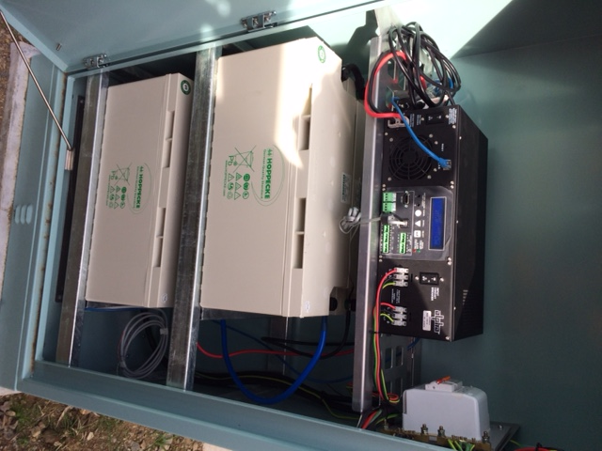
UPS
Smoothing of power supply
Notification through SCATS MMS
IP address interrogation
Uninterrupted service

Slide 7
UPS
Services continued though and after the November earthquake thanks to UPS.

Slide 8
Kaikoura SH1
Signalized section of SH1 south of Kaikoura
About 1.25 Km long stretch
Huge effort by contractors to install in short time frame
4 PTZ cameras and 1 fixed camera
Slip monitoring as well

Slide 9
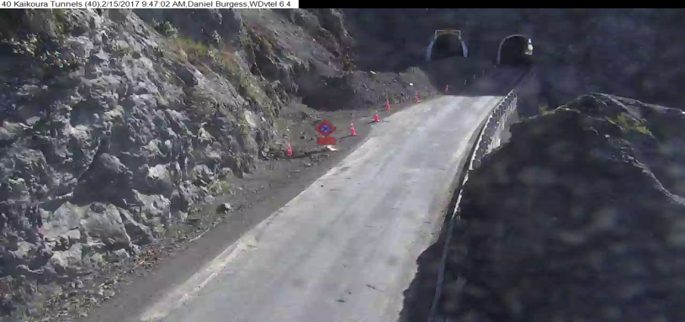
Kaikoura SH1

Slide 10
Future
Ramp signals maybe
Ongoing support of local councils
Continued emphasise on the one network approach.

Slide 11
Wellington City Council traffic operations Update
SNUG CONFERENCE
2016 - 2017

Slide 12
Have now completed the LED Vehicle Module upgrades.
SCATS & CCTV Traffic Camera network now managed by Fusion.
Implementation of new Asset Management System to Manage Traffic Signals, CCTV Equipment and Electronic Signs. This is a joint venture with WTOC.
Assisting with new cycle-way improvements throughout the City.
Assisting with new Double Decker Bus Routes in the CBD.
Installed more Pedestrian Countdown timers in CBD, has been well received by the pedestrian public.

Slide 13
Completed the SCATS communication upgrade transferring the analogue sites to the Fusion digital network.
SCATS Communication, upgraded Serial to Ethernet Connector Eltima to version 7.1.
Working on Plan for improved CCTV camera coverage.
On-track with implementing the capital works program in accordance with WCC’s Asset Management Plan.

Slide 14
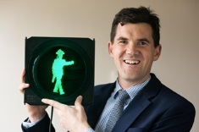
Installed two more alternative Green Pedestrian Displays
No adverse comments,
No signal display misunderstanding
No reported incidents at the Intersections.

Slide 15
Mast-Arm pole Failure Dec 2016.

Slide 16
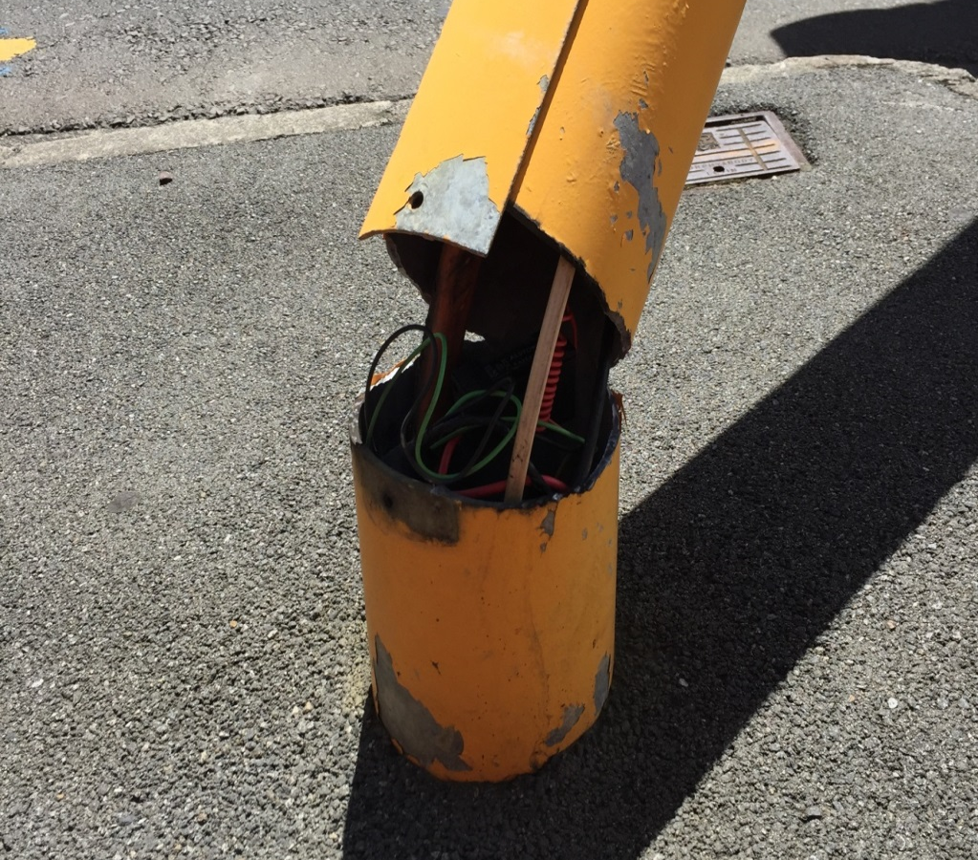
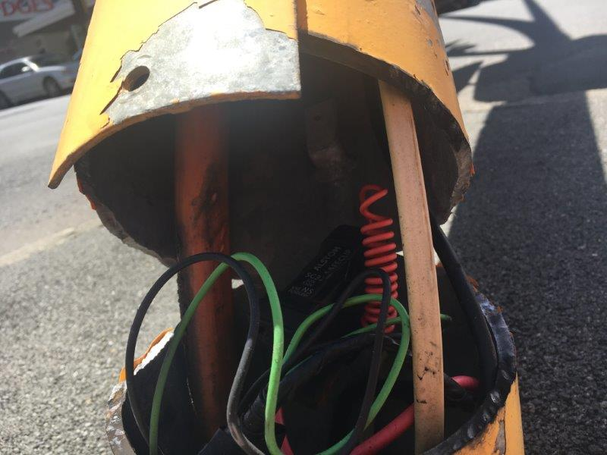
Pole Fracture point at the bottom corners of the inspection cut out.

Slide 18
Pole Failure Learnings.
Insure PS1 and PS3 documentation is provided for each pole with design assumptions:-
Wind loading
Design life
Attachments
Design Sail area.
Identification plate installed on each pole which also outlines the permissible Attachments.
Don’t Assume the Contractor has completed all the requirements of the contract until you have received all the documentation.
Contractor will be required to remove cover plate of the inspection opening to check for cracking.
Design life of mast-arm poles revaluated for the future replacement program

Slide 19
Increased Traffic Management Post Earthquake.
Road and Lane Closures To Facilitate Building Demolition.

