Slide 1
ITS World Congress
Some Insights

Slide 2
Congress Key Themes
Connected & Autonomous Vehicles
Big Open Data
Smart Cities
Mobility As A Service
Personalisation of Data
Notes:
CAV: they spent a lot of time differentiating the two. CVs are everywhere and there were examples of I2V like vehicle dashboard countdown to green. AVs still a while a way.
Big Open Data: The sheer volume of data is overwhelming everyone and better methods are required to choose what data to keep and what to ignore. There are also issues with open data being unreliable. They also talked about how much data is siloed and but could be useful to all areas. Big data is important, but Big understanding is more important. 90% of the data now existing was created in the last 2 years. People are ambivalent about their data privacy. SCATS collects lots of useful information but it isn’t easily accessible by ourselves or third parties.
Smart cities is basically looking at different ways cities collect, use and distribute various data sets to improve their services to the public.
MAAS: Talking about focusing on the person and their end to end journey, getting them where they need to go using any combination of private and public transport in a seamless manner. This is what people want and the challenge is how do we keep moving in that direction.
Personalisation of Data was another key topic. People only care about data that is revelant to them. They don’t care about data that means nothing to them and doesn’t help them. It goes back to how we share data and what type of data we share and who we share it with.

Slide 3
Trends
Aging populations
More people living in cities
Climate Change
Energy Demand
Connectivity
Notes:
Bosch. 15% decline in traffic accident casualties worldwide.

Slide 4
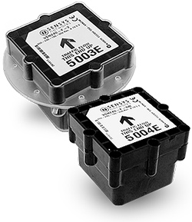
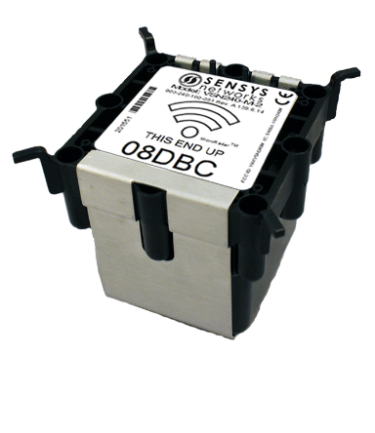
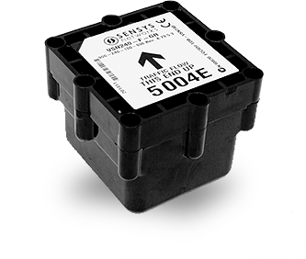
Various Sensors
Notes:
There were plenty of groups selling their various sensors, but I thought to highlight these. I’m not sure if anyone has tried these sensors in NZ, but a company called sensys networks was promoting these magnetometer and radar devices for vehicle and cyclist detection. I thought it was interesting as these devices don’t have wires and the magnetometer sensors can be placed up to 10cm underground.

Slide 5
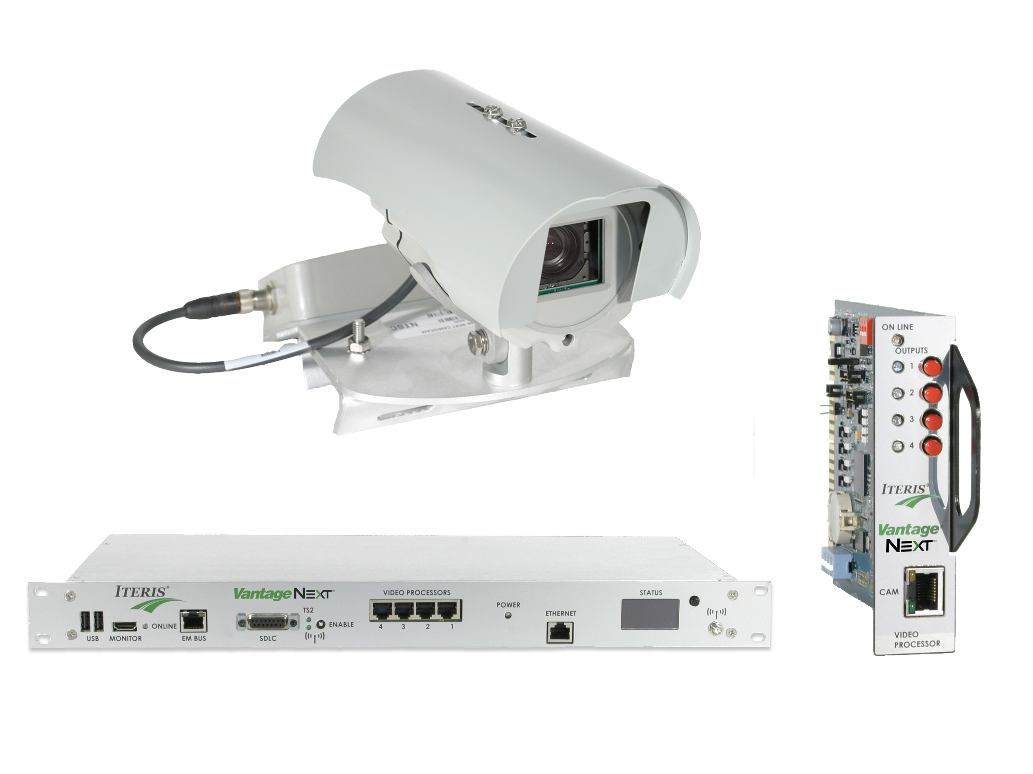
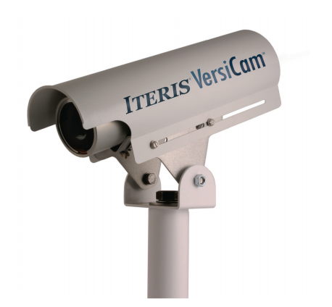
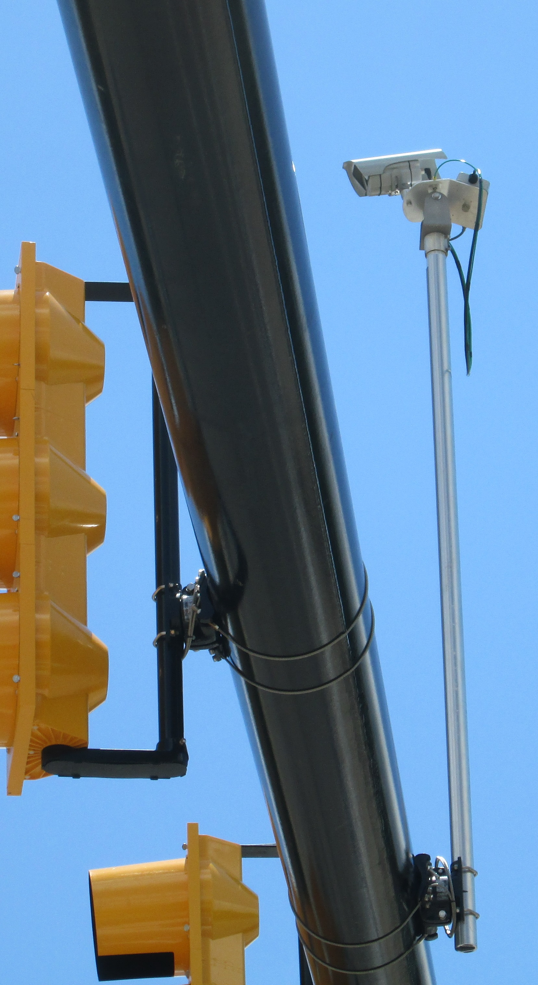
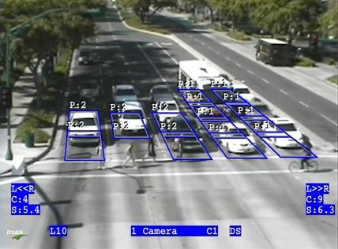
Notes:
Again this is not a new device, its been around a few years, but this company iteris has enhanced their video analytics so they can upgrade their camera software remotely and they have recently added in pedestrian counting functions. I think the system isn’t completely accurate and does undercount but I thought it was an interesting feature and it tells you which direction they were going as well. I know that the Flir cameras we have used have similar features, but I haven’t seen them count pedestrians in this manner which I thought was interesting.

Slide 6
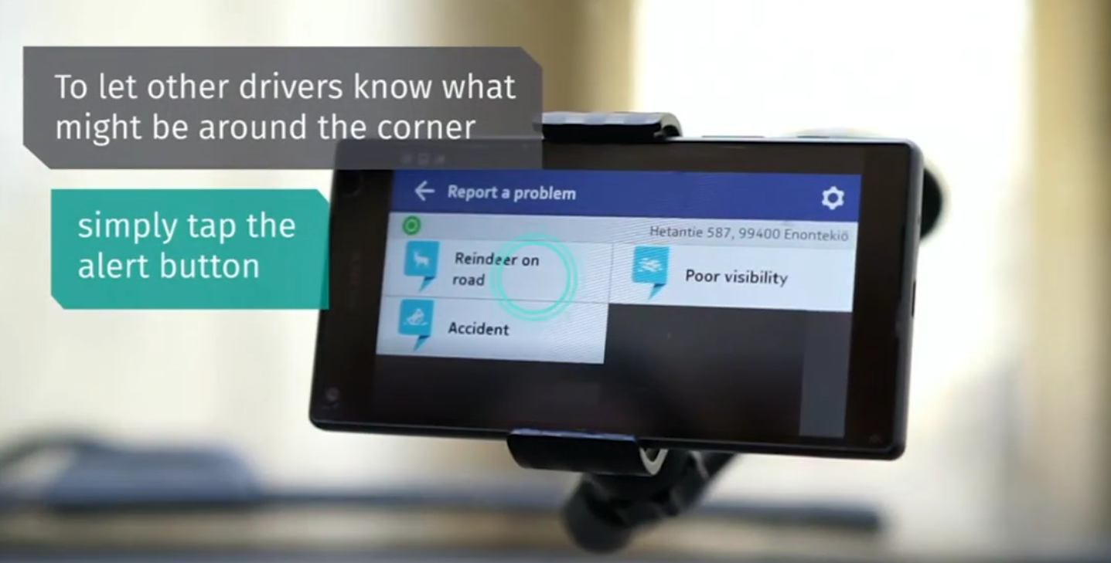
Notes:
So many presentations on aps. An ap from japan telling drivers to speed up or slow down to optimise traffic flow. This ap shown here is from Finland used in the far north where they have reindeer running all over the road and they have several thousand reindeer hit every year. This is connected to a GPS mapping system that allows drivers to report deer on the road so that other drivers can be aware as they approach. It is very popular and a successful ap. I think something similar could be useful to report potholes or ice on the road other issues. They emphasised the importance of creating safe apps that aren’t a distraction.

Slide 7
Notes:
An ap from Australia advising drivers on the speed limit on the road they are in. Based on consumer trends, we are entering a post ap world. There is a decline in the number of new aps being downloaded. Retention of new aps is being minimised. People are moving to fewer apps. People can order uber from facebook without using the uber ap. People are spending more time on fewer social media platforms. Personalisation of data and communication is important. Using Machine learning.

Slide 8
Xerox Vehicle Occupancy
Notes:
95% Accuracy rates. Trial in France

Slide 9
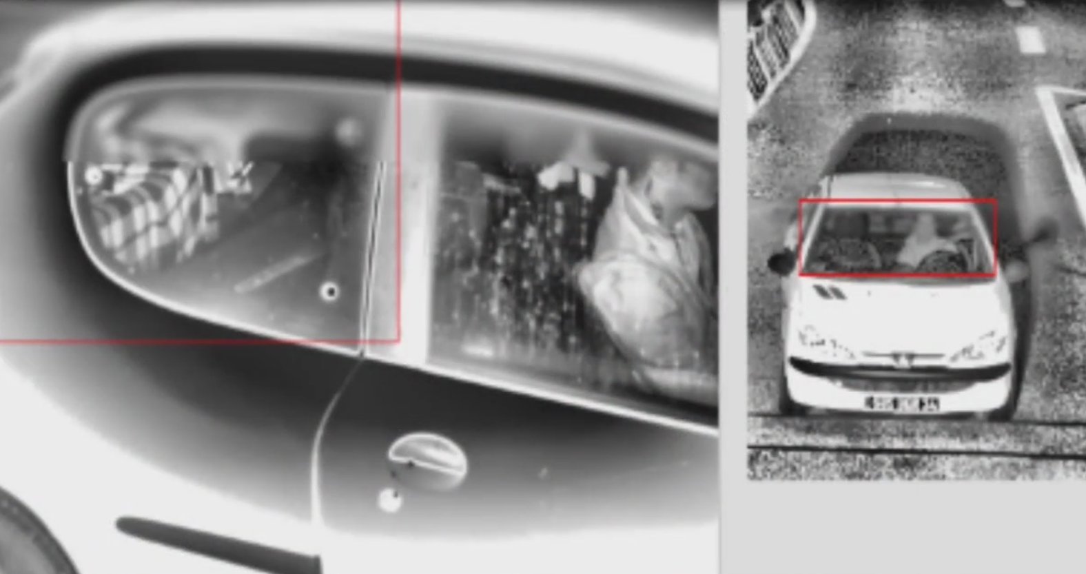

Slide 10
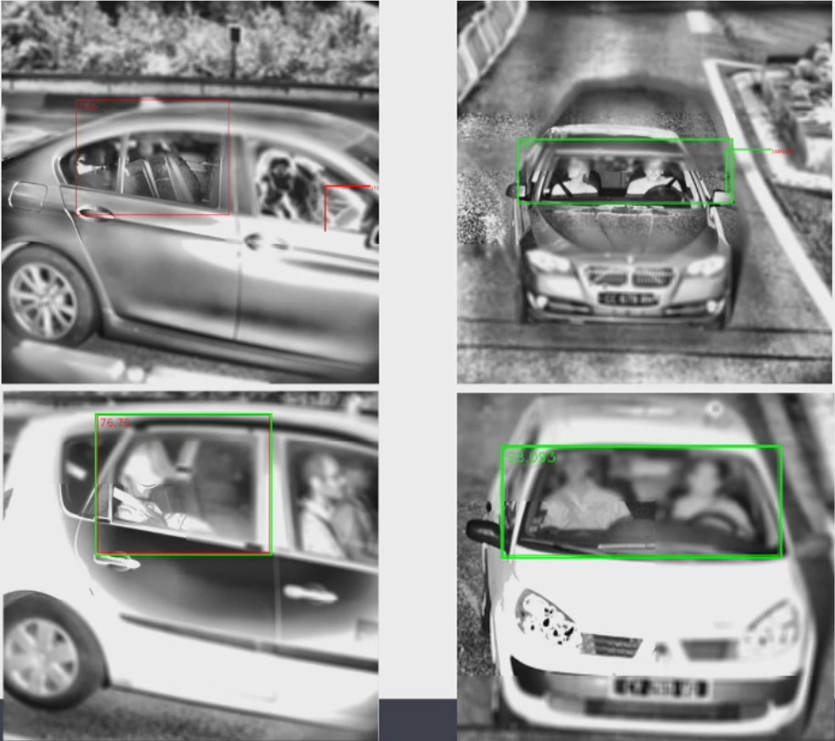

Slide 11
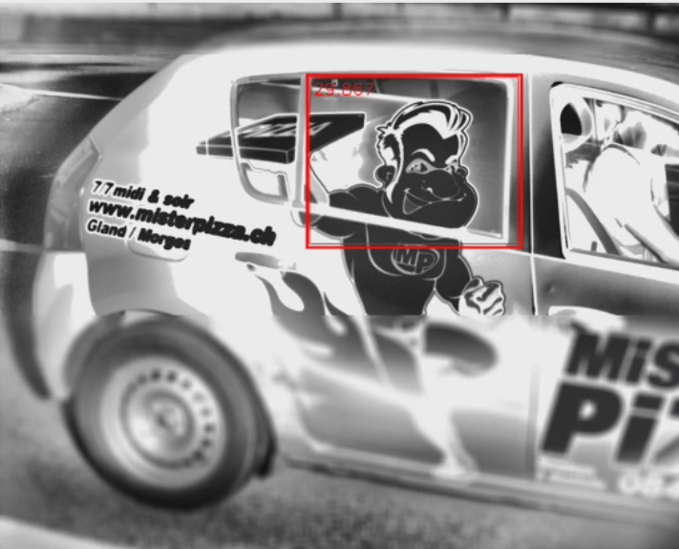

Slide 12
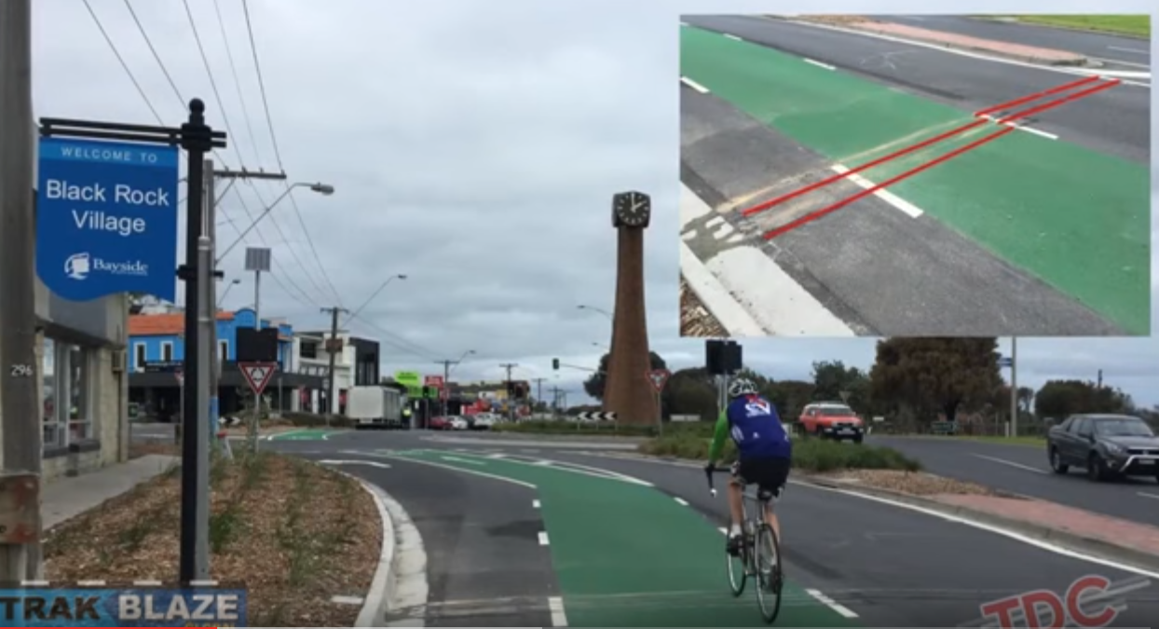
Notes:
Piezo electric system

Slide 13
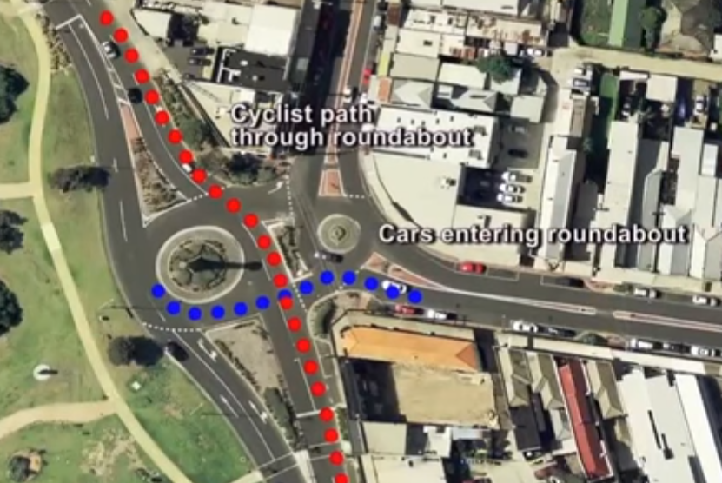

Slide 14
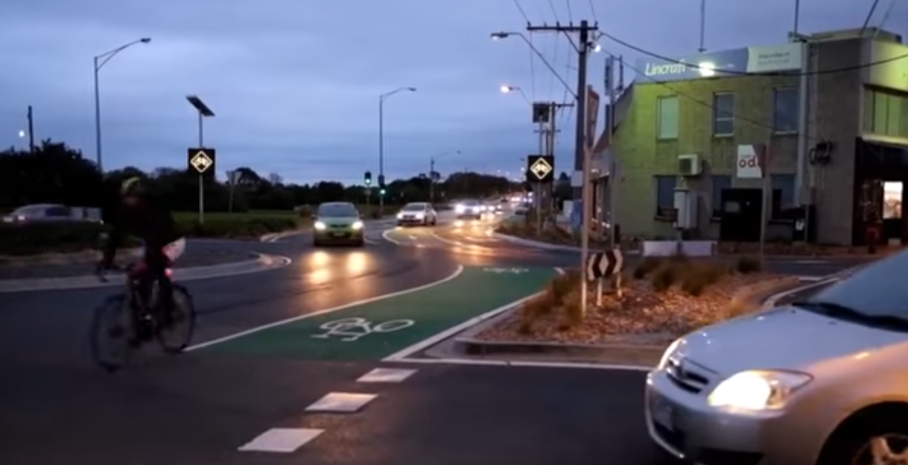
Notes:
https://www.youtube.com/watch?v=gH0--NtTrg8

Slide 16
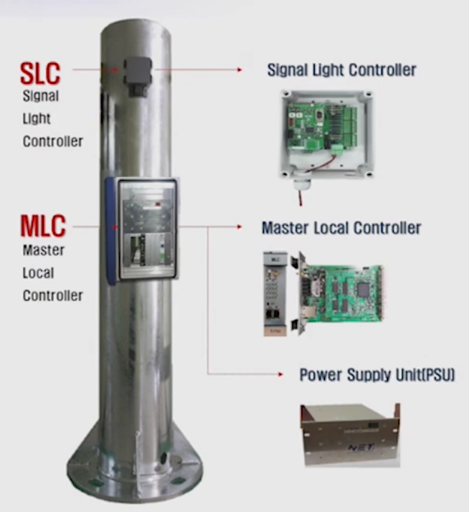
Notes:
Korea is developing their next 4th generation of traffic controllers that use digital communications to turn lamps on and off. They are also developing security protocols for 4g connections to controllers.

Slide 17
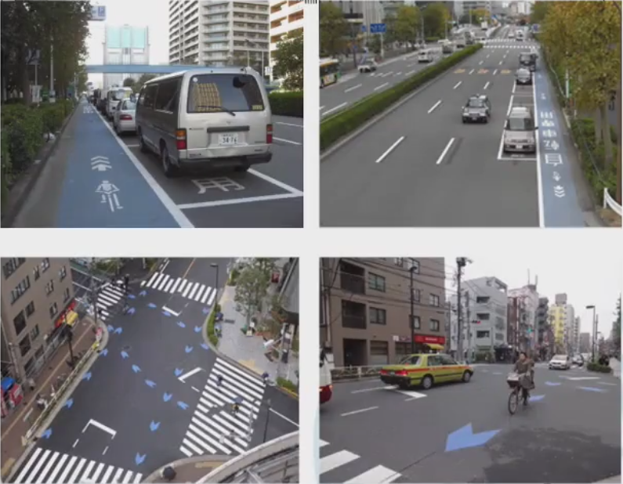
Notes:
Guide arrows for cyclists. They had some success in reducing cycle accidents.

Slide 18
Notes:
This isn’t a new idea, but I thought it was interesting. Japan has lots of hills and vehicles slow down going up hill so they use synchronised lights moving at a set speed to get cars to speed up or slow down as needed. They apparently had good results with the system increasing throughput through a tunnel.

Slide 19
Notes:
Really interesting theoretical discussion from Japan. Dramatic increase in capacity at an intersection.
Of course it is a model and theory only and may not be practical in the real world. I just thought it was an interesting idea.
No more green band coordination system.

Slide 20
Notes:
Theoretically best at peak time ,but not off peak. The models suggest you can decrease the cycle time and increase capacity at the same time.

Slide 21
Notes:
Monash University doing research into level crossing closure time prediction to give info to road users on the delay estimates. Alexa.delbosc@monash.edu monash ITS linkedin

