Slide 1
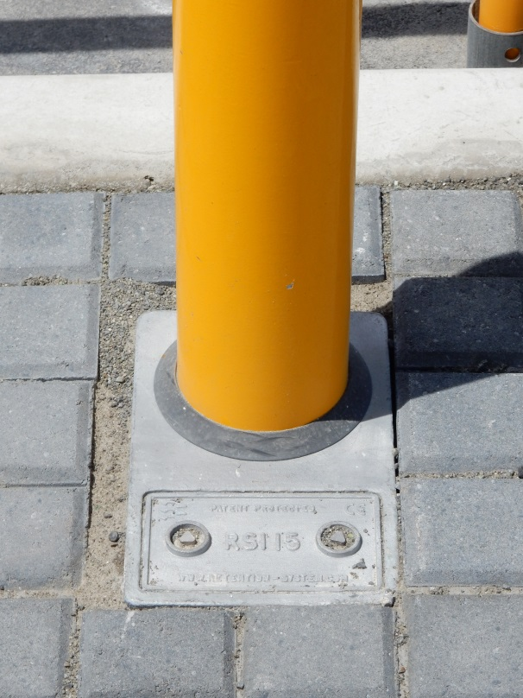
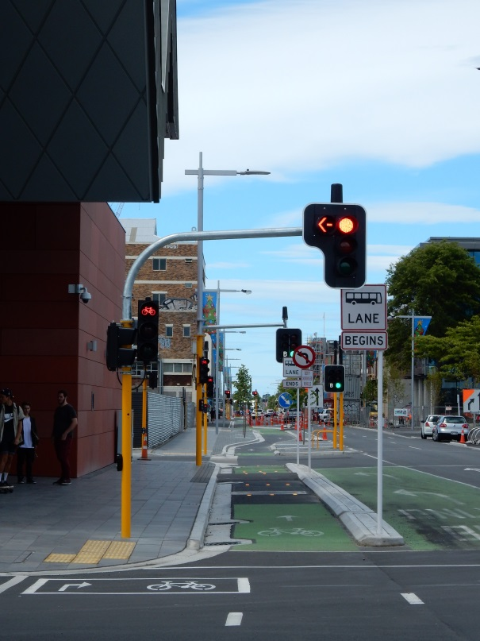
Pole Design, Fatigue & P43
What does P43 mean for Traffic Pole design moving forward?
What do we do with our aging Traffic Poles

Slide 2
Pole Design & P43
PS1 Producer Statements need
to be specific, based on correct information & current.
A PS1 isn’t a Silver Bullet if the design basis is incorrect.
PS1 calculations are based on information provided.
Things to consider:
Wind loading - location
Size and weight of fixtures
Future potential for additions
Standards and codes updates

Slide 3
Pole Manufacture & Sign Off
When do you get the PS1 and supporting documentation – before, after, or never?
Who signs off the pole – does it comply?
Where did the materials come from – do they comply?
Paint Finish – Is it a 10 year Certified Paint System?
Do any paint touch up’s comply with the Paint System?

Slide 4
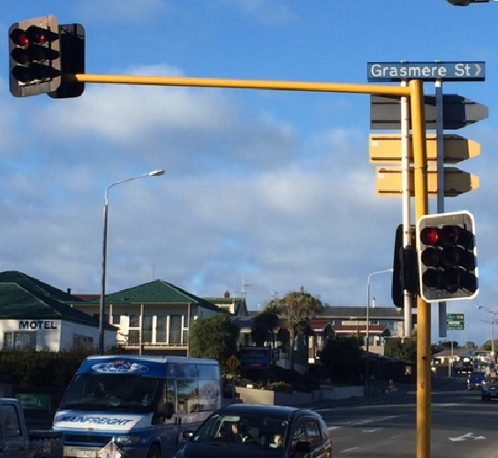
What PS1’s Can’t Allow For
Who decides enough is enough?
How many poles are overloaded on your network?

Slide 5
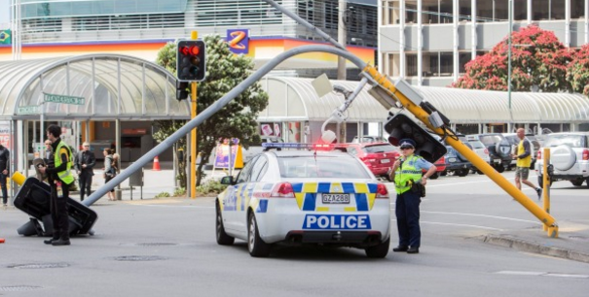
Who Checks your Current Assets

Slide 6
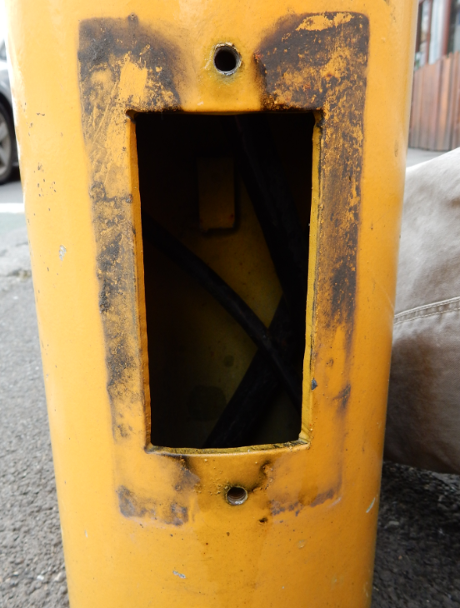
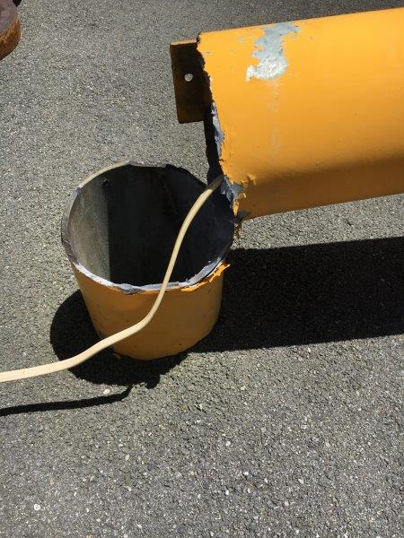
Mistakes of the Past?

Slide 7
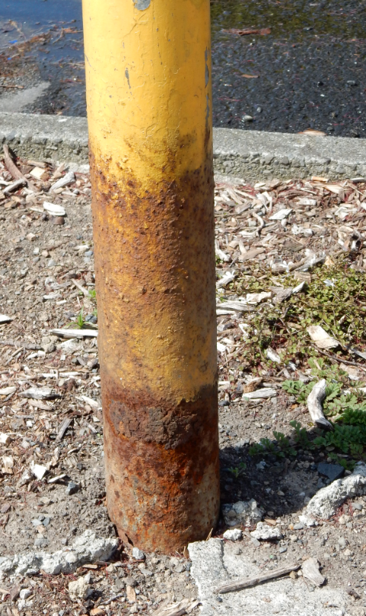
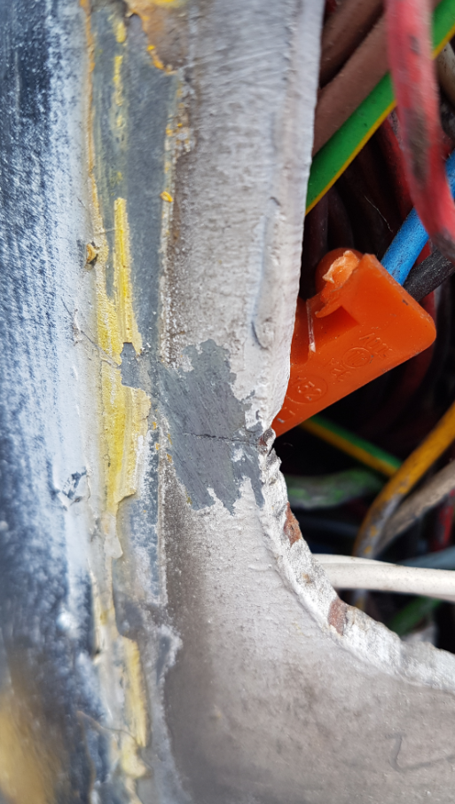
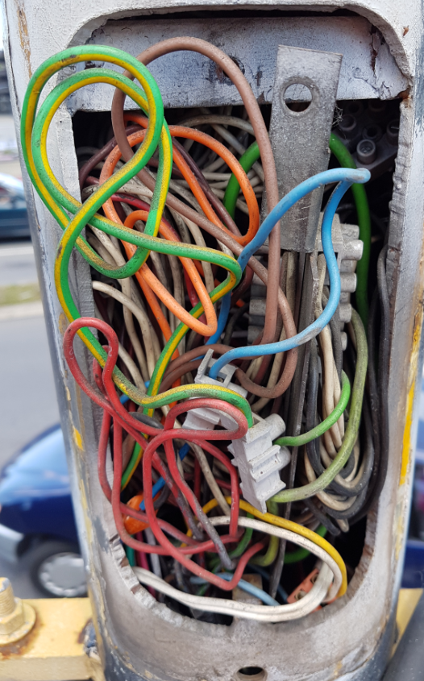
Mastarm & Pole Inspection’s
Do you know the state of your aging traffic poles?

