Slide 1
ATOC – The Numbers and other stuff
Rogan Parker
SNUG
September 2025

Slide 2
Intersection numbers
Intersections | Mid-block Pedestrian crossings | Ramp Signals | Ramp signal count sites | Total
820 | 254 | 96 | 51 | 1221
AT (AC) | NZTA | Ak Airport
980 | 229 | 12
Notes:
We have 1221 signalised sites
3 Road controlling authorities – but Auckland Council will become the RCA instead of AT. We don’t expect significant change at ATOC, but let’s see what happens.
Ak International Airport limited continue with their masterplan. Had a number of layout changes for access to terminals. Ongoing project with 2nd runway opening in 2038.

Slide 3
Other stuff
Dynamic lanes: Whangaparaoa Rd, Panmure Bridge, Redoubt Rd, Maioro St
Dynamic bus lane: Main Highway, Ellerslie
TIBC: Pedestrian crossings – variable walk time and variable protection
Repeat Right turns
Drones: Testing use for event management and data collection
CCTV trailer: Mobile CCTV unit.
AI: Investigating Microsoft and Google models.
Bus priority: Scats priority Engine. Now looking at opportunities for freight and emergency vehicles.
Major Projects: CRL next year. Reeves Rd flyover opening October. Penlink 2028
Notes:
4 Dynamic lanes. Maioro St has just opened. We also have a Dynamic bus land on Main Highway. At specific times and when congested, the kerbside lane becomes a bus lane.
TIBC project are continuing. They are working well on pedestrian crossings for increased walk times (based on pedestrian density) and increasing partial protection.
Drones are a new thing, we are training some pilots and will see what use we have for them. Currently in training stage – no deployment yet
We are drinking the AI Cool-aid but early days.
Bus priority is embedded in Scate priority Engine and we are now looking at opportunities in freight and emergency services.
Some big projects coming on line: Reeves Rd flyover opens citybound on 1 October and east bound on 26 October. Citybound will ease congestion on Ti Rakau / Pakuranga, but will increase the arrival flows at neighbouring intersection. East bound should see good improvements in PM peak. CRL work still ongoing with construction expected to finish in December. Some months of testing with opening in 2026. Penlink is underway and lots of work behind the scenes: eta is 2028 and will have a significant effect on the Silverdale area which is a growing rapidly.

Slide 4
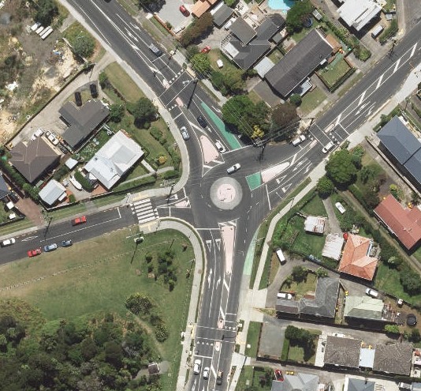
Glenfield Rd roundabout
Raised signalised pedestrian crossings
Notes:
Interesting unusual project: 4 leg roundabout with raised signalised crossings on 3 legs. Raised zebra on 4th leg which is a low use cul de sac. Been open for 18months and performing well. Not sure I’d recommend it as a general layout but does seem to fit the current use case.

