Slide 1

NZTA Intelligent Transport Systems (ITS) Standards and Specifications (S&S)
Traffic Signals

Slide 2
Agenda
Part 1 – Background
1 min – Agenda and Introduction (James)
5 min - Background and ITS Delivery Framework (Russell)
5 min - Delivery Team and NZTA Drafting Principles (Alex)
Part 2 – Specification Document
15 min - Traffic Signal Delivery Specification (Alex, James, Steen and Russell)
10 min - Open Floor Discussion (All)
Part 3 – Design Document
15 min - Traffic Signal Design Standard and Guidance (Alex, James, Steen and Russell)
10 min - Open Floor Discussion (All)

Slide 3
Introduction
As part of the NZ Transport Agency Waka Kotahi (NZTA) ITS S&S project Beca have collaborated with stakeholders to deliver the following documents:
NZTA Delivery Specification
NZTA Design Standard
The documents were previously prepared and produced by the Signals NZ User Group (SNUG).

Slide 4
Background
The ITS S&S documents provide assurance for delivering solutions and the necessary equipment and systems for NZTA projects.
Design standards
Delivery specifications
Core requirements standards
Notes:
The ITS S&S documents provide assurance for delivering solutions and the necessary equipment and systems for NZTA projects.
Design is achieved through design standards that ensure operational outcomes, safety, security, and maintainability are considered in transport network solutions.
Delivery is managed via delivery specifications, supporting procurement and systems integration to guarantee correct equipment and required functionality.
Core requirements (standards and specifications) set out common conditions and obligations across all NZTA ITS design standards, helping manage duplication of requirements.
Overall, these documents ensure clarity, consistency, and fitness for purpose in ITS design and delivery.

Slide 5
ITS S&S Framework
Phase 1a
Generate
Phase 1b
Review
Participate and deliver expert panel workshops
Phase 2
Consultation & Proofing
Industry, Council and Technical Standards Committee (TSC) Consultation
Produce first draft
Phase 3
Ratification
Schedule meetings with subject matter experts (SMEs) & Senior Advisor (Anandita Pujara)
Research and assess options
Discuss any difference between old/new document versions
Consolidate feedback, prepare responses and convene with NZTA Document Manager
Prepare any action plans with feedback received
Meet with any SME’s to discuss feedback
Update documents as per ratification group feedback (following endorsement)
Process feedback from industry consultation and TSC committee
External proofing
Notes:
The intelligent transport systems (ITS) design standard and delivery specification (S&S) framework is a collection of repeatable processes and capabilities to support the creation and ongoing maintenance of the ITS S&S documentation.
It provides an open and collaborative environment to develop best practice in the ITS industry and to ensure new or upgraded ITS S&S are easily accessible to all interested parties.
It provides a way to manage duplication, ensure consistency, and capture feedback and learnings to support continuous improvement.
The framework ensures that our ITS S&S documentation is produced to a high quality so that we can deliver a safer system for all users and provide certainty, consistency and clarity for our people and industry suppliers.
The ITS S&S framework benefits all national transport network projects. By updating and ensuring the consistency and quality standard of our ITS S&S documentation, NZTA can realise the full benefit of our network upgrade and ensure a safer system for all users.

Slide 6
Delivery Resources
Technical Standards Committee (TSC)
NZ Transport Agency
Senior Advisor
NZ Transport Agency
Subject Matter Experts
Traffic Signal RCAs, Contractors, Suppliers, Consultants & SNUG
Document Authors
Consultant Panel of Document Authors
External Proofer
Project Sponsor
Jamie Lowe/ Tom Zotov
Senior Advisor
Anandita Pujara
(Document Owner)

Slide 7
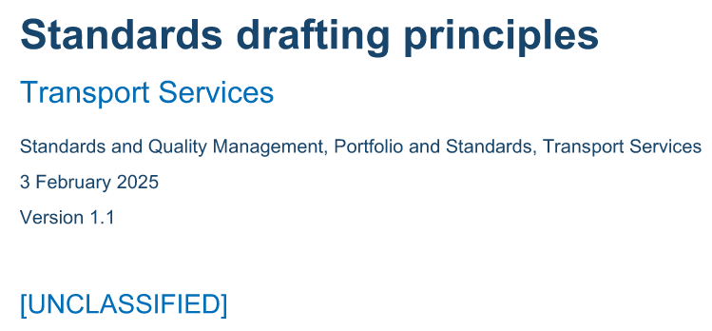
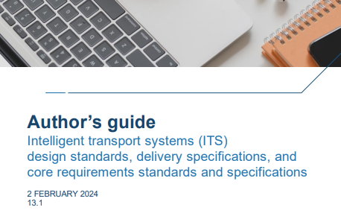
NZTA Standard Drafting Principles
Clarity and consistency
Defined scope and flexibility
Audience-focused content
Avoid redundancy
Professional language and structure
Re-use industry standards where possible
The authors guide is also available for quality standards of each standard and specification documentation, and it does not define the content.
Notes:
Drafting Principles
Clarity and Consistency: Standards must be clear, concise, unambiguous, and consistent with established drafting principles, definitions, templates, and frameworks.
Defined Scope and Flexibility: Each Standard should have a well-defined scope and be flexible enough for use by all relevant authorities and organisations where practicable.
Audience-Focused Content: Content should be tailored to the primary audience’s needs—focusing on what users need to do or understand —avoiding unnecessary background or justification.
Avoid Redundancy: Minimise cross-referencing or repeating information from other documents, especially if it may change frequently or lacks context.
Professional Language and Structure: Use appropriate contract terminology in commercial agreements and avoid naming specific organisational roles unless standardised; ensure version control and adherence to writing/brand guides.
Authors guide
NZ Transport Agency Waka Kotahi (NZTA) is creating repeatable and consistent practices for developing and maintaining the intelligent transport system (ITS) design standards, delivery specifications and core requirements standards and specifications (S&S).
As Russell mentioned earlier, NZTA is delivering this via a structured framework that is a foundation to:
• Provide alignment of the ITS S&S with the NZTA business and operational outcomes.
• Provide alignment with Traffic Control Devices and Austroads S&S, if available
• Manage NZTA risks through all stages of the delivery lifecycle
• Provide consistency and clarity for vendors, thereby reducing their risks through all stages of the delivery lifecycle
• Capture best practice and knowledge from which repeatable solutions can be built
• Manage departure requests and feedback as part of continuous improvement and knowledge
• Provide ITS S&S that support the design of systems, and for the supply of ITS equipment for the transport network.

Slide 8
Traffic Signal Change Process
NZTA would like to prepare a change process for traffic signal documents.

Slide 9
List of Future ITS S&S Documents
NZTA will be updating the list to the standards and specifications – refer to the link below.
For anyone in the room who would be interested in being a SME or would like to receive updates.
Please subscribe
https://nzta.govt.nz/roads-and-rail/intelligent-transport-systems/registration

Slide 10

Traffic Signal
Delivery Specification

Slide 11
Document Structure
Expert Panel Comment
“The document doesn't feel like it flows now, with the rearranging of quite a few sections.
It used to be divided into separate sections for material requirements & selection, installation requirements, testing, and maintenance / warranty handover.
Now it doesn't have a clean feel about what is selection, or installation.”
Outcome
Authors have avoided slicing sections of text and retained the existing structure where possible.
Text has been allocated into the desired sections of the NZTA specification template.
Technical and performance requirements sections have been generated to meet NZTA drafting principles.

Slide 12
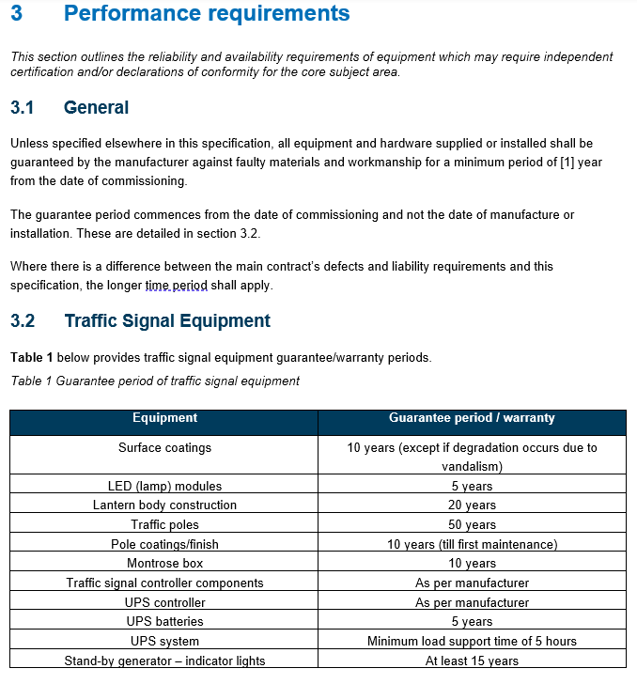
Section 3 – Performance Requirements
Expert Panel Comment
Discussions took place regarding the performance requirements for traffic signals at the Expert Panel Workshop.
To eliminate any misconception of signal guarantee’s or warranty requirements, authors have prepared a tabled schedule providing clearer warranty and guarantee periods for Contractors and Suppliers.
Refer to Table 1.
Notes:
Reinforce industry standards and consolidated.

Slide 13
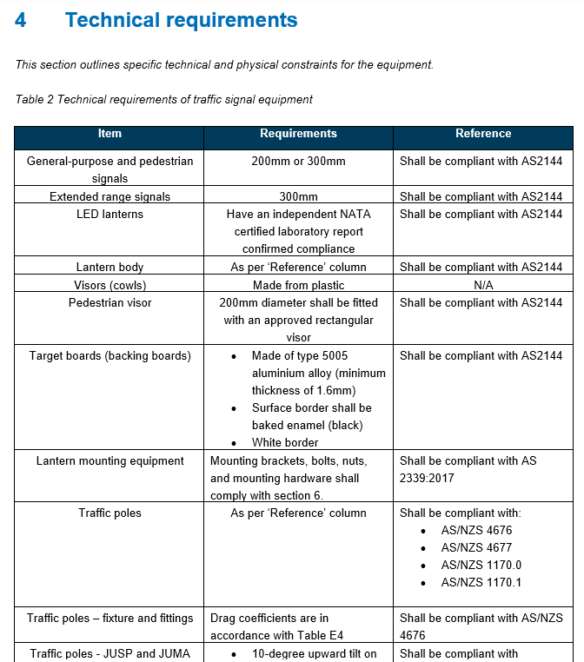
Section 4 – Technical Requirements
Expert Panel Comment
Technical requirements for the supply and installation of traffic signals have been tabled to provide context to the related AS/NZS standard.
For example, this includes compliance with the supply of LED lanterns and lantern body requirements, including any bracket or mounting hardware.
Refer to Table 2
Notes:
Reinforce industry standards

Slide 14
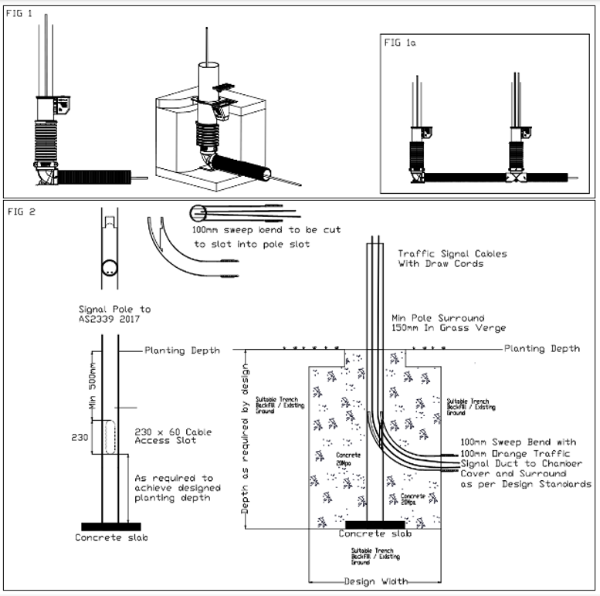
Appendix E: Ground Plant Pole – Duct Access Details
SNUG Committee Improvement
Preferred method of installing a signal pole is using a retention socket that facilitates the signal cable to enter from the bottom of the pole (refer to FIG 1a).
Where the preferred method above is impractical or if the existing pole is remaining and cannot be reused in a retention socket, the installation team are to device a method to facilitate cable entry and removal without having to excavate around the pole during future works.
FIG2 shows one option, using a long 90º bend 100 mm diameter, cut as appropriate, to facilitate the bend entering the signal pole and guiding the cable up into pole from the chamber.
Notes:
Requirements
Cabling of the pole is to be able to be undertaken without disturbing the ground around the pole.
Additional cables are to be able to be pulled into the pole without disturbing the ground around the pole.
The installation team must minimise the entry of backfill/ concrete into the signal pole during installation – noting the preferred installation is to have a mass concrete base.

Slide 15
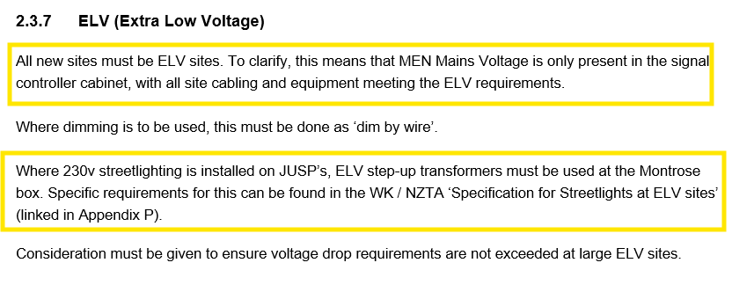
Section 2.3.7 - Extra Low Voltage (ELV)
Expert Panel Comment
ELV for traffic signals is what we are trying to work towards within the industry.
There are obvious H&S benefits with ELV installations, however we acknowledge RCAs have challenges with installing ELV.
Notes:
The industry are aware of the current challenges with stepping up/down of voltage of street light supply at JUSPs. Likely further iterations may be required to get this where it needs to be.

Slide 16
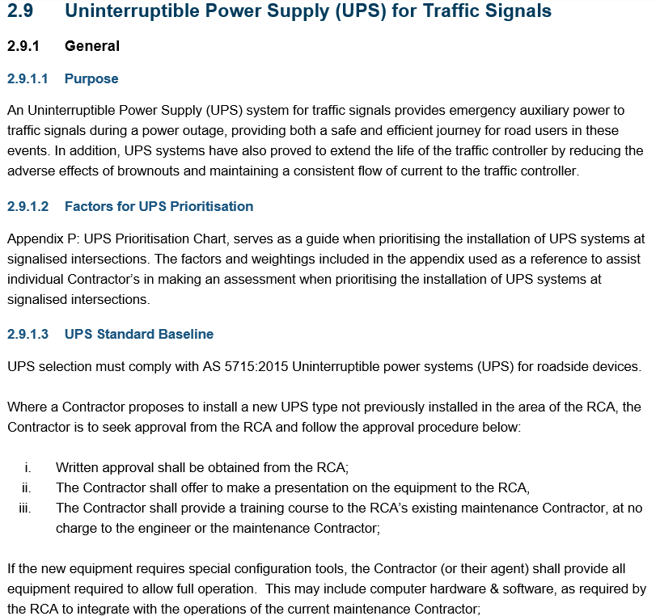
Section 2.9 – Uninterruptible Power Supply (UPS) for Traffic Signals
NZTA Drafting Principle
This section of the specification has been added to the NZTA UPS Specification doc which provides specific details for traffic signal UPS installation.
No edits to this text have been undertaken by the authors or NZTA Senior Advisor.

Slide 17
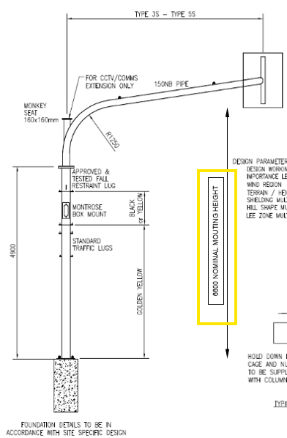
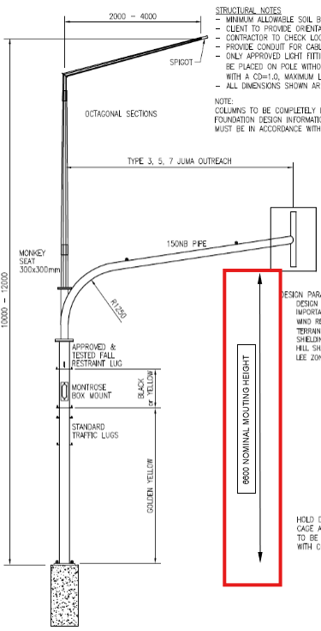
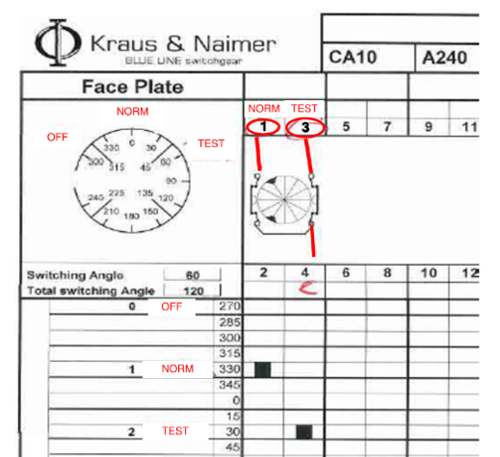
Figure Improvements
Industry Consultation Comment
Authors have undertaken improvements to the following Figures:
C13 and C14 – added minimum clearance from backing boards to ground level
Appendix J - has been re-drawn for better clarity
Appendix L – updates refer to the new NZTA ‘Asset and Work Manager’ Platform

Slide 18
Document Changes
To ensure alignment with P43 Specification for Traffic Signals and avoiding large amounts of change.
Authors and the NZTA Senior Advisor have not changed or altered any of the text, simply tailored the existing spec to align with the NZTA Delivery Specification Template.

Slide 19
Opportunity for Open Floor Discussion

Slide 20

Traffic Signal
Design Standard

Slide 21
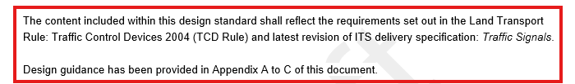
Traffic Signal Design Requirements vs
Traffic Signal Design Guidance
Expert Panel Comment
Outcomes
To avoid any misconception of what is traffic signal design requirements and guidance…
Design Requirements (e.g. TCD Rule related) have been kept in the main body of the document.
Design guidance has been moved into the appendix sections and the language used has been aligned with guidance words (e.g. ‘recommended,’ ‘may,’ ‘could’ and ‘should.’
A disclaimer has also been provided in Section 1.1 which provides context.
During the expert panel workshop, there were several comments made regarding the writing components of the design document.
Examples are provided below:
Design requirements vs Design Guidance
Shall vs may
Will vs should
Required vs recommended
The drafting principles and author handbook avoids using words such as ‘may’ or ‘should.’

Slide 22
The Use of Product Names
Expert Panel Comment
Outcomes
We acknowledge in the traffic signal industry that avoiding the use of supplier and vendor names can be challenging.
There are some parts of the design standard which uses terms such as ‘in-ground’ and ‘overhead’ detection.
During the expert panel workshop, there were several comments made regarding the use of vendor names.
Examples are provided below:
Above Ground Detector (AGD)
ATC Controllers
VC5 and VC6
SCATS Specific Controllers

Slide 23
Overhead Detection
Expert Panel Comment
Outcomes
Authors have had to be descriptive on the guidance or usage of overhead devices at signalised intersections.
It’s important that the designer/ Consultant understands what the device capabilities are and what the detector is being used for (e.g. kerbside/ on-crossing detection or stop line detection).
Avoid installing overhead detection at poles which move (i.e. hinged signal poles).
The use of overhead detection was discussed frequently at both expert panel workshops and at industry consultation.
For example:
Should we be using ‘Overhead Detection’ as the device name
Suitable locations for these devices
Preferred mounting position and pole type
Functionality – what are designers trying to achieve
Limitations of such devices
Notes:
Principles for the document – avoid using vendors and supplier names
Terminology and industry is changing and we want to leave this space open.
Detection methods are evolving.

Slide 24
Location of Junction Boxes
Expert Panel Comment
Outcomes
In recent years, the connection of in-ground detector loops has evolved across New Zealand.
The introduction of loop junction boxes has removed the need to saw-cut through concrete kerbs and channels.
The location of junction boxes has been challenging for both Consultants and Contractors to locate them in the best possible position.
The main drivers for this is to keep our contractor safe on site will maintaining or testing detector loops.
Therefore, positioning has been prescribed with at least 1m clearance from the kerb where possible. Confirm with regional RCAs prior to design.
Positioning of junction boxes were discussed regularly at both expert panel and at Industry Consultation.
"They should be located at the back of the footpath away from live traffic lanes at least 2-3m behind the kerb line so they can be safely maintained“
“Located at least 2m? Shouldn't this be 1m?”

Slide 25
Approach Phasing
Outcomes
Approach phasing was initially presented within the design standard.
Following discussions at expert panel workshop and with SMEs this is a deign preference for Christchurch and some parts of the Central and Southern Regions.
Typically driven by software developers.
This was removed from the design document and will be redirected to the Christchurch and WTOC Regional Specifications for designer guidance.
Expert Panel Comment
“Do most regions want designer to label approaches?
I think this is a CIS writer's job. I always request detectors are split up to give each one a separate approach (1-4) wherever possible so that you have more flexibility re changing Gap times.
Useful if you want to set a broken detector's gap to 0s but not the adjacent detector’s.”

Slide 26
What does this mean for Regional Specifications and Special Conditions?
Expert Panel Comment
Outcomes
We still want regional RCAs to continue to develop their specifications.
The purpose of this document is to provide better consistency for design across New Zealand.
We acknowledge that there will be specific regional requirements for traffic signals and that’s where our RCAs can drive good practice solutions and technology within the industry.

Slide 27
Opportunity for Open Floor Discussion

Slide 28
Thank you!
For anyone in the room who would be interested in being a SME or would like to receive updates.​
​
Please subscribe​
https://nzta.govt.nz/roads-and-rail/intelligent-transport-systems/registration

