Slide 1
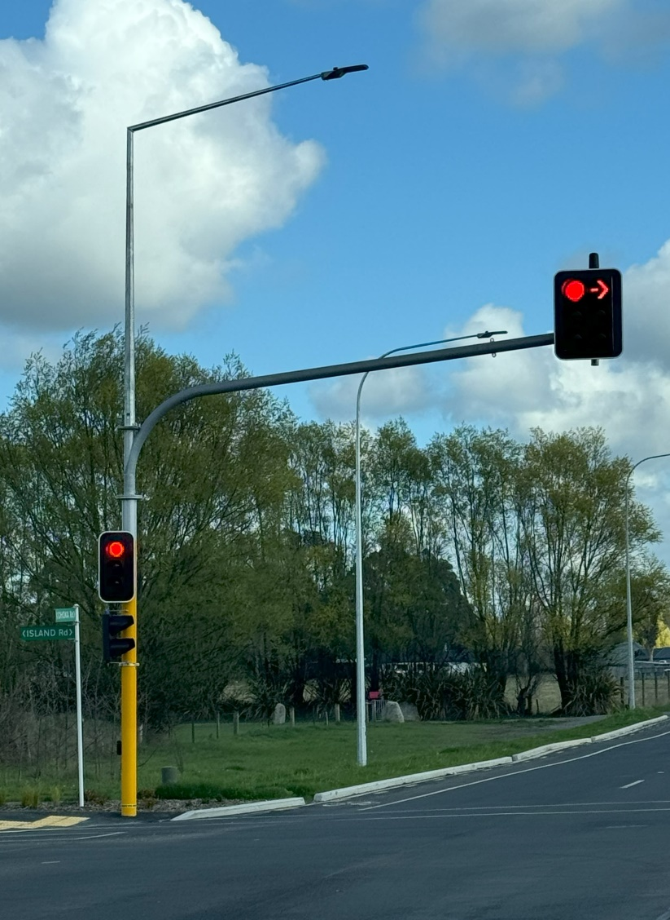


SNUG
CONFERENCE
2025
Notes:
Welcome
I hope everybody enjoyed their dinner last night.

Slide 2
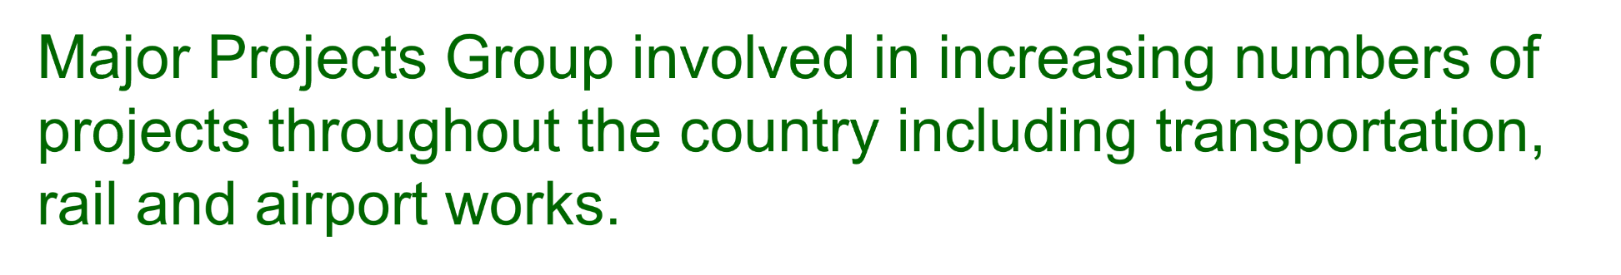
2024 – 2025 In Review
Major Project Group has continued to grow with the addition of Will Baltus this year, he is here to learn about SNUG and its people.
Government announced 15 Roads of National Significance (RoNS) most of which are still years away. Tolling of new roading in Canterbury currently out for submissions.
Councils starting to tender and award transportation projects across the country.
Te Kaha Surrounding Streets traffic and streetlighting project completed on budget and 2 months ahead of time. Te Kaha Stadium is on budget and on time for opening in April 2026.
Notes:
2
Will worked for Spunlite as Auckland Territory Manager prior to coming to MP.
MP is growing in size and workload in transportation and infrastructure projects throughout the country.
The proposed tolling of the Belfast to Pegasus Motorway and Woodend Bypass is causing huge discussion in Canterbury.
We are seeing more and more project work which has been delayed now coming out for pricing and tender award.
Te Kaha Surrounding Streets was a project won by Isaac Construction, Project managed by Lucas Haning, Street Lighting by Connetics and Signals by Downer.

Slide 3
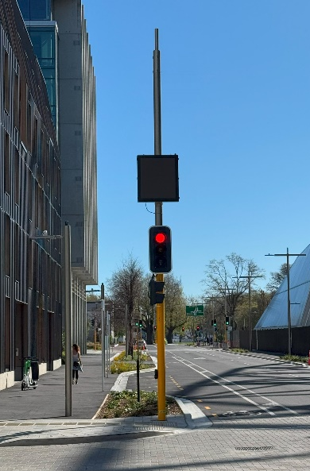
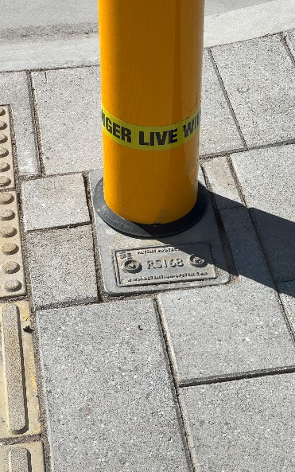
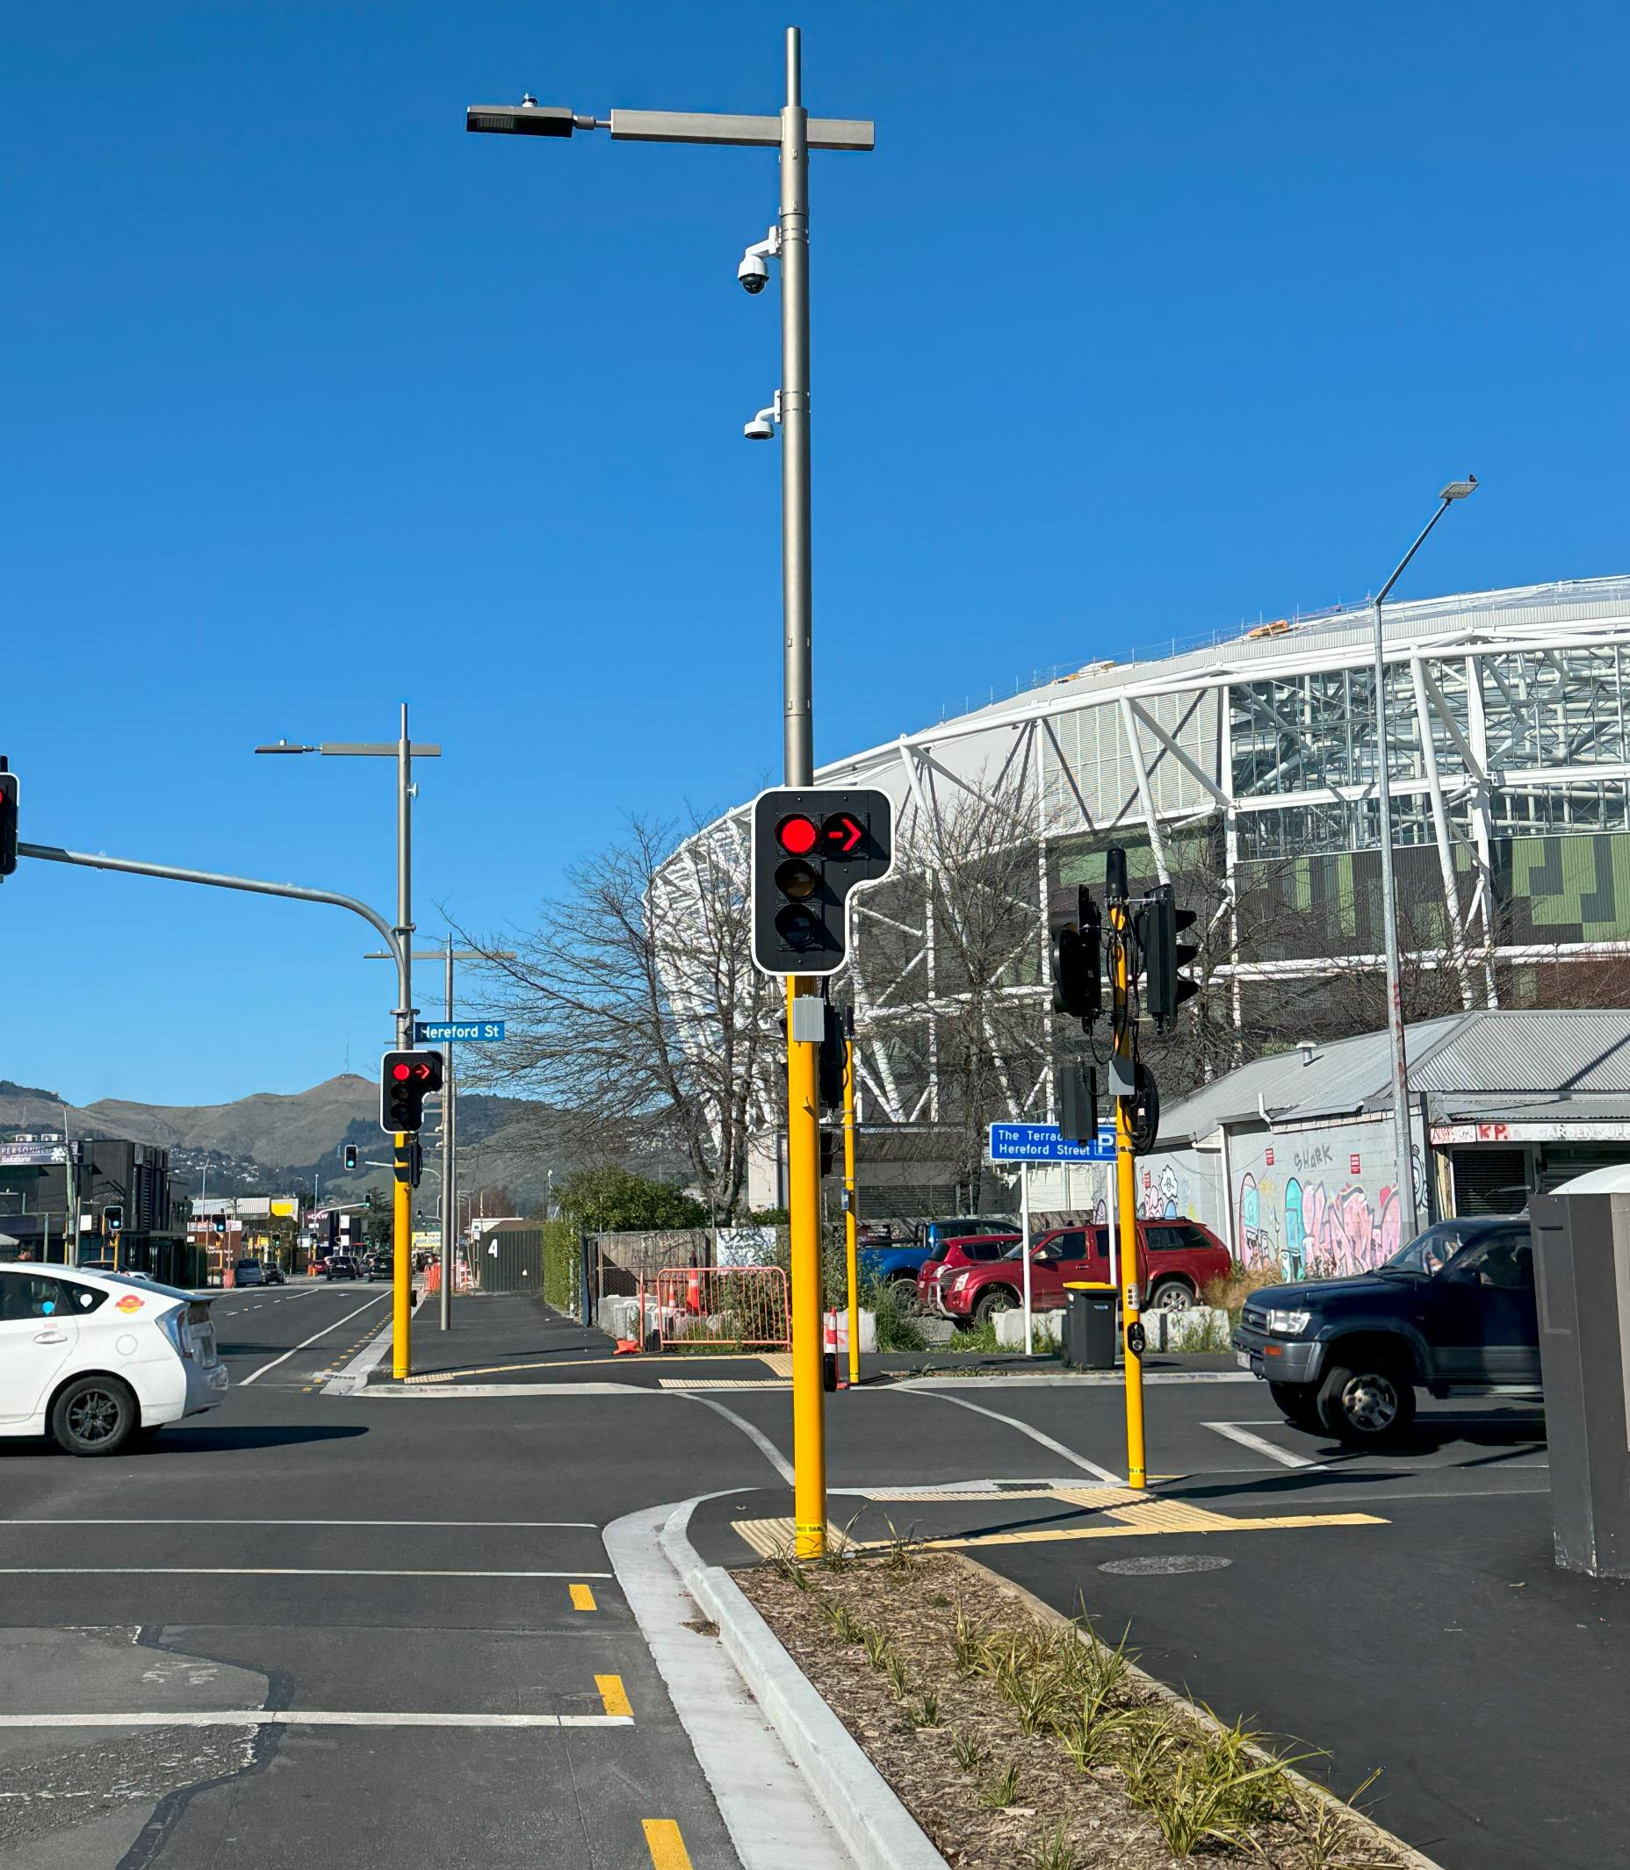
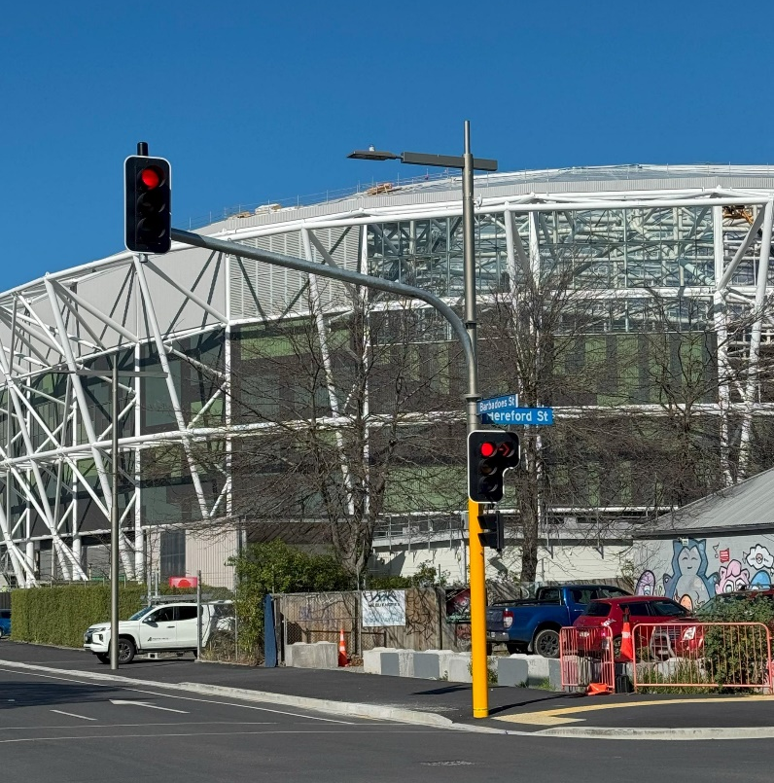
Notes:
Christchurch’s new UFO

Slide 4
2024 – 2025 In Review
Just after SNUG last year, we saw TCS leave the market in the South Island which caused chaos for councils and creditors.
Downer ITS are the current CCC signals maintenance contractor and have completed upgrade works in conjunction with Fulton Hogan and Isaac Construction.
Isaac Construction stepped in and started a signals division filling the void for the third contractor in the region. They have successfully completed a number of transportation projects this year.
Notes:
4
As mentioned yesterday by Jahn things have changed in Christchurch in the past year

Slide 5
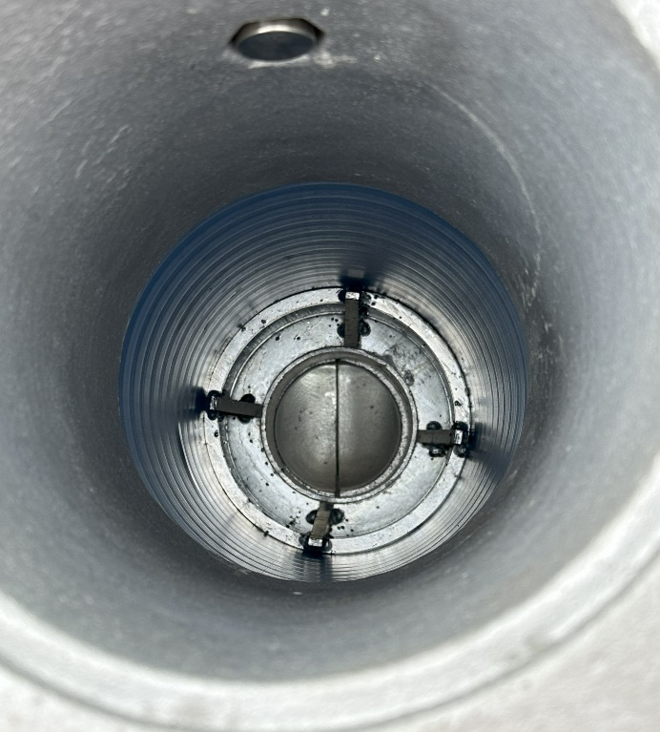
2024 – 2025 In Review
“High Torque” Retention Socket is on our stand for you to have look at. This is the Retention Socket design that can be used for the installation of JUMA’s in NZ.
The “High Torque” Retention Socket is based on the same basic design as all sockets. It has four fins in the base; the pole is slotted to match these fins preventing the JUMA rotating.
We will be installing evaluation sites for the “High Torque” Socket in the next couple of months based on the RS168 - 150NB design.
Ultimately the “High Torque” Retention Sockets will be available in 150NB, 200NB, and 250NB sizes.
Notes:
5

Slide 6
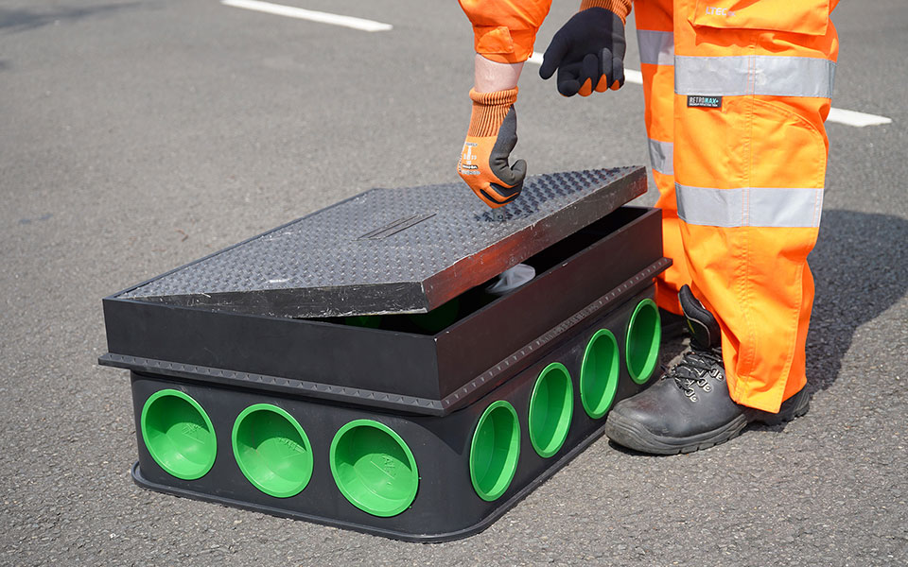
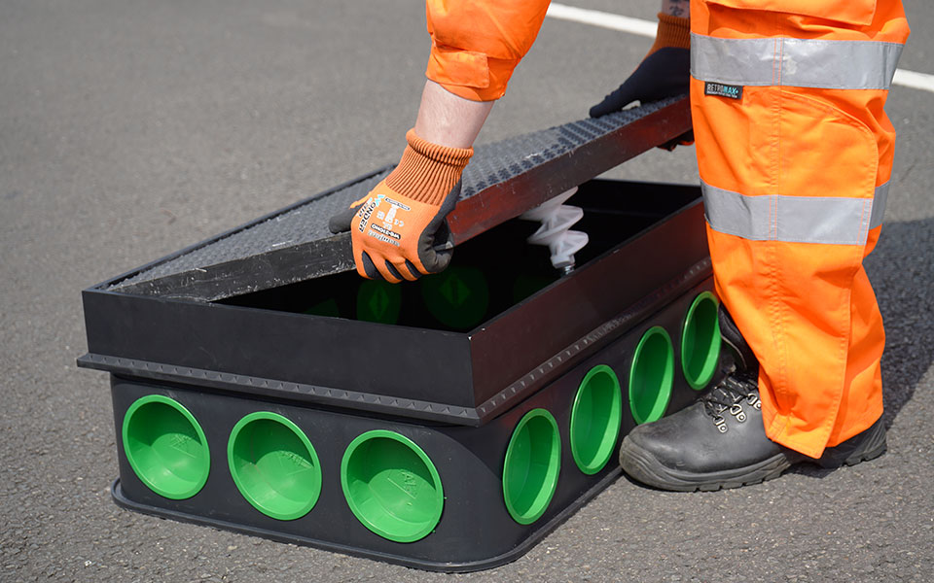

2024 – 2025 In Review
The new STAKKA Box 600 x 600mm Liftlock composite lid and frame is also on our stand. A locking cam when turned also lifts the lid to allow easy removal.
No more pry bars or crow bars for lifting chamber lids.
Notes:
6
STAKKAboxes are modular so you can achieve any depth using additional sections

Slide 7
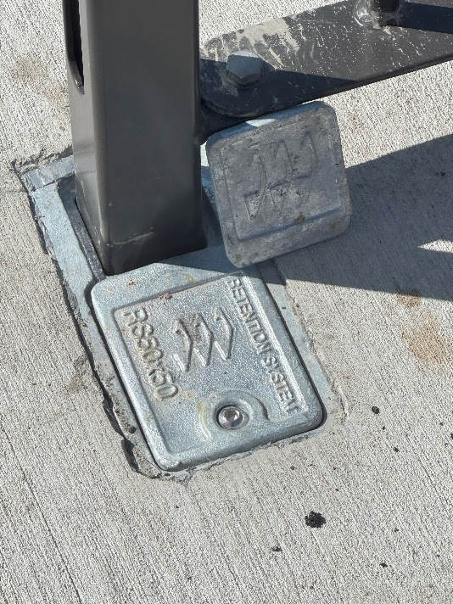
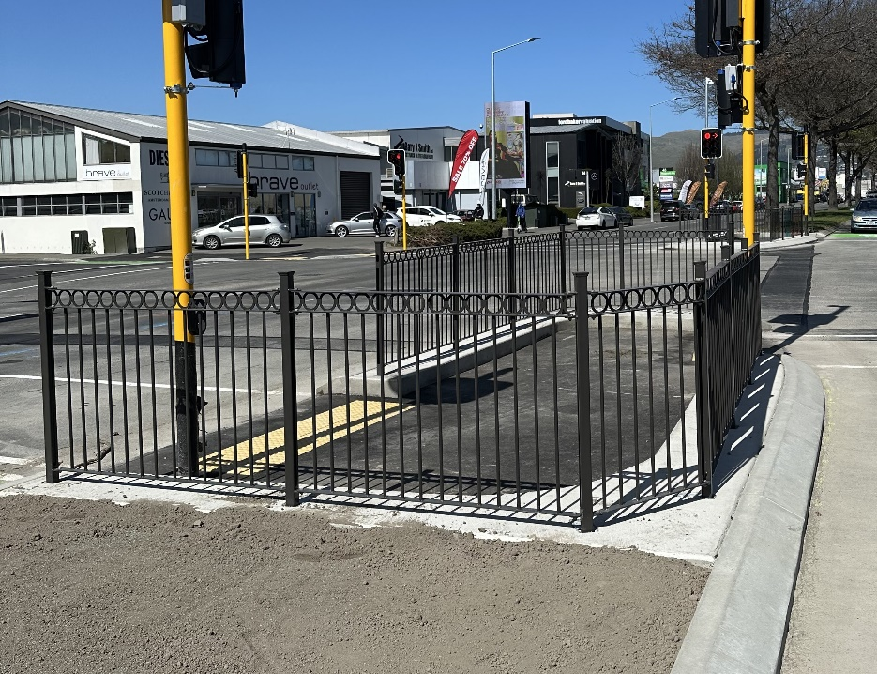
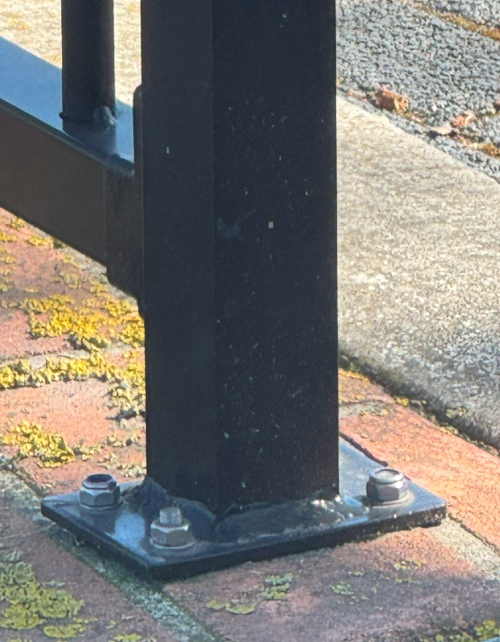
2024 – 2025 In Review
We have started supplying RS50 x 50 Retention Sockets
for pedestrian fencing projects in centre median strips and traffic reservations.
Historically in Australasia posts have been masonry anchored in place causing issues with replacement and vandalism.
Notes:
7
If this fencing were installed down the centre median it could easily be removed and replaced to allow the flow of pedestrians during large events like concerts and sports.
The fencing can be supplied to any design specific to council or landscape architect requirements.

Slide 8
2024 – 2025 In Review
Retention Socket Sales continue to grow in many regions – crash damage ground plant poles now being swapped out to Retention Socket ones.
We are promoting Retention Sockets into Australia, working on TMR Queensland approval update, Transport for NSW, Salisbury Council South Australia, several airports and infrastructure projects.
We are focusing on transportation and infrastructure projects where sockets can be utilized for multi sector use, not just traffic installations.
We have a Structural Engineering Company certifying all designs and installations for Australia.
Notes:
8
We have a TMR design and approval which has lapsed so getting this renewed.
In many states traffic designs are hard to change so we are working on other uses like Speed Warning Signs, Street Lighting, street Furniture
Different states have different certification requirements, the one engineer has offices in all states.

Slide 9
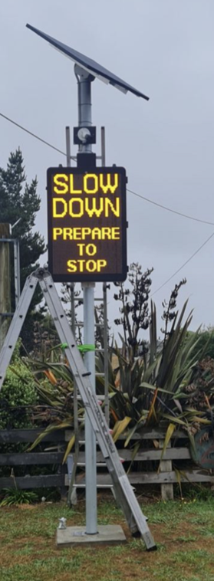
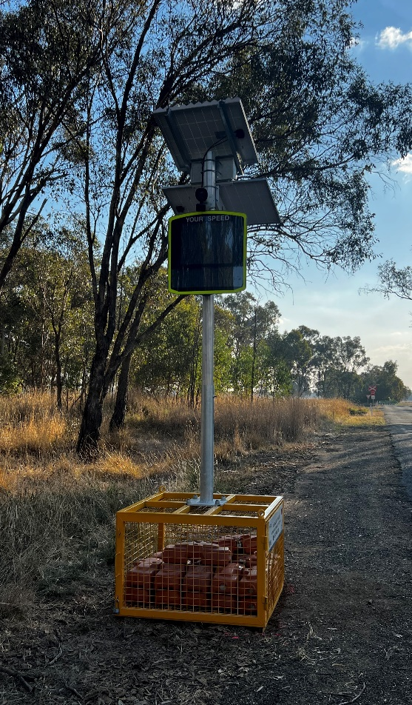
2024 – 2025 In Review - Australia
Spunlite has had success in NZ and Australia with trial sites for uncontrolled rail crossings in conjunction with the Arcs Group.
We are also working with consultants on several School Speed zone projects using Retention Sockets instead of temporary concrete blocks or cages.
Notes:
9
We have had great feedback on the trials for uncontrolled rail crossings with KiwiRail providing funding for continued trials.
Australia has over 25000 uncontrolled rail crossings. NZ has around 5000.
A council may have budget for only 10 Speed Warning units and install Sockets at 40 or 50 sites and rotate the units.
BCC currently employs two full time staff rotating Speed Warning units around school sites.

Slide 10
2025 To the future
Local government elections are being held throughout NZ, the results may delay or cancel many projects.
Wellington Golden Mile Project, all current candidates for mayor are looking to cancel the project.
Christchurch, one candidate for mayor is more cycleway and public transport friendly.
Auckland Council shake up with AT now to look after only buses, trains, ferries – local boards to look after roading – watch this space.
Again as with central government elections we will wait to see the results and fallout from successful candidates in the coming months.
Notes:
10
There is a huge amount of uncertainty positive and negative around controversial infrastructure projects.
Tory pressed go on Golden Mile in Wellington, mayoral candidates are saying it wont continue.
Christchurch’s current mayor cancelled a number of cycleway projects, one candidate wants them back.
When the government changed two years ago many roading projects had funding cancelled, a few are only now coming back on the table.
Cross party agreement on infrastructure projects has got to be the way forward to quit the 3 year stop start stop process.

Slide 11
Q&A
Notes:
11

