Slide 1
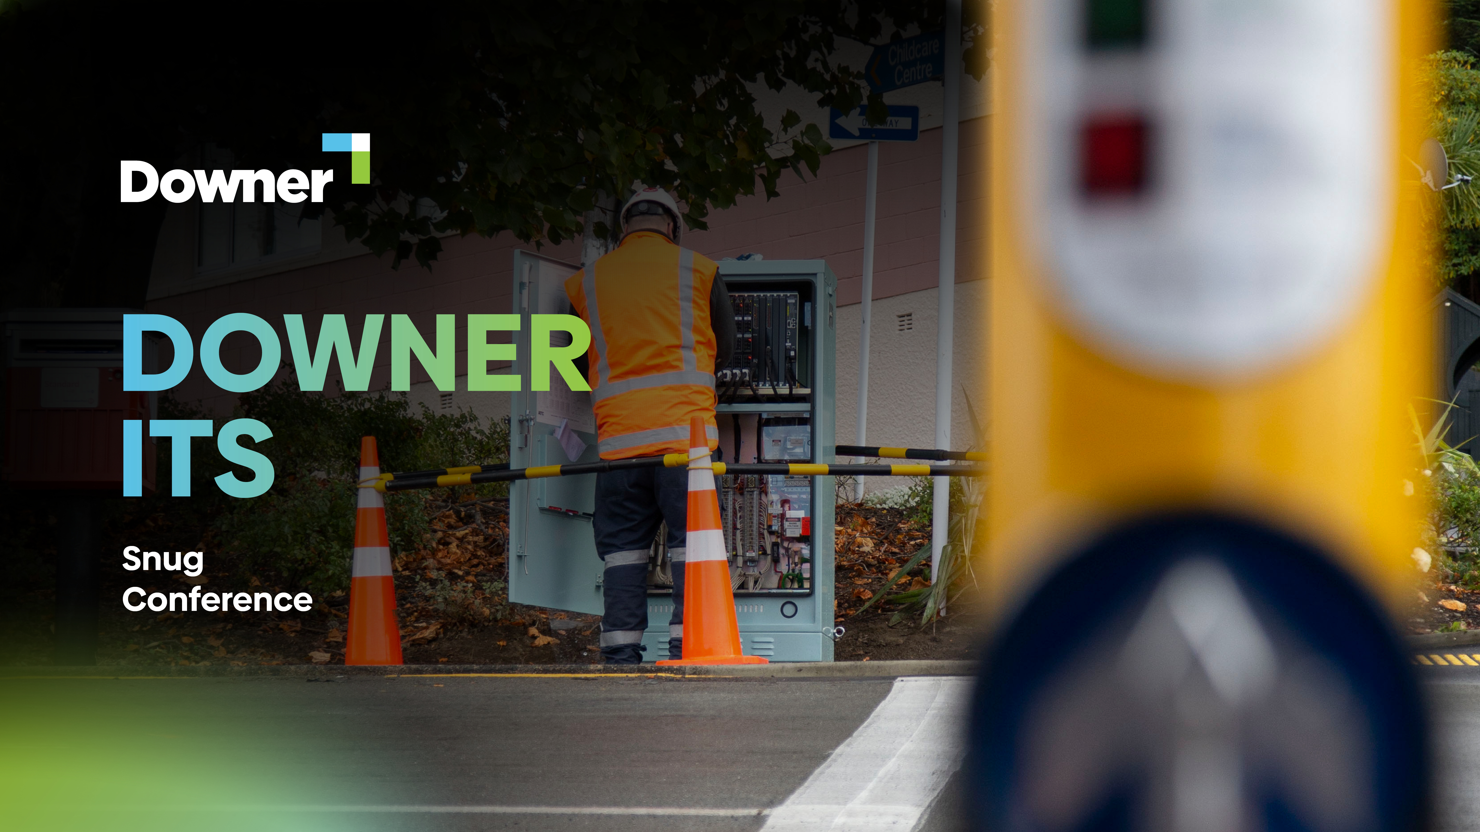

Slide 2
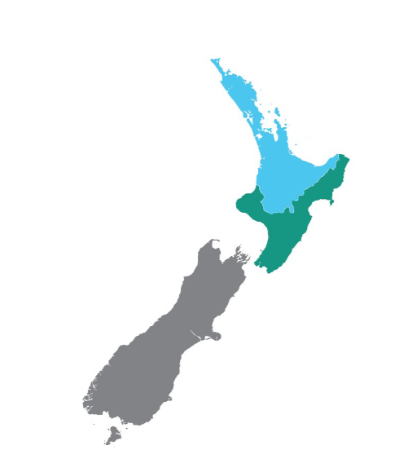
Major contracts and projects
WTA Maintenance contract
WCC Electrical services maintenance contract
Traffic Signals
Electronic Signs
Street lighting
CVIU Weigh stations
Ohakea
Taupo
Mckay
Te Ara Tupua – Pedestrian and Cycle way
Auckland
Wellington
Christchurch
Queenstown
Te Anau
Dunedin
DOWNER ITS – Sung Conference

Slide 3

Queenstown and Milford
5 x New intersections
6 more traffic signal sites planned
Frankton roundabout
Fibre network along NZTA state highway corridor
DOWNER ITS – Sung Conference
Notes:
My teams in Queenstown and Te Anau have been working on the

Slide 4
ITS Christchurch
Christchurch City Maintenance
Te Kaha - 13 Intersection
190 School Zone Signs
Auckland
Wellington
Christchurch
Queenstown
Te Anau
Dunedin
DOWNER ITS – Sung Conference

Slide 5

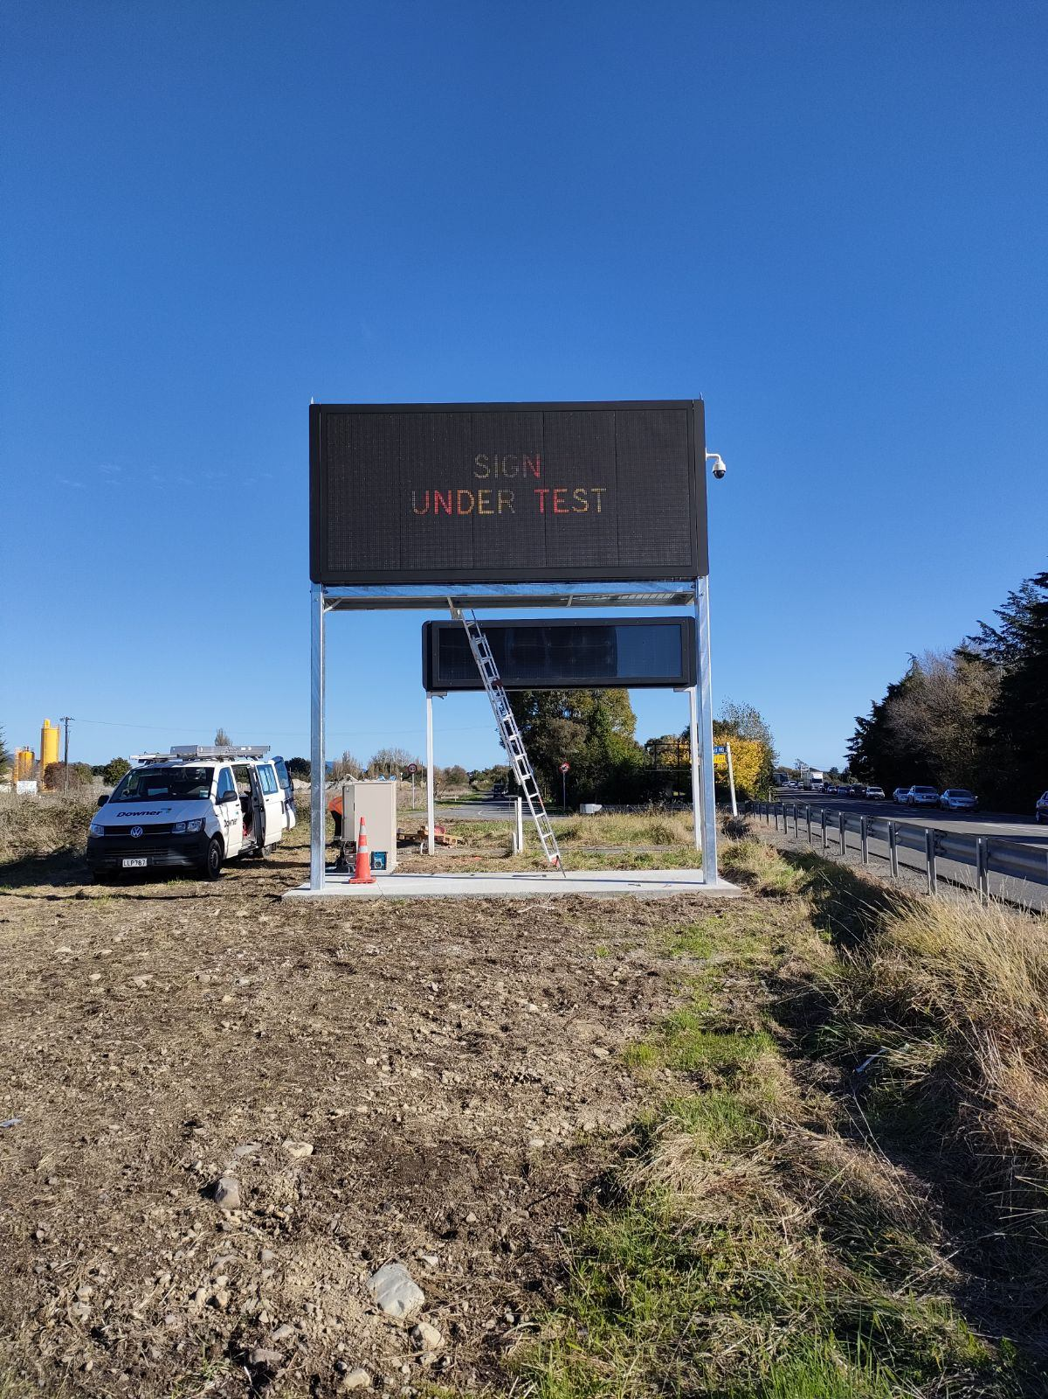
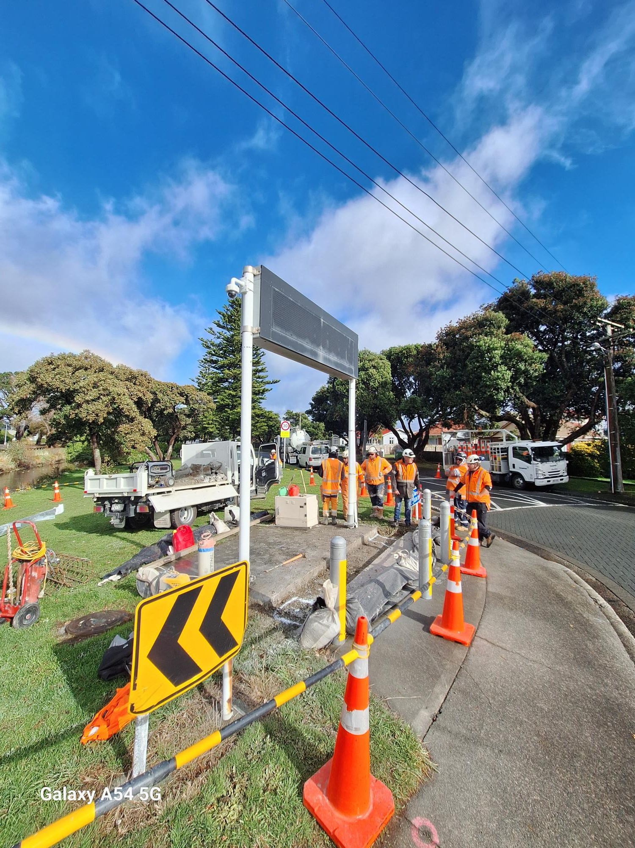
ITS Wellington
DOWNER ITS – Sung Conference
Notes:
We had a huge last year in the Wellington region
TQHR Traffic Signals
Retained both our ITS and Traffic signals contracts with WTA and HCC, KCDC, PCC, UHCC
Won the WCC TSSES contract Downer are now hold all of the traffic signal maintenance contracts in the Wellington region.

Slide 6

TOAD – Tone Output Adjusting Device
DOWNER ITS – Sung Conference
Notes:
Downer developed a small add on device to allow preseting of audio driver tone volumes, with a day and separate night volume possible
This switch of day to night preset can be easily controlled using a time of day output from the signal controller.

Slide 7


